Slide 1


Slide 2
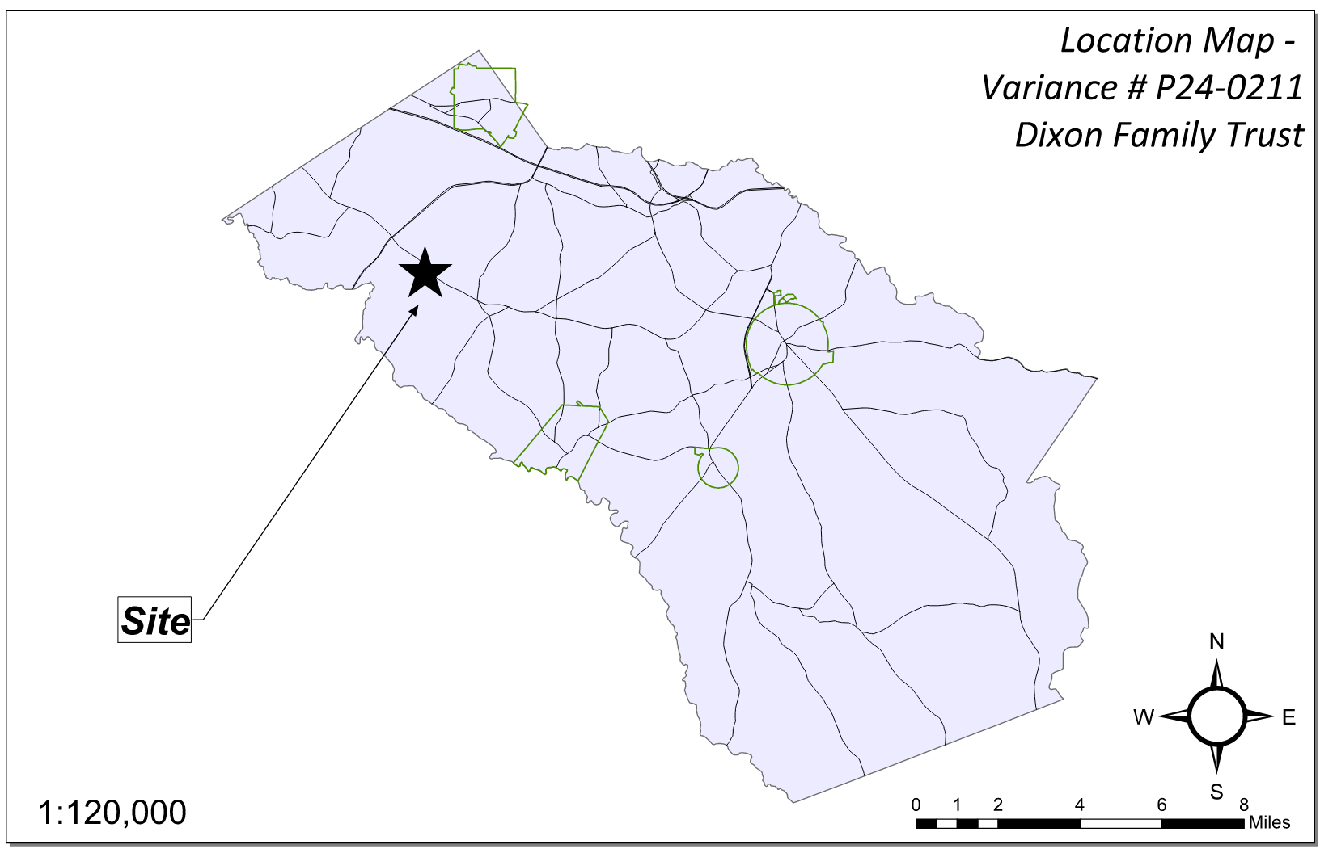
Site Location

Slide 3
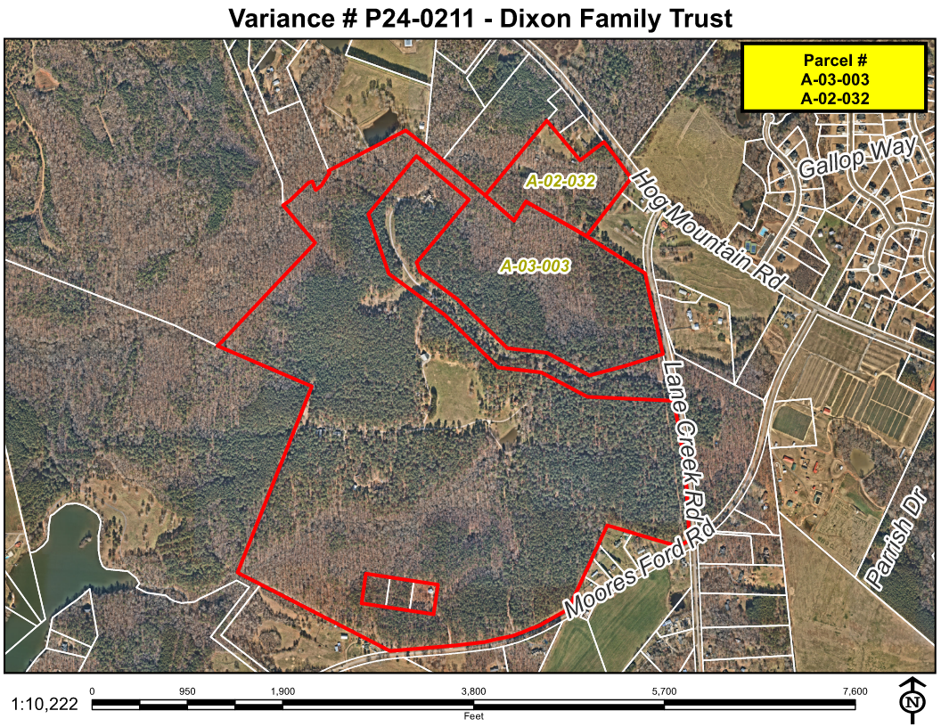
Aerial Imagery

Slide 4
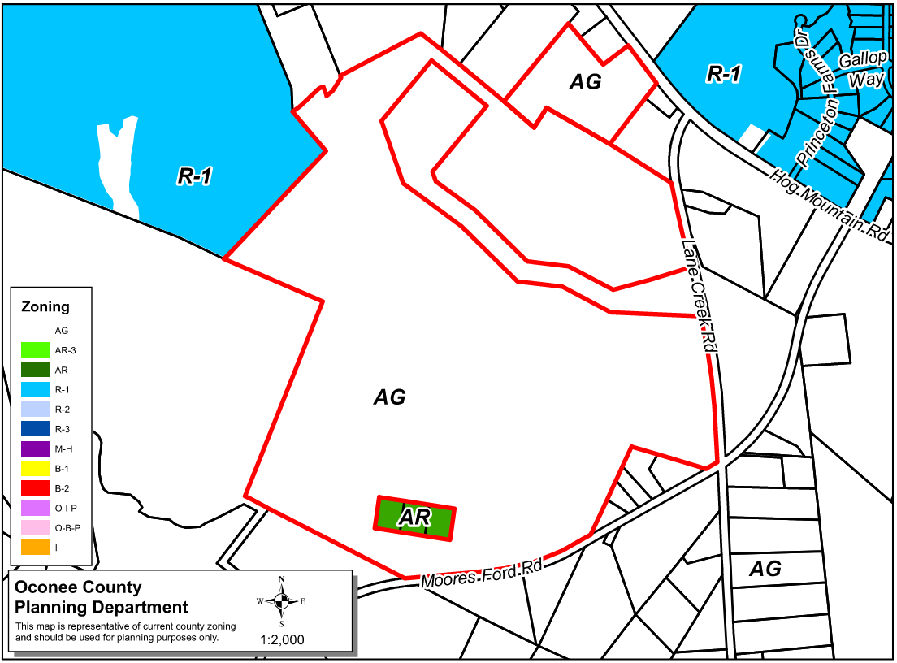
Zoning
AG

Slide 5
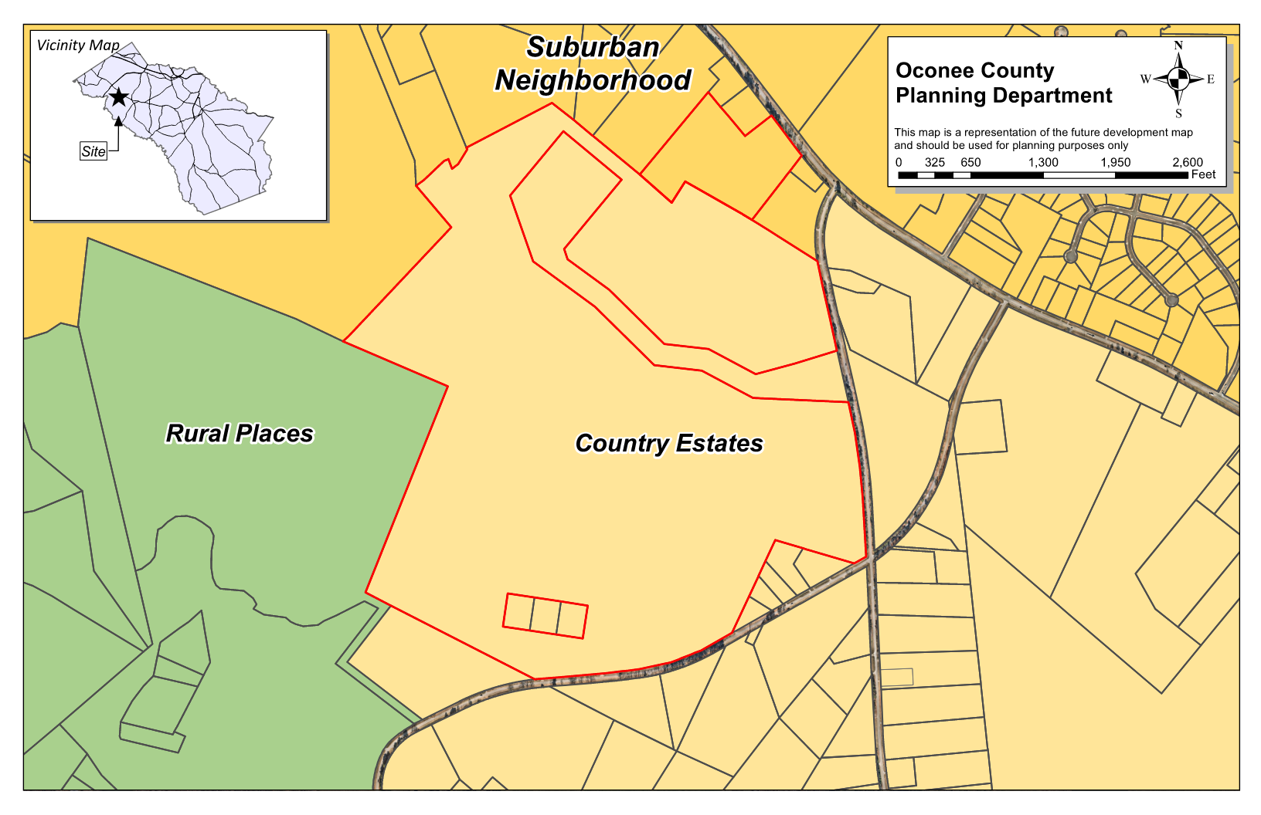
Future Development

Slide 6
Summary of Request
A Special Exception Variance from Section 609.1 to:
1) To allow a portion of an existing residential gravel drive to remain as a service drive and remove the requirement for a paved commercial drive.
2) Remove the requirement for curb and gutter to allow the commercial access road to have vegetated ditches.
3) Allow gravel parking in lieu of paved parking for the spaces next to the rental units.

Slide 7
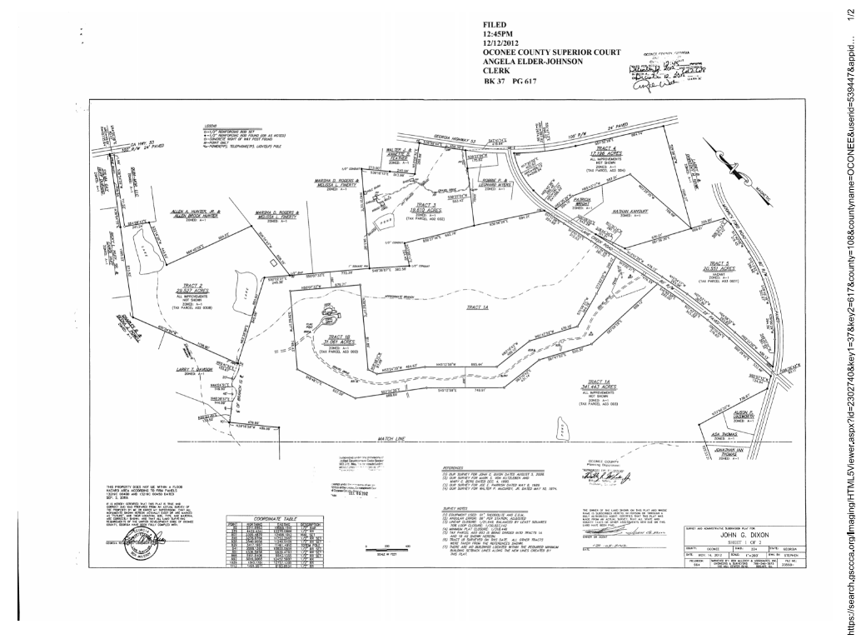
Recorded Plat

Slide 8
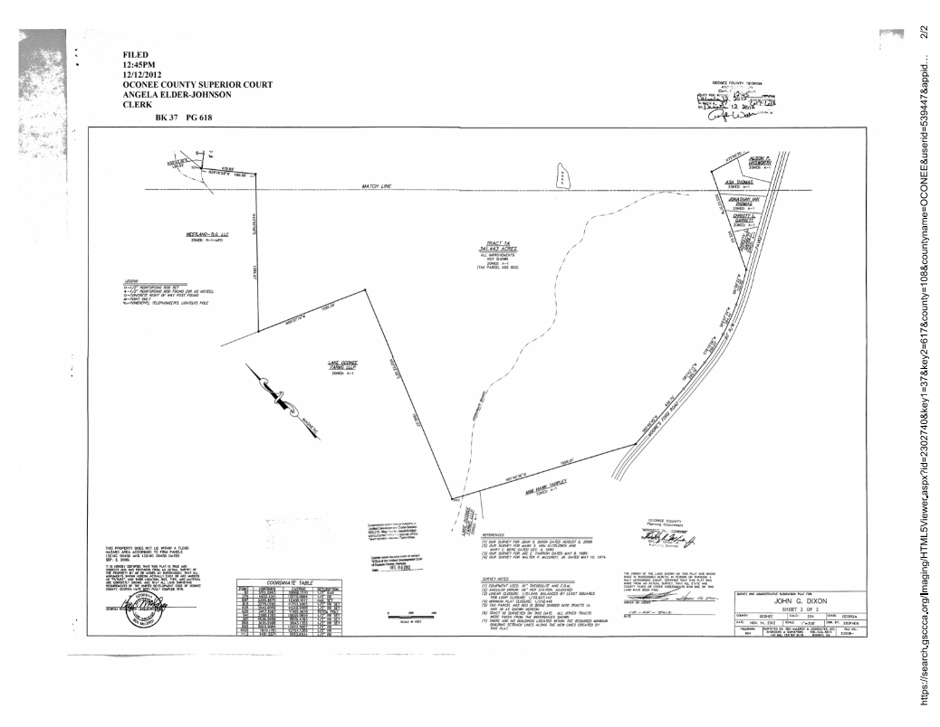
Recorded Plat

Slide 9
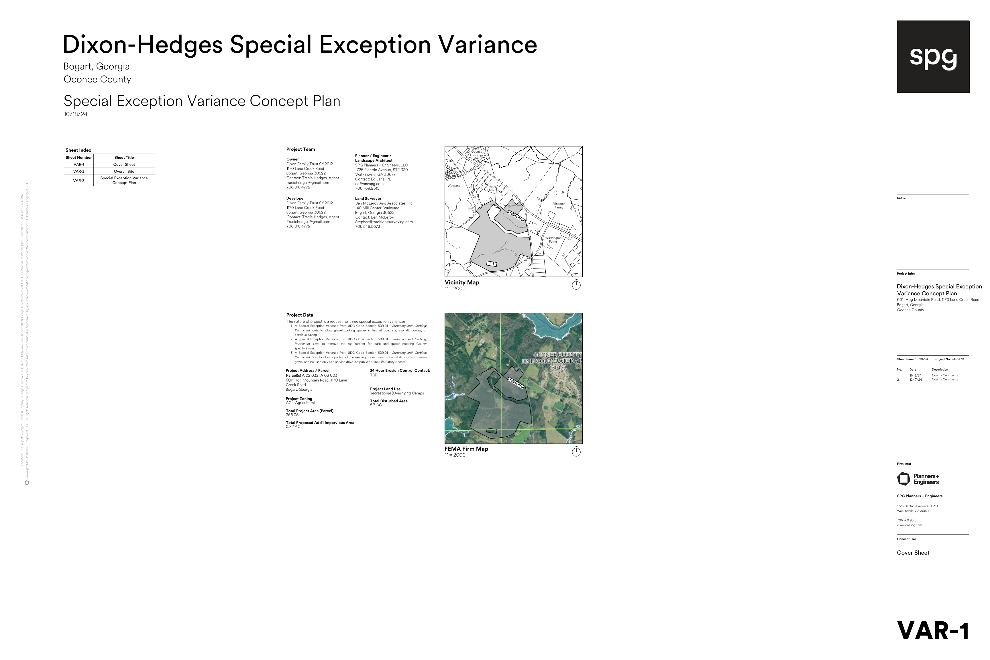
Concept Plan

Slide 10
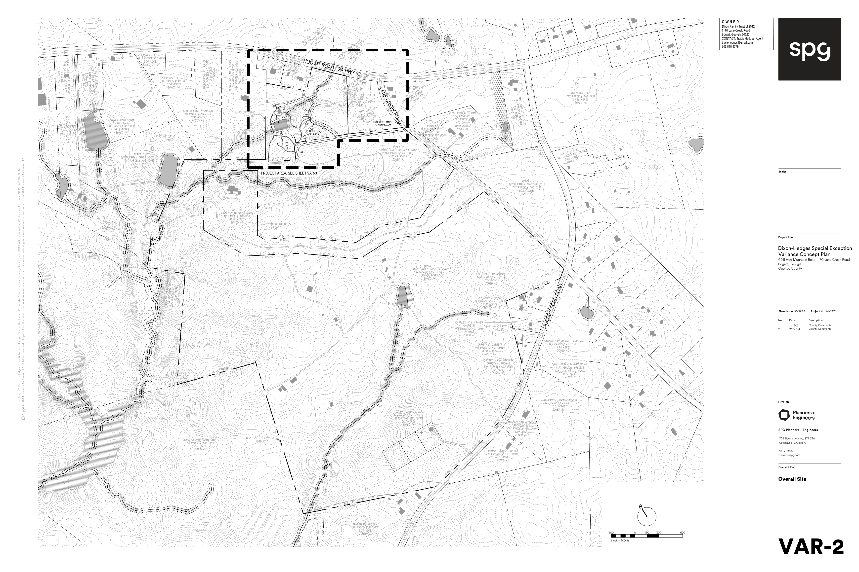
Concept Plan

Slide 11
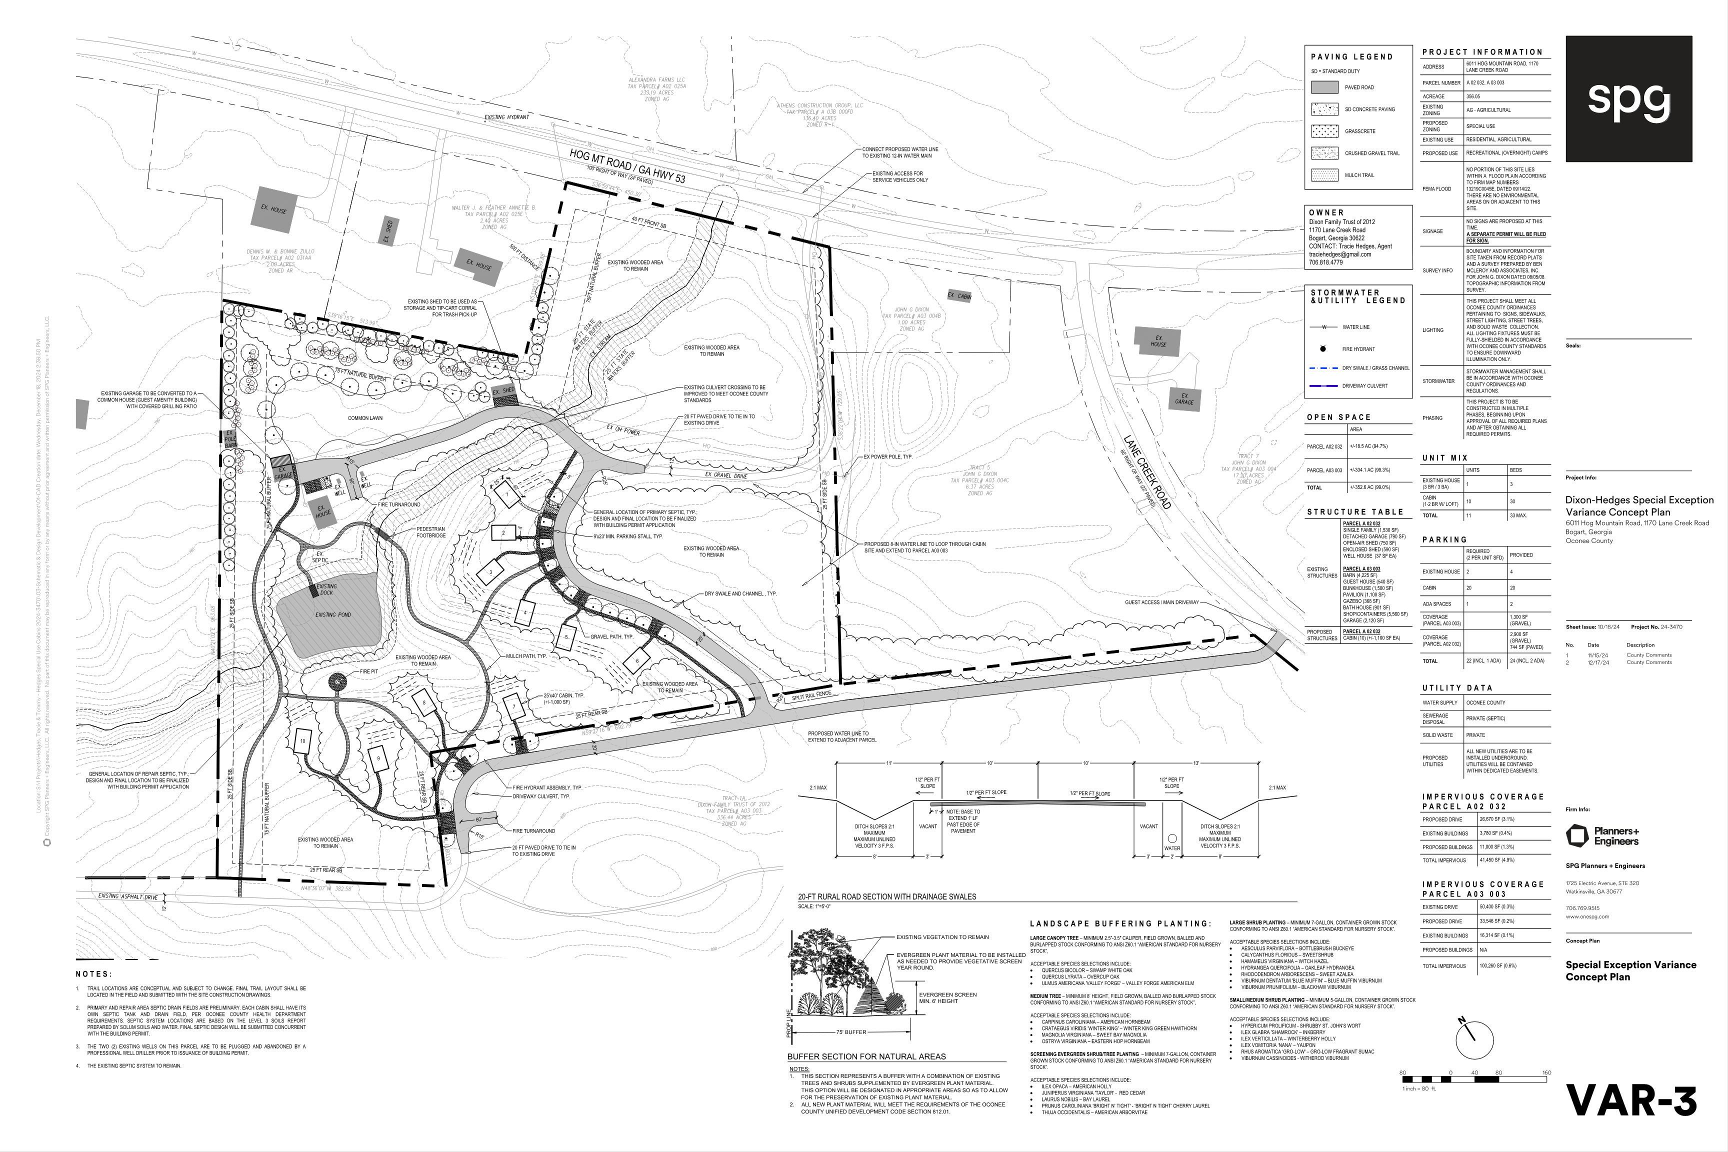
Concept Plan

Slide 12
STAFF RECOMMENDATION & CONDITIONAL RECOMMENDATIONS
Based upon the standards and limitations for special exception variance approval, part of this request does meet all necessary conditions to grant a special exception variance to Section 609.1 to:
• Remove the requirement for curb and gutter to allow the commercial access road to have vegetated ditches.
• Allow gravel parking in lieu of paved parking for the spaces next to the rental units.
Staff recommends denial of part of the variance to Section 609.1 to:
• Allow a portion of a gravel drive to remain as a service drive and remove the requirement for paved commercial drive as this drive is the current legal access to the property.
Should the present request be approved, staff recommends the following conditions to be fulfilled at the owner/developer’s expense.
1. Development design and structures shall meet or exceed the standards indicated on the concept plan, narrative, representative architectural sketches, and other documents submitted with the variance application and attached hereto. This condition shall not construe approval of any standard that is not in conformity with the Unified Development Code.
2. The owner at their own expense shall construct the improvements required by the County for public water and public waste services for the subject property and shall convey the same to the County, free of all liens. Said improvements shall include all on-site improvements and such off-site improvements as are required by the County to provide service to subject property.
3. At its expense, Owner shall make all right of way improvements and shall dedicate all rights of way which are required by the County after the County’s review of Owner's development plans pursuant to the County’s ordinances and regulations. All such improvements shall be shown on the preliminary site plan and site development plans for the project and no development permit shall be issued until Owner has agreed to such improvements and dedication.

