Slide 1


Slide 2
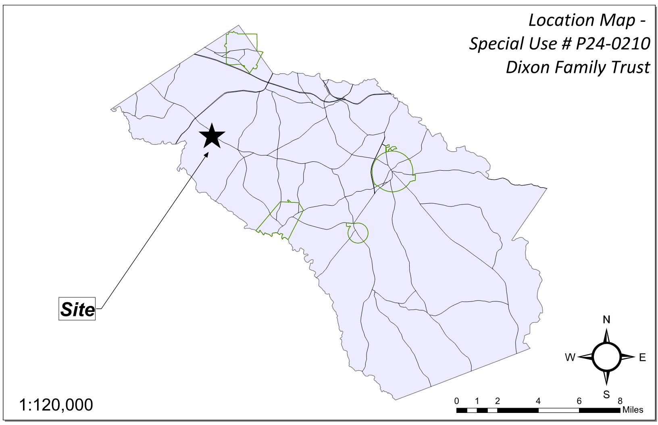
Site Location

Slide 3
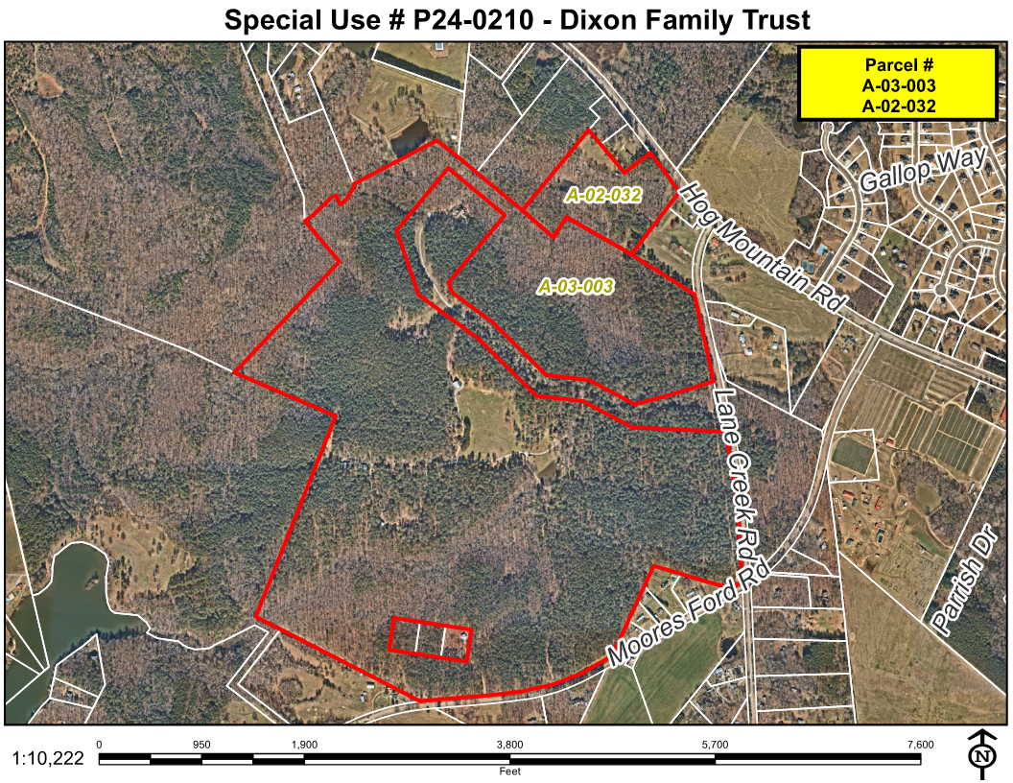
Aerial Imagery

Slide 4
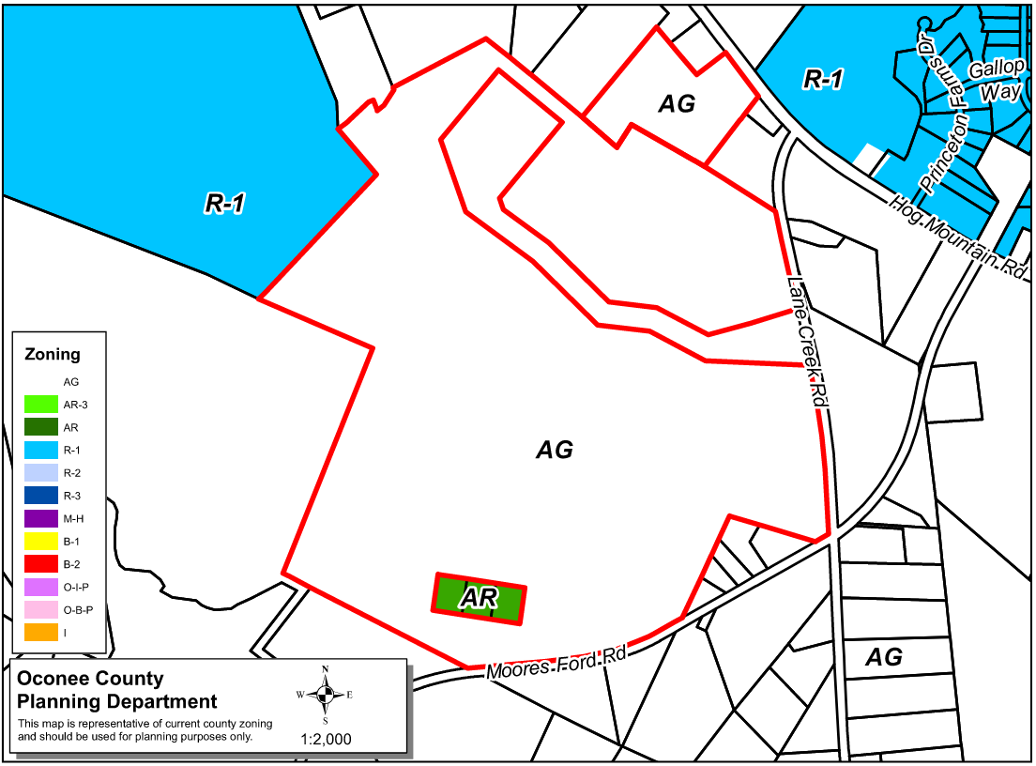
Zoning
AG

Slide 5
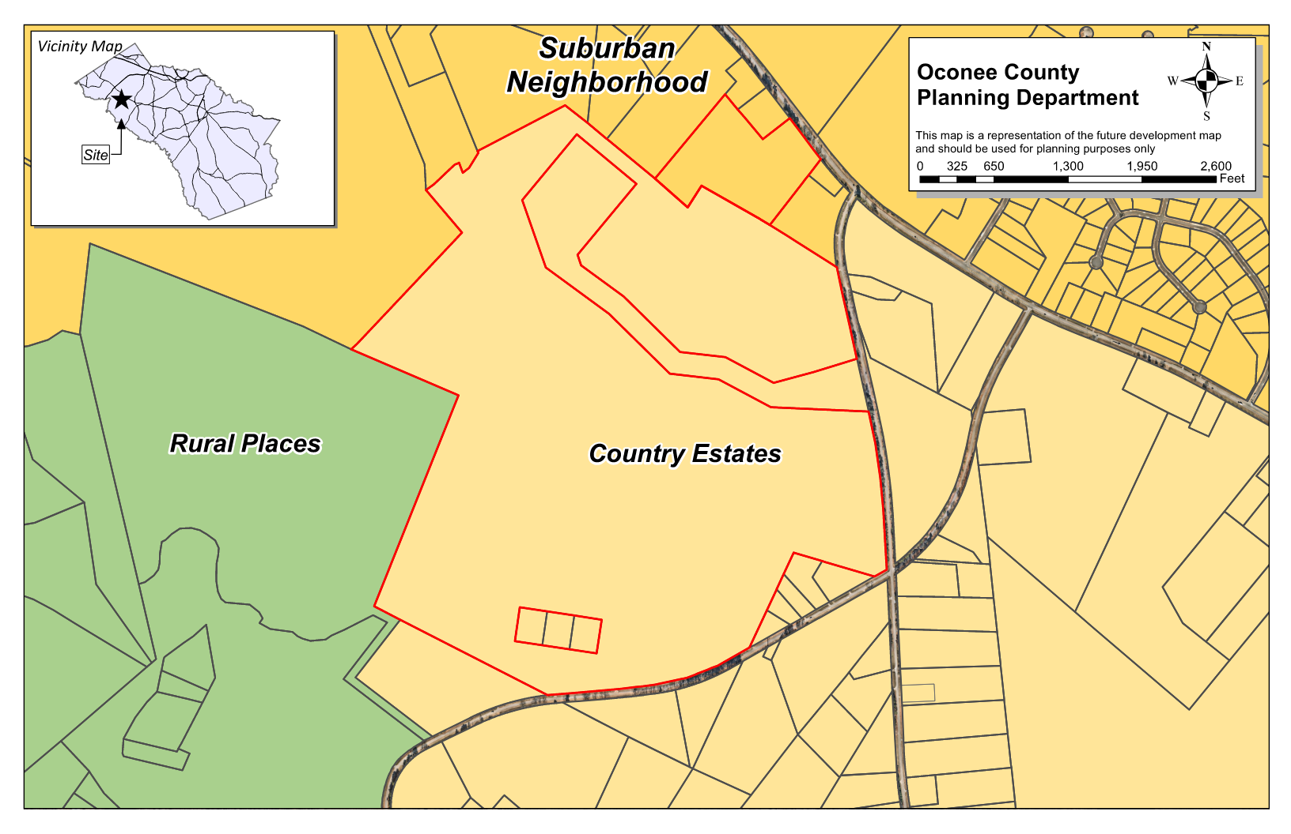
Future Development

Slide 6
Summary of Request
The applicant is requesting Special Use Approval for Recreational Overnight Camps with the construction of 10 recreational cabins for overnight rentals along with converting an existing dwelling to use for overnight rentals.

Slide 7
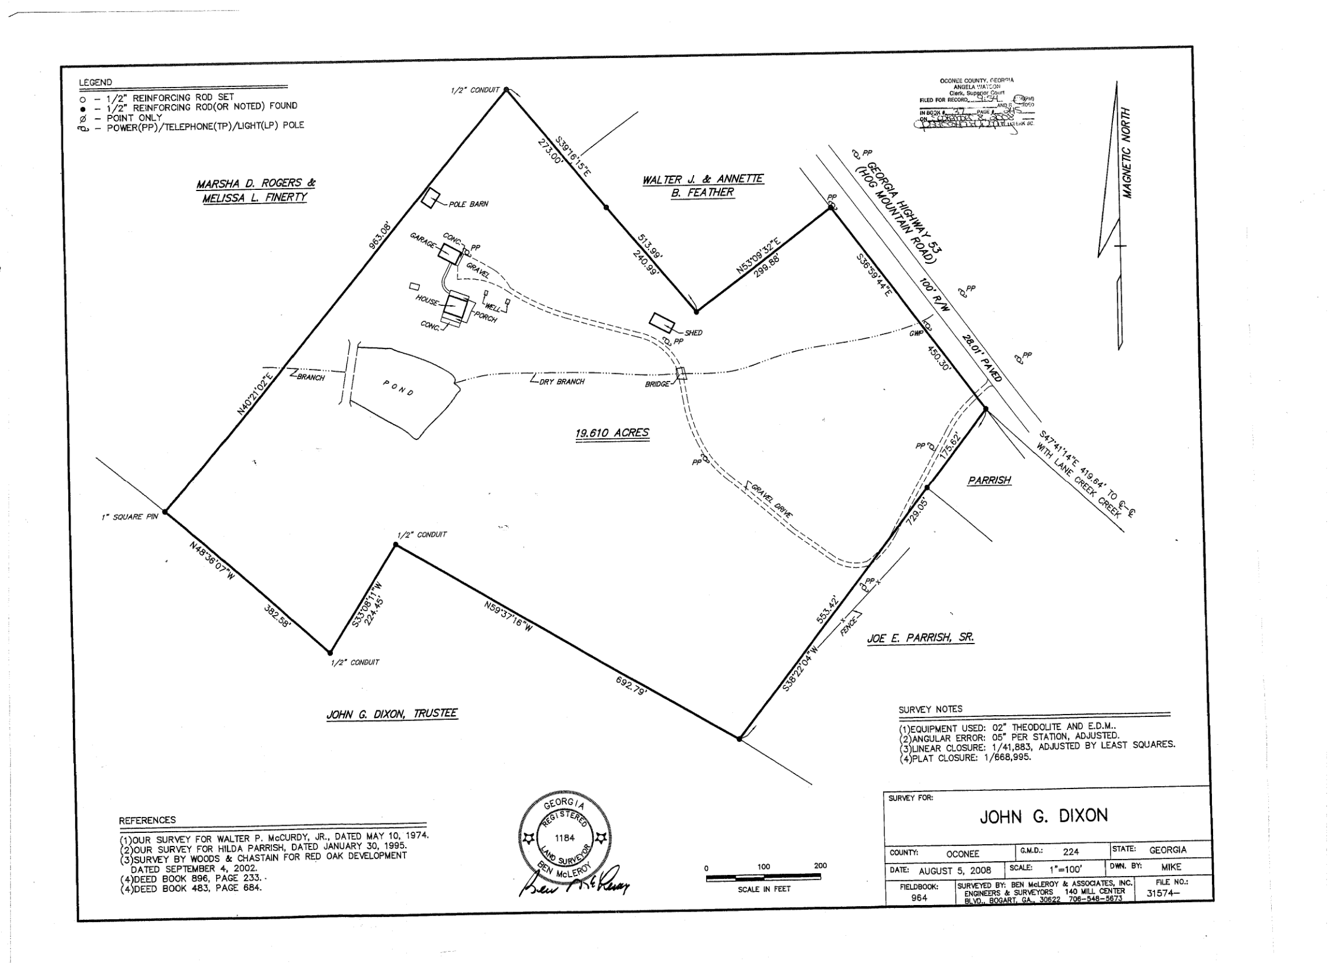
Recorded Plat

Slide 8
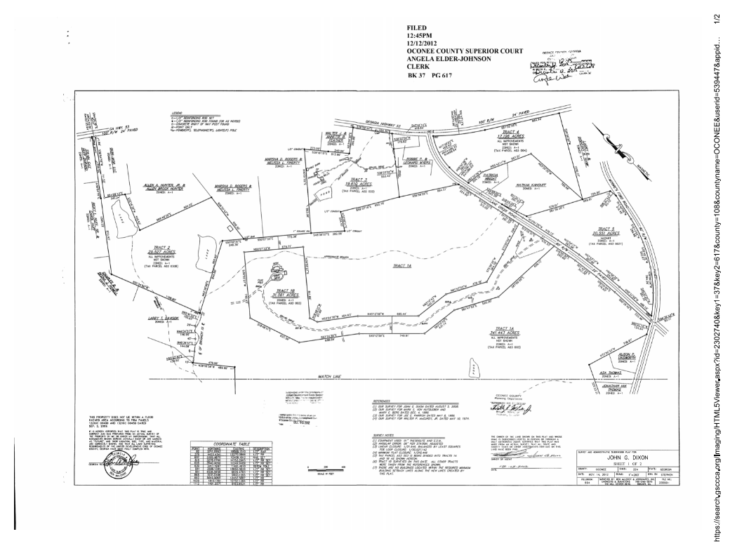
Recorded Plat

Slide 9
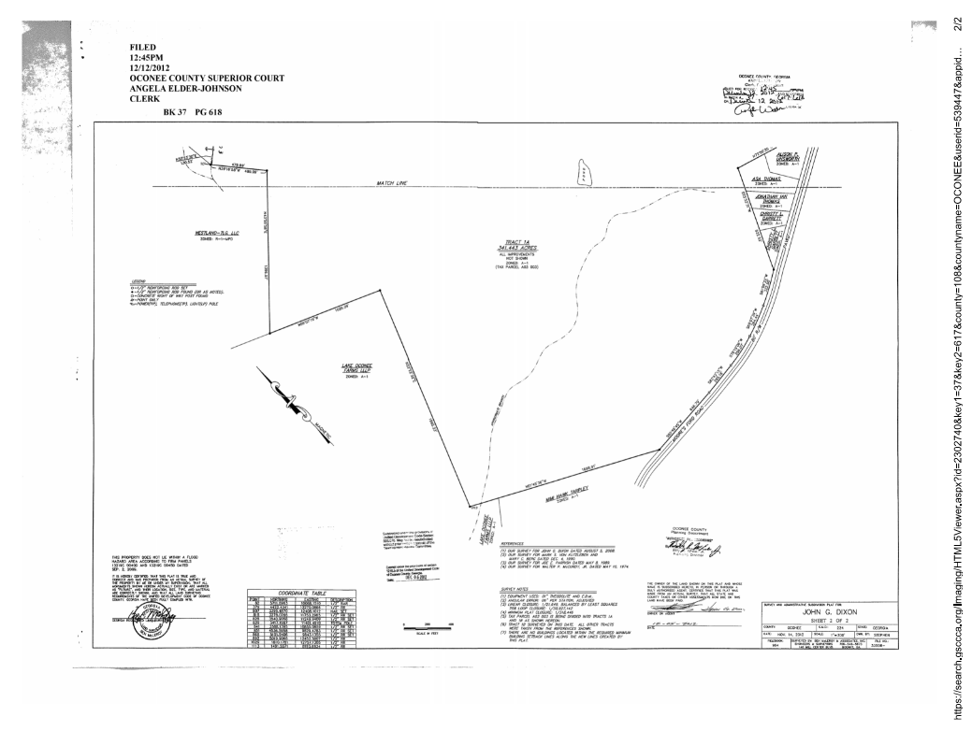
Recorded Plat

Slide 10
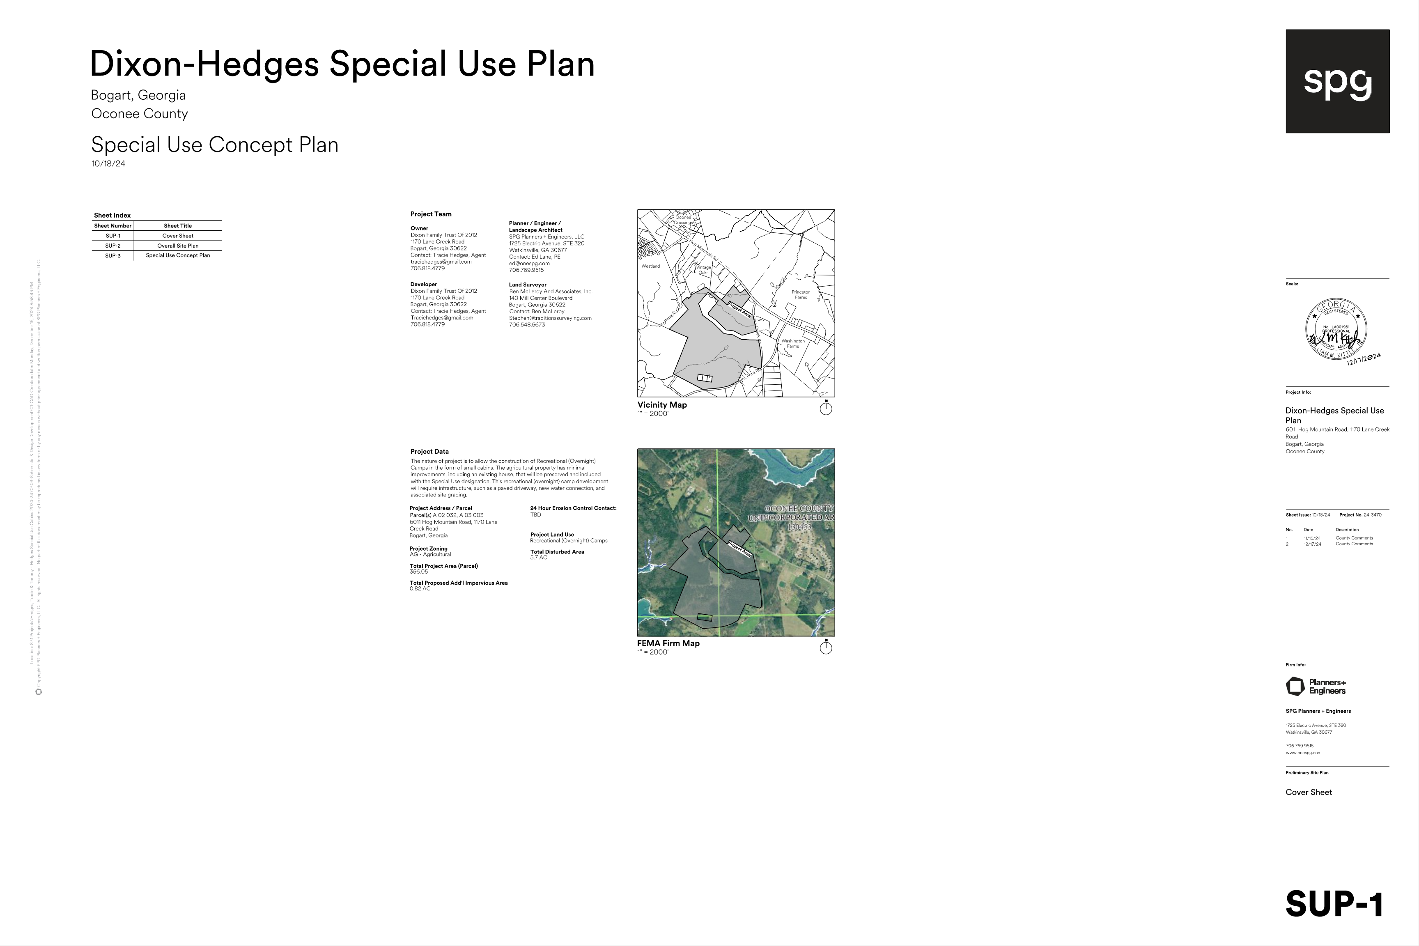
Concept Plan

Slide 11
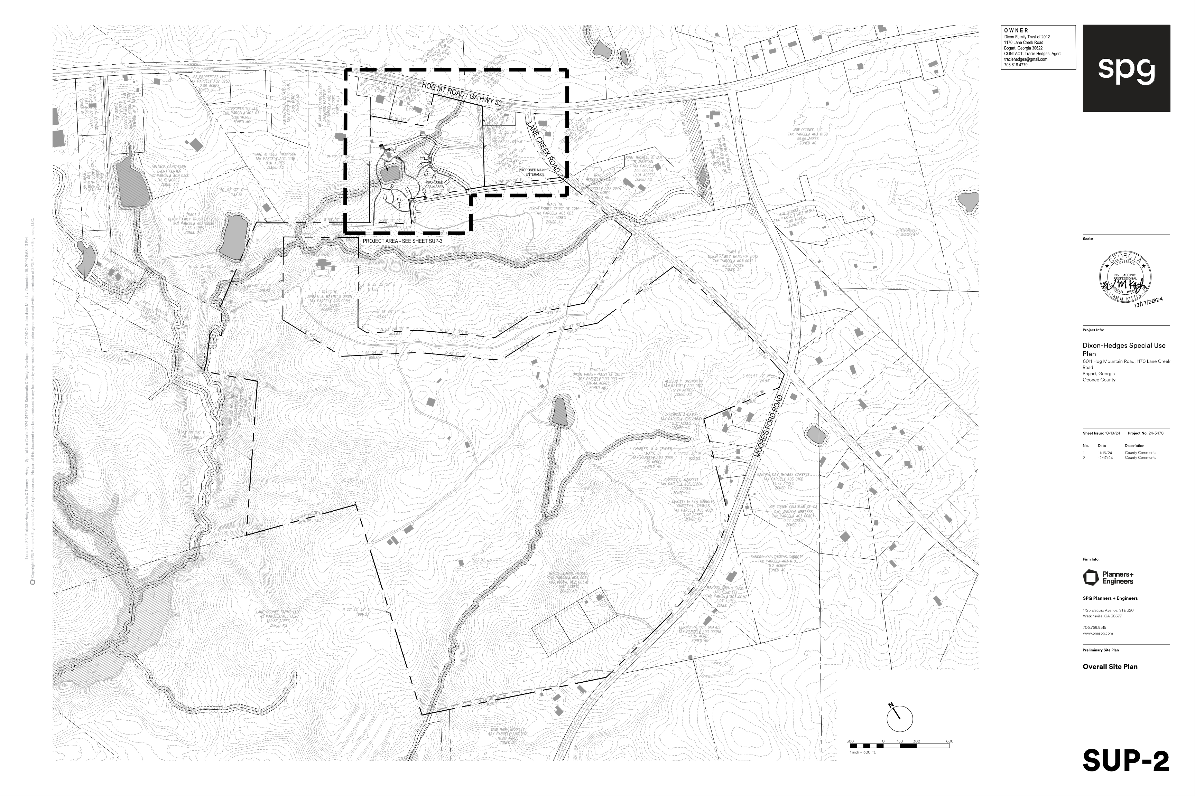
Concept Plan

Slide 12
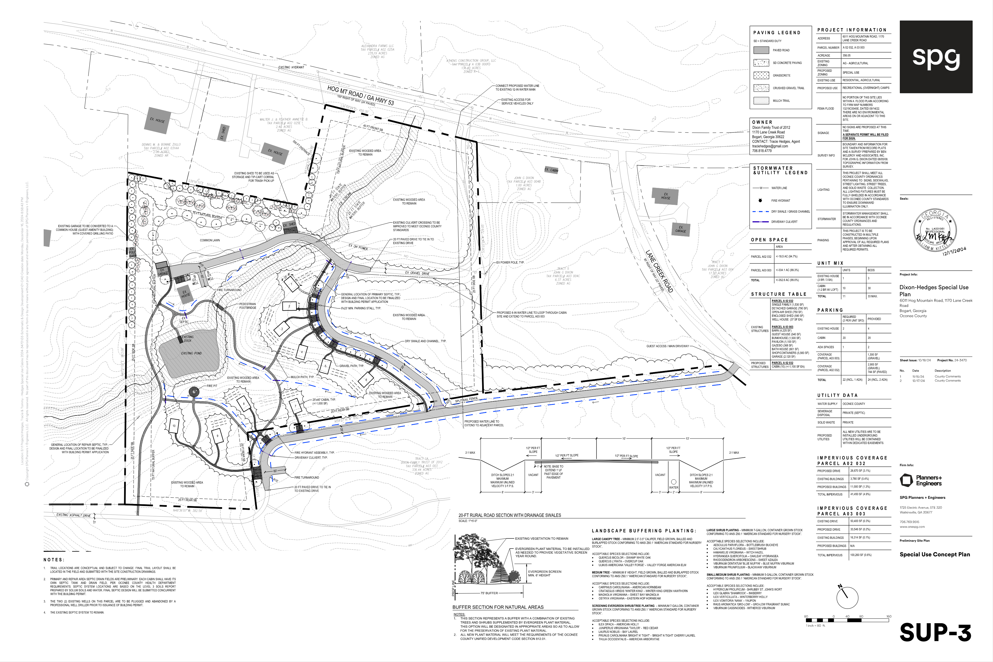
Concept Plan

Slide 13

Architectural Images

Slide 14
Staff Recommendation
Based on Board of Commissioners policies, decision-making criteria, and standards outlined in the development codes of Oconee County, staff recommends approval of the special use request. Staff recommends it be subject to the following conditions to be fulfilled by the developer/owner at their expense:
1. Development design and structures shall meet or exceed the standards indicated on the concept plan, narrative, representative architectural sketches, and other documents submitted with the zoning application and attached hereto. This condition shall not construe approval of any standard that is not in conformity with the Unified Development Code.
2. The owner at their own expense shall construct the improvements required by the County for public water and public waste services for the subject property and shall convey the same to the County, free of all liens. Said improvements shall include all on-site improvements and such off-site improvements as are required by the County to provide service to subject property.
3. At its expense, Owner shall make all right of way improvements and shall dedicate all rights of way which are required by the County after the County’s review of Owner's development plans pursuant to the County’s ordinances and regulations. All such improvements shall be shown on the preliminary site plan and site development plans for the project and no development permit shall be issued until Owner has agreed to such improvements and dedication.
4. The preliminary and site development plan shall indicate a 50’ buffer along all property lines adjacent to existing residential uses adjacent to areas that propose a commercial use in accordance with Table 8.1.

Slide 15
Staff Recommendation
Based on Board of Commissioners policies, decision-making criteria, and standards outlined in the development codes of Oconee County, staff recommends approval of the special use request. Staff recommends it be subject to the following conditions to be fulfilled by the developer/owner at their expense:
5. There shall be no outdoor amplified music after 9:00 PM.
6. All existing and proposed commercial drives on the property shall be constructed to meet Fire Codes, capable of supporting the imposed load of fire apparatus weighing up to 75,000 pounds (34 050 kg).

Slide 16
Planning Commission Recommendation
Planning Commission recommends approval subject to the 6 conditions recommended by staff, with a modification to Condition #4 and a new Condition #7:
4. The preliminary and site development plan shall indicate a 75’ natural buffer along all property lines adjacent to existing residential uses adjacent for areas that propose a commercial use in accordance with Table 8.1.
7. The fire pit shall be located in a central point of the project.

