Slide 1


Slide 2
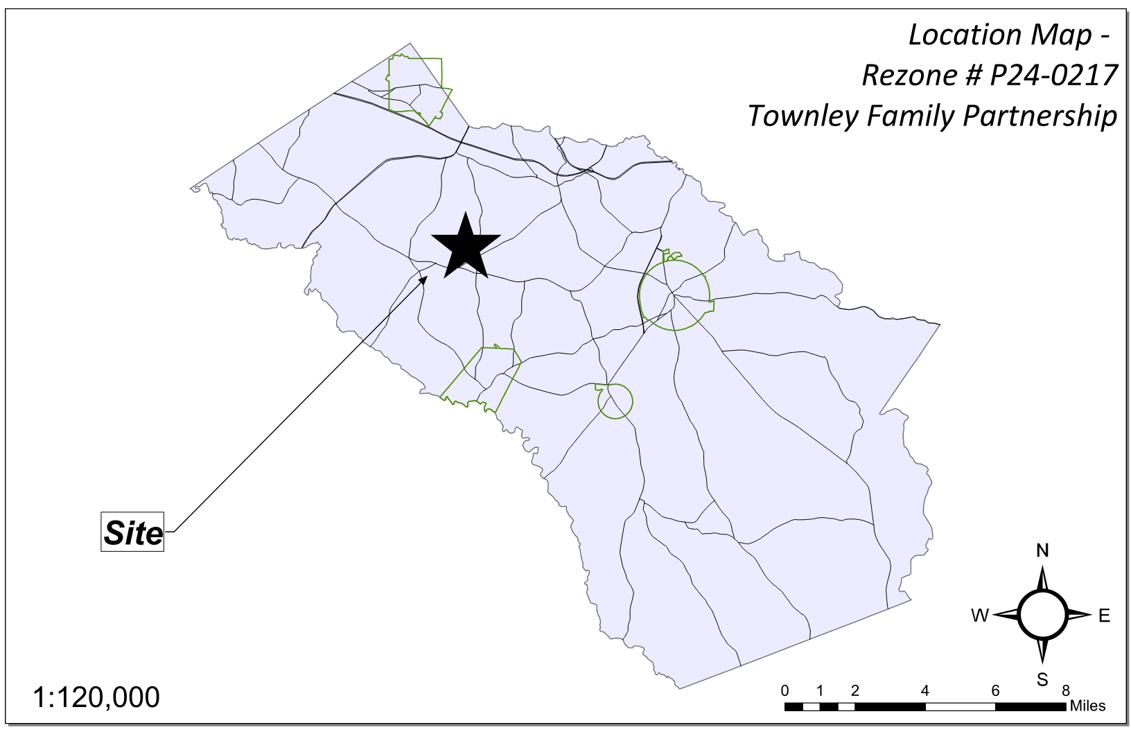
Site Location

Slide 3
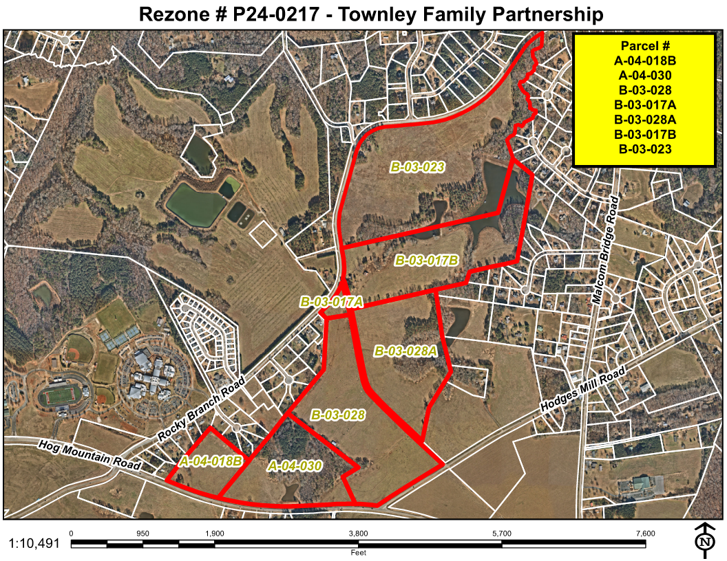
Aerial Imagery

Slide 4
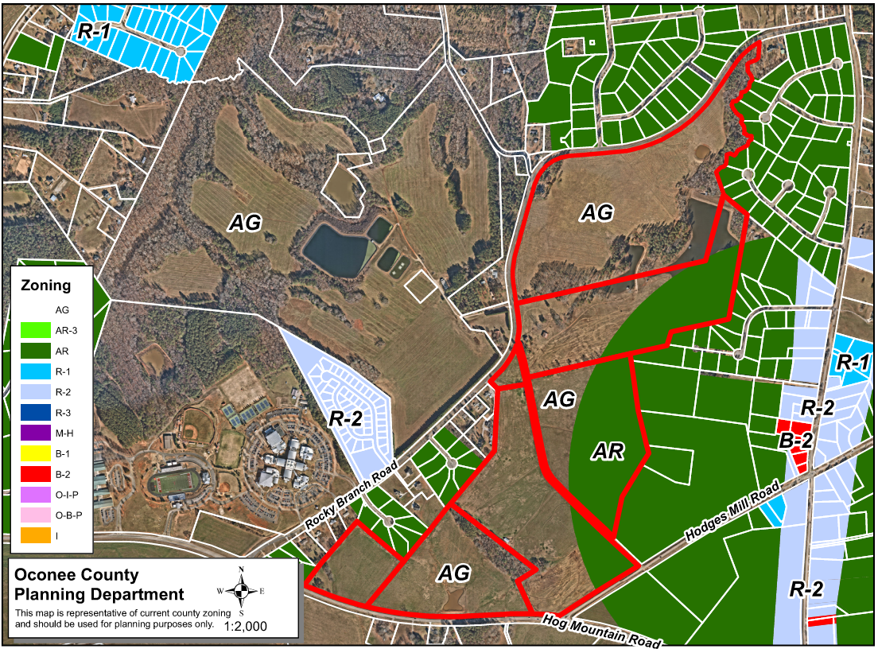
Zoning
AG

Slide 5
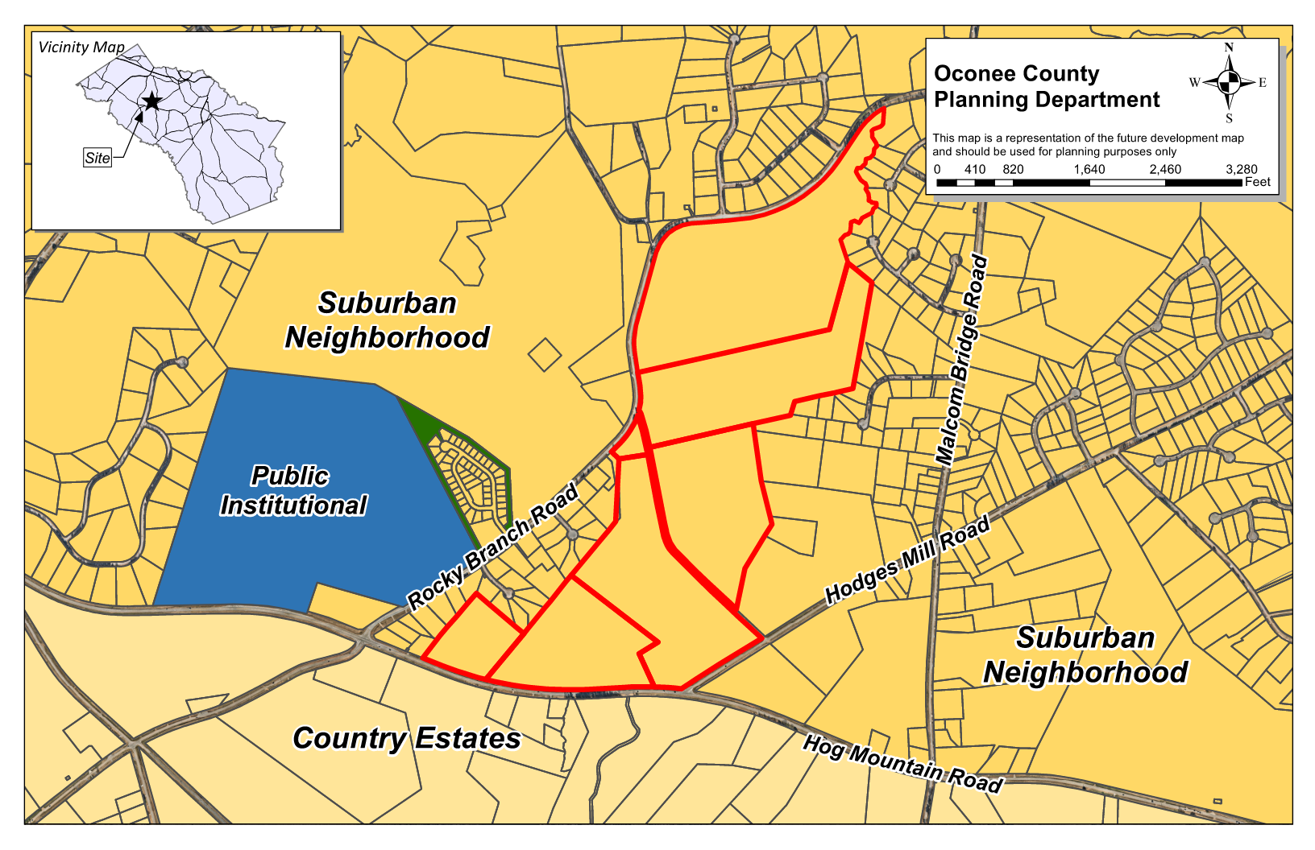
Future Development

Slide 6
Summary of Request
Rezone ±194.46 acres from AG (Agricultural) to AR (Agricultural-Residential District).

Slide 7
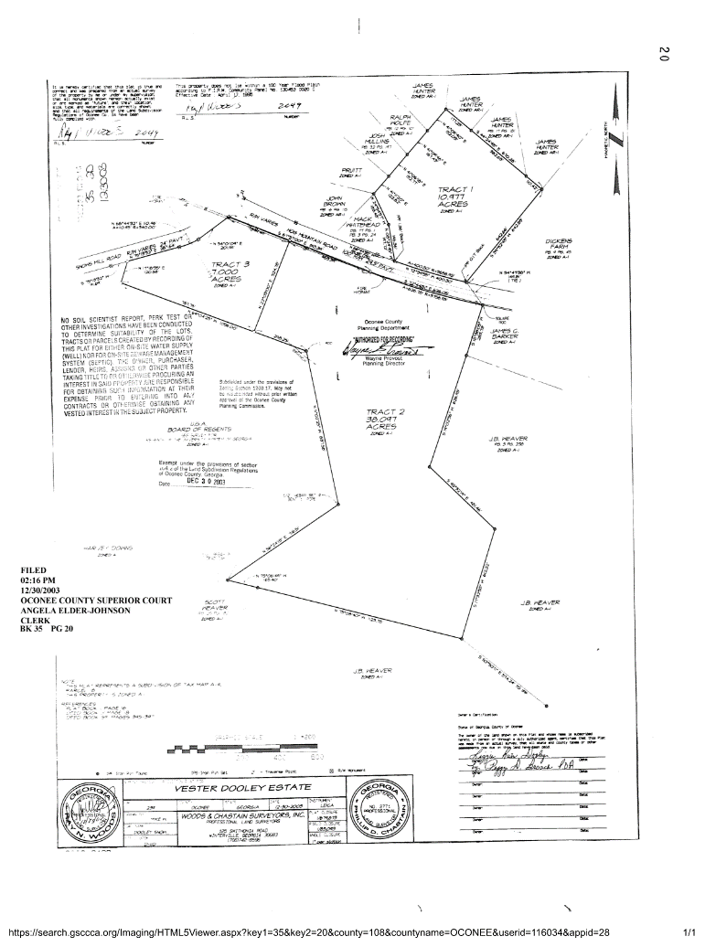
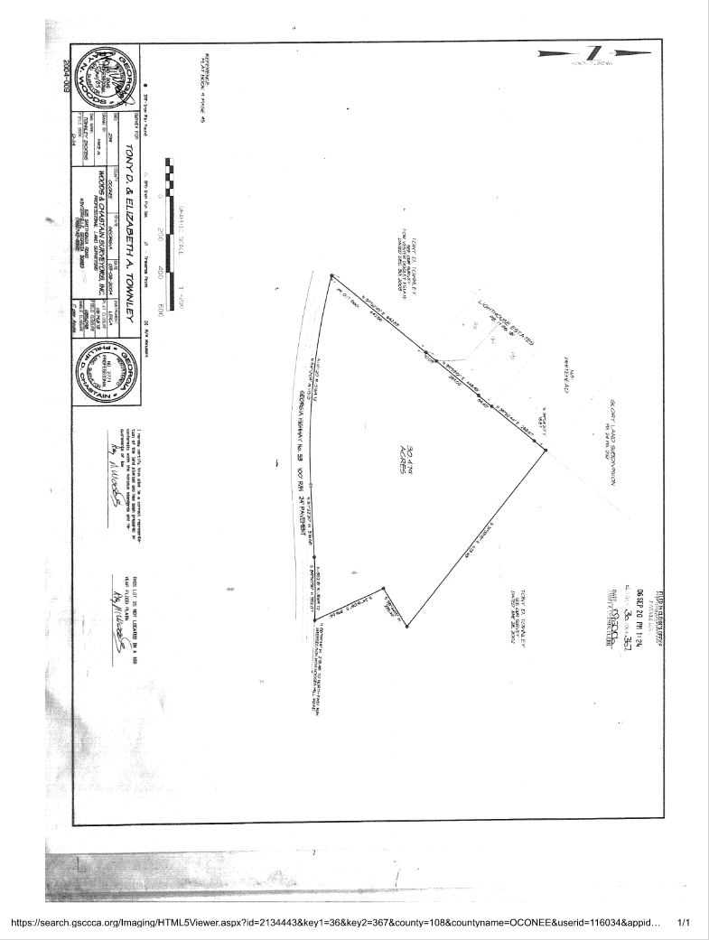
Recorded Plats

Slide 8
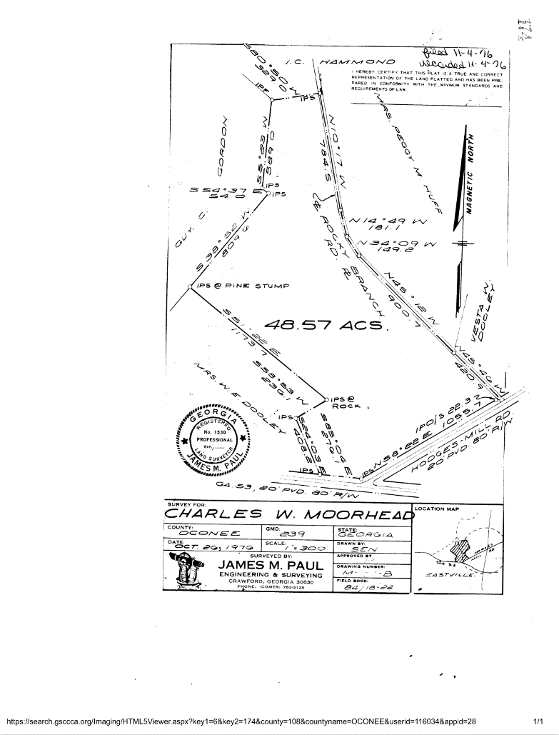
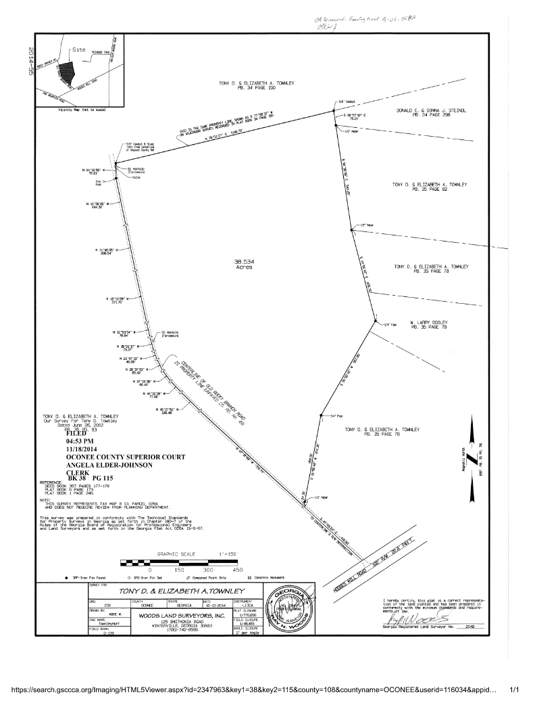
Recorded Plats

Slide 9
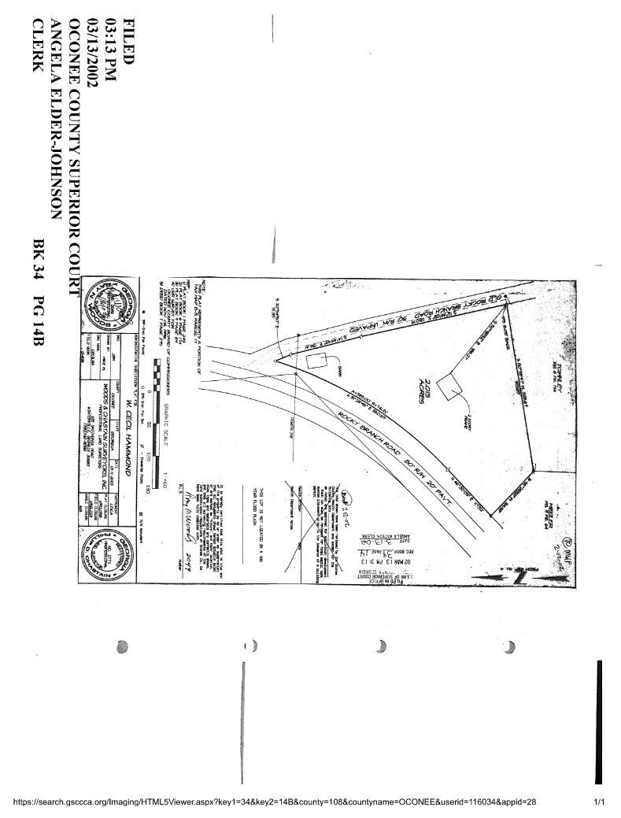
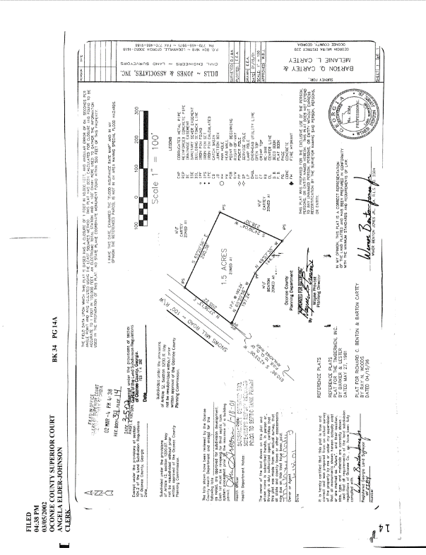
Recorded Plats

Slide 10
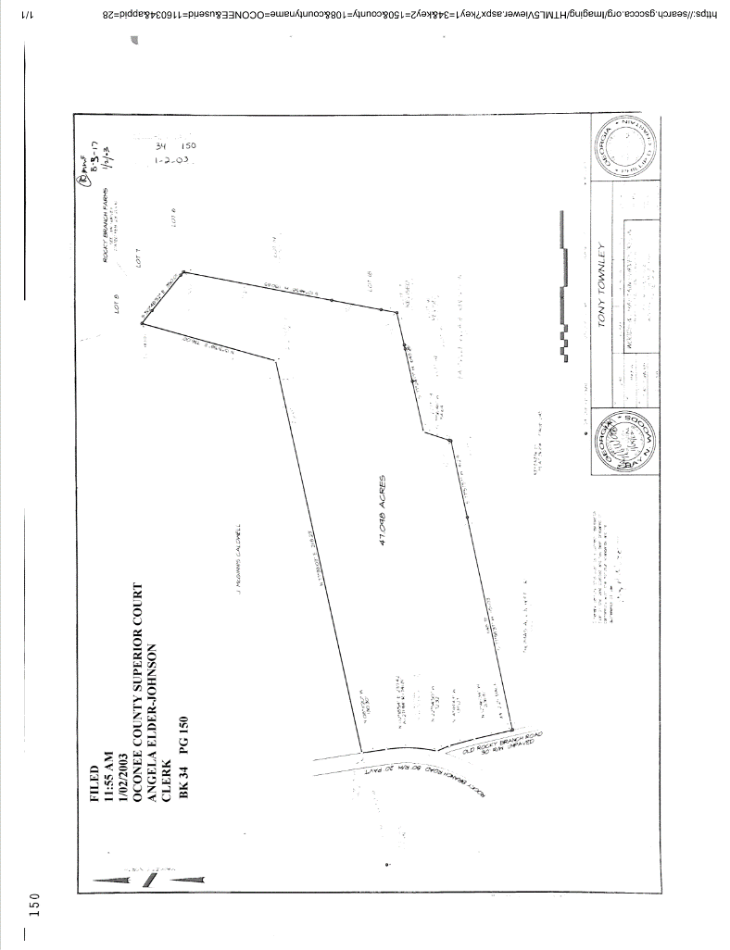
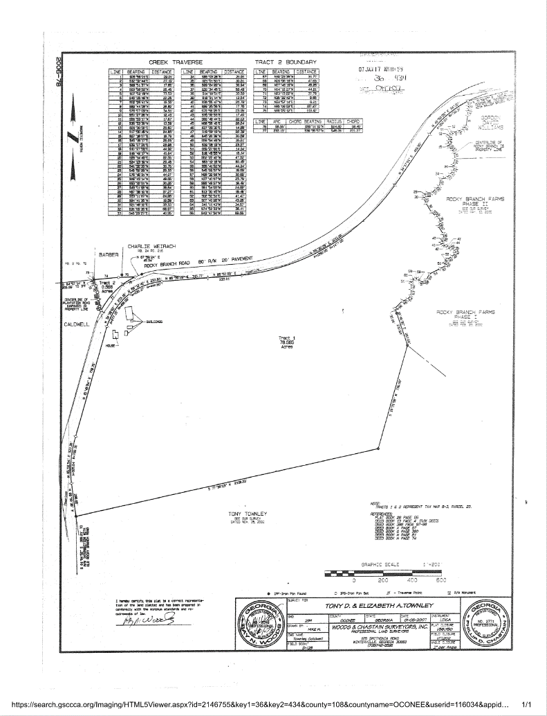
Recorded Plats

Slide 11
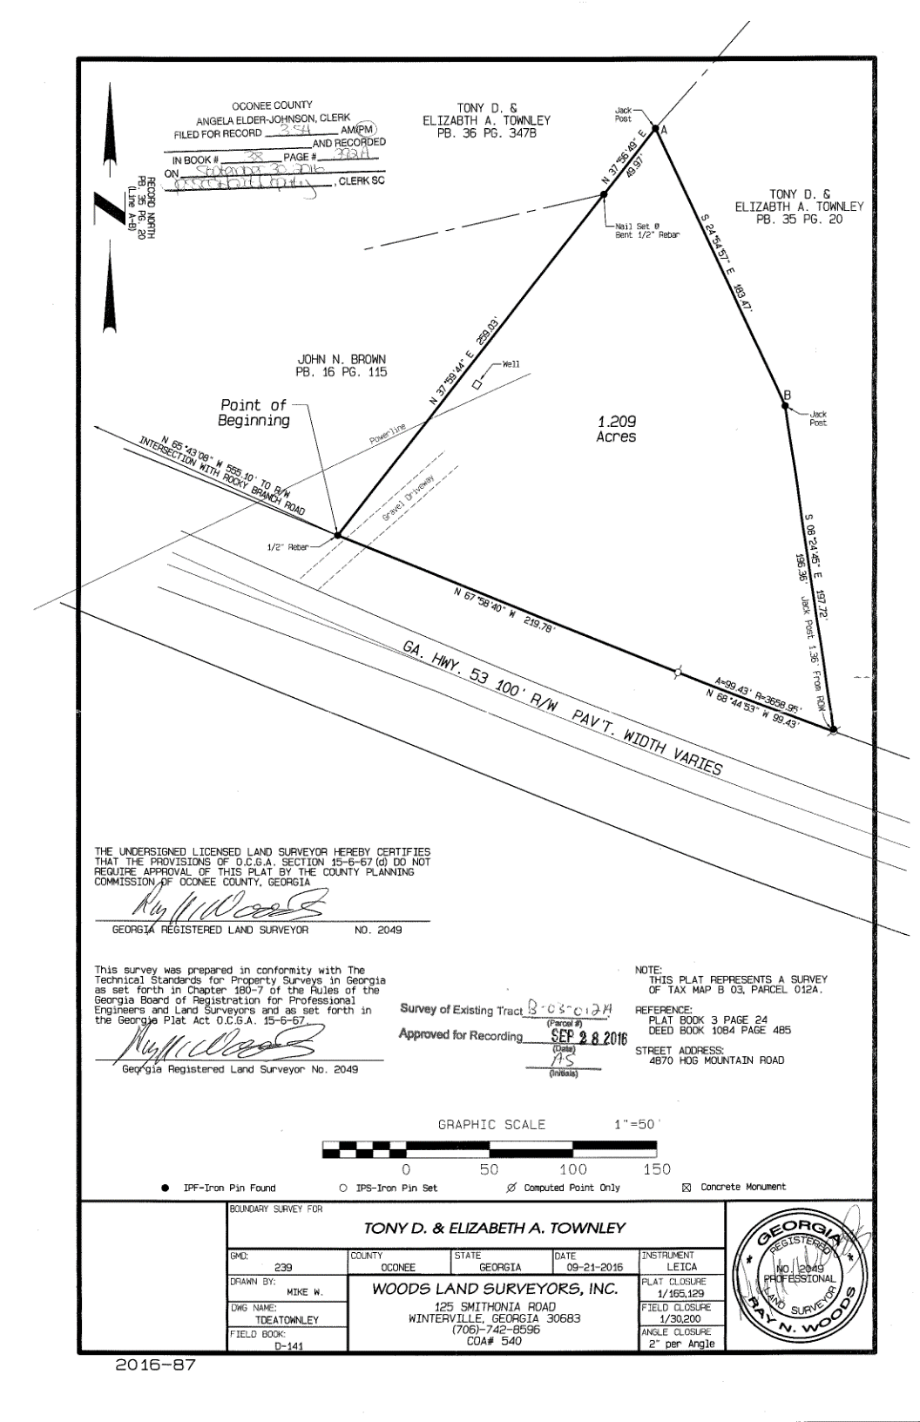
Recorded Plats

Slide 12
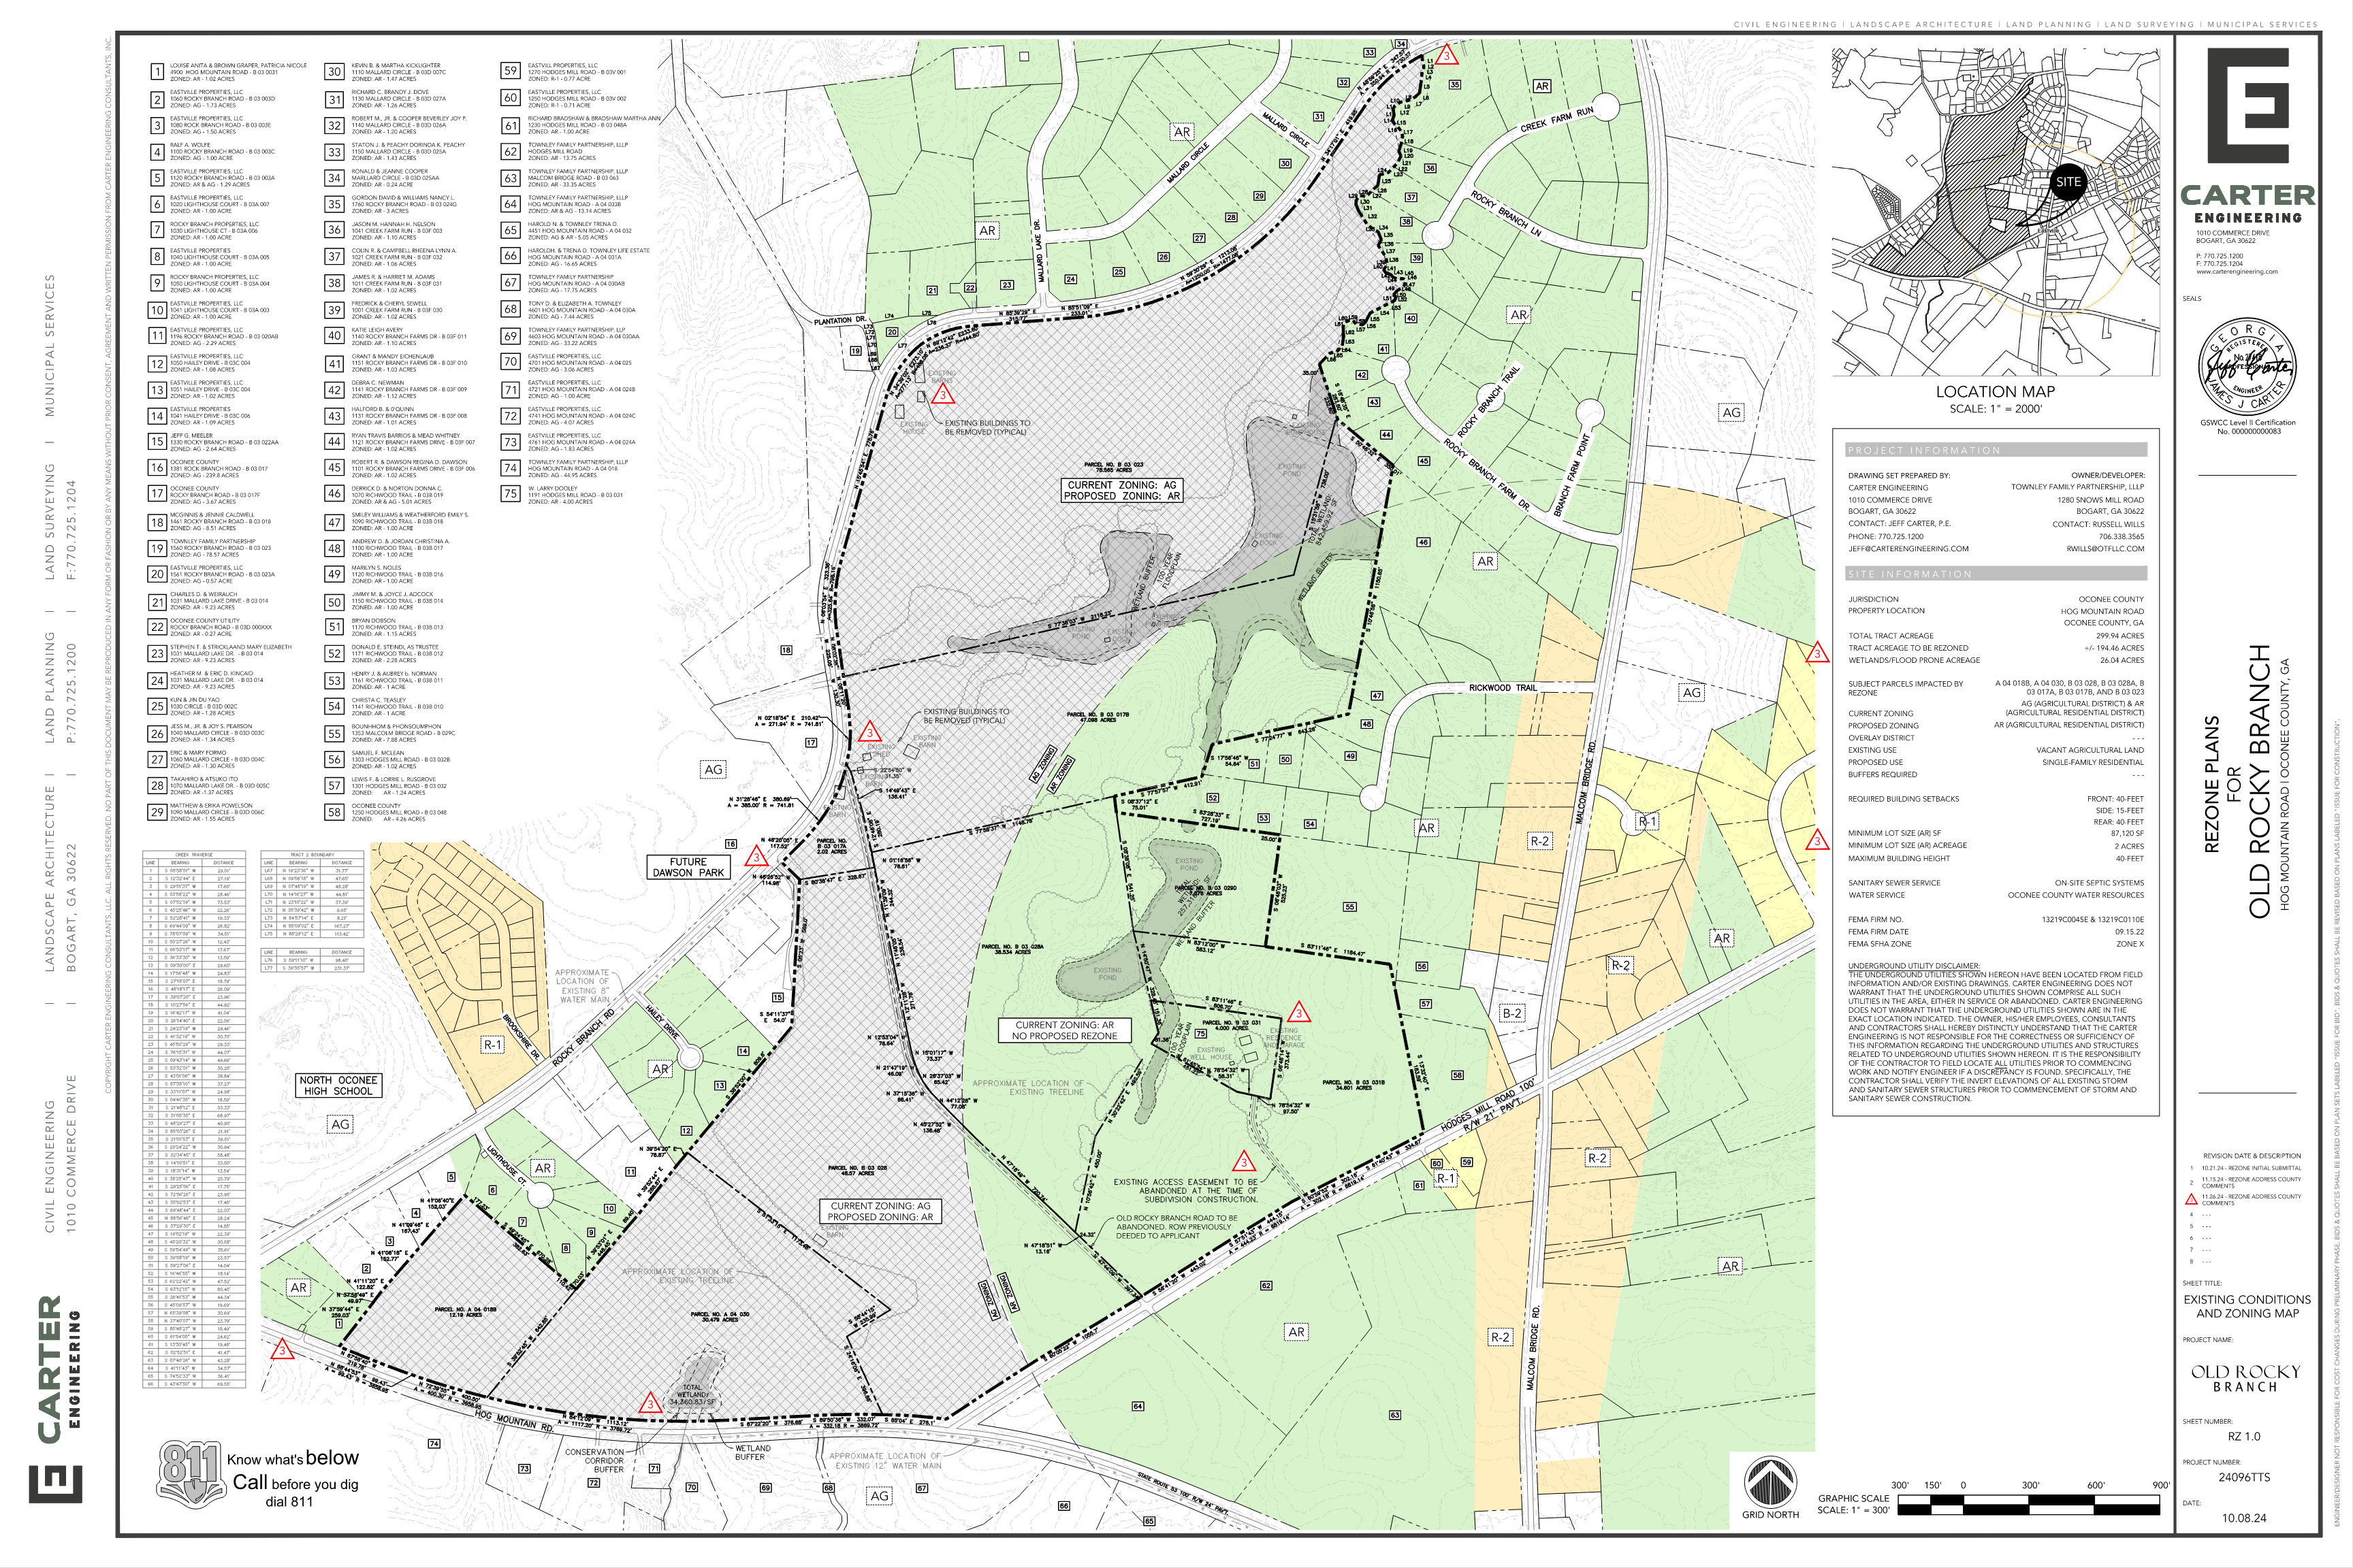
Concept Plan

Slide 13
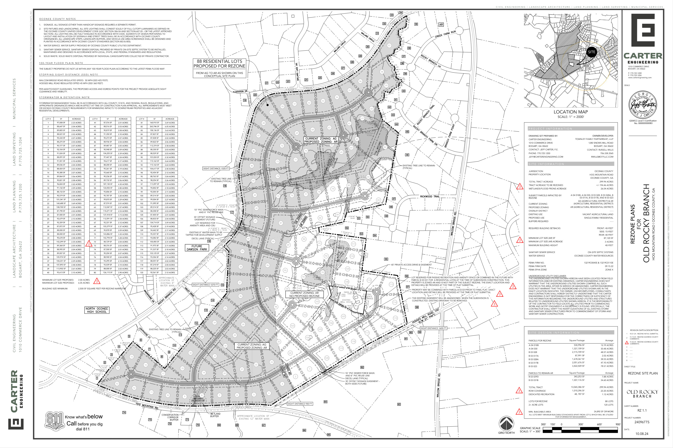
Concept Plan

Slide 14
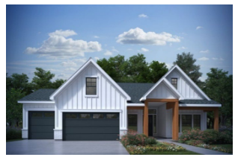
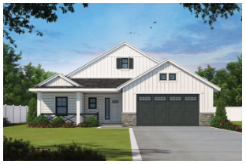
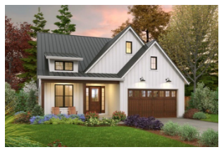
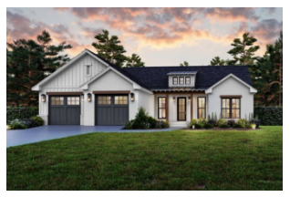
Architectural Images

Slide 15
Staff Recommendation
Based on Board of Commissioners policies, decision-making criteria, and standards outlined in the development codes of Oconee County, staff recommends conditional approval of the request to rezone ±299.94 acres to AR subject to the following conditions to be fulfilled at the expense of the owner/developer:
1. Development design and structures shall meet or exceed the standards indicated on the concept plan, narrative, representative architectural sketches, and other documents submitted with the zoning application and attached hereto. This condition shall not construe approval of any standard that is not in conformity with the Unified Development Code.
2. The owner at their own expense shall construct the improvements required by the County for public water for the subject property and shall convey the same to the County, free of all liens. Said improvements shall include all on-site improvements and such off-site improvements as are required by the County to provide service to subject property.
3. At its expense, Owner shall make all right of way improvements and shall dedicate all rights of way which are required by the County after the County’s review of Owner's development plans pursuant to the County’s ordinances and regulations. All such improvements shall be shown on the preliminary site plan and site development plans for the project and no development permit shall be issued until Owner has agreed to such improvements and dedication.
4. All conditions of approval shall apply to Parcels B 03 029D (1355 Malcom Bridge Road) and B 03 031B (1161 Hodges Mill Rd) as indicated on the concept plan.
5. No Final Plat shall be granted for a period of ten (10) years from the date of Board of Commissioners approval.

Slide 16
Staff Recommendation
Based on Board of Commissioners policies, decision-making criteria, and standards outlined in the development codes of Oconee County, staff recommends conditional approval of the request to rezone ±299.94 acres to AR subject to the following conditions to be fulfilled at the expense of the owner/developer:
6. All areas along exterior boundaries and rights of way abutting GA 53, Rocky Branch Road, and Hodges Mill Road shall indicate an open space area 15 feet wide. The design of the open space areas to be approved by the Director of Planning and Code Enforcement at the time of Preliminary Plat submission. Within the open space area, a buffer that contains a 10-foot wide and 4-foot-tall berm shall be installed with evergreen landscaping that is 6’ high at the time of planting prior to granting Final Plat approval.
7. An eight (8) foot wide concrete multi-use path shall be installed within the public right of way for the road(s) that connect Rocky Branch Road, and Hodges Mill Road. The multi-use path shall also be installed along Hodges Mill Road south to the intersection with GA 53 (Hog Mountain Road). The multi-use path shall be installed prior to granting Final Plat approval.

Slide 17
Planning Commission Recommendation
Planning Commission recommends denial.

