Slide 1


Slide 2
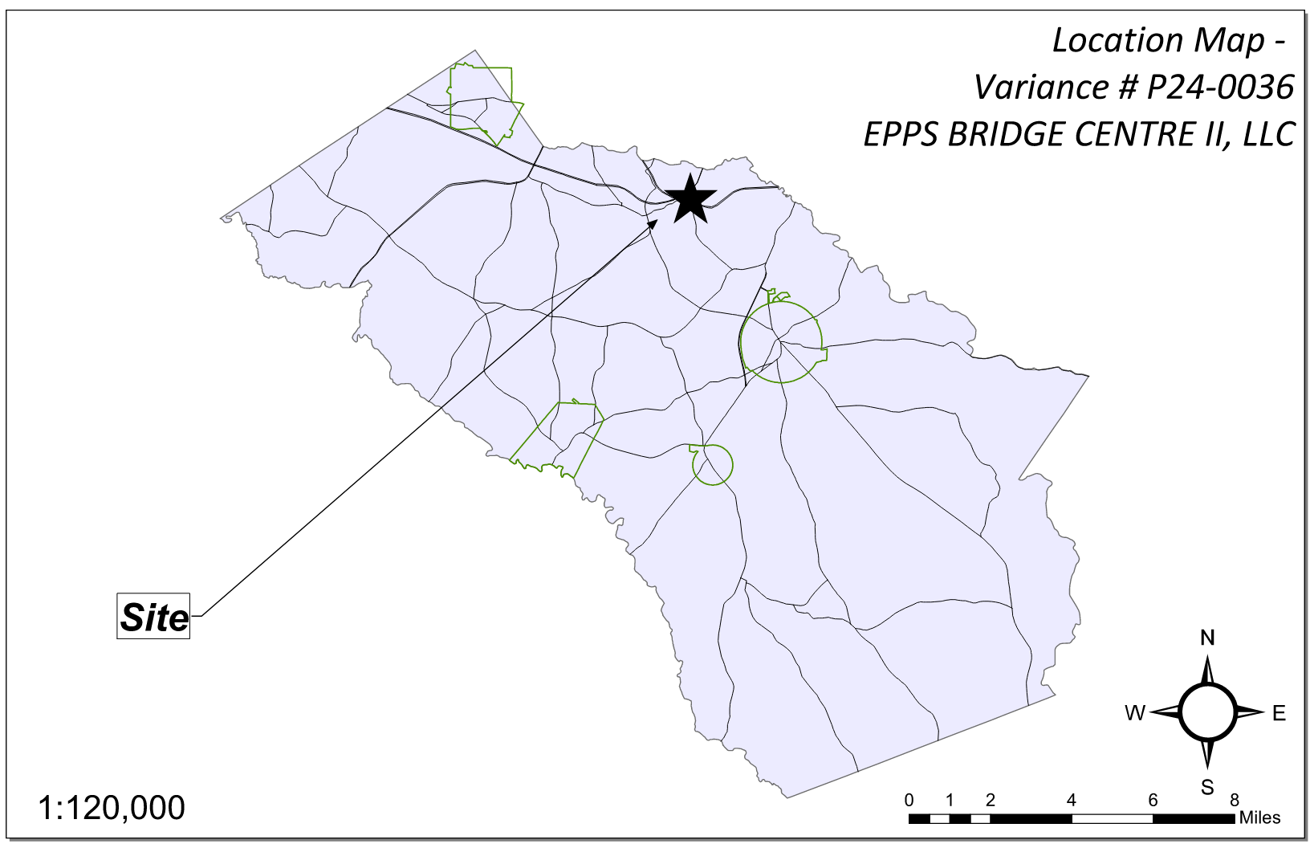
Site Location

Slide 3
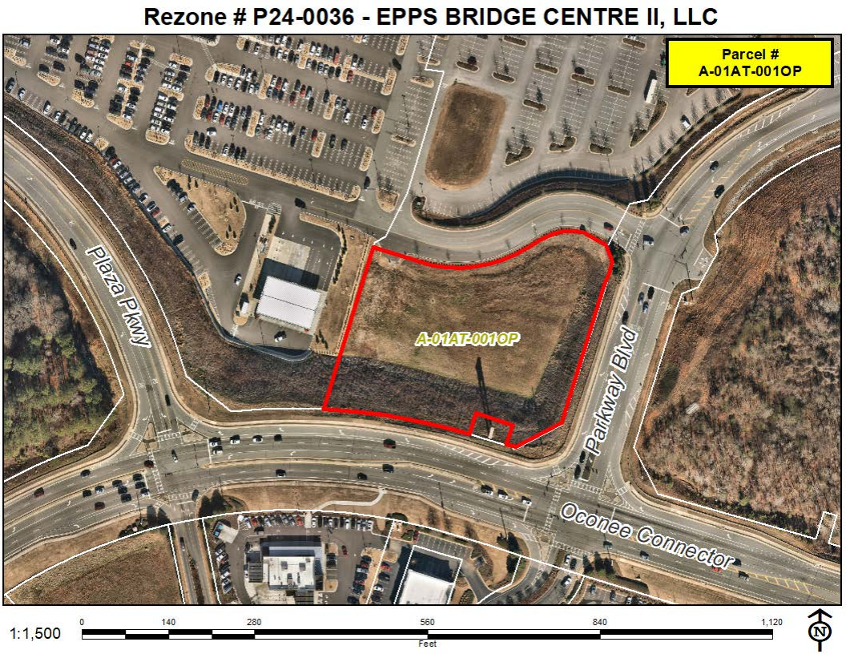
Aerial Imagery

Slide 4
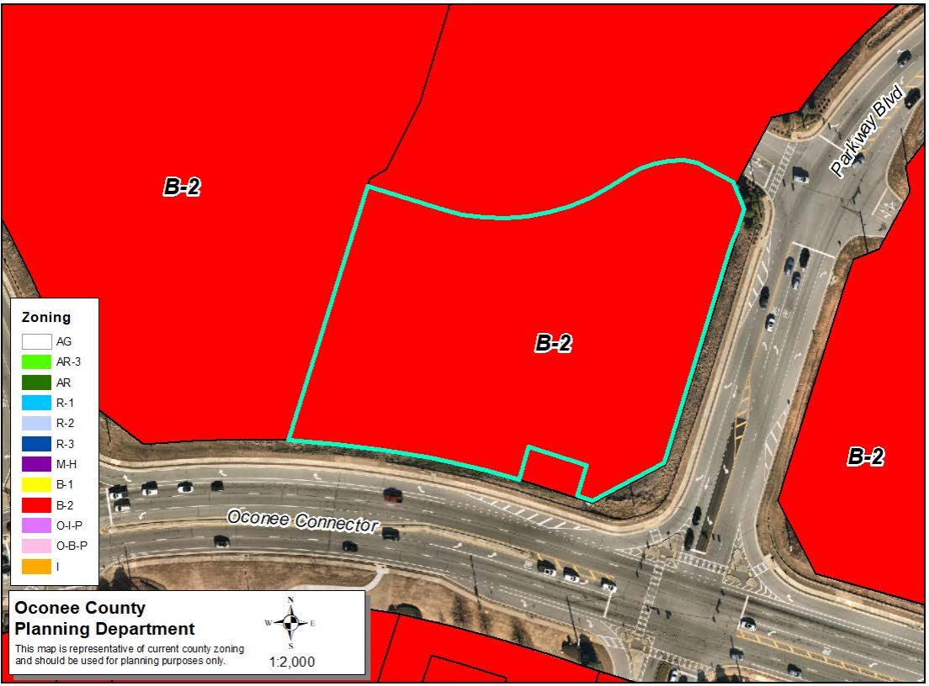
Zoning
AG

Slide 5
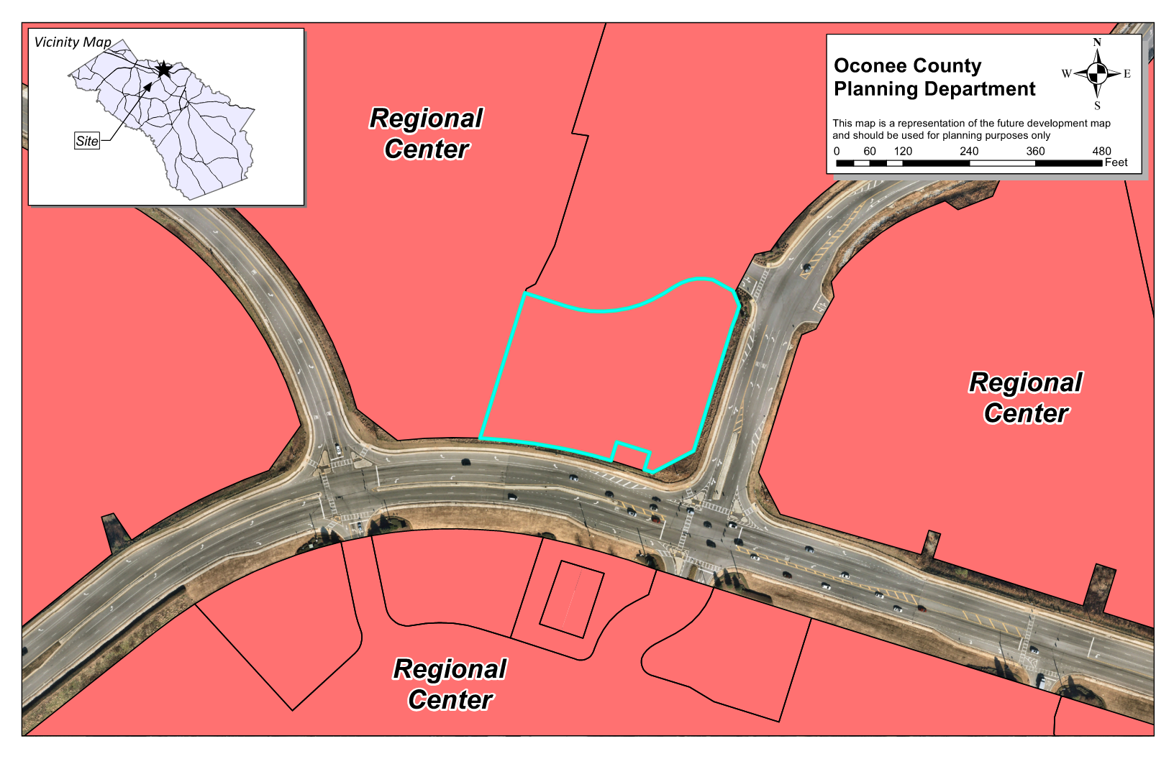
Future Development

Slide 6
Summary of Request
Change the conditions of the previous zoning (case #6812), zoned B-2, to modify previous conditions and the concept plan. The requested changes are:
1. Amend the concept plan to allow construction of an Automotive Oil Change and Lubrication Shop and a Car Wash.
2. Amend the allowed uses on the property to include: Automotive Oil Change and Lubrication Shops; Automotive Parts, Accessories, and Tire Stores; Automotive Repair and Maintenance, except Car Washes; General Automotive Repair; and Car Washes.

Slide 7
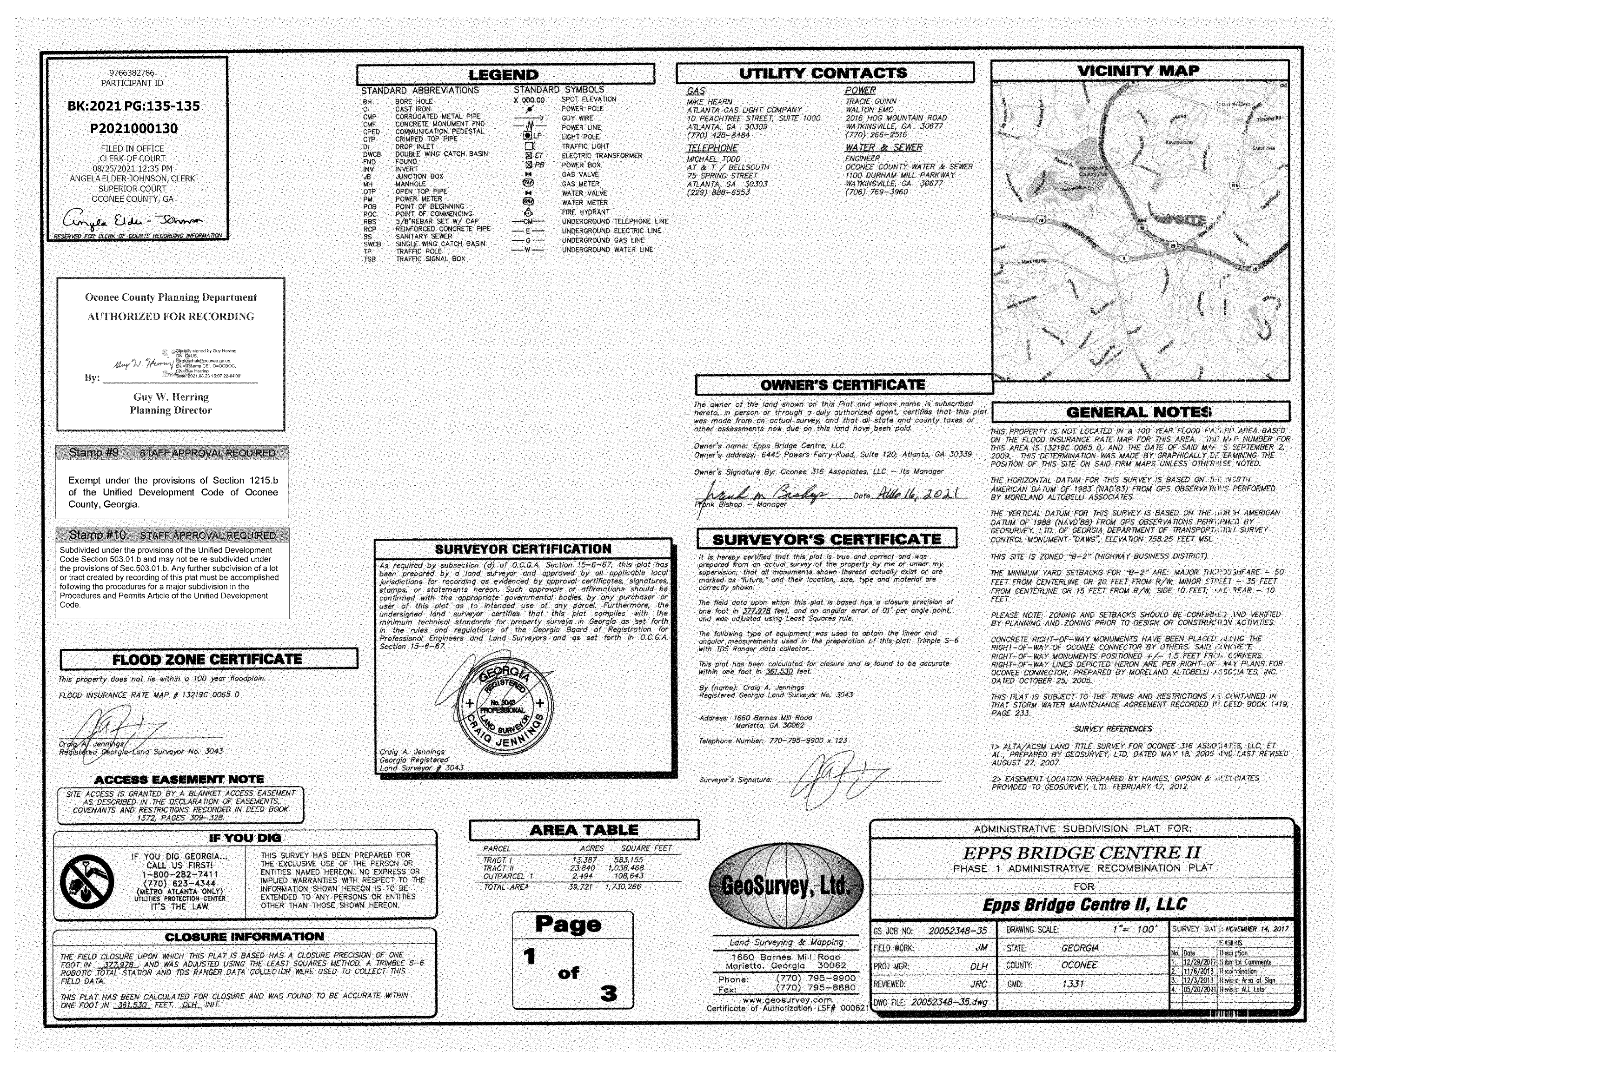
Recorded Plat

Slide 8
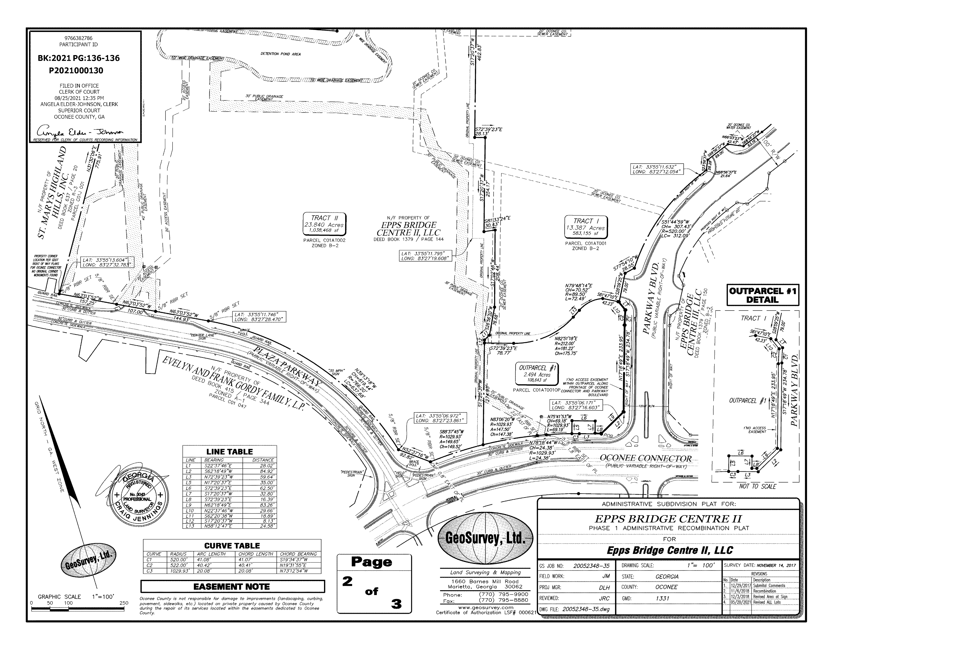
Recorded Plat

Slide 9
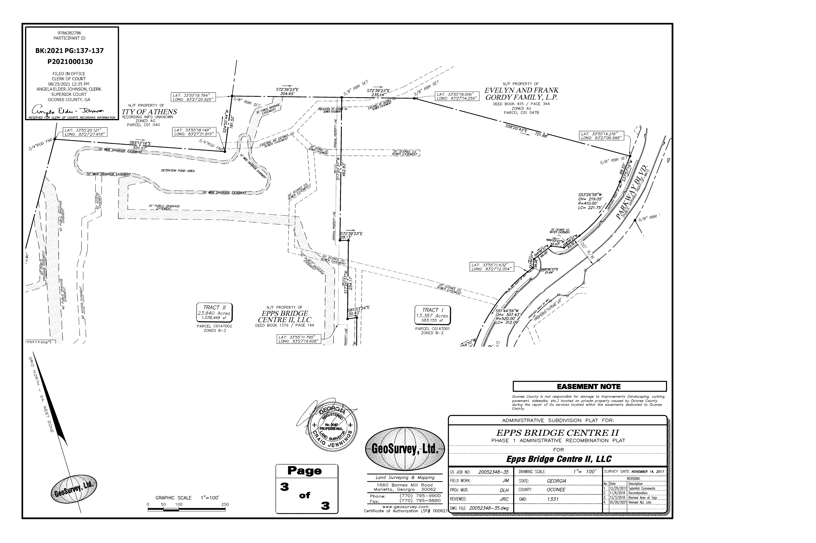
Recorded Plat

Slide 10
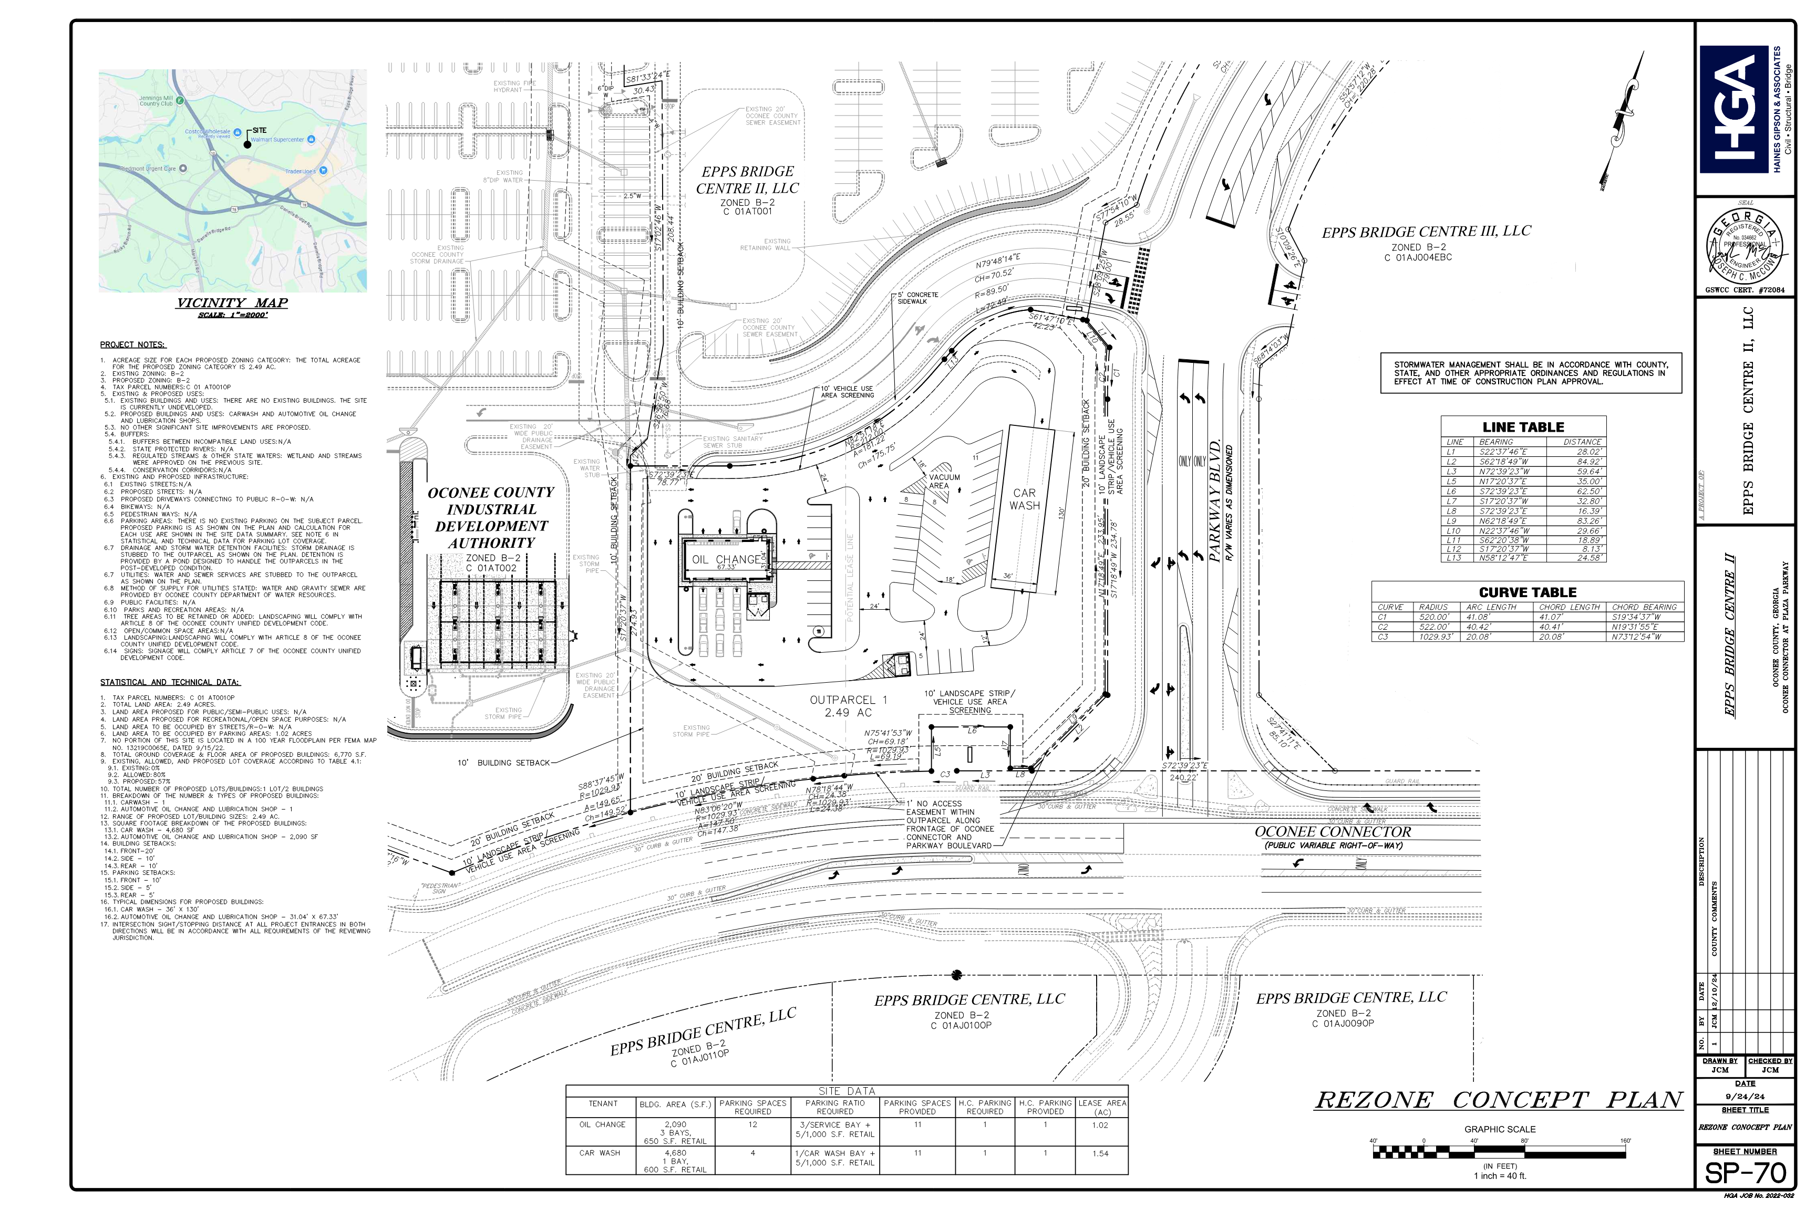
Concept Plan

Slide 11
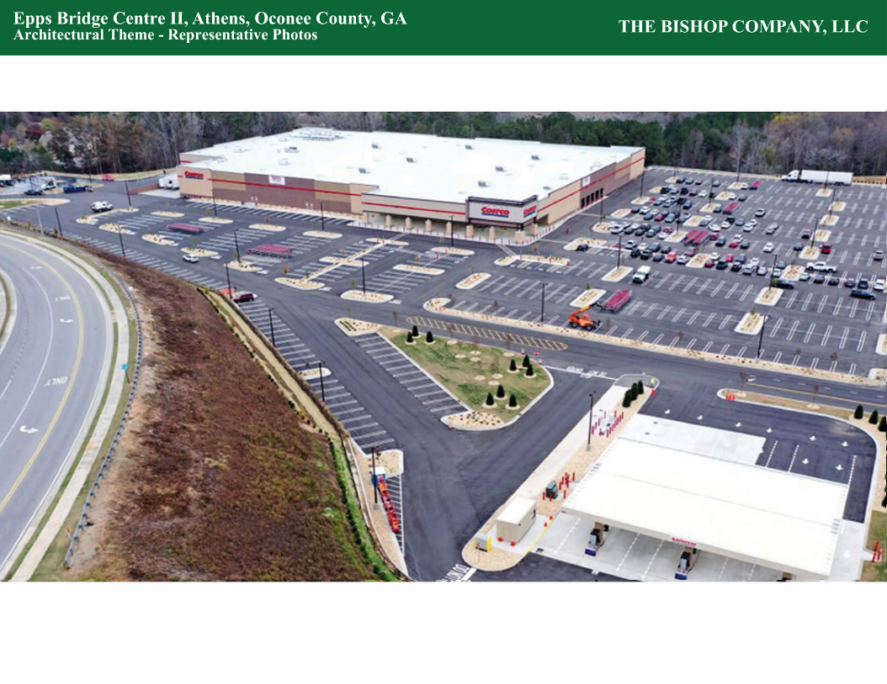
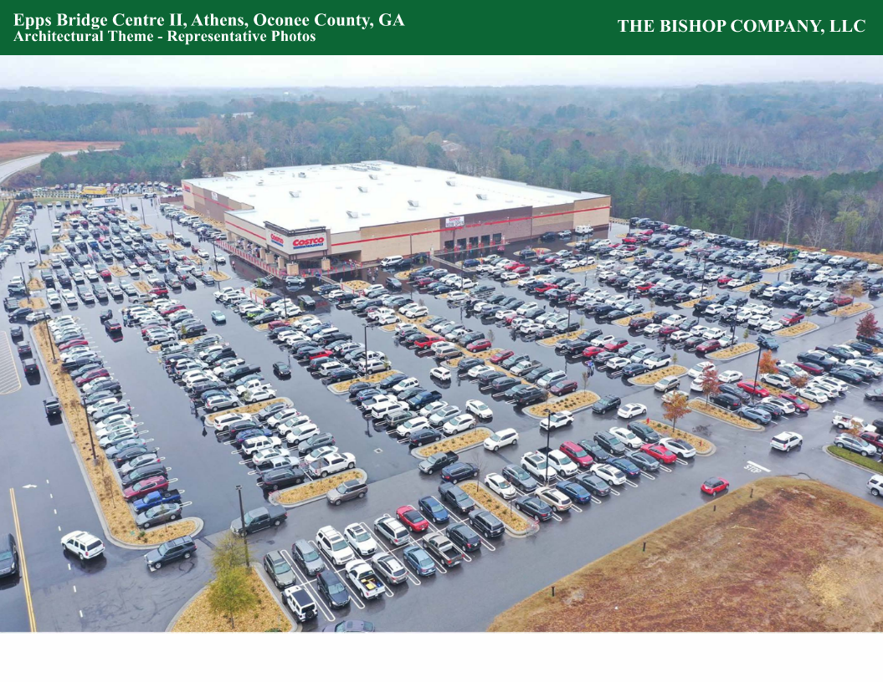
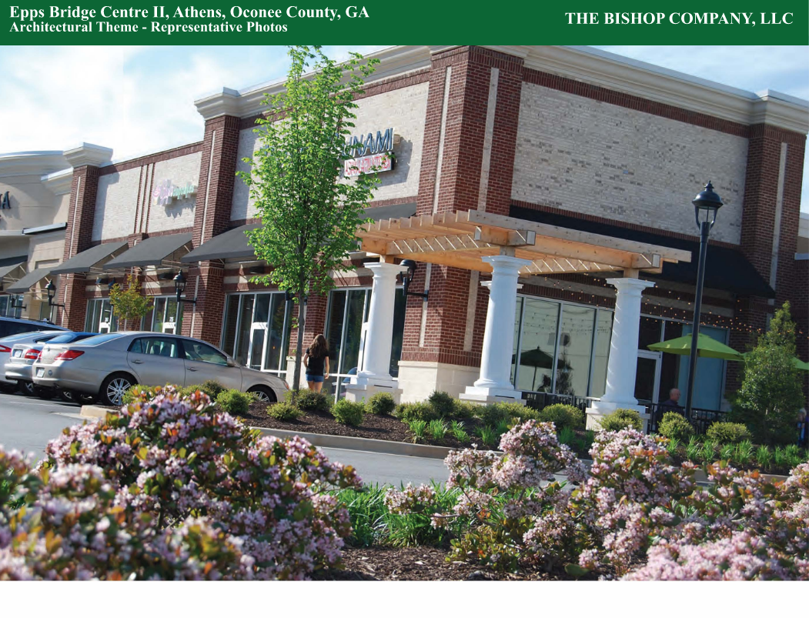
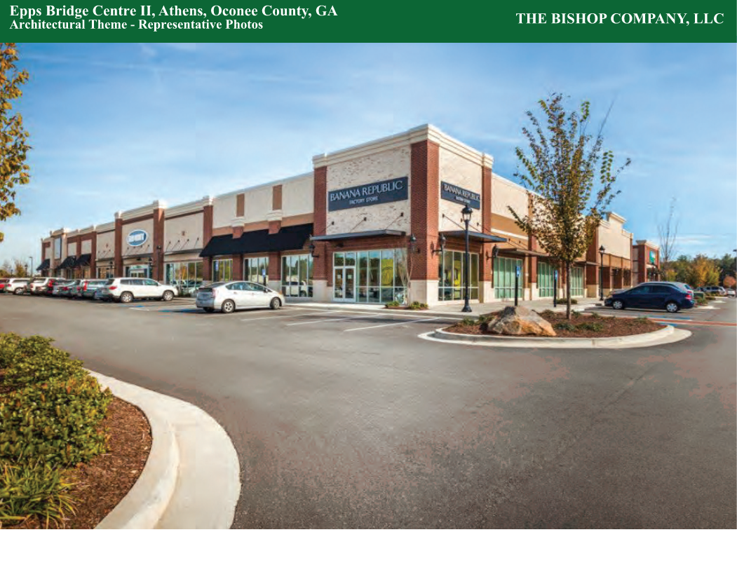
Architectural Images

Slide 12
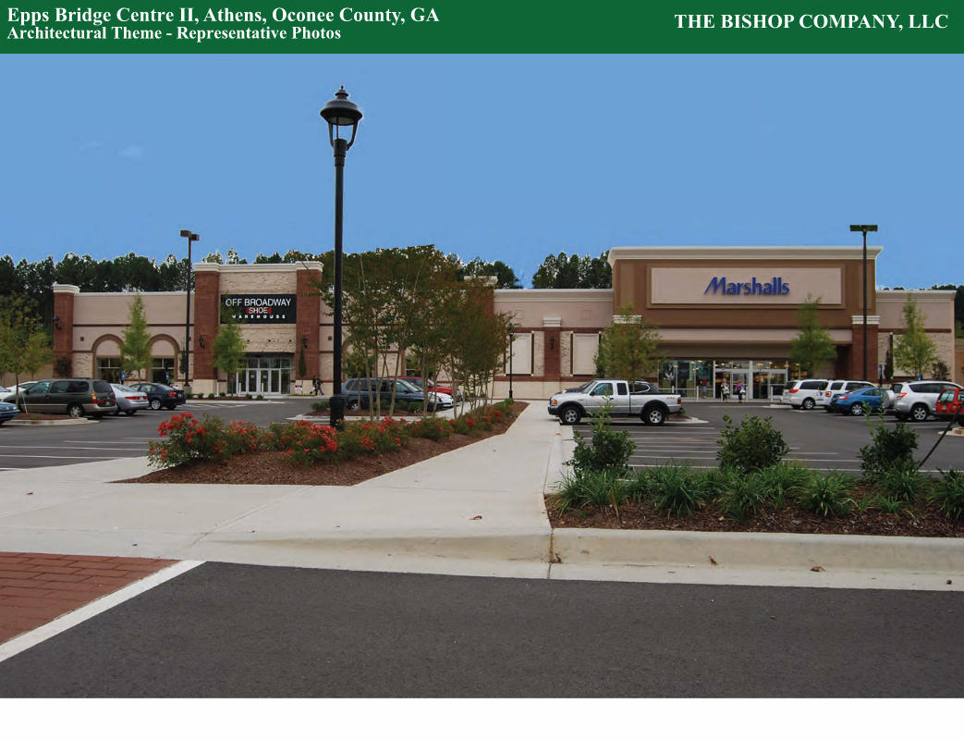
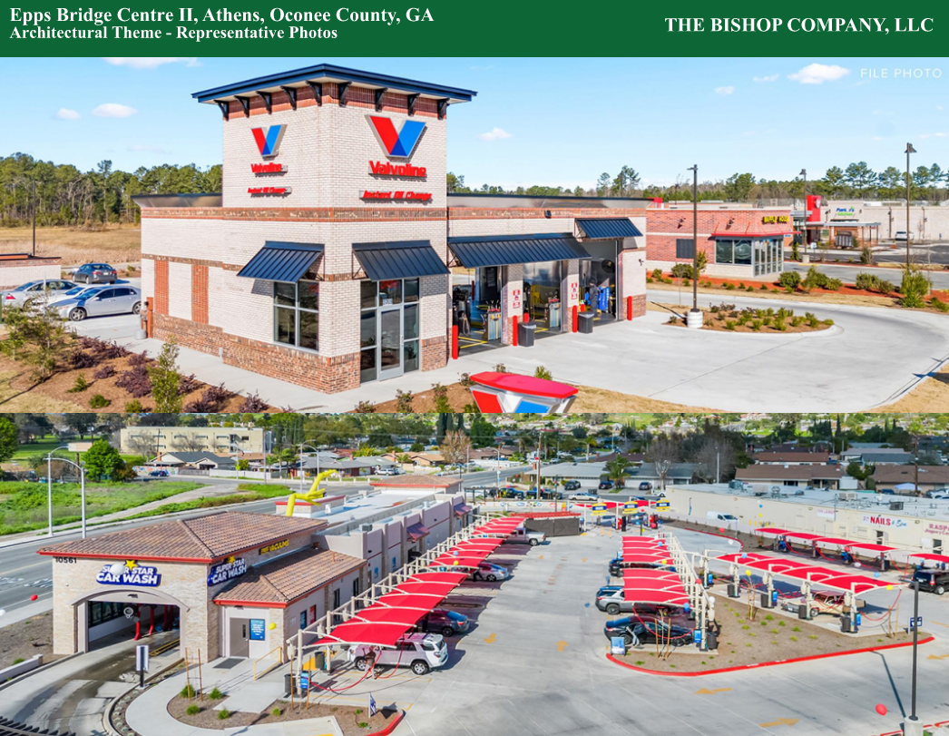
Architectural Images

Slide 13
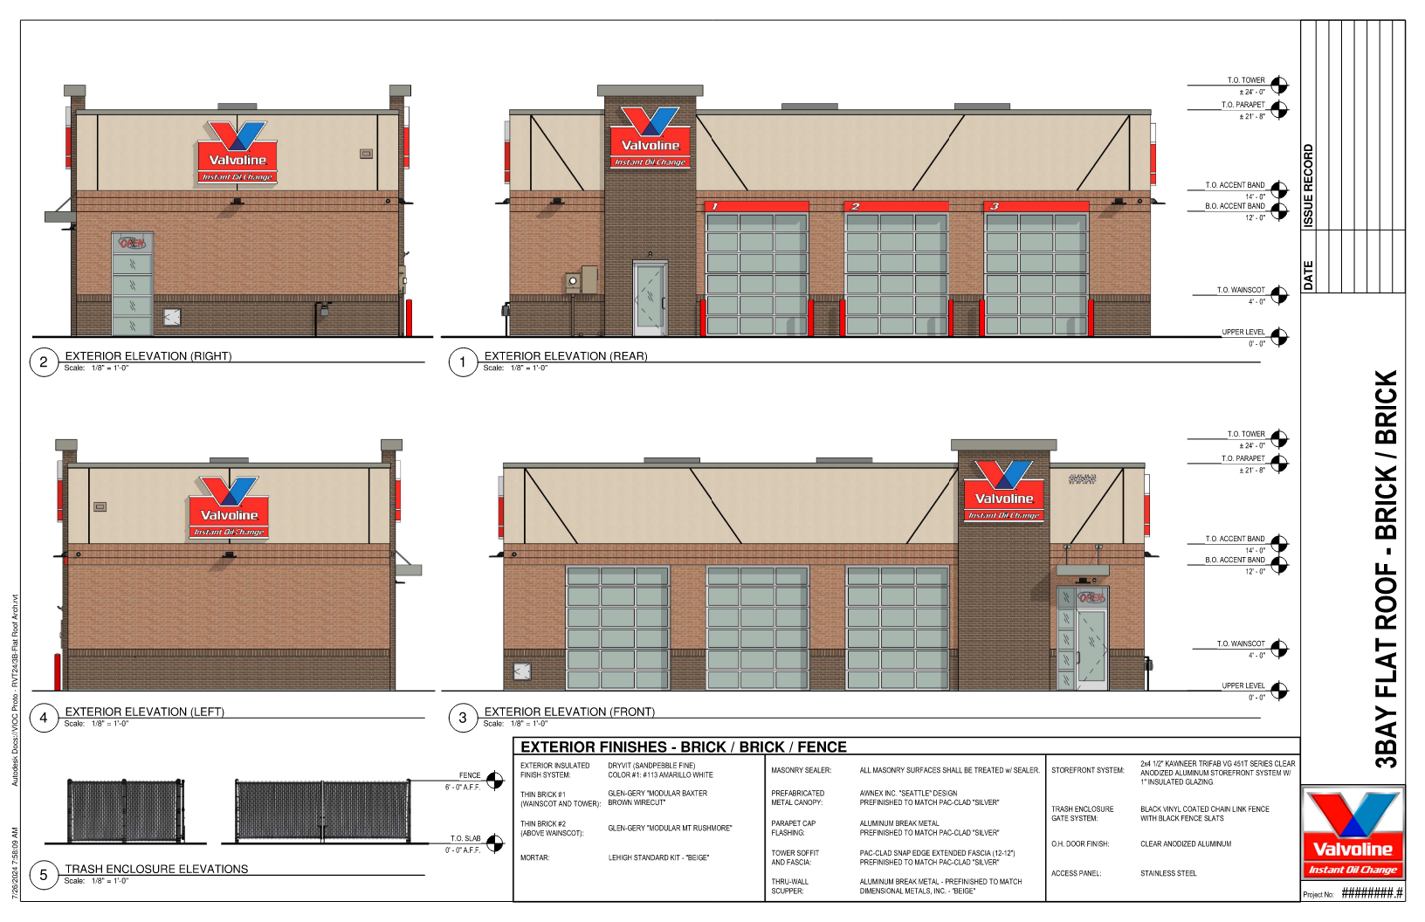
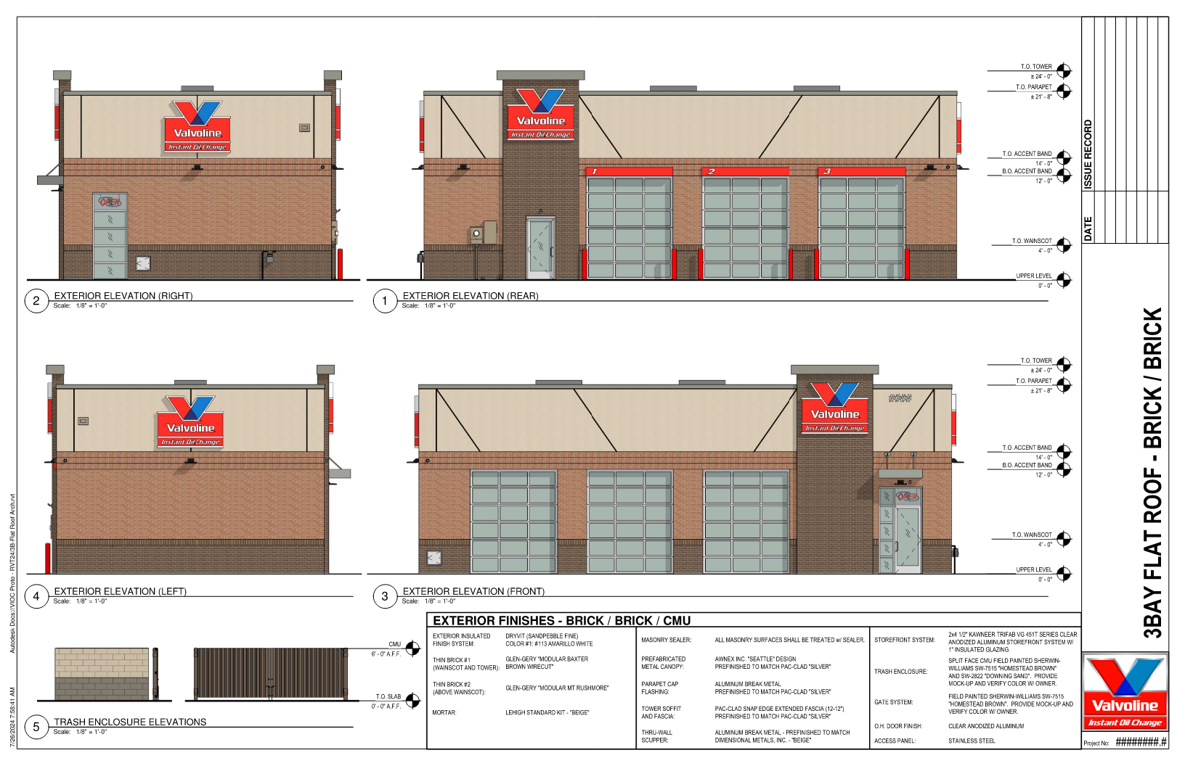
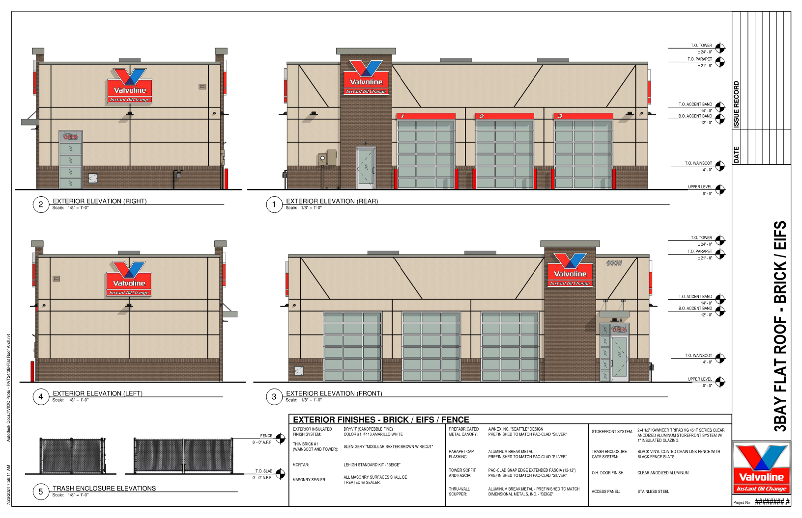
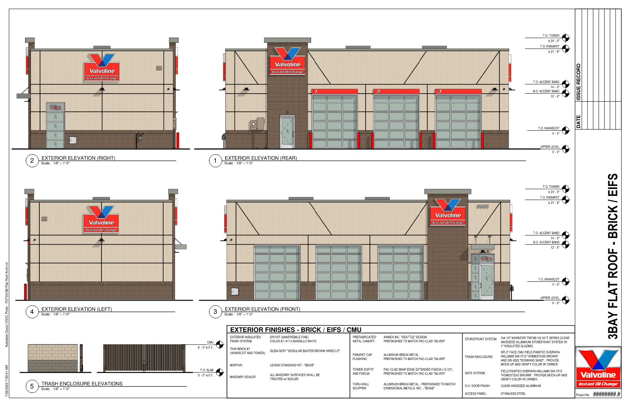
Architectural Images

Slide 14
Staff Recommendation
Based on Board of Commissioners policies, decision-making criteria, and standards outlined in the development codes of Oconee County, staff recommends conditional approval of this request for a change of conditions subject to the following conditions to be fulfilled at the expense of the owner/developer:
1. Development design and structures shall meet or exceed the standards indicated on the concept plan, narrative, representative architectural sketches, and other documents submitted with the zoning application and attached hereto. This condition shall not construe approval of any standard that is not in conformity with the Unified Development Code.
2. The owner at their own expense shall construct the improvements required by the County for public water and public wastewater services for the subject property and shall convey the same to the County, free of all liens. Said improvements shall include all on-site improvements and such off-site improvements as are required by the County to provide service to subject property.
3. At its expense, Owner shall make all right of way improvements and shall dedicate all rights of way which are required by the County after the County’s review of Owner's development plans pursuant to the County’s ordinances and regulations. All such improvements shall be shown on the preliminary site plan and site development plans for the project and no development permit shall be issued until Owner has agreed to such improvements and dedication.
4. Automotive Oil Change and Lubrication Shop and a Car Wash are added to the previous permitted uses of retail, banking and restaurants for the out-lot.
5. No outdoor storage or display is permitted including auto parts or tires.

