Slide 1


Slide 2
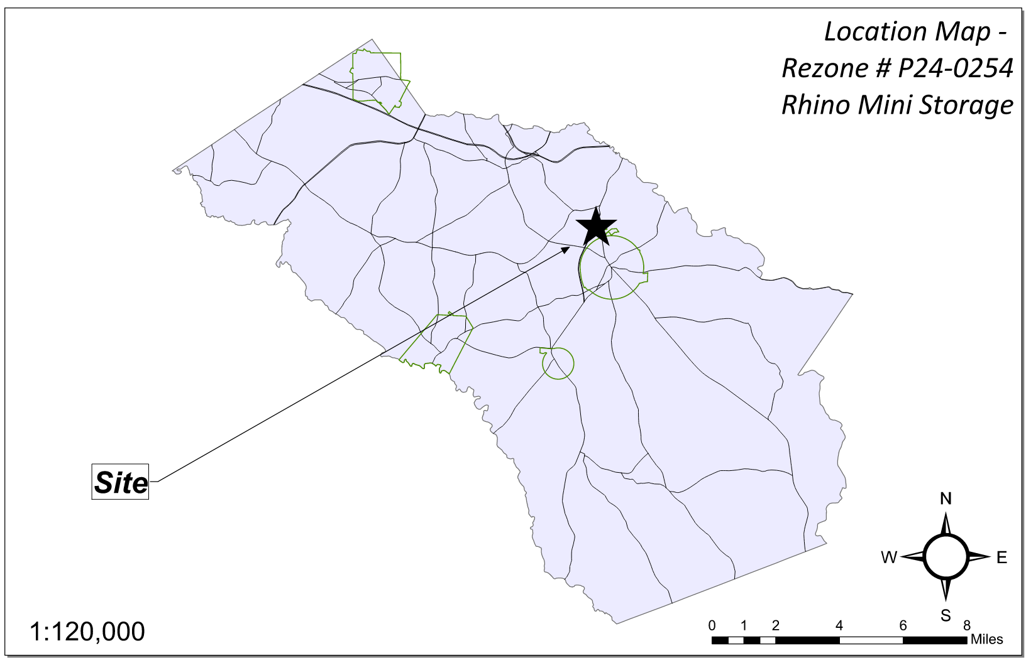
Site Location

Slide 3
Aerial Imagery

Slide 4
Zoning
AG

Slide 5
Future Development

Slide 6
Summary of Request
Modify the previously approved rezoning (P23-0157) to increase the maximum allowed office area from 23,400 SF to 73,800 SF, increase the number of buildings from four to ten, and remove the previously approved Assisted Living Facility from the concept plan.

Slide 7
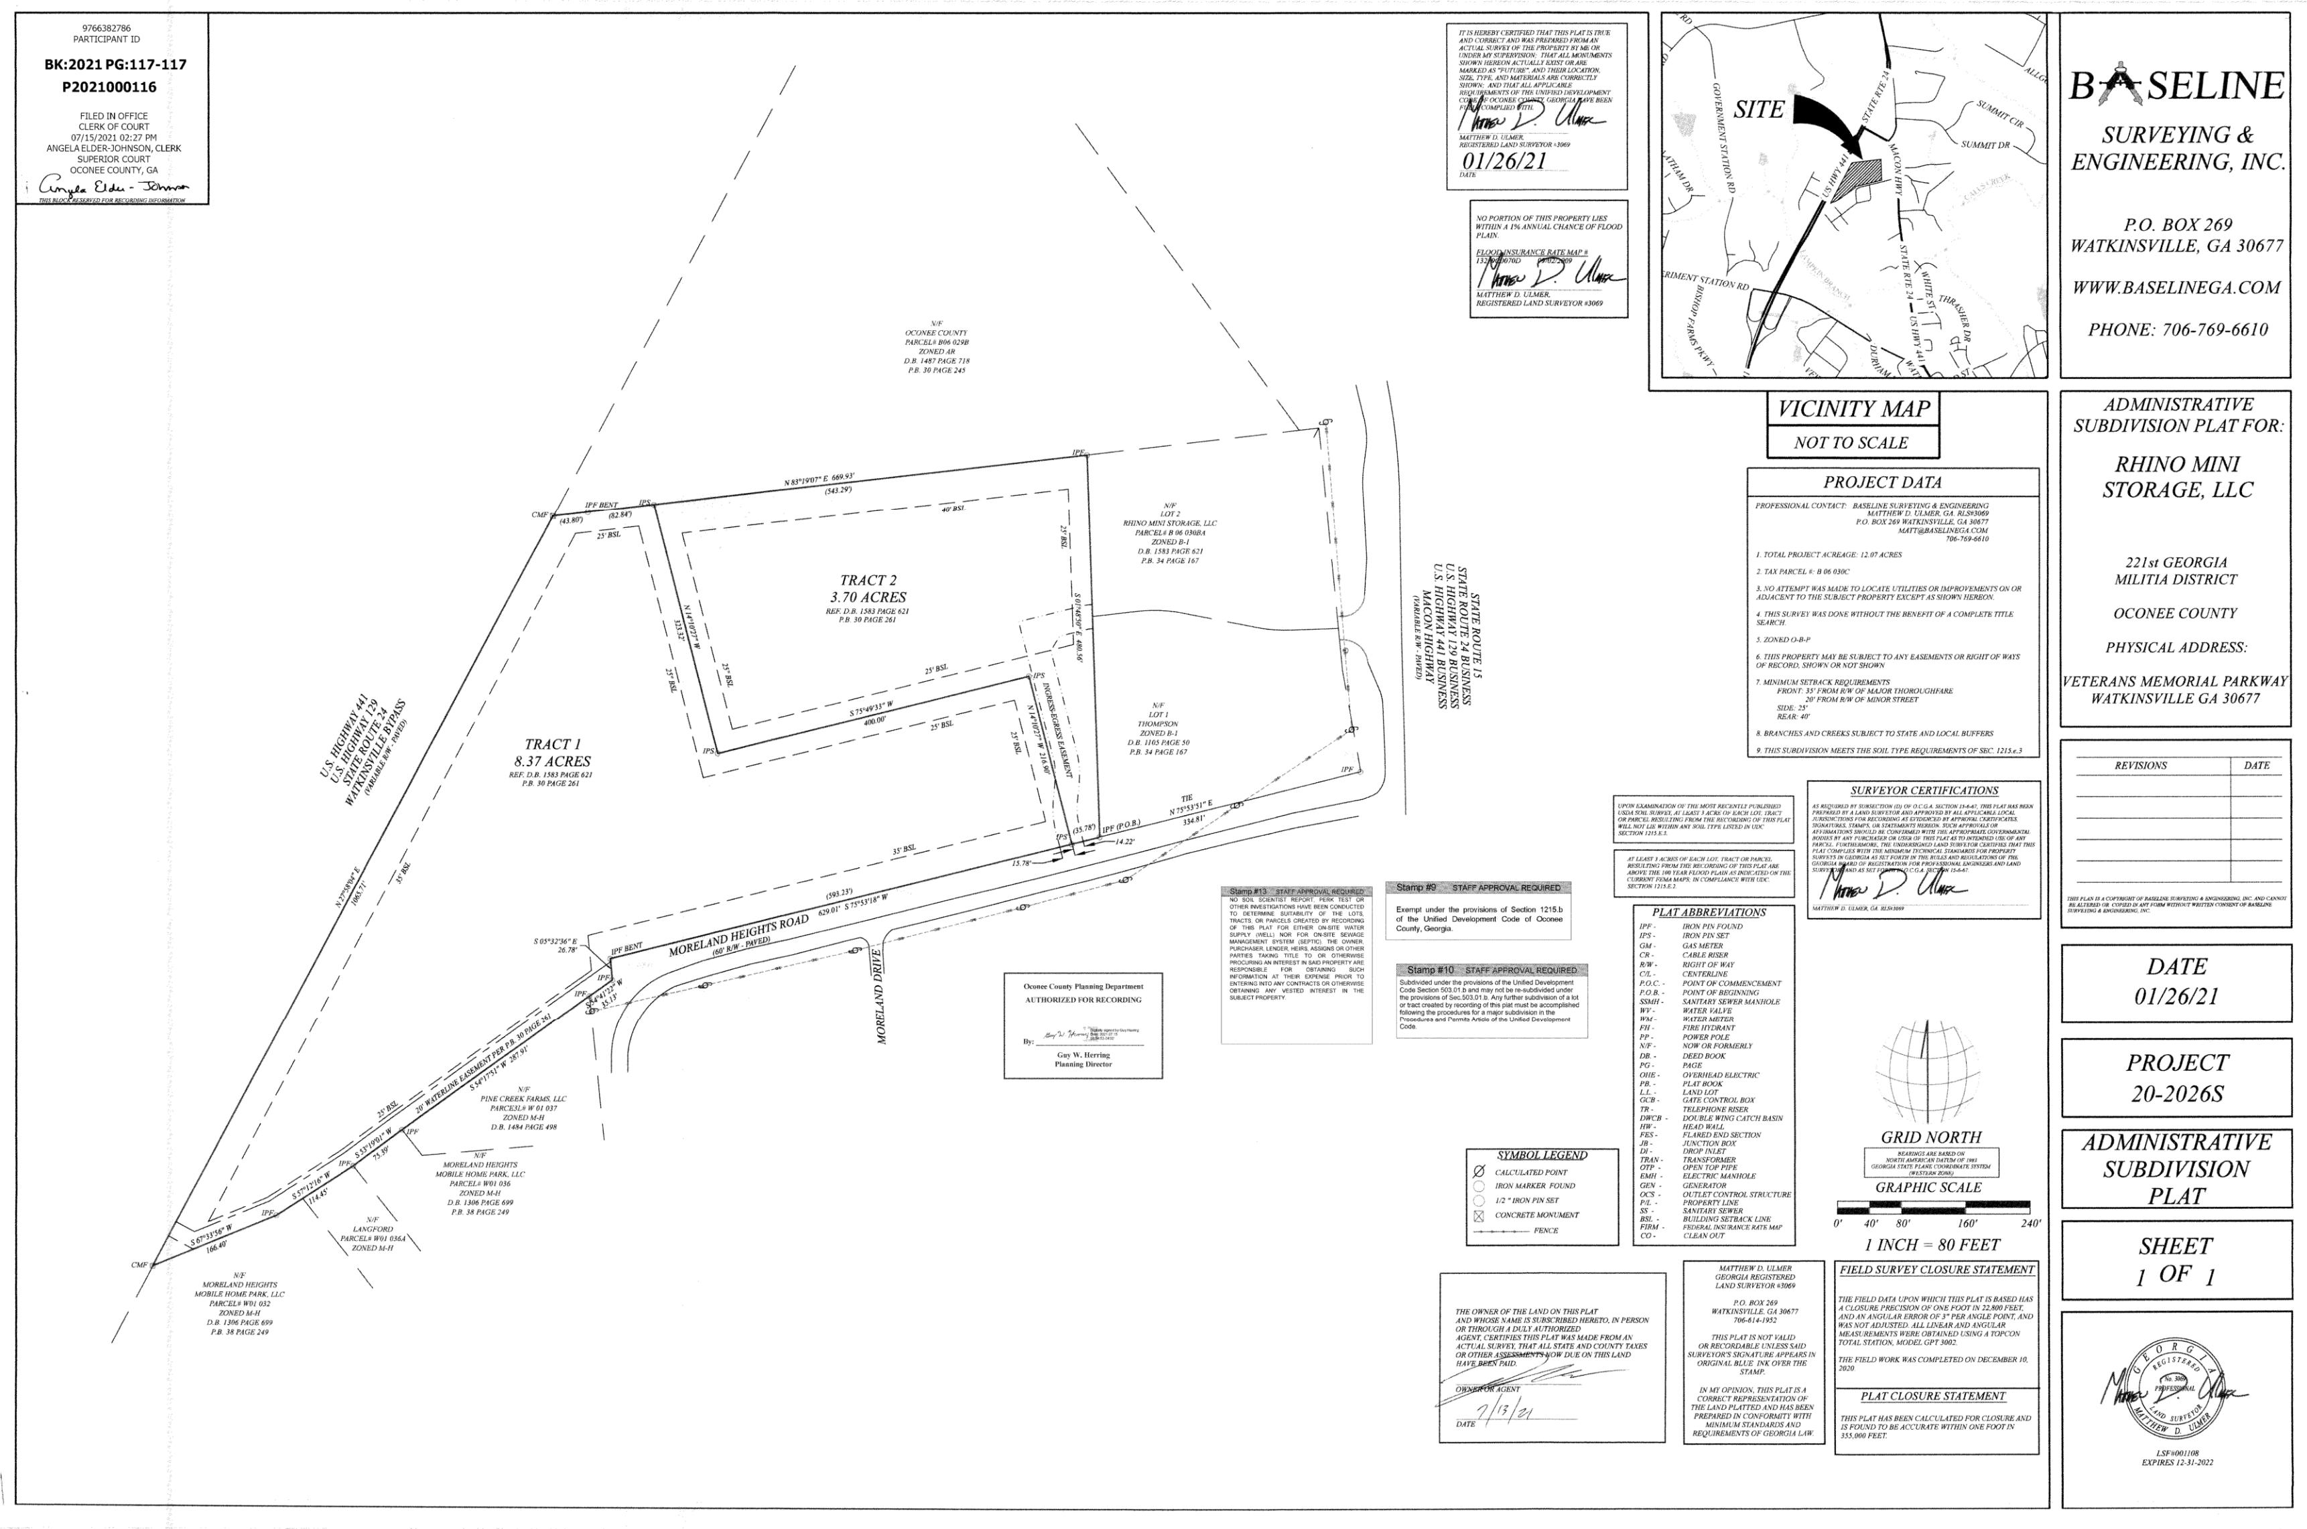
Recorded Plat

Slide 8
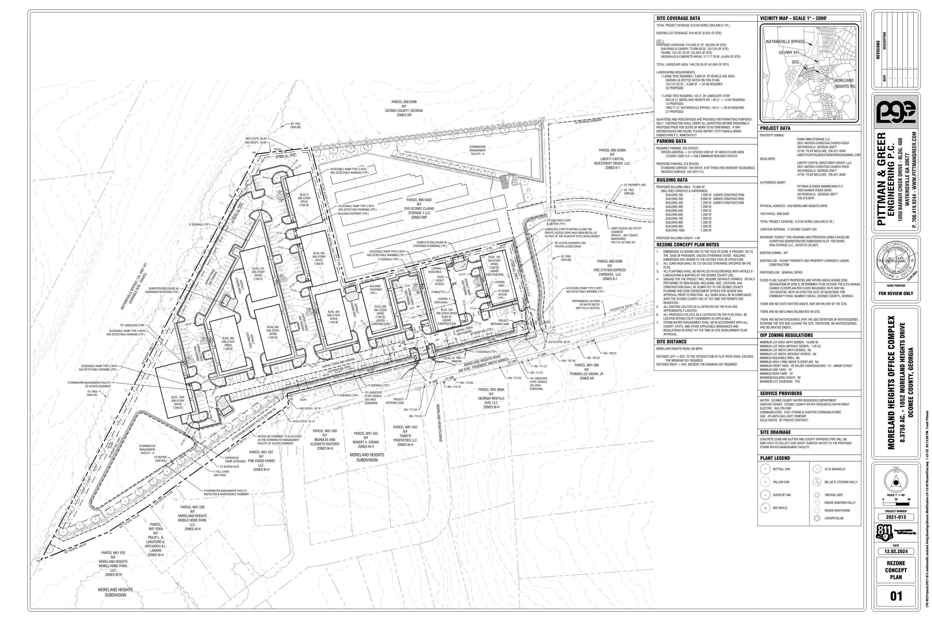
Concept Plan

Slide 9
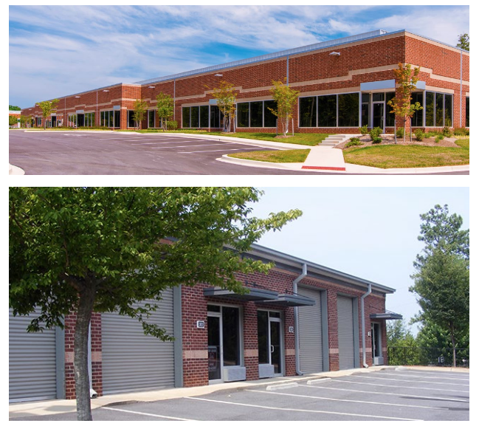
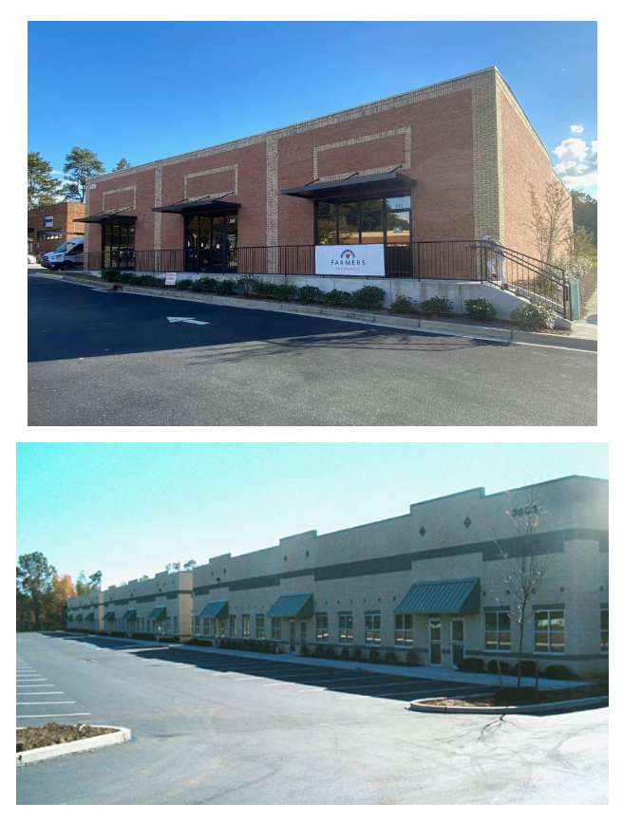
Architectural Images

Slide 10
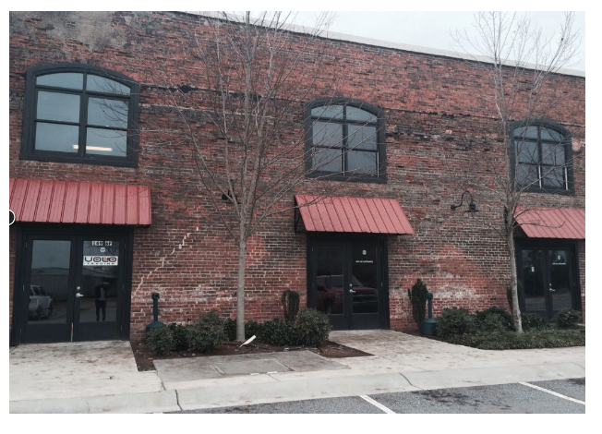
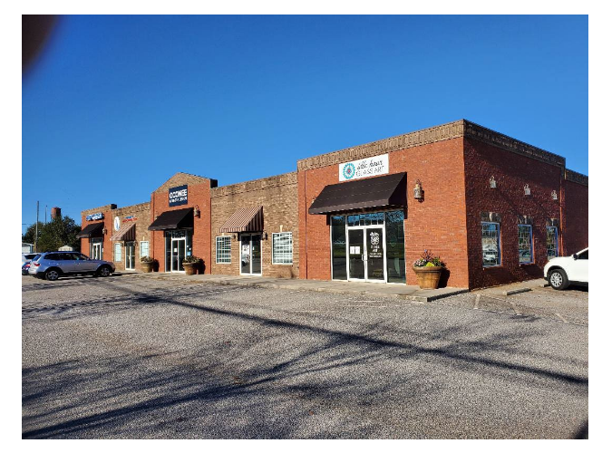
Architectural Images

Slide 11
Staff Recommendation
Based on Board of Commissioners policies, decision-making criteria, and standards outlined in the development codes of Oconee County, staff recommends conditional approval of this request subject to the following conditions to be fulfilled at the expense of the owner/developer:
1. Development design and structures shall meet or exceed the standards indicated on the concept plan, narrative, representative architectural sketches, and other documents submitted with the zoning application and attached hereto. This condition shall not construe approval of any standard that is not in conformity with the Unified Development Code.
2. The owner at their own expense shall construct the improvements required by the County for public water and public waste services for the subject property shall convey same to the County, free of all liens. Said improvements shall include all on-site improvements and such off-site improvements as are required by the County to provide service to subject property.
3. At its expense, Owner shall make all right of way improvements and shall dedicate all rights of way which are required by the County after the County’s review of Owner's development plans pursuant to the County’s ordinances and regulations. All such improvements shall be shown on the preliminary site plan and site development plans for the project and no development permit shall be issued until Owner has agreed to such improvements and dedication.
4. All structures shall be brick or stone on all sides.
5. The total building square footage shall not exceed 73,800 square feet.
6. A traffic impact statement that meets the requirements of the UDC as amended through February 3, 2025, shall be submitted with the Site Development Plan application for review as the proposed average daily trips (ADT) is increasing from previous approvals from 515 to 800 ADT.

Slide 12
Planning Commission Recommendation
Planning Commission recommends approval subject to the conditions recommended by staff, with a new Condition #7:
7. The developer shall install a 4’ opaque fence along Moreland Heights Road.
Should the Board accept the Planning Commissions recommended condition, Planning Staff would suggest that the Condition #7 read as follows:
“The developer shall install a 4-foot-tall imitation wood vinyl fence in addition to and within the vehicle use screening area along Moreland Heights Road.”

