Slide 1


Slide 2
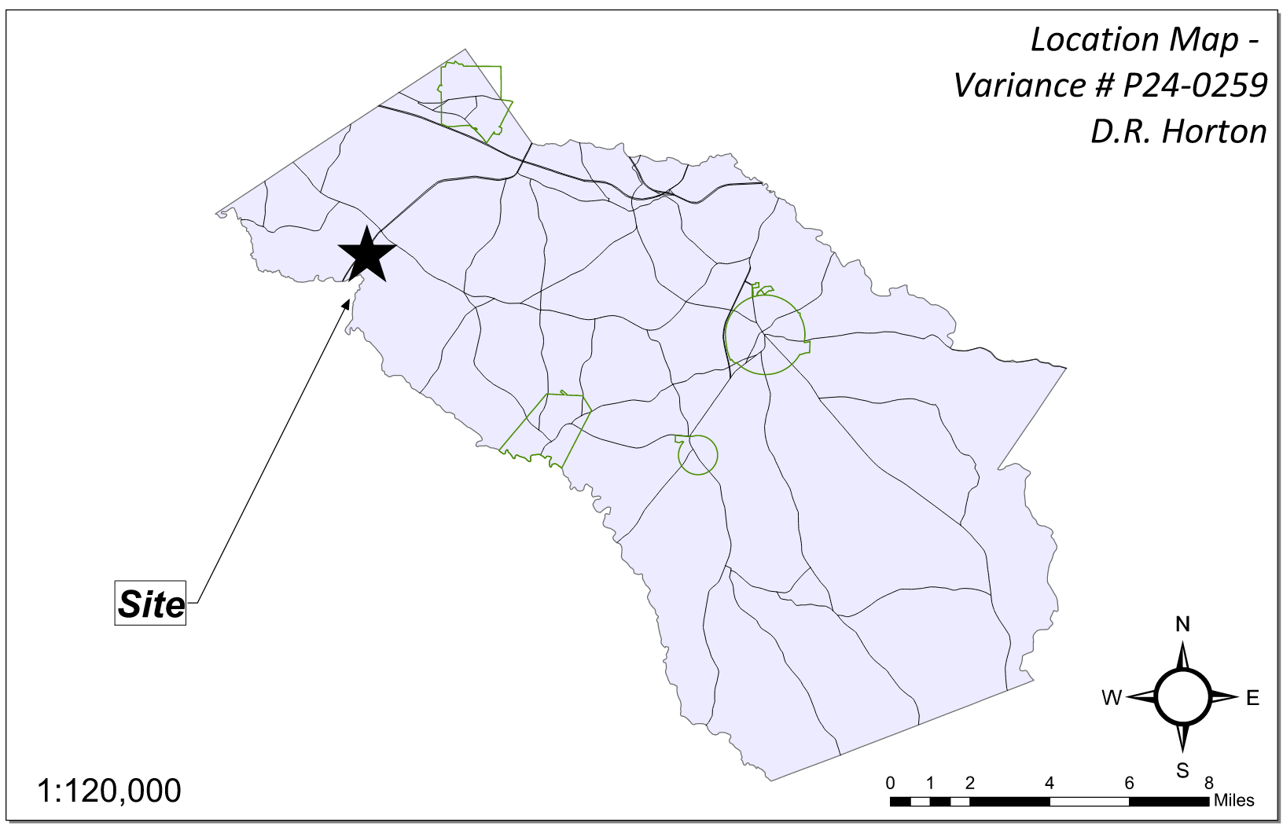
Site Location

Slide 3
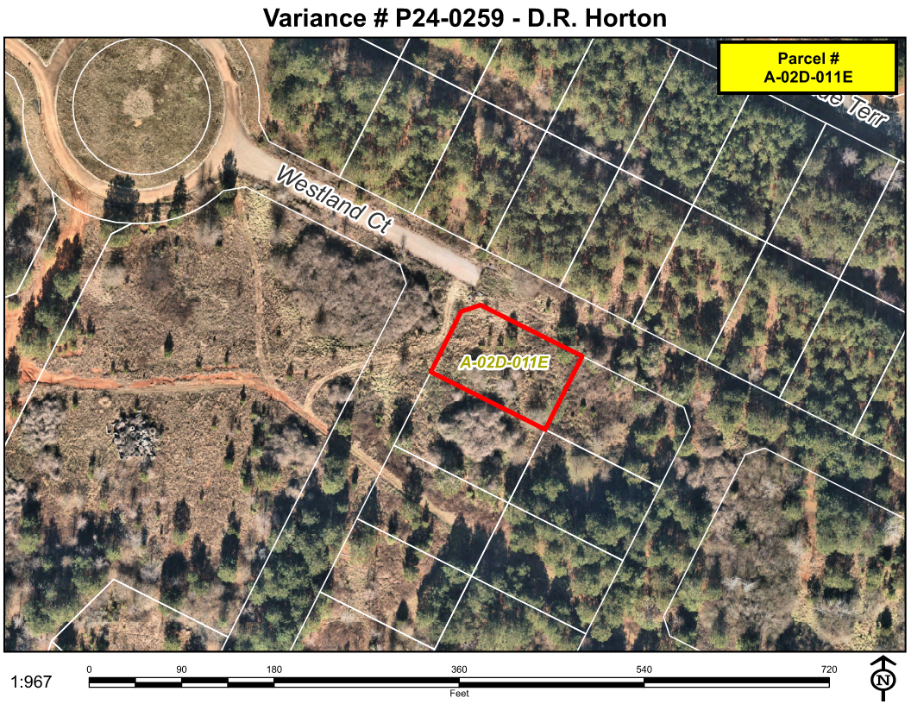
Aerial Imagery

Slide 4
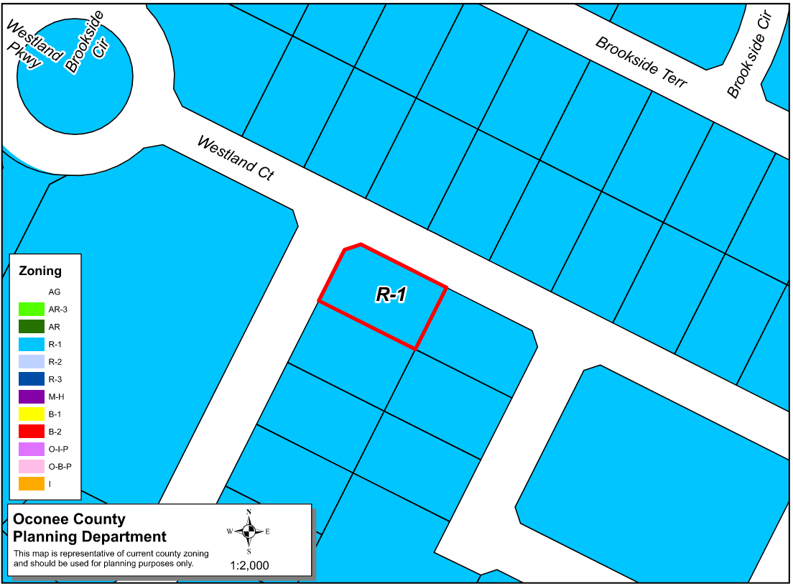
Zoning
AG

Slide 5
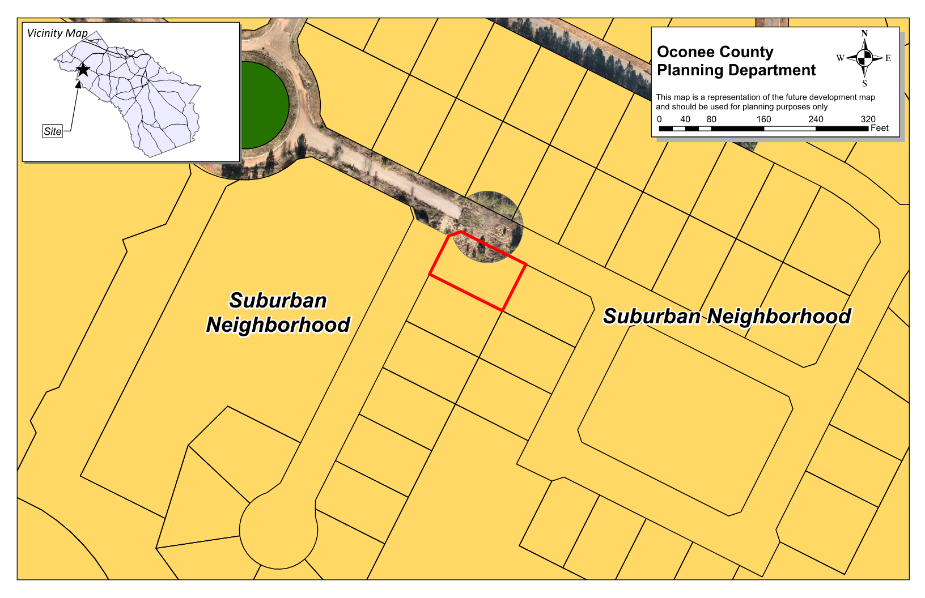
Future Development

Slide 6
Summary of Request
A special exception variance from Oconee County Unified Development Code Sections 409.01 and Table 4.1, to reduce the minimum required side setbacks from 10 feet to 9 feet for an existing single-family dwelling.

Slide 7
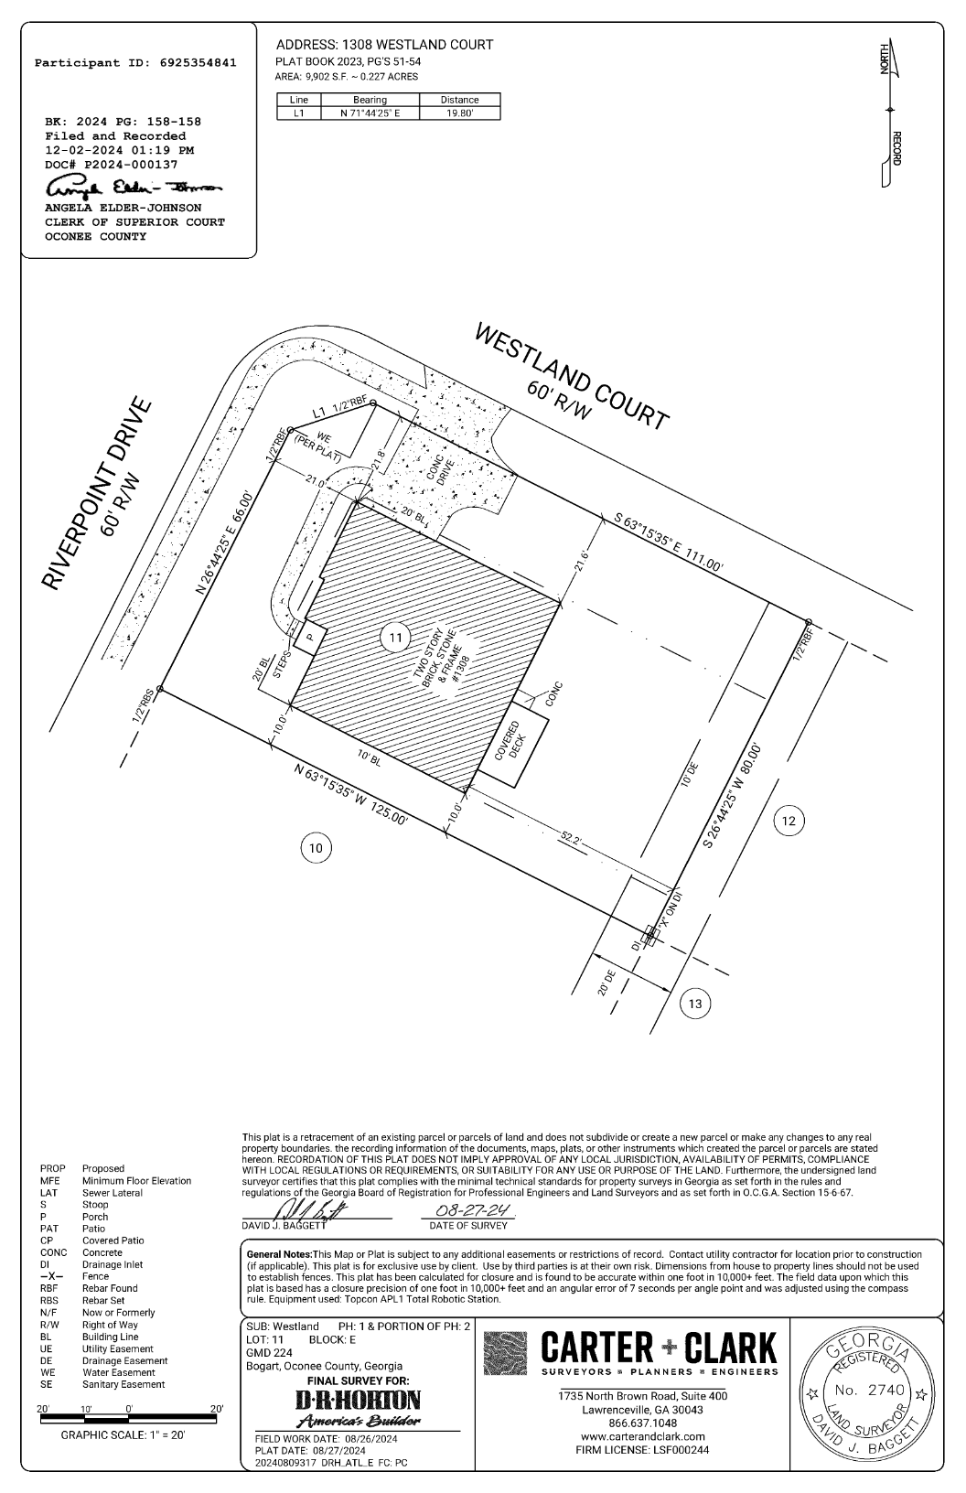
Recorded Plat

Slide 8
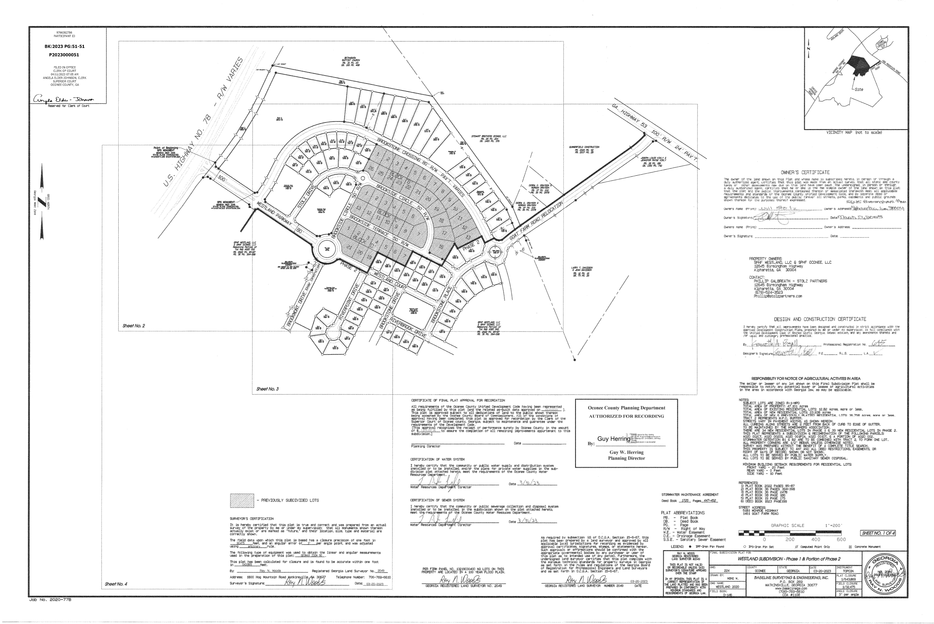
Recorded Plat of Subdivision

Slide 9
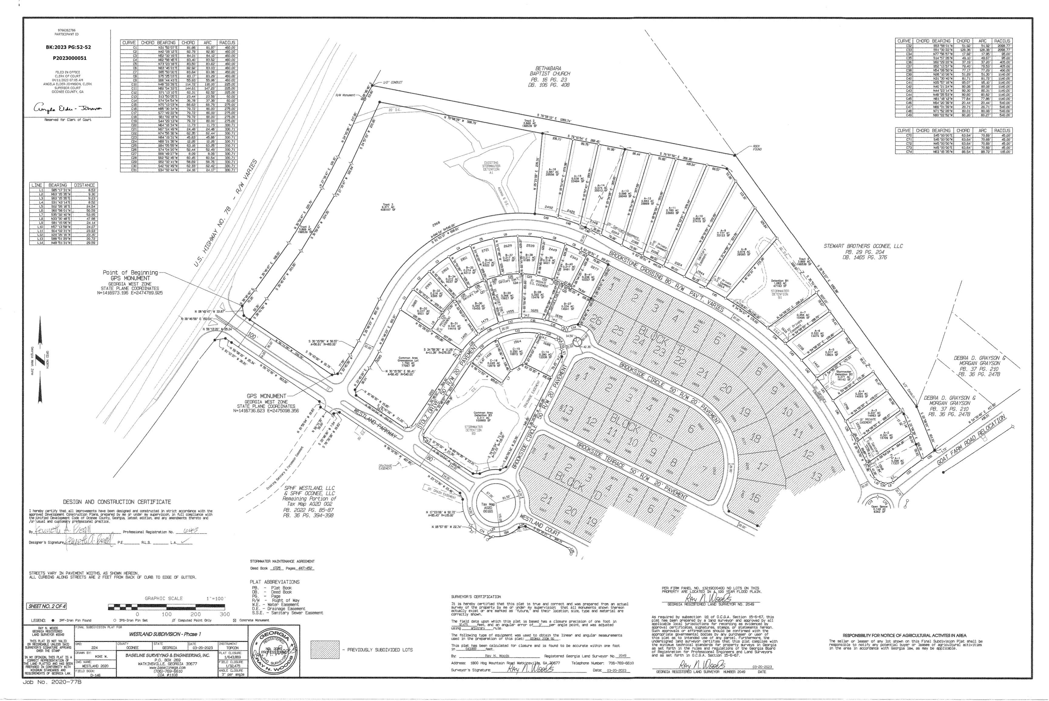
Recorded Plat of Subdivision

Slide 10
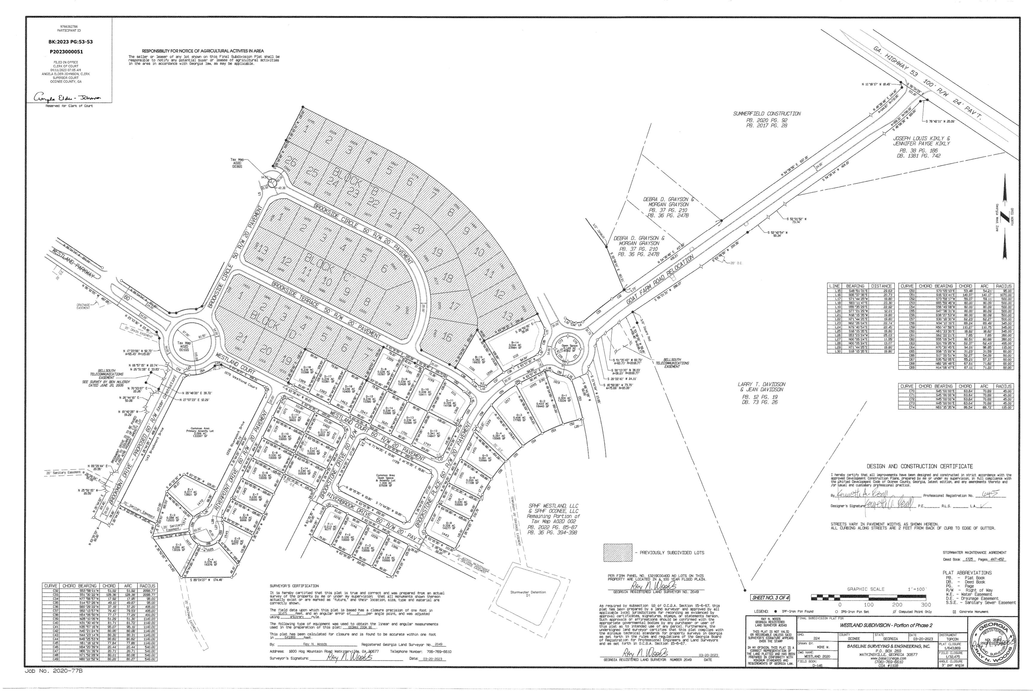
Recorded Plat of Subdivision

Slide 11
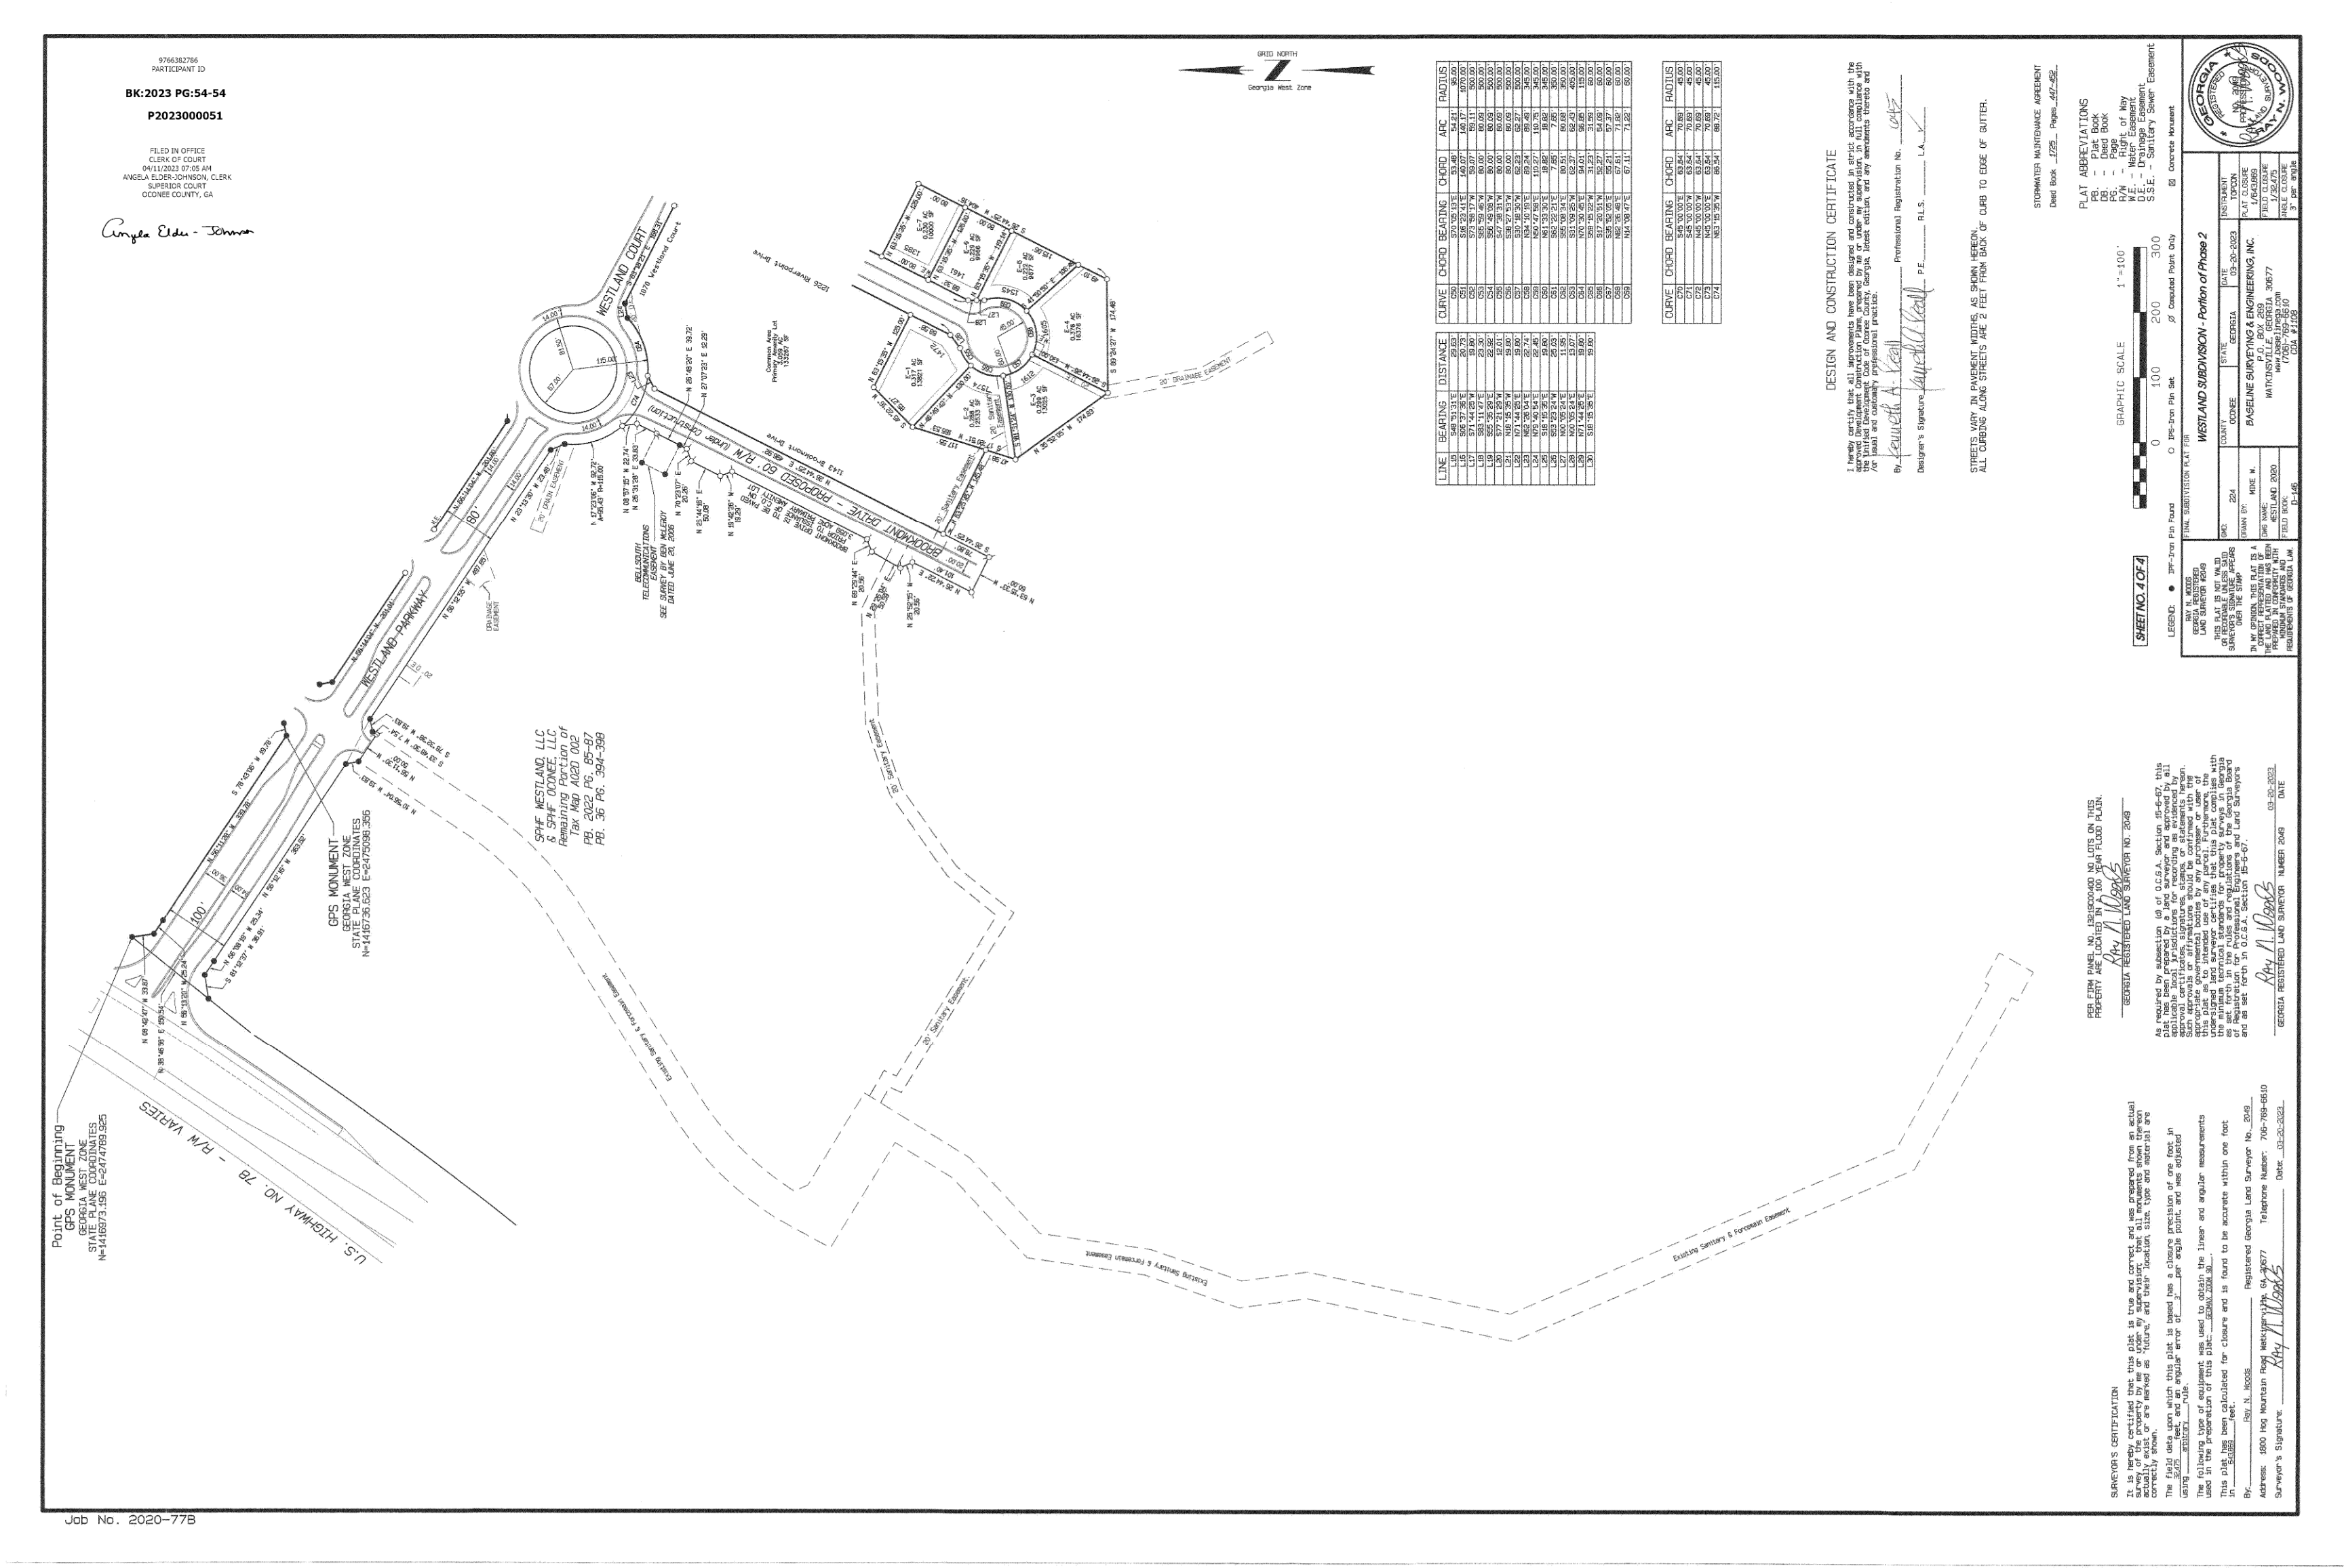
Recorded Plat of Subdivision

Slide 12
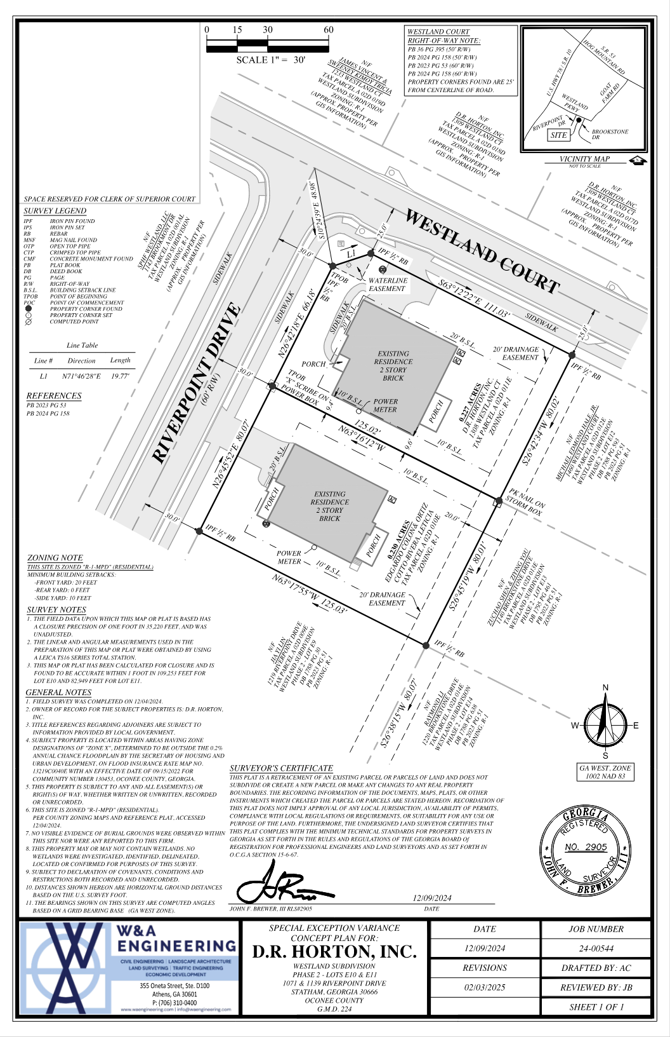
Concept Plan

Slide 13
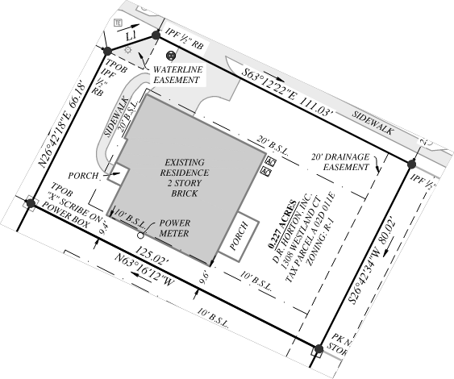
Concept Plan (Enlarged)

Slide 14
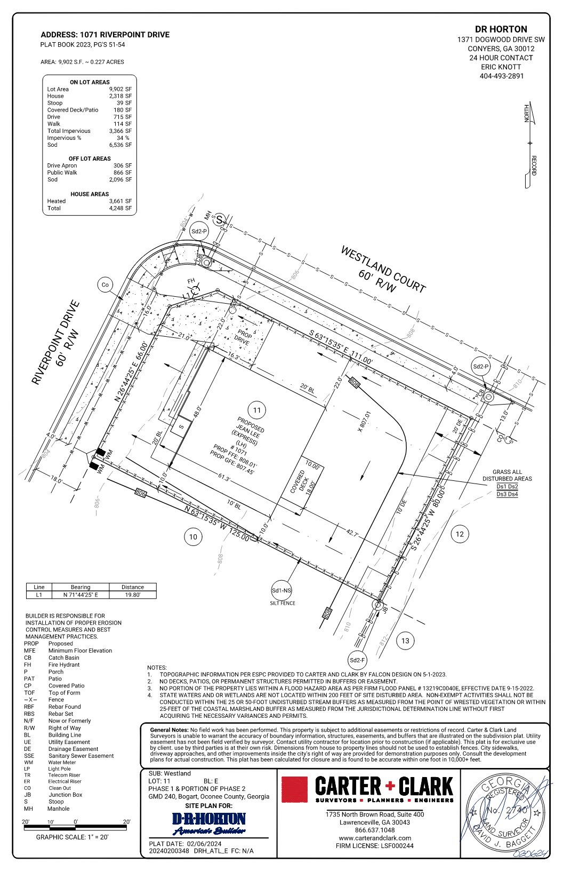
Site Plan from Residential Application

Slide 15
Staff Recommendation
Based upon the standards and limitations for special exception variance approval, this request does meet all necessary conditions grant a special exception variance if a finding of fact is made that there is no encroachment into an adjacent property and the placement of the house was due to an error by the original surveyor and the contractor building the house wider than permitted. Should the present request be approved, staff recommends the following conditions be fulfilled at the owner/developer’s expense.
1. Development design and structures shall meet or exceed the standards indicated on the concept plan, narrative, and other documents submitted with the variance application and attached hereto. This condition shall not construe approval of any standard that is not in conformity with the Unified Development Code except as varied below.
2. A variance is granted to reduce the required right-side setback from 10 feet to 9 feet in the immediate area of the setback encroachment only as shown on the concept plan and as-built survey dated 2-3-2025 by John F. Brewer, RLS (W & A Engineering).

