Slide 1


Slide 2
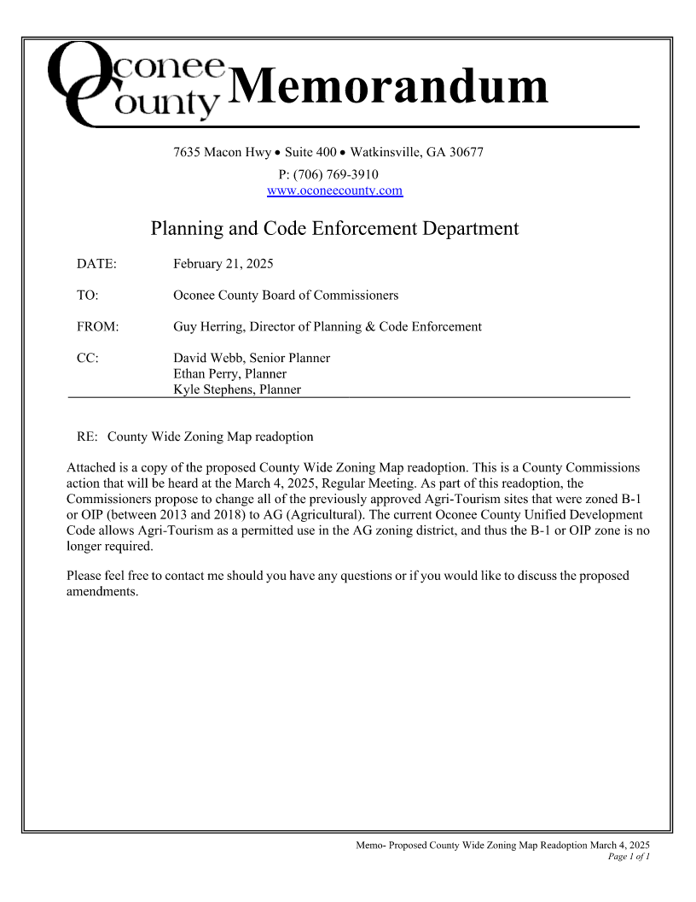
Memo to BOC

Slide 3
Official Zoning Map Amendment and Re-adoption
Attached is a copy of the proposed County Wide Zoning Map for amendment and readoption. As part of this action, the Board proposes to change all the previously approved Agri-Tourism sites that were zoned B-1 or OIP (between 2013 and 2018) to AG (Agricultural). The current Oconee County Unified Development Code allows Agri-Tourism as a permitted use in the AG zoning district, and thus the B-1 or OIP zone is no longer required.

Slide 4
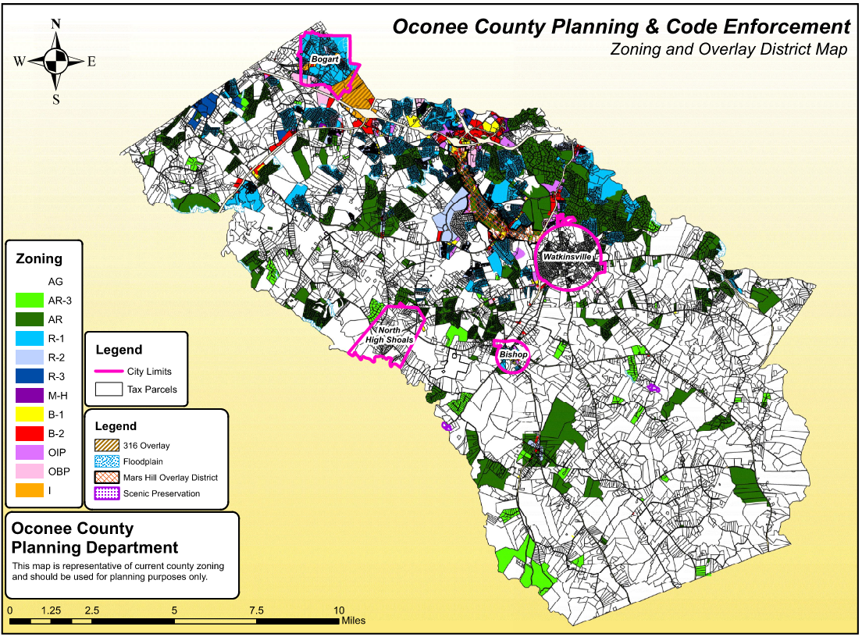
Memo to BOC

Slide 5
