Slide 1


Slide 2
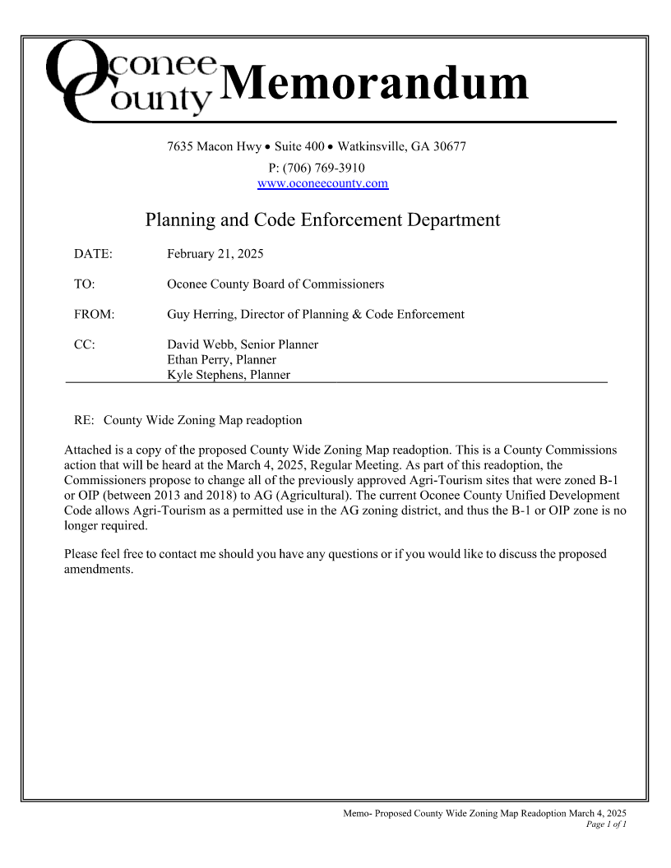
Memo to BOC

Slide 3
Zoning Map Readoption March 4, 2025
Below is a summary of the proposed County Wide Zoning Map readoption for consideration at the March 4, 2025 Board of Commissioners Regular Meeting. The changes are indicated on the following slides.

Slide 4
Text from Memo to BOC
Attached is a copy of the proposed County Wide Zoning Map readoption. This is a County Commissions action that will be heard at the March 4, 2025, Regular Meeting. As part of this readoption, the Commissioners propose to change all of the previously approved Agri-Tourism sites that were zoned B-1 or OIP (between 2013 and 2018) to AG (Agricultural). The current Oconee County Unified Development Code allows Agri-Tourism as a permitted use in the AG zoning district, and thus the B-1 or OIP zone is no longer required.

Slide 5
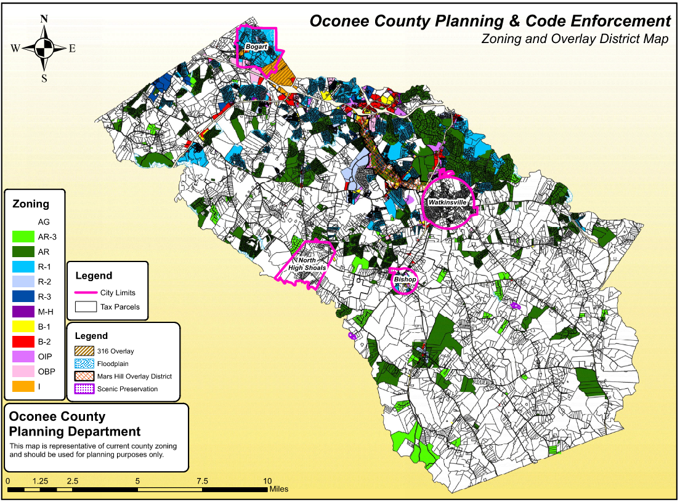
Memo to BOC

