Slide 1

Oconee County Report for 2024

Slide 2
National EMS
1976
National EMS was started by Pat and Mary Ellen Atkins in 1976
1986
National Stated to Provided 911 services in Rockdale County in 1986
1993
In 1993, National Became the first ambulance service in the State of Georgia to become Nationally Accredited by the Commission of Accreditation of Ambulance Services (CAAS)
2009
In 2009, National was selected by St. Mary’s and Piedmont Athens as the emergency Ambulance Provider for Athens-Clarke and Oconee County.
2018
National EMS joins the Priority Ambulance family of Companies
Today
National EMS is a local employer for over 200 EMTs and Paramedics respond to over 51,000 calls per year and continues to provides 911 service for four counties.

Slide 3
Our Leadership
John Bandzul-Vice President of Operations
Tracey Laflam-Operations Manager-Athens-Clarke/Oconee
Hailey Brown-Operations Manager-Rockdale-Morgan
Caleb Willis-Communications Manager
Kyle Atkins- Training Administrator
Riki Delmar-CQ/CI Manager
Joy Peppers-DQA Manager

Slide 4
Total Number of 911 Responses 2024
4,111calls for service received
2,812 transports
Average P-1 Response Time: 09:06
Average of all response times (P-1and P-2) 13:45

Slide 5

Number of times of response times over 12:59 (P-1 Calls)
January-34
February-10
March-19
May-14
June-21
July-20
August-25
September-21
October-16
November-19
December-20
April-20

Slide 6

Response times
We meet the P-1 response target -93.3 % of the time (90% is in the MOU)

Slide 7
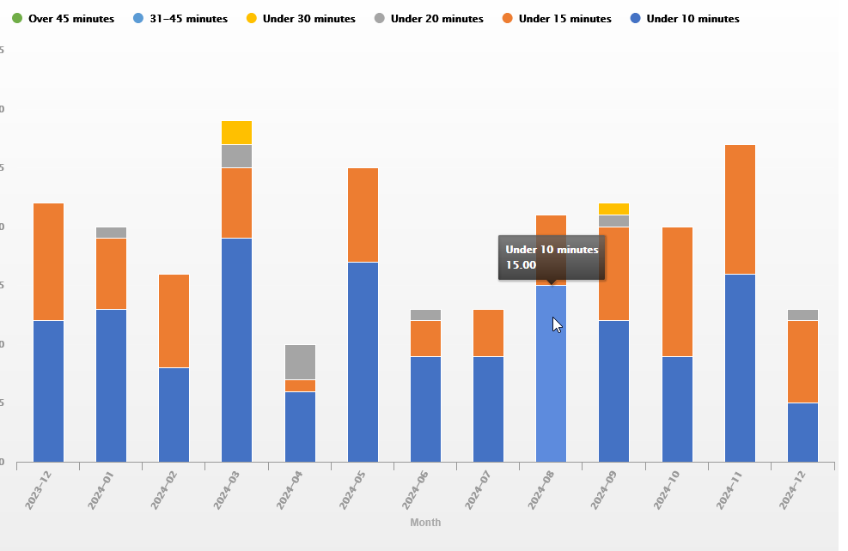
Over 12

Slide 8

Staffing
Oconee County is guaranteed two paramedic-level trucks 24 hours a day, 7 days a week.
401-Paramedic/AEMT
402-Paramedic/AEMT
In 2024, all days were covered by the required staffing of the MOU. Not a single day was covered with less than the Paramedic Level.

Slide 9

Disaster Plan
Our disaster plan is the same as 2024, with no changes.
This was reviewed by our recent reaccreditation process, which happened in January; the independent reviewers found zero faults.

Slide 10

Medical Protocol Changes
In 2024, we updated our medical protocols to a new format, updated our medications and dosing, and worked with our medical director to provide more robust patient care.
12-lead EKG transmission for AEMTs and EMTs
New Medication Bags for AEMTs
Medications Crosscheck
Care navigator Protocol

Slide 11
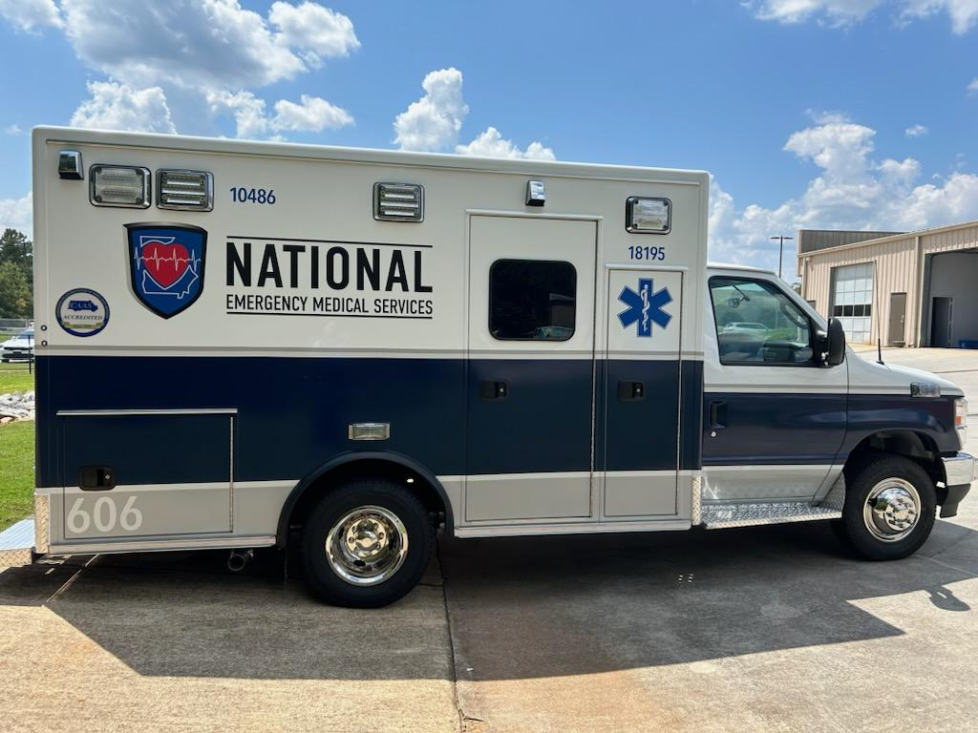
National EMS
National EMS is a privately held company that is a part of the Family of Companies of Priority Ambulance.
National EMS is a financially sound company with resources that put us at little risk of default.

Slide 12
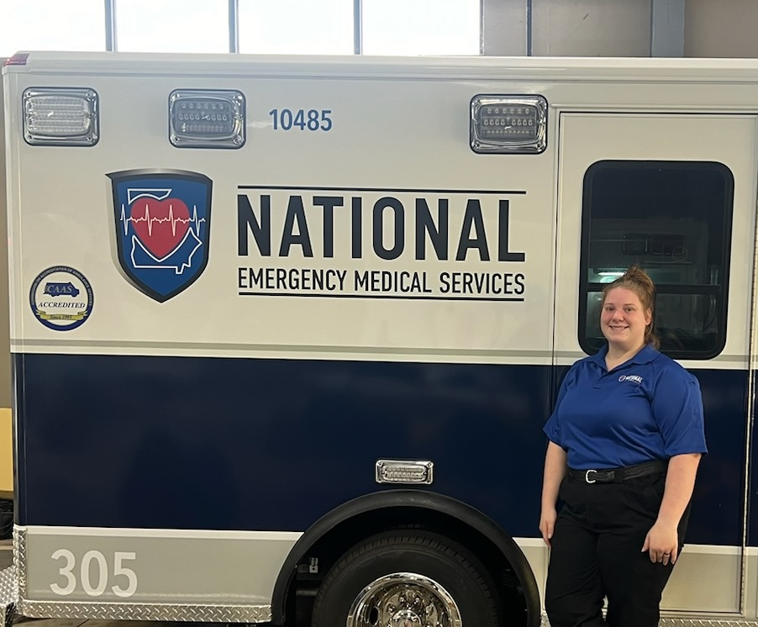
Transport Vehicles in Oconee/ACC
Oconee County is currently guaranteed two Paramedic Level transport ambulances 24 hours a day, 7 days a week.
An additional ambulance, a paramedic-level transport ambulance, is placed in service in Oconee County on a 24-hour basis. This ambulance is shared with Athens-Clarke.
Athens-Clarke has 13 transporting ambulances available to them. (This does not include our IFT trucks, which can be used for 911 coverage if system saturation is reached.

Slide 13
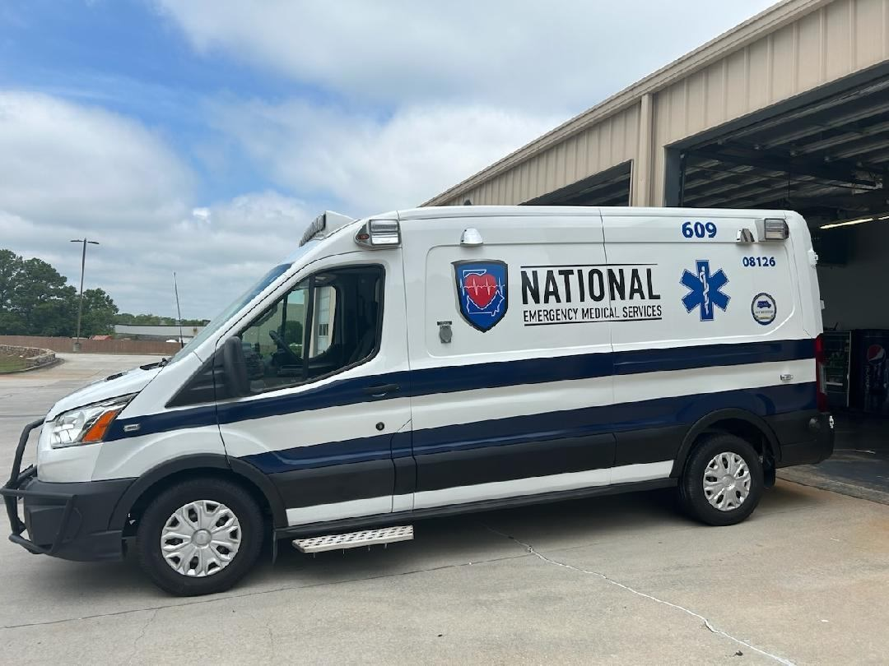
Number of Vehicles over 8 years/200K
As we continue to recover from COVID, our focus remains on replacement ambulances.
New box truck-style ambulances currently take around 16 months from the time of order to delivery.
National EMS received three new trucks in 2024.
We are on track to receive five more new trucks this year
We currently have no ambulances that are over eight years old, and one of two front lines have over 200,000 miles.

Slide 14
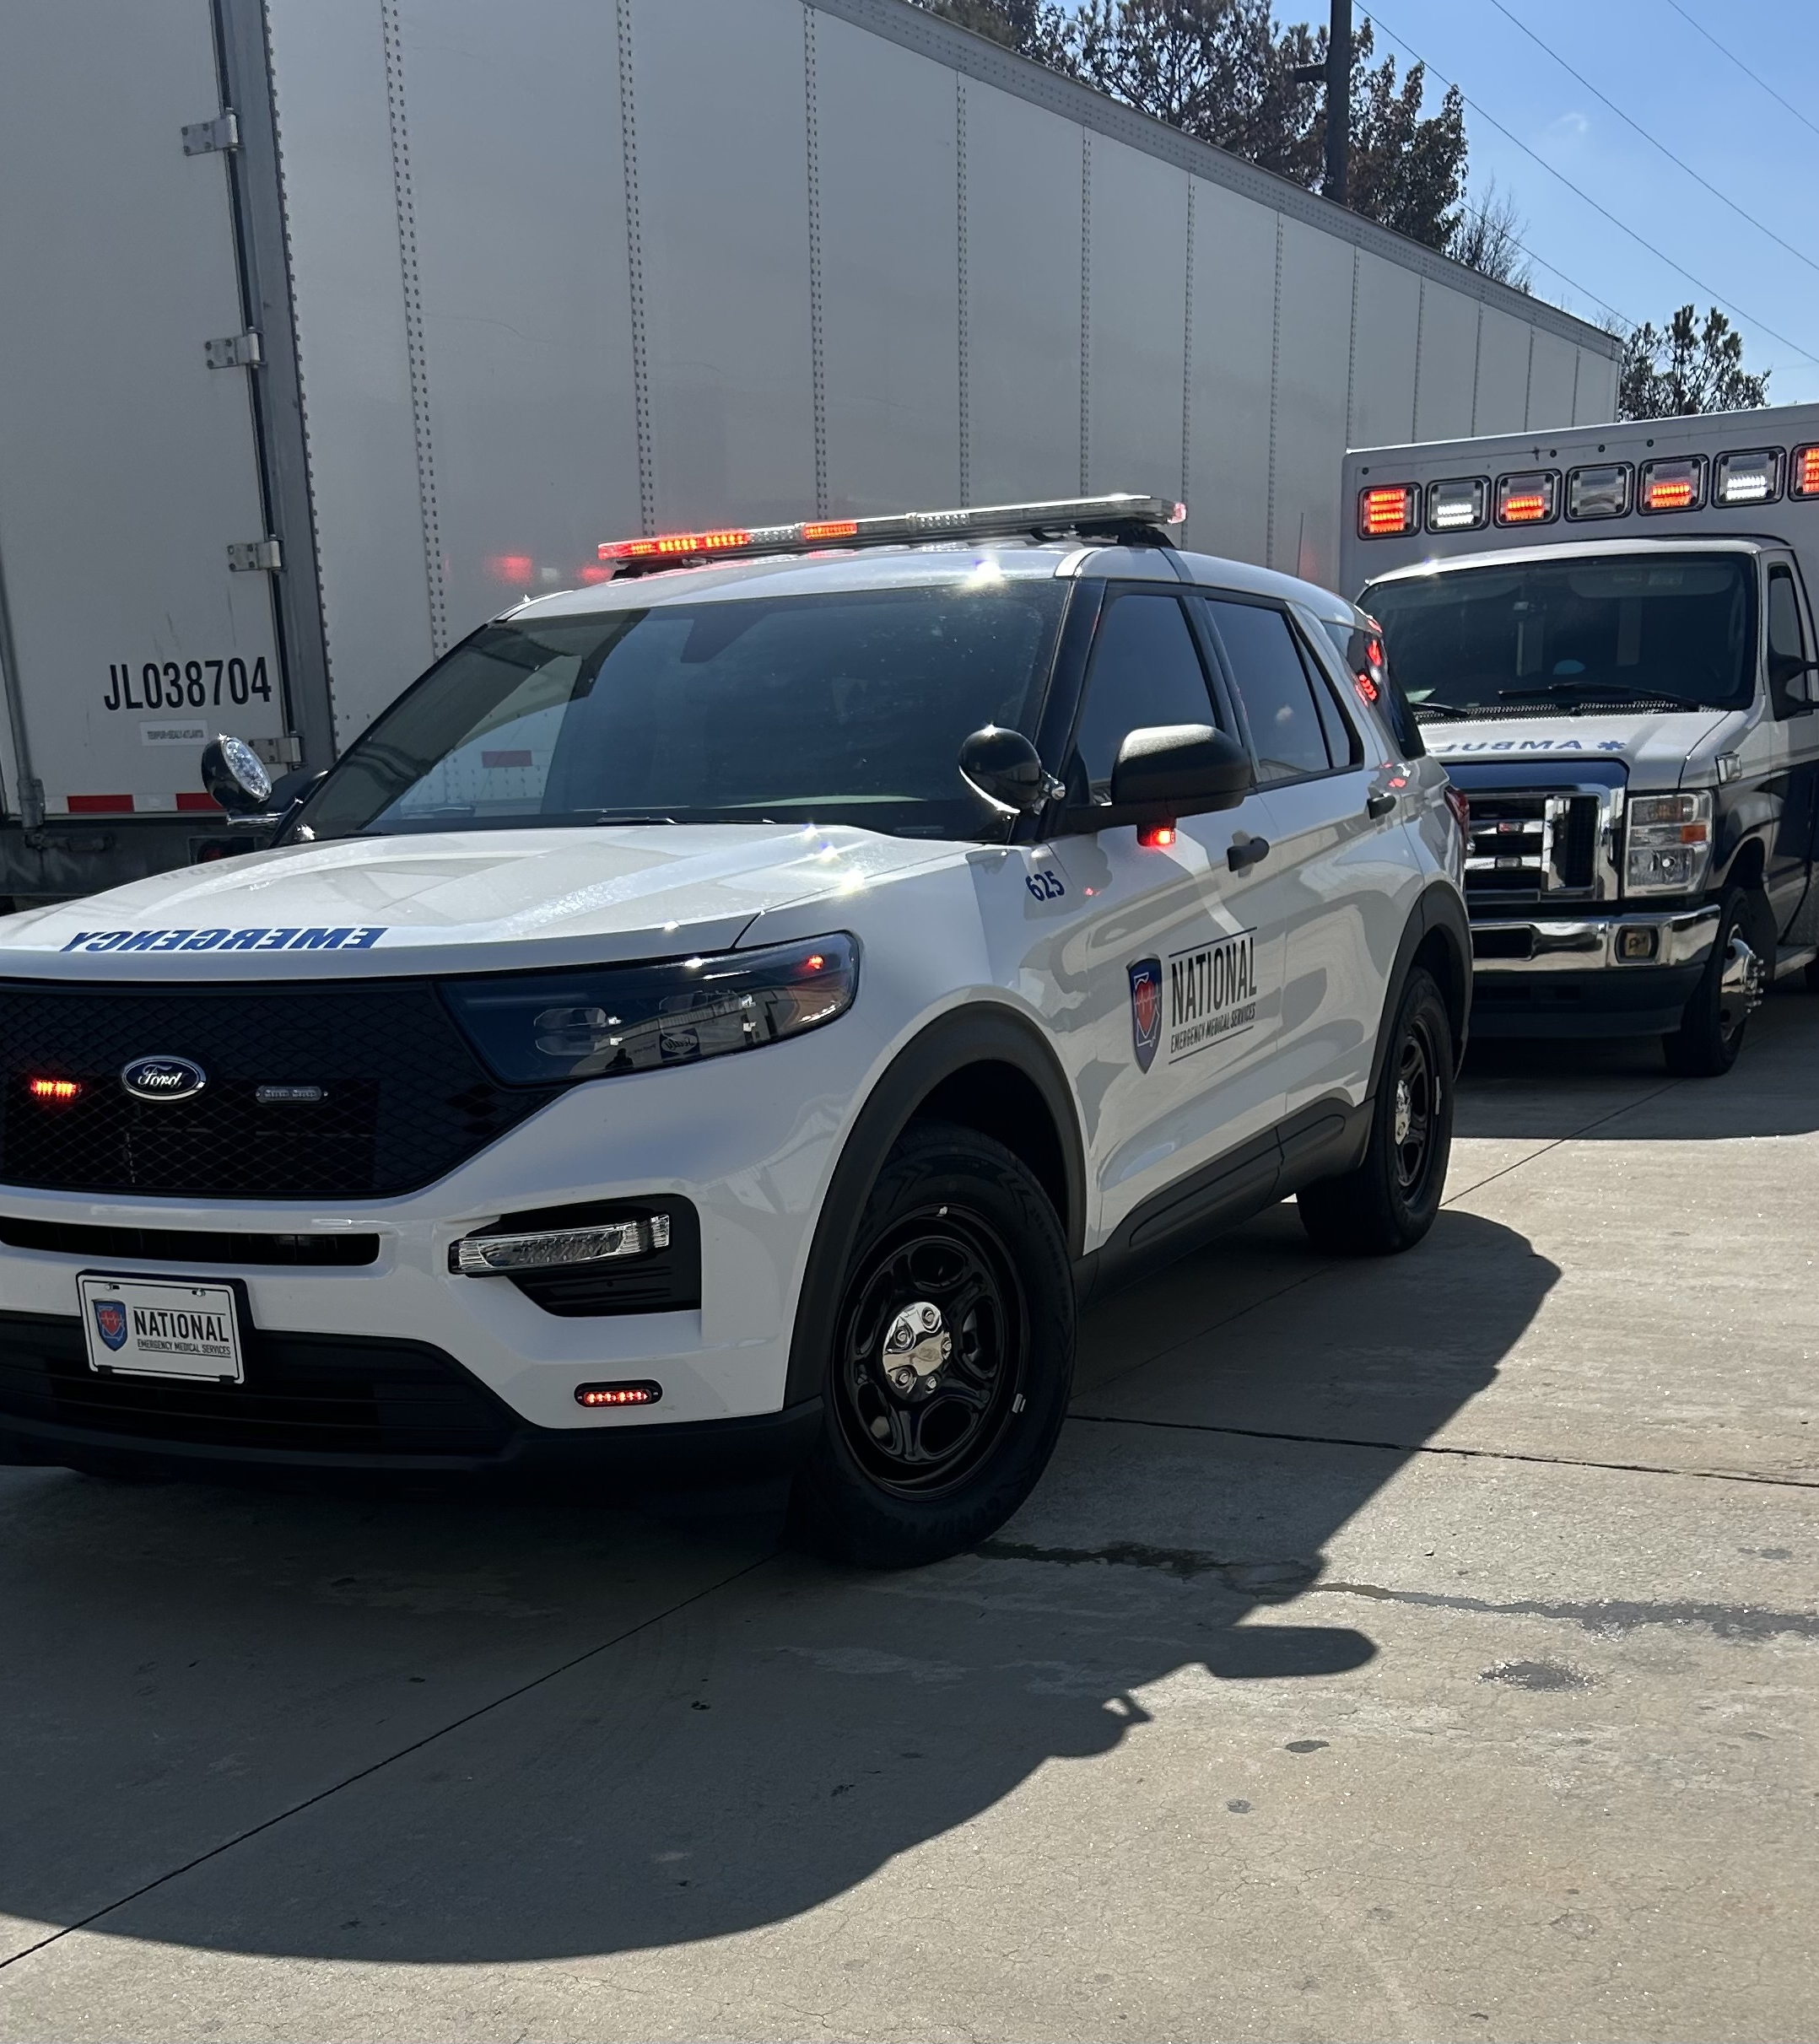
Equipment Condition
National EMS has robust maintenance contracts with all our major vendors.
This year, we plan on adding Lucas CPR devices to more of our fleet in 2025.
New stretchers continue to be ordered when ambulances are replaced by new ones.
EKG monitors are serviced by Zoll and are still the top product that is offered by Zoll.
New Stair Chairs have been ordered from Stryker
New radio over IP system was added to improve communications with our County Partners.

Slide 15
STEMI/Strokes/Trauma Activations
STEMI-11
Stroke-29
Trauma-17

Slide 16

Q/A
We employ a full-time Q/A manager who reviews all ALS reports.
She works cooperatively with our medical director
Monthly Q/A meetings regarding our metrics, and include all leadership and medical directors.
Our Q/A process has been able to stop several bad outcomes before they happened.

Slide 17
Challenges for the next 12 months
Funding
Radio system
Continue to recruit and retain top-level talent

Slide 18
Rates/Money
ALS-1 Emergency-$3206.78
ALS-2 Emergency-$4427.50
BLS Emergency-$3206.78
Mileage-$47.82
Refusal-$253.00
Oconee Sub-$16,666.66-Per Month
150/UH to have an ambulance stand by
7200 dollars a day for readiness, or $216,000 per month.
The current subsidy pays $547.94 per day.

