Slide 1


Slide 2
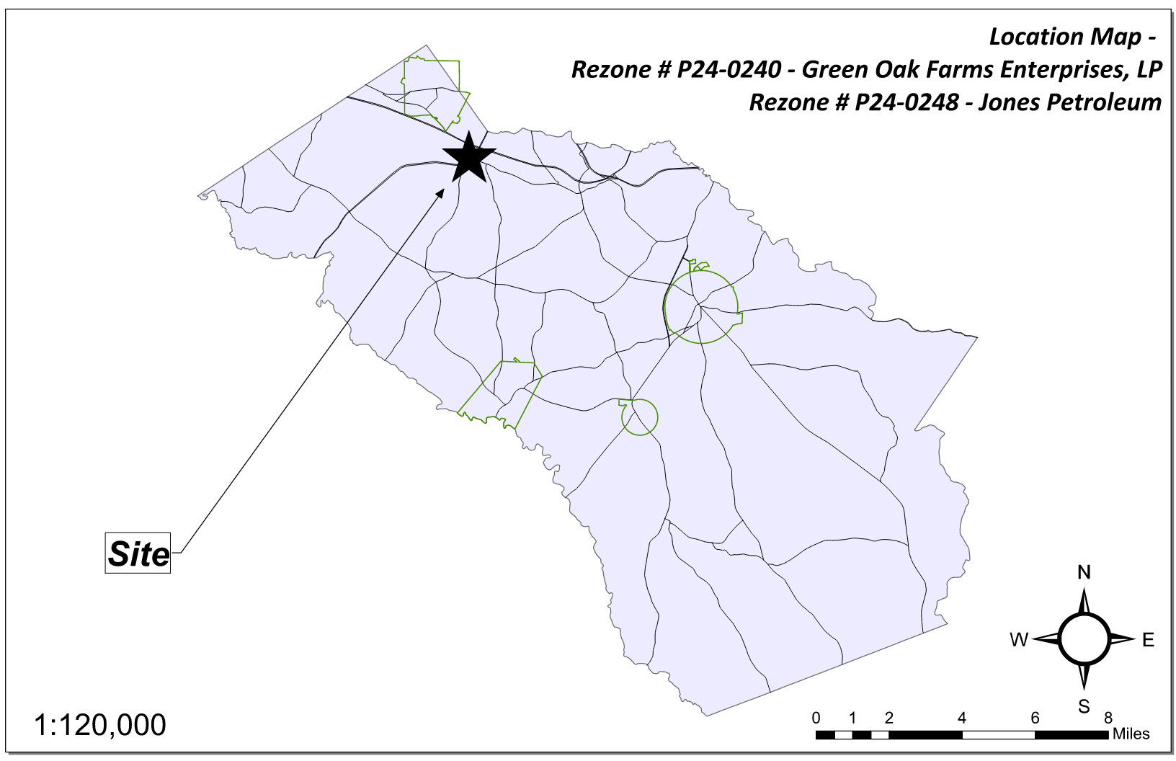
Site Location

Slide 3
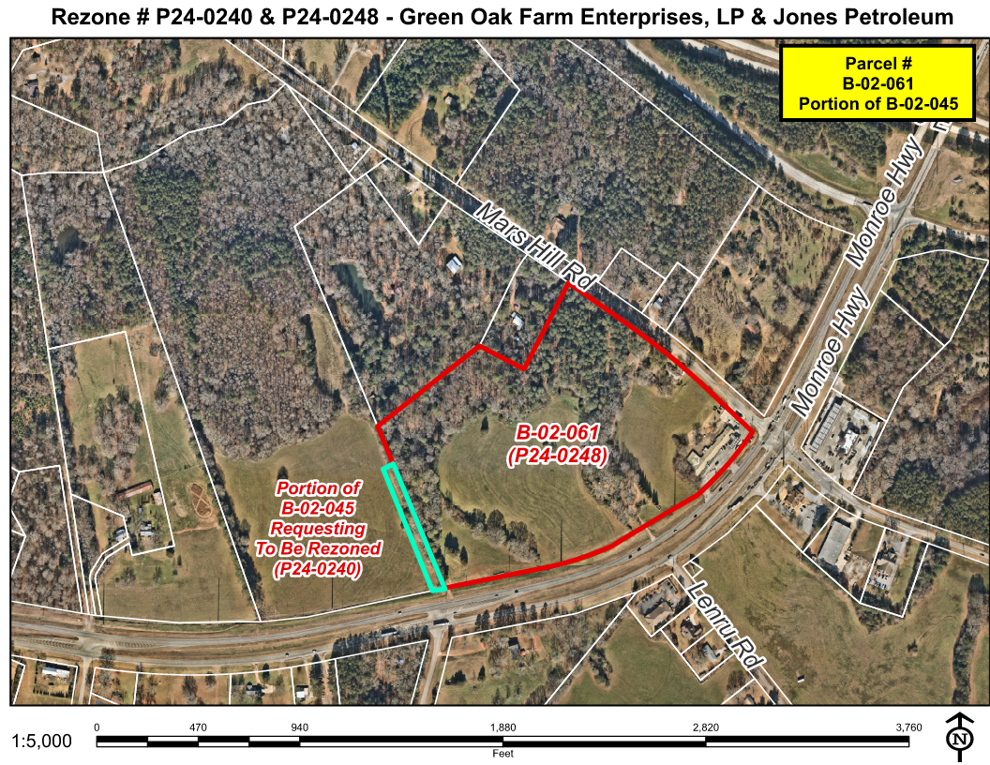
Aerial Imagery

Slide 4
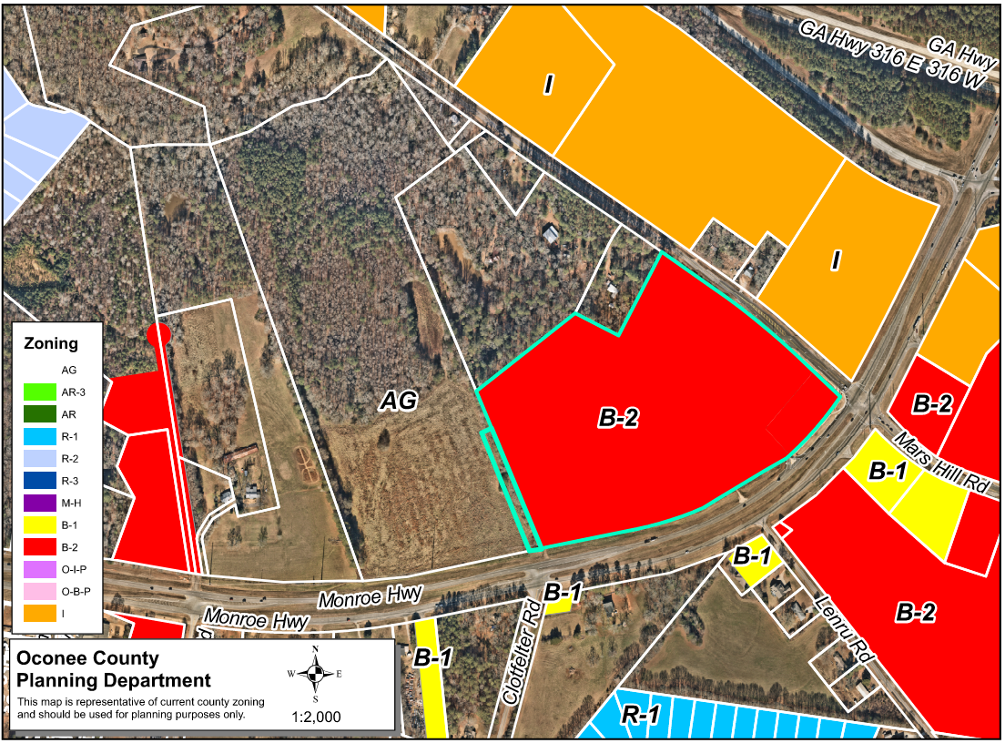
Zoning
AG

Slide 5
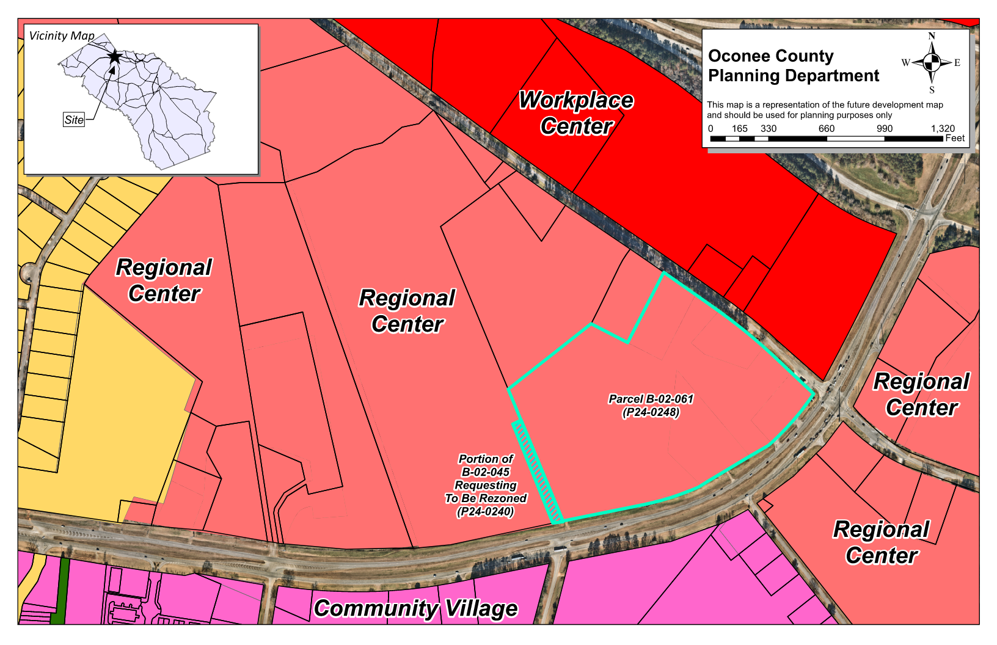
Future Development

Slide 6
Summary of Request
P24-0240:
Rezone ±0.902 acres from AG (Agricultural) to B-2 (Highway Business) to provide a proposed access drive that connects to an existing B-2 zoned property.
P24-0248:
Modification of previous zoning #7702 to amend an existing B-2 zone (Highway Business) to revise the proposed entrances, building sizes, architecture and lot layout for a commercial shopping center and subdivision.

Slide 7
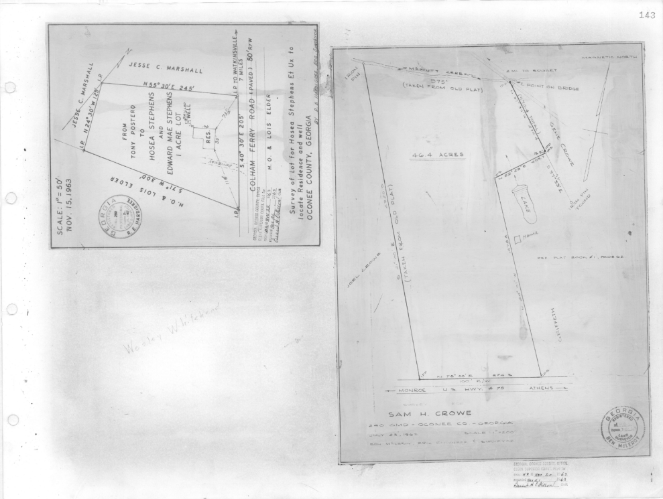
Recorded Plat (P24-0240)

Slide 8
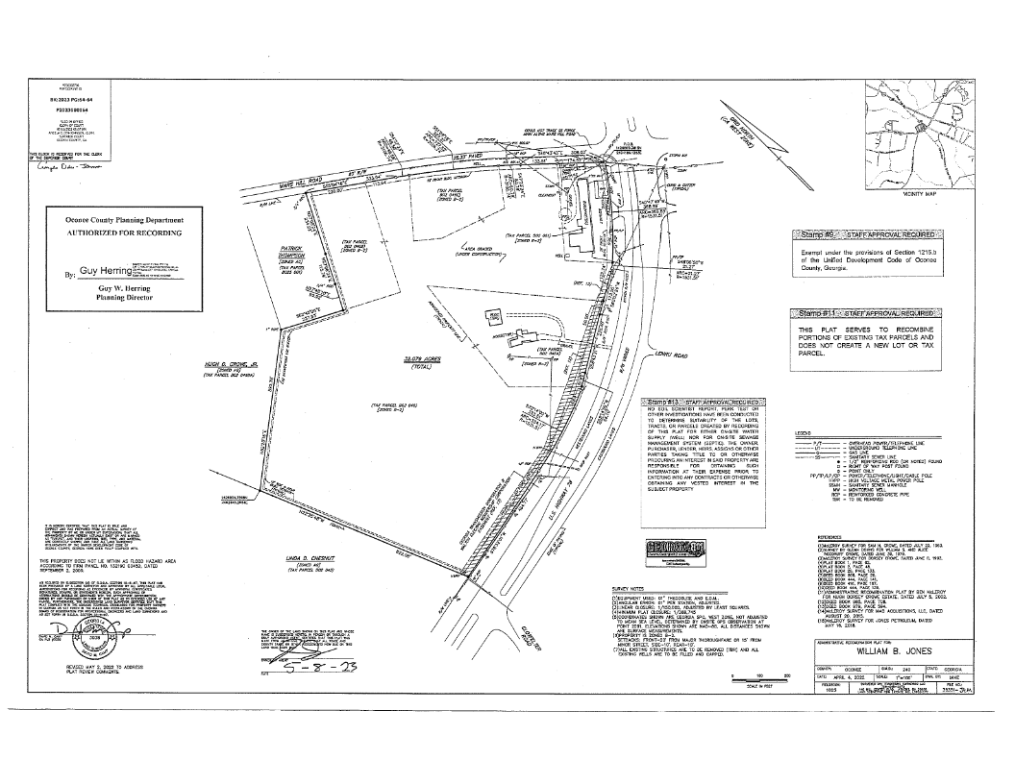
Recorded Plat (P24-0248)

Slide 9
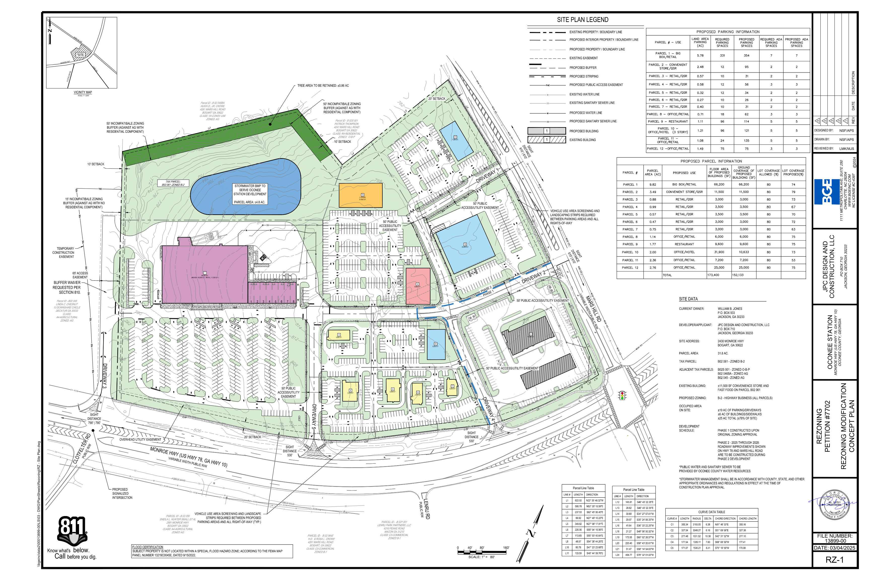
Concept Plan

Slide 10
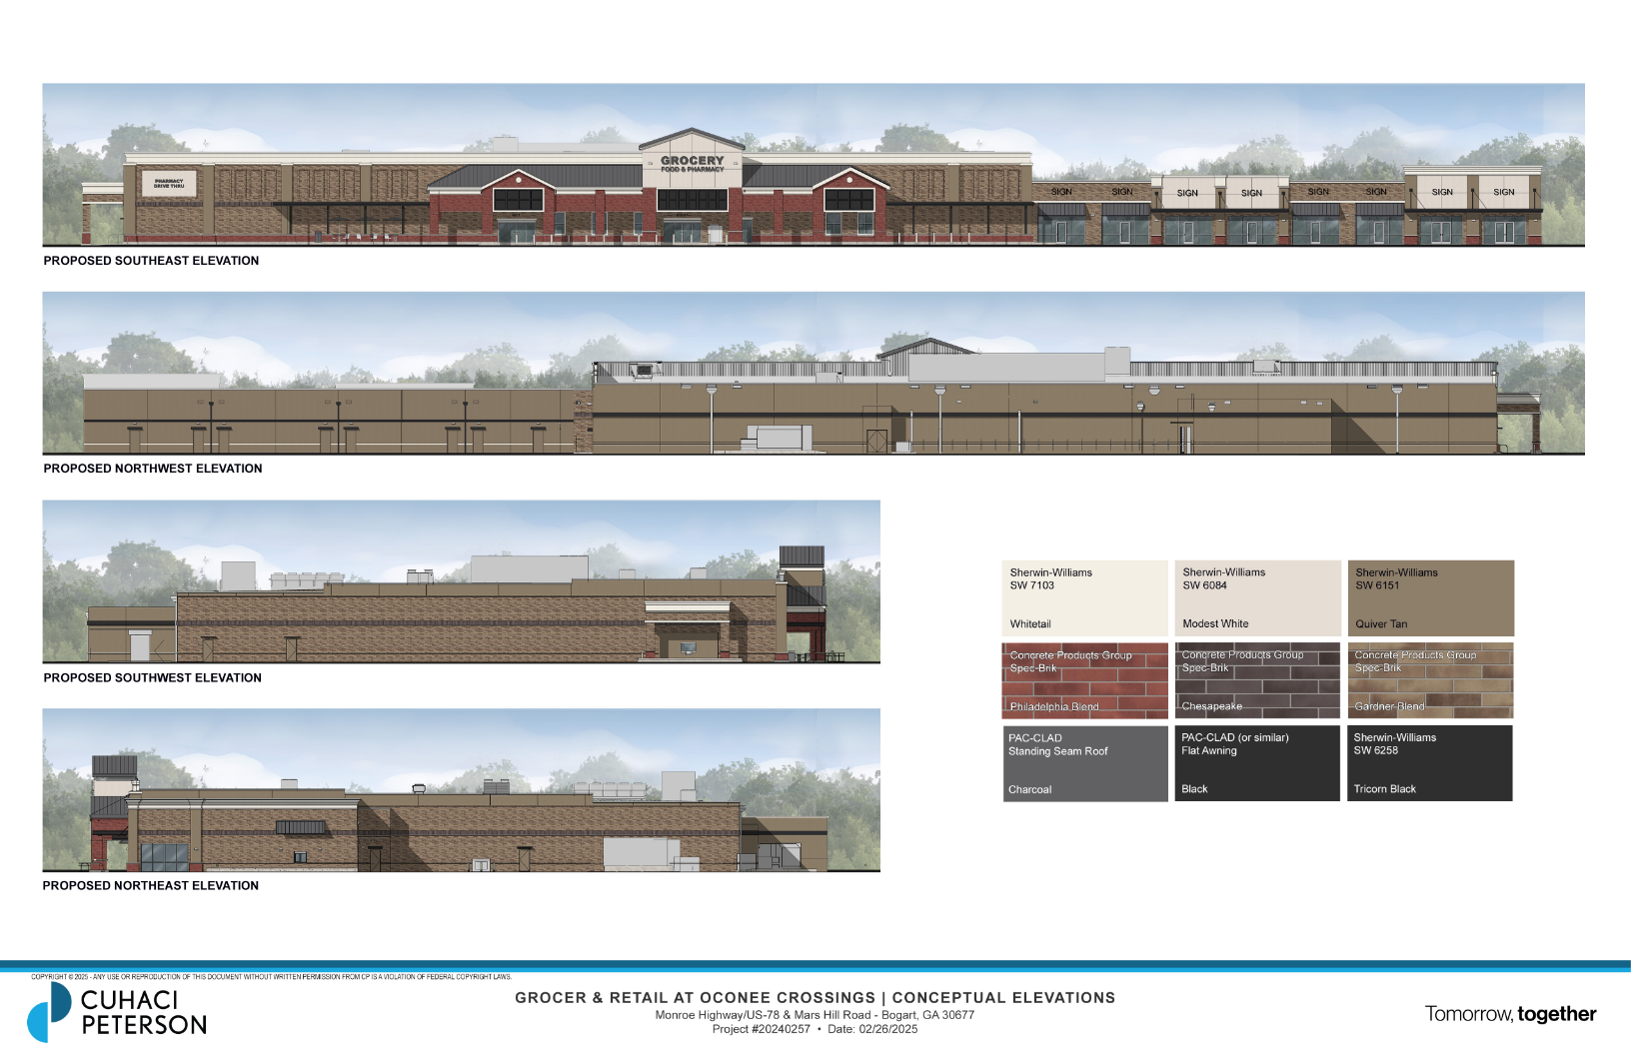
Architectural Images

Slide 11
Staff Recommendation (P24-0240)
Based on Board of Commissioners policies, decision-making criteria, and standards outlined in the development codes of Oconee County, staff recommends conditional approval of the request to rezone ±0.902 acres to B-2 subject to the following conditions to be fulfilled at the expense of the owner/developer:
1. Development design and structures shall meet or exceed the standards indicated on the concept plan, narrative, representative architectural sketches, and other documents submitted with the zoning application and attached hereto. This condition shall not construe approval of any standard that is not in conformity with the Unified Development Code.
2. The owner at their own expense shall construct the improvements required by the County for public water for the subject property and shall convey the same to the County, free of all liens. Said improvements shall include all on-site improvements and such off-site improvements as are required by the County to provide service to subject property.
3. At its expense, Owner shall make all right of way improvements and shall dedicate all rights of way which are required by the County after the County’s review of Owner's development plans pursuant to the County’s ordinances and regulations. All such improvements shall be shown on the preliminary site plan and site development plans for the project and no development permit shall be issued until Owner has agreed to such improvements and dedication.
4. A revised Traffic Impact Analysis shall be submitted that shows conclusively that a Level of Service “C” or better is met at all intersections and access points. Site Development Plans must incorporate improvements needed to meet Level of Service “C” or better at all intersections and access points prior to approval by Public Works and Planning and Code Enforcement.

Slide 12
Staff Recommendation (P24-0240)
Based on Board of Commissioners policies, decision-making criteria, and standards outlined in the development codes of Oconee County, staff recommends conditional approval of the request to rezone ±0.902 acres to B-2 subject to the following conditions to be fulfilled at the expense of the owner/developer:
5. With the conditions of UDC Section 810 being met for the unnecessary buffer waiver along the subject property, the buffer waiver is approved.
6. All conditions of approval for the concurrent application for rezoning # P24-0248, if approved, shall apply.

Slide 13
Planning Commission Recommendation (P24-0240)
Planning Commission recommends approval subject to the conditions recommended by staff.

Slide 14
Staff Recommendation (P24-0248)
Based on Board of Commissioners policies, decision-making criteria, and standards outlined in the development codes of Oconee County, staff recommends conditional approval of the request to amend the conditions of the previously approved B-2 zoning #7702 being 31.8 acres subject to the following conditions to be fulfilled at the expense of the owner/developer:
1. Development design and structures shall meet or exceed the standards indicated on the concept plan, narrative, representative architectural sketches, and other documents submitted with the zoning application and attached hereto. This condition shall not construe approval of any standard that is not in conformity with the Unified Development Code.
2. The owner at their own expense shall construct the improvements required by the County for public water for the subject property and shall convey the same to the County, free of all liens. Said improvements shall include all on-site improvements and such off-site improvements as are required by the County to provide service to subject property.
3. At its expense, Owner shall make all right of way improvements and shall dedicate all rights of way which are required by the County after the County’s review of Owner's development plans pursuant to the County’s ordinances and regulations. All such improvements shall be shown on the preliminary site plan and site development plans for the project and no development permit shall be issued until Owner has agreed to such improvements and dedication.
4. A revised Traffic Impact Analysis shall be submitted that shows conclusively that a Level of Service “C” or better is met at all intersections and access points. Site Development Plans must incorporate improvements needed to meet Level of Service “C” or better at all intersections and access points prior to approval by Public Works and Planning and Code Enforcement.

Slide 15
Staff Recommendation (P24-0248)
Based on Board of Commissioners policies, decision-making criteria, and standards outlined in the development codes of Oconee County, staff recommends conditional approval of the request to amend the conditions of the previously approved B-2 zoning #7702 being 31.8 acres subject to the following conditions to be fulfilled at the expense of the owner/developer:
5. Any freestanding signs allowed shall only be permitted as ground (monument) signs and shall not exceed twenty feet in height.
6. Architectural standards as shown on elevations dated 2/26/2025 and submitted 3/10/2025 with at least 80 percent of exterior wall surfaces of all buildings and structures shall be either brick veneer, stone veneer or glass, or combination thereof where visible from internal drives or external roadways. Additional primary and accent materials are allowed as indicated in UDC Section 306.03.
7. All vegetative screening, landscaping, and buffers shall meet the design standards as set forth in Article 8 of the Unified Development Code, except that all required landscape strips shall contain one tree per 25 lineal feet of landscape strip. Said trees shall be a mixture of evergreen and deciduous trees, and of species that will attain a normal height at maturity of more than 40 feet.
8. Service areas and dumpsters shall be visually screened from public view by a six-foot masonry wall with façade materials matching the exterior of the principal structure with black painted metal/steel enclosure doors. Enclosure doors made of wood or chain link are prohibited.
9. With the conditions of UDC Section 810 being met for the unnecessary buffer waiver along the subject property, the buffer waiver is approved.
10. All conditions of approval for the concurrent application for rezoning # P24-0240, if approved, shall apply.

Slide 16
Planning Commission Recommendation (P24-0248)
Planning Commission recommends approval subject to the conditions recommended by staff, along with one additional Condition #11: 11. Limit the proposed hotel to 2 stories with the same proposed square footage.

