Slide 1


Slide 2
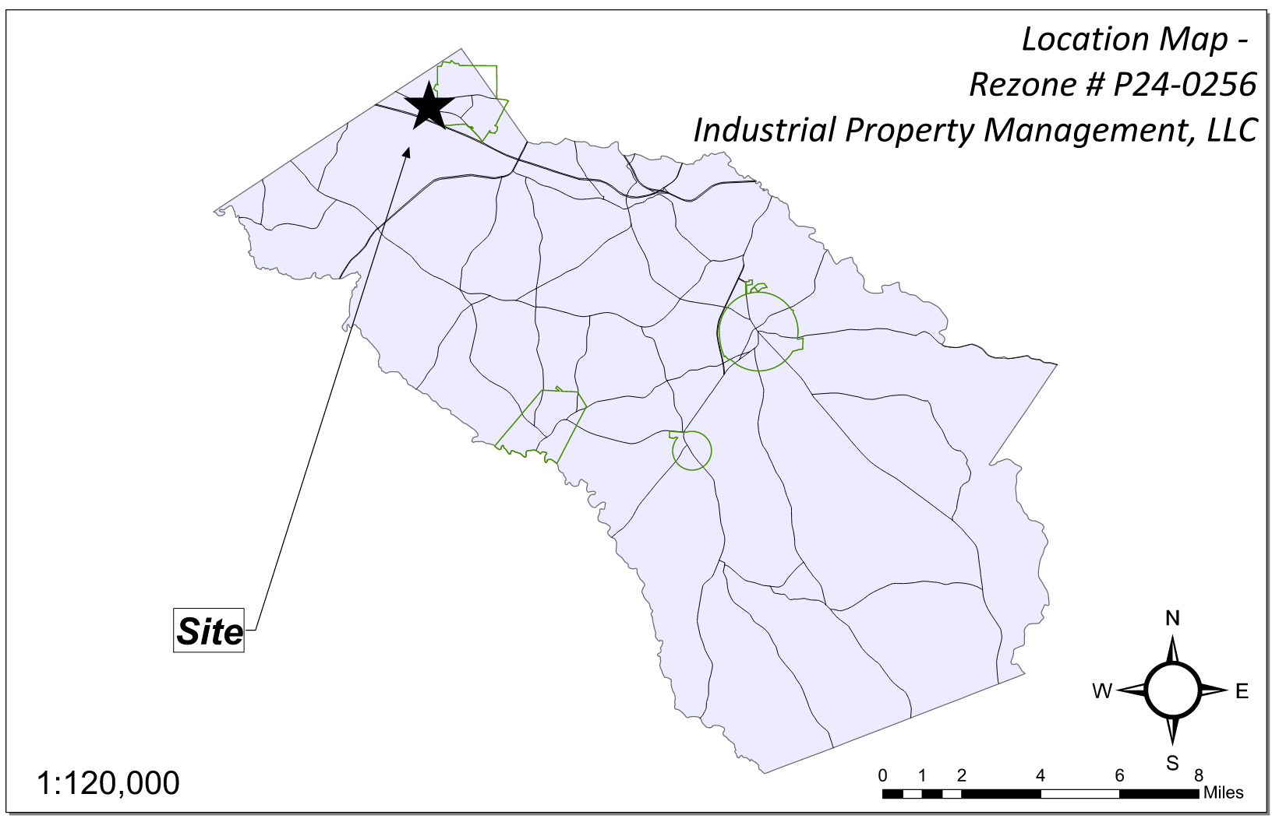
Site Location

Slide 3
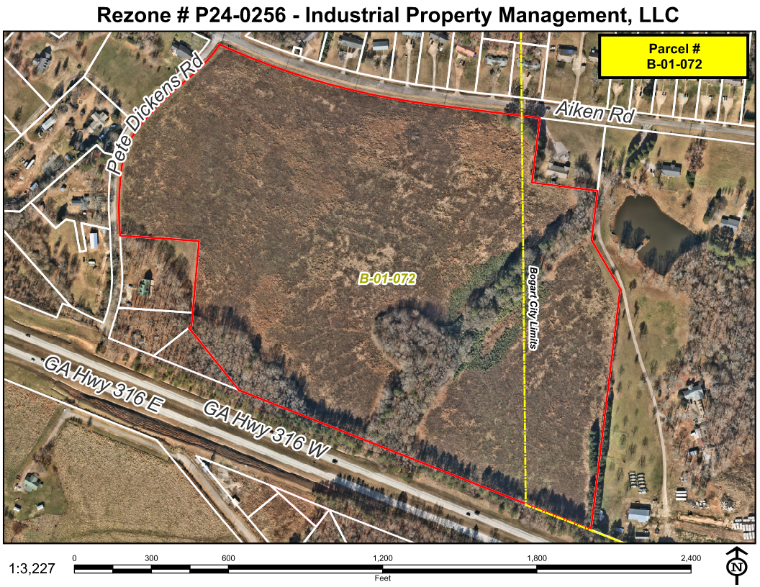
Aerial Imagery

Slide 4
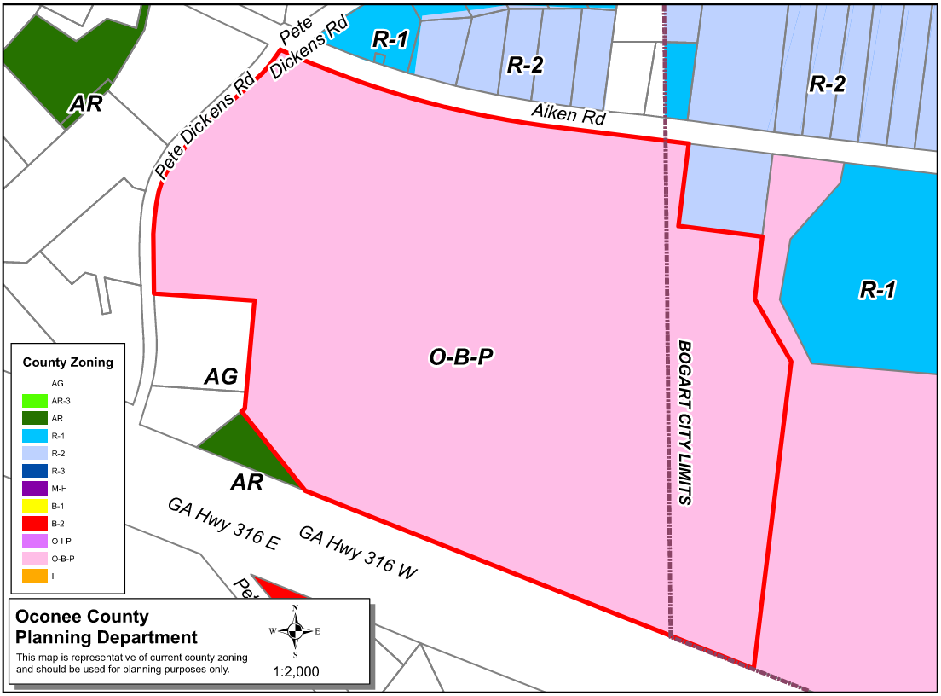
Zoning
AG

Slide 5
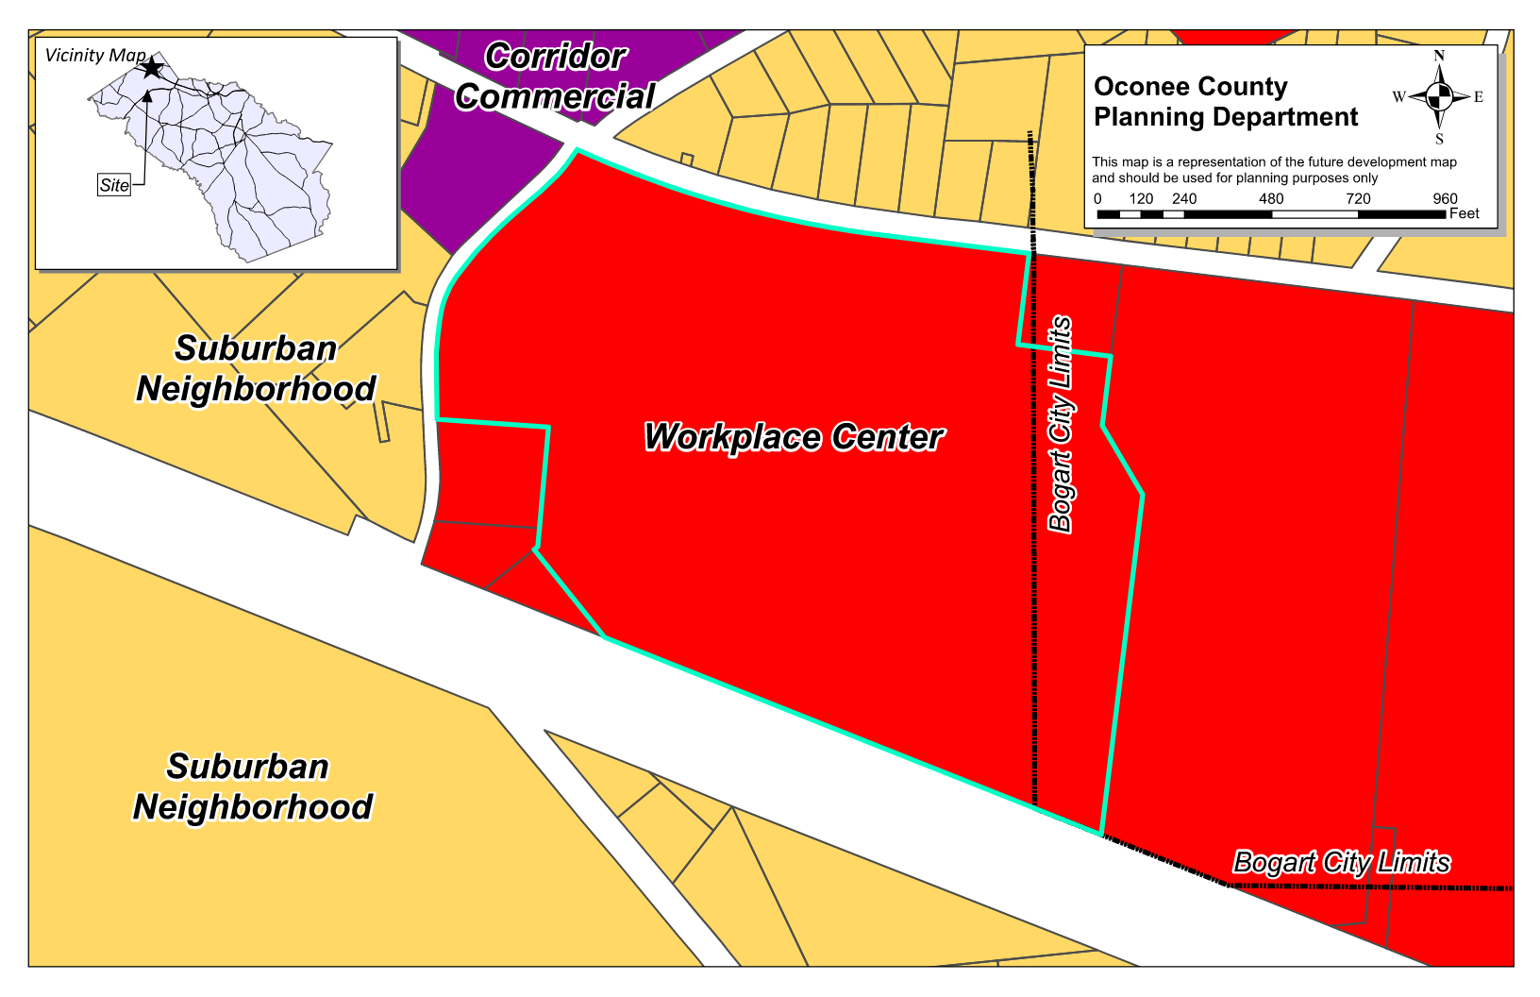
Future Development

Slide 6
Summary of Request
Modify the conditions of zoning P24-0067 for an existing OBP (Office Business Park) zoned property to revise the concept plan with a shift of building locations and delete previous conditions on buffers.

Slide 7
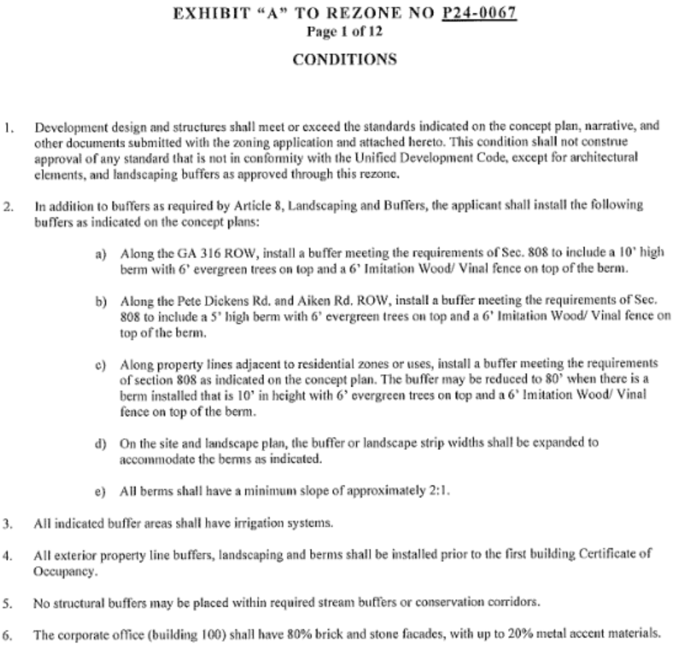

Slide 8
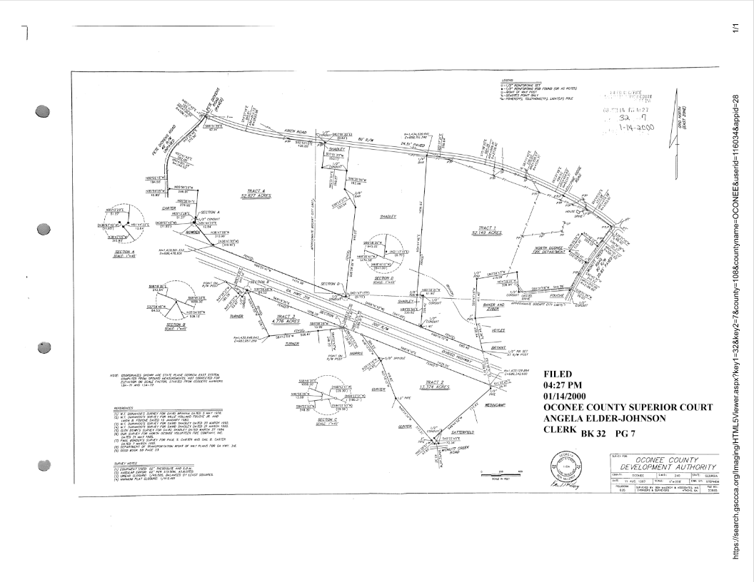
Recorded Plat

Slide 9
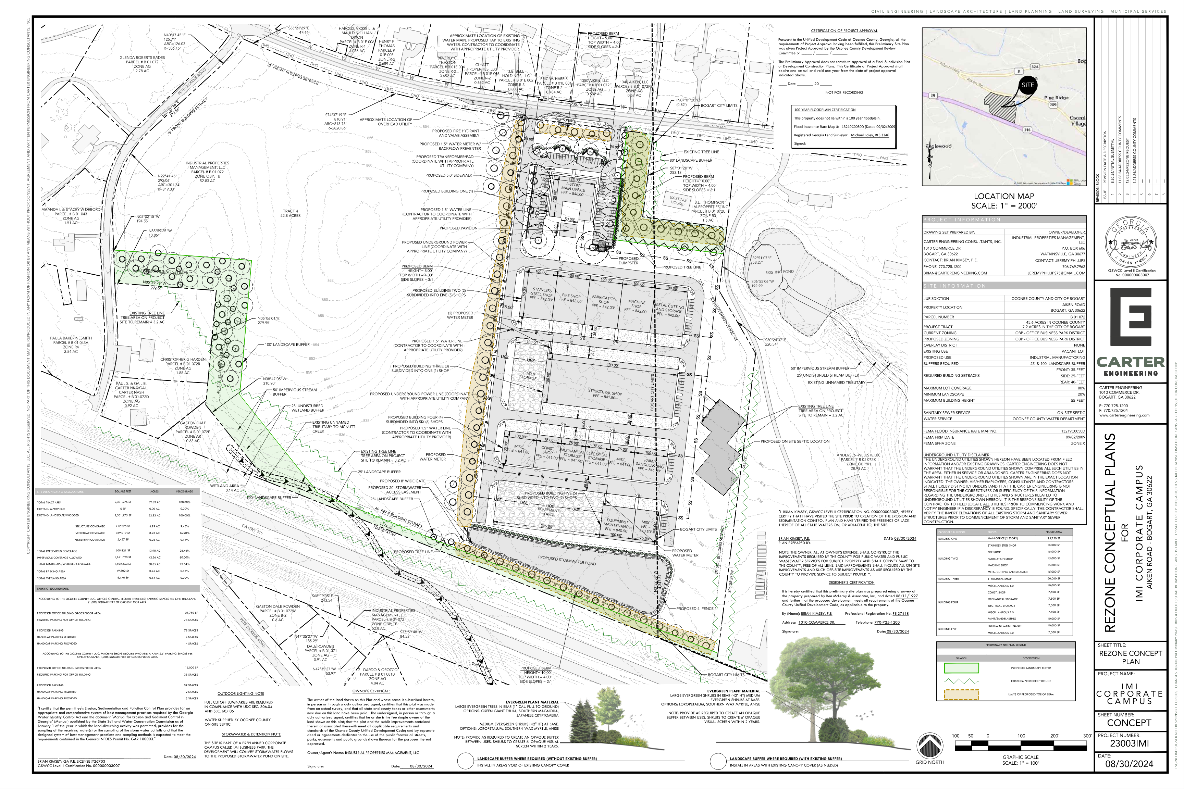
Concept Plan

Slide 10
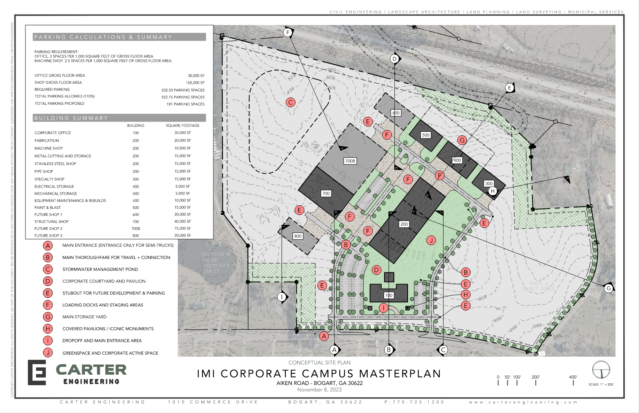
Previous P24-0067 Concept Plan

Slide 11
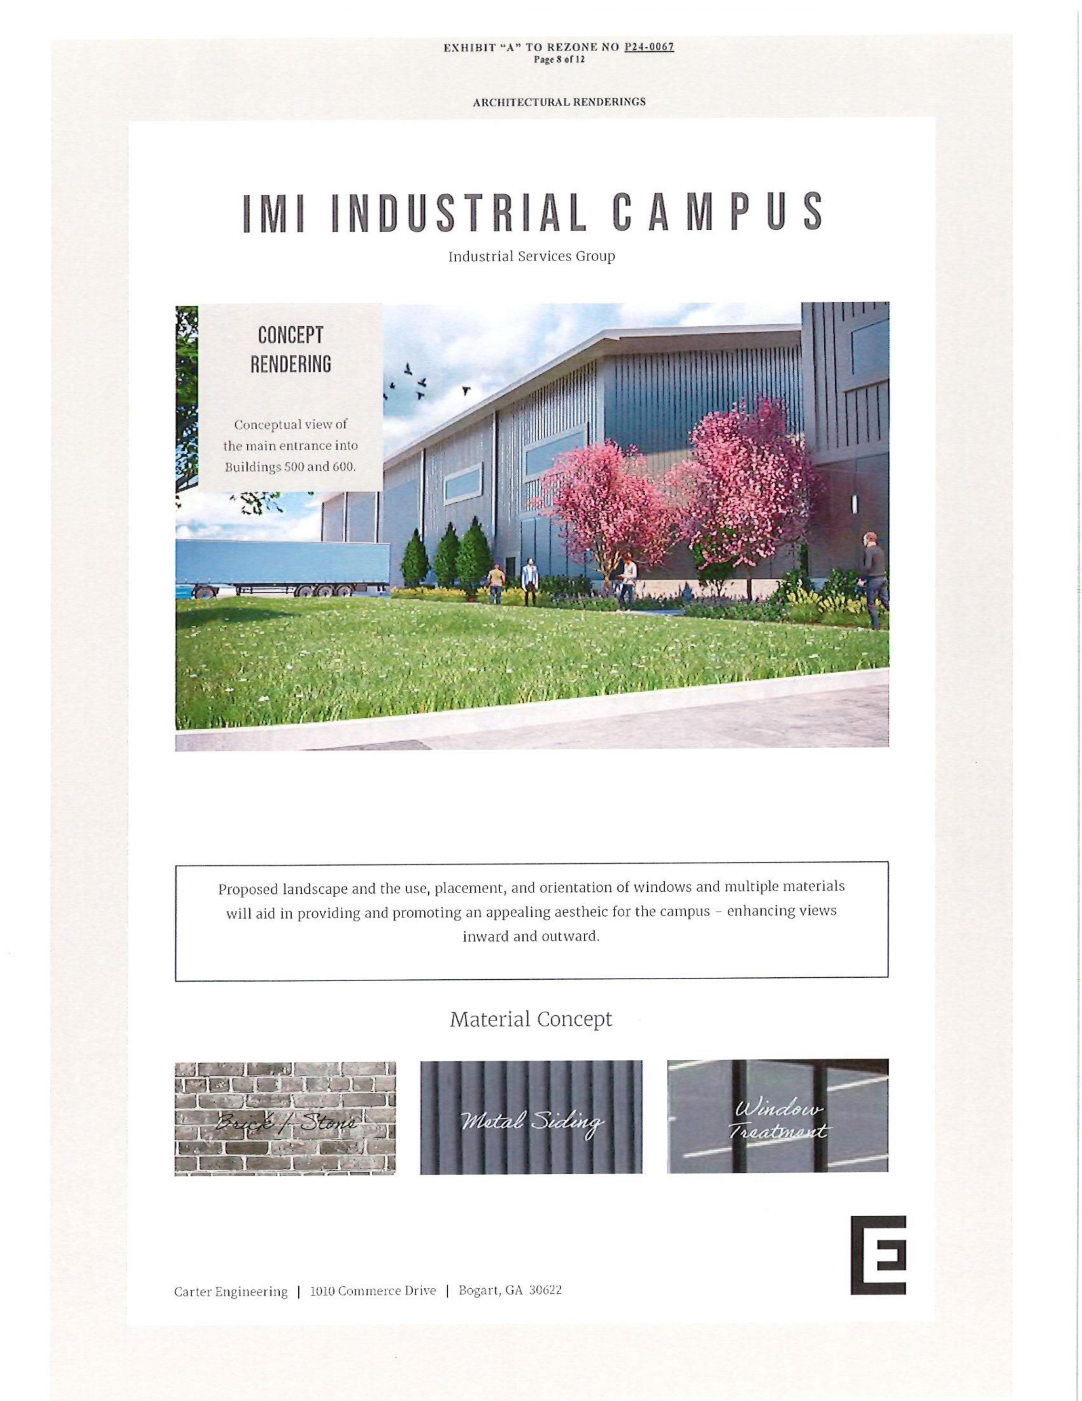
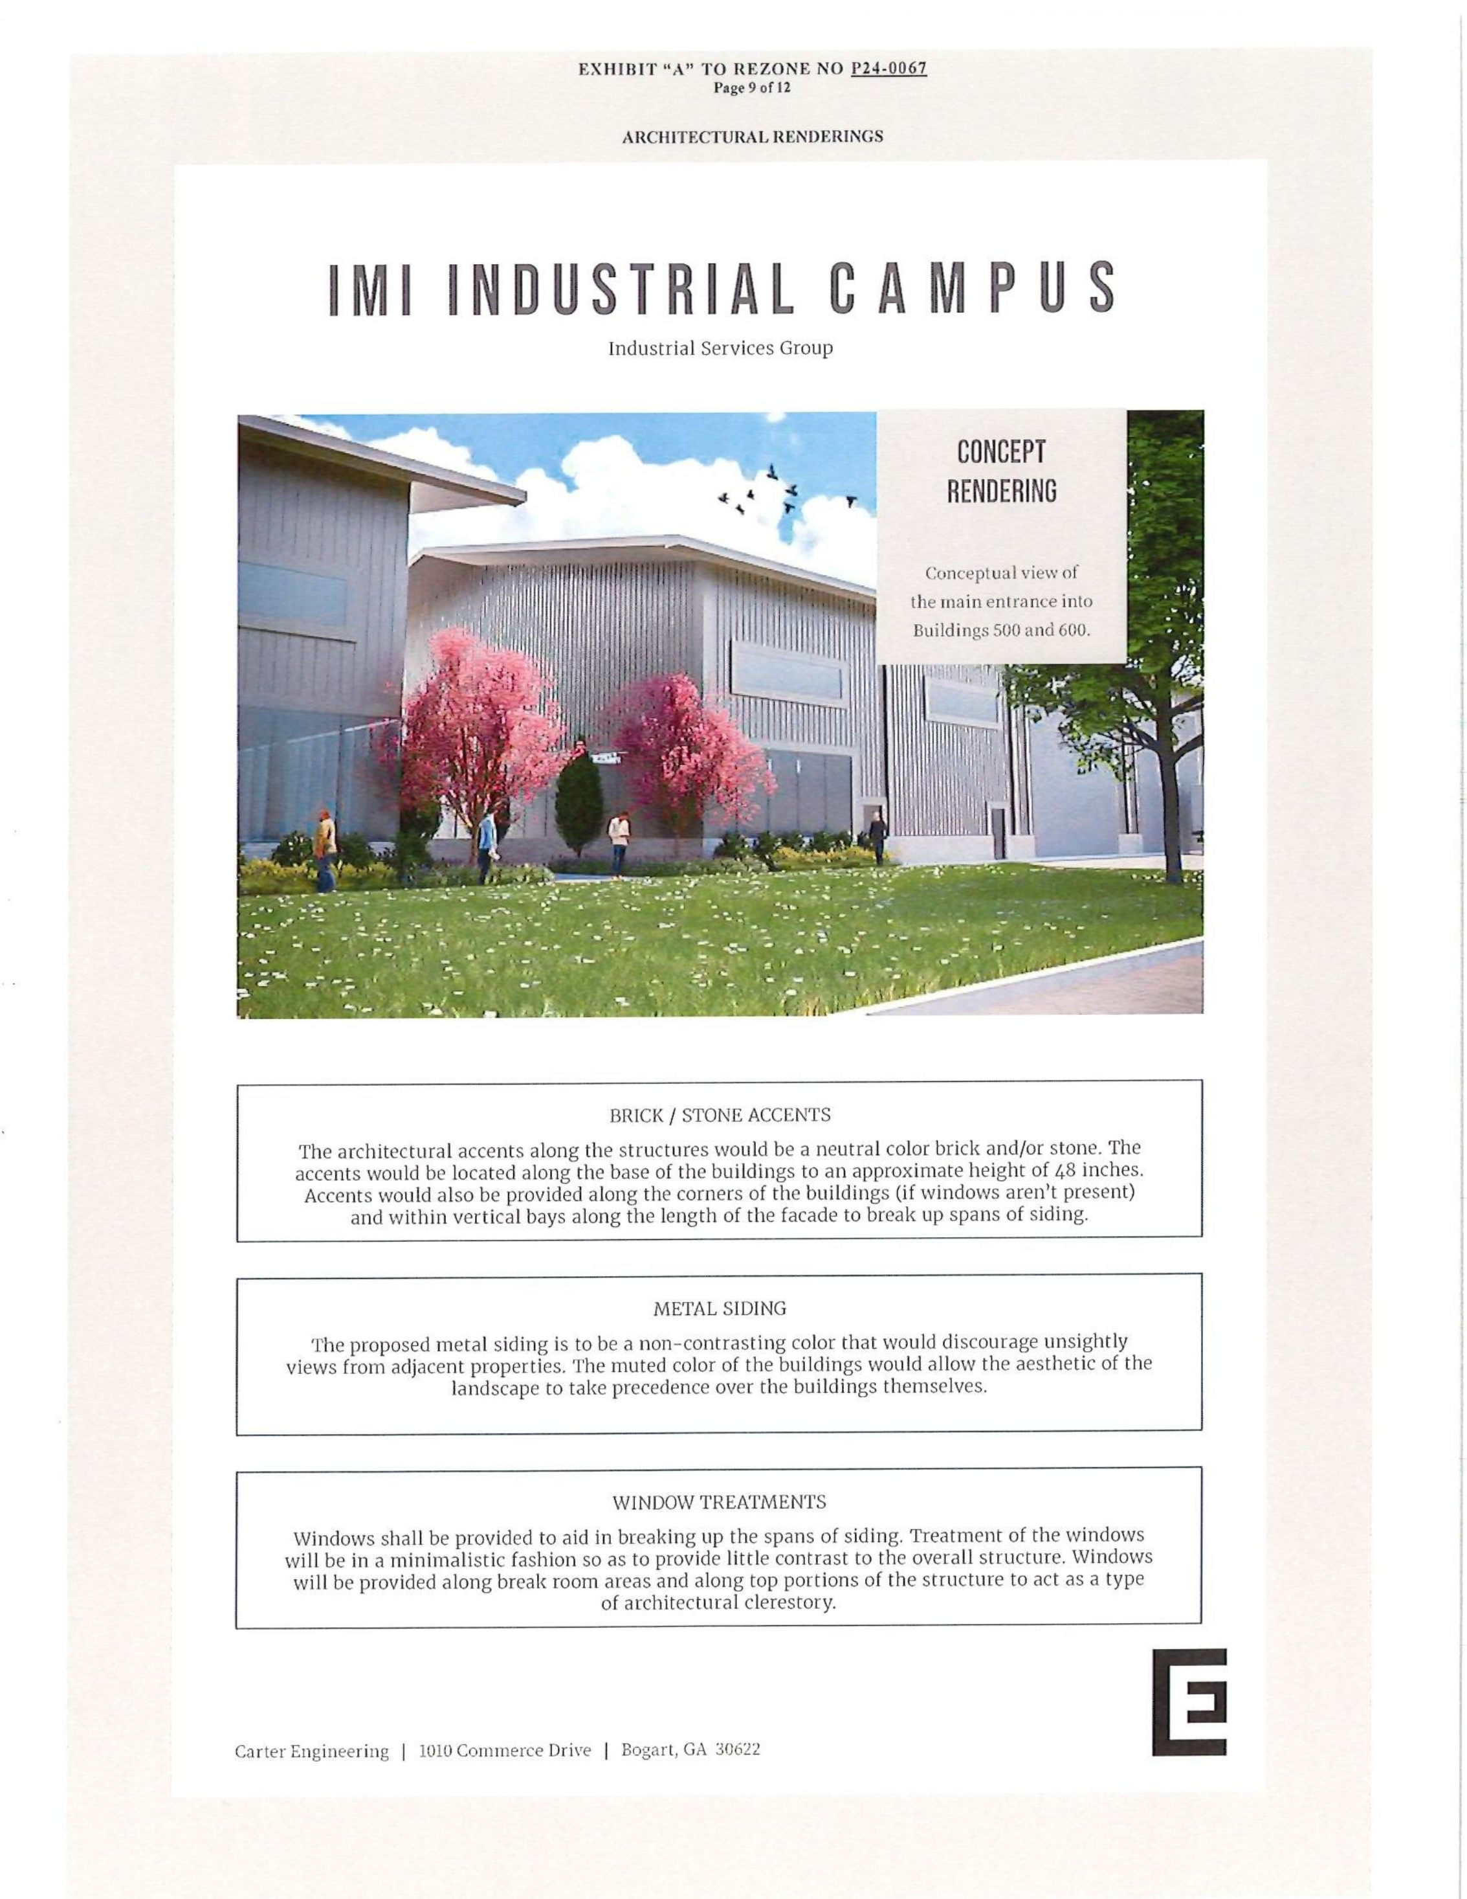
Architectural Images

Slide 12
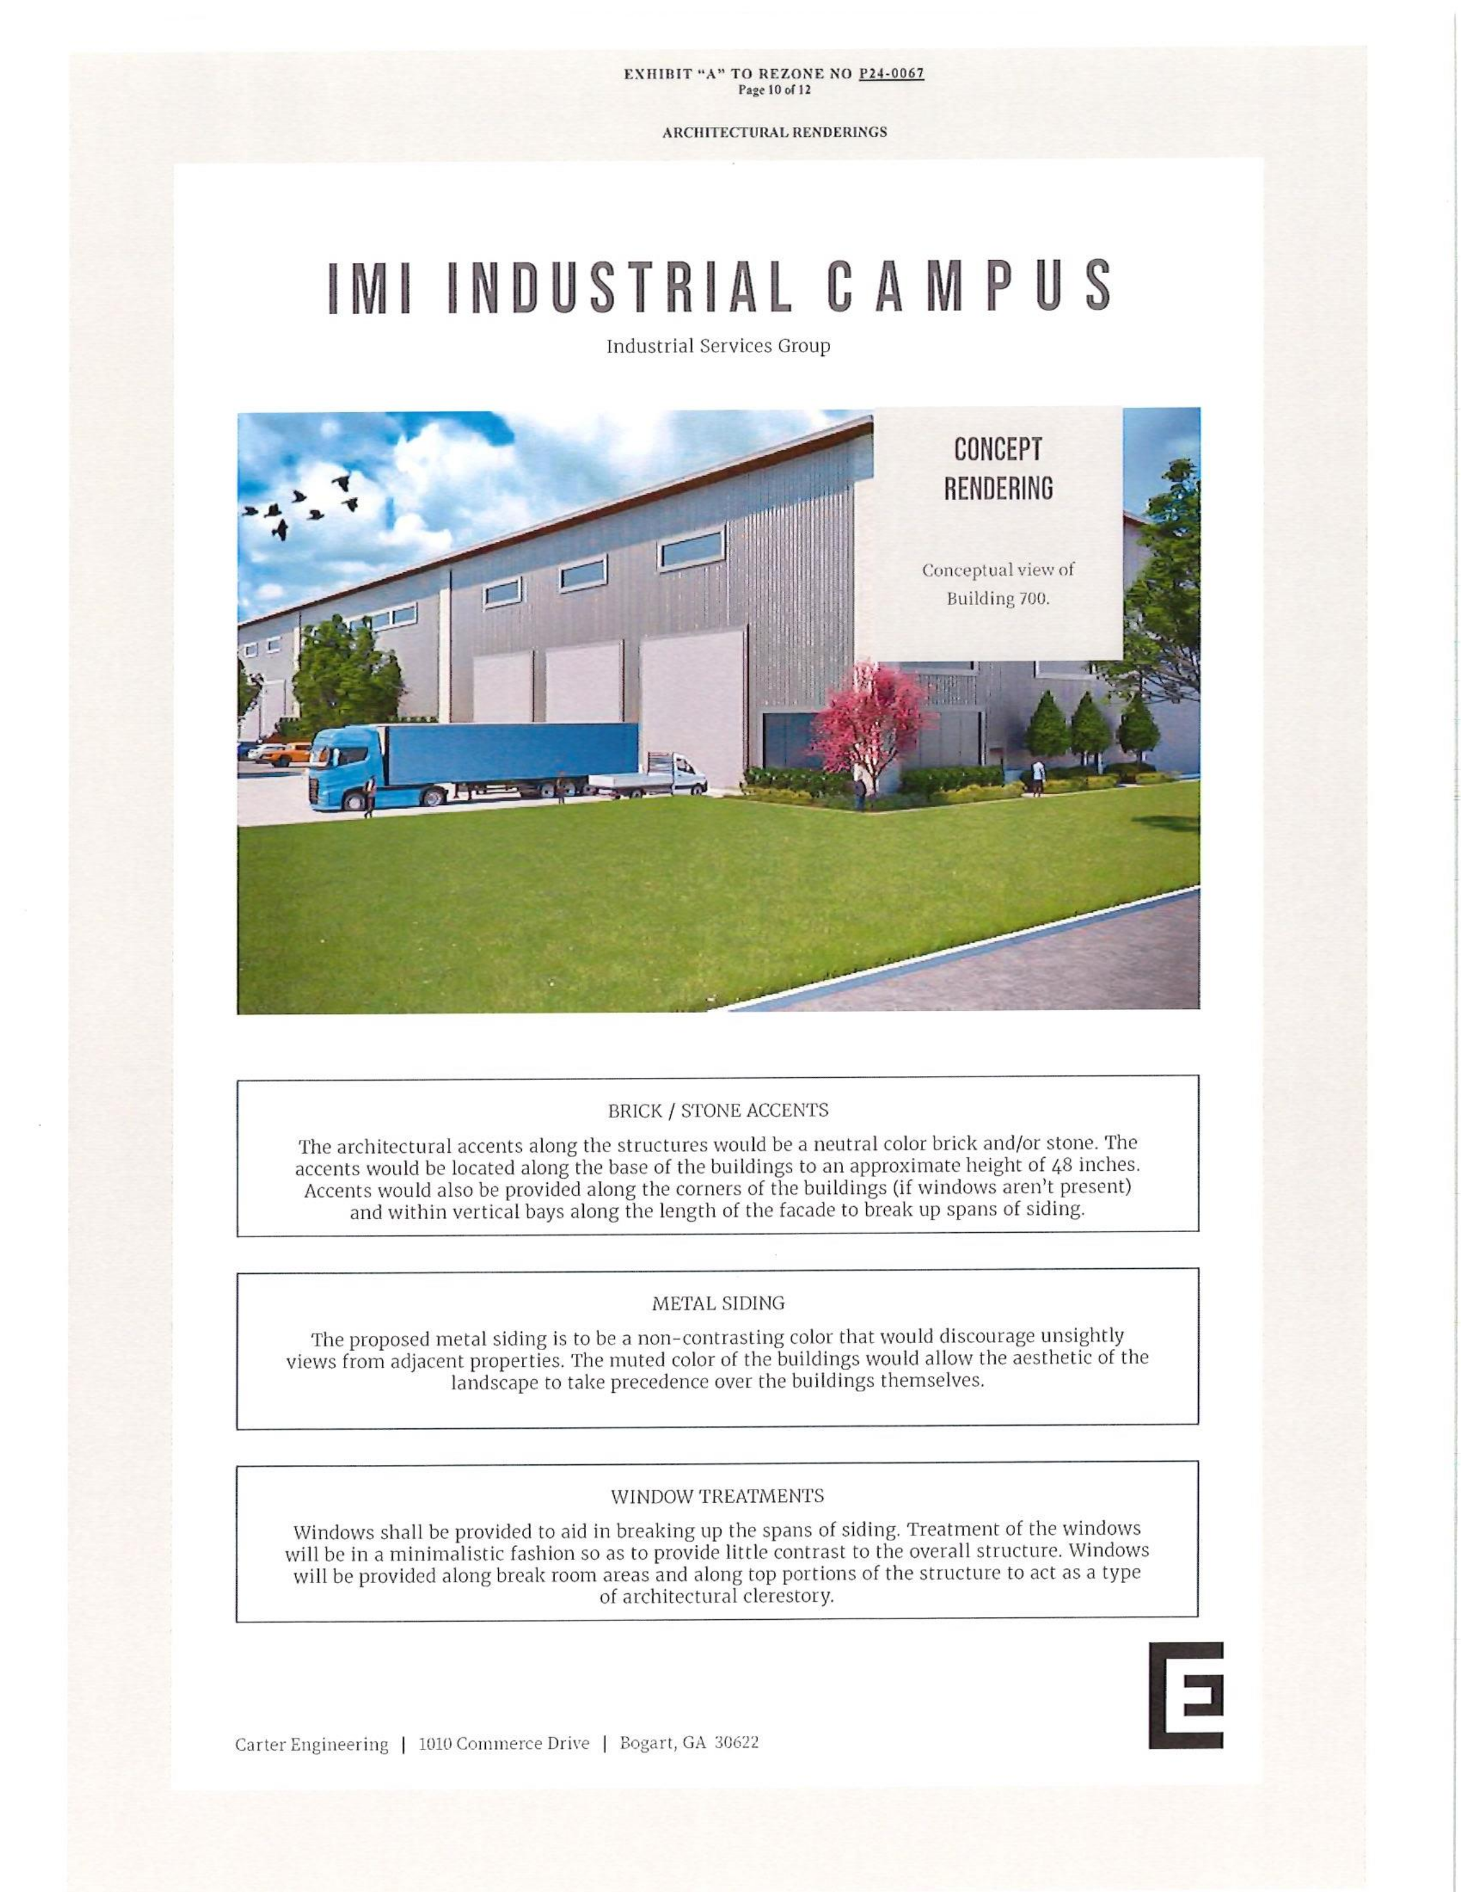
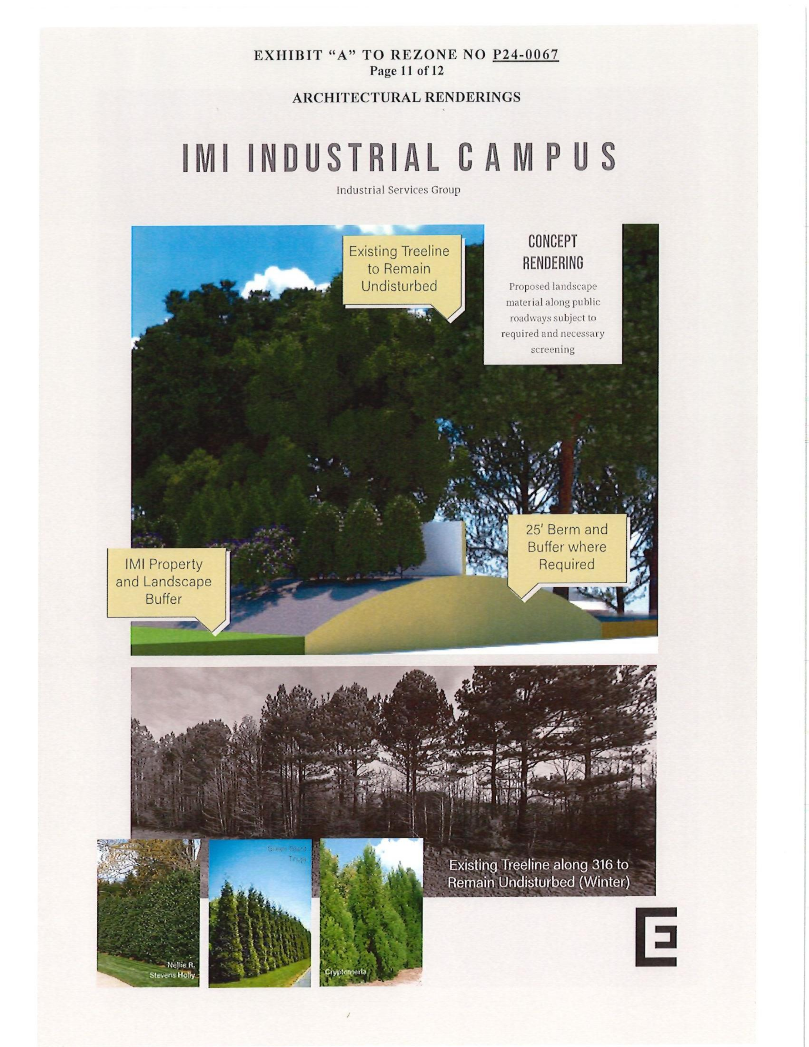
Architectural Images

Slide 13
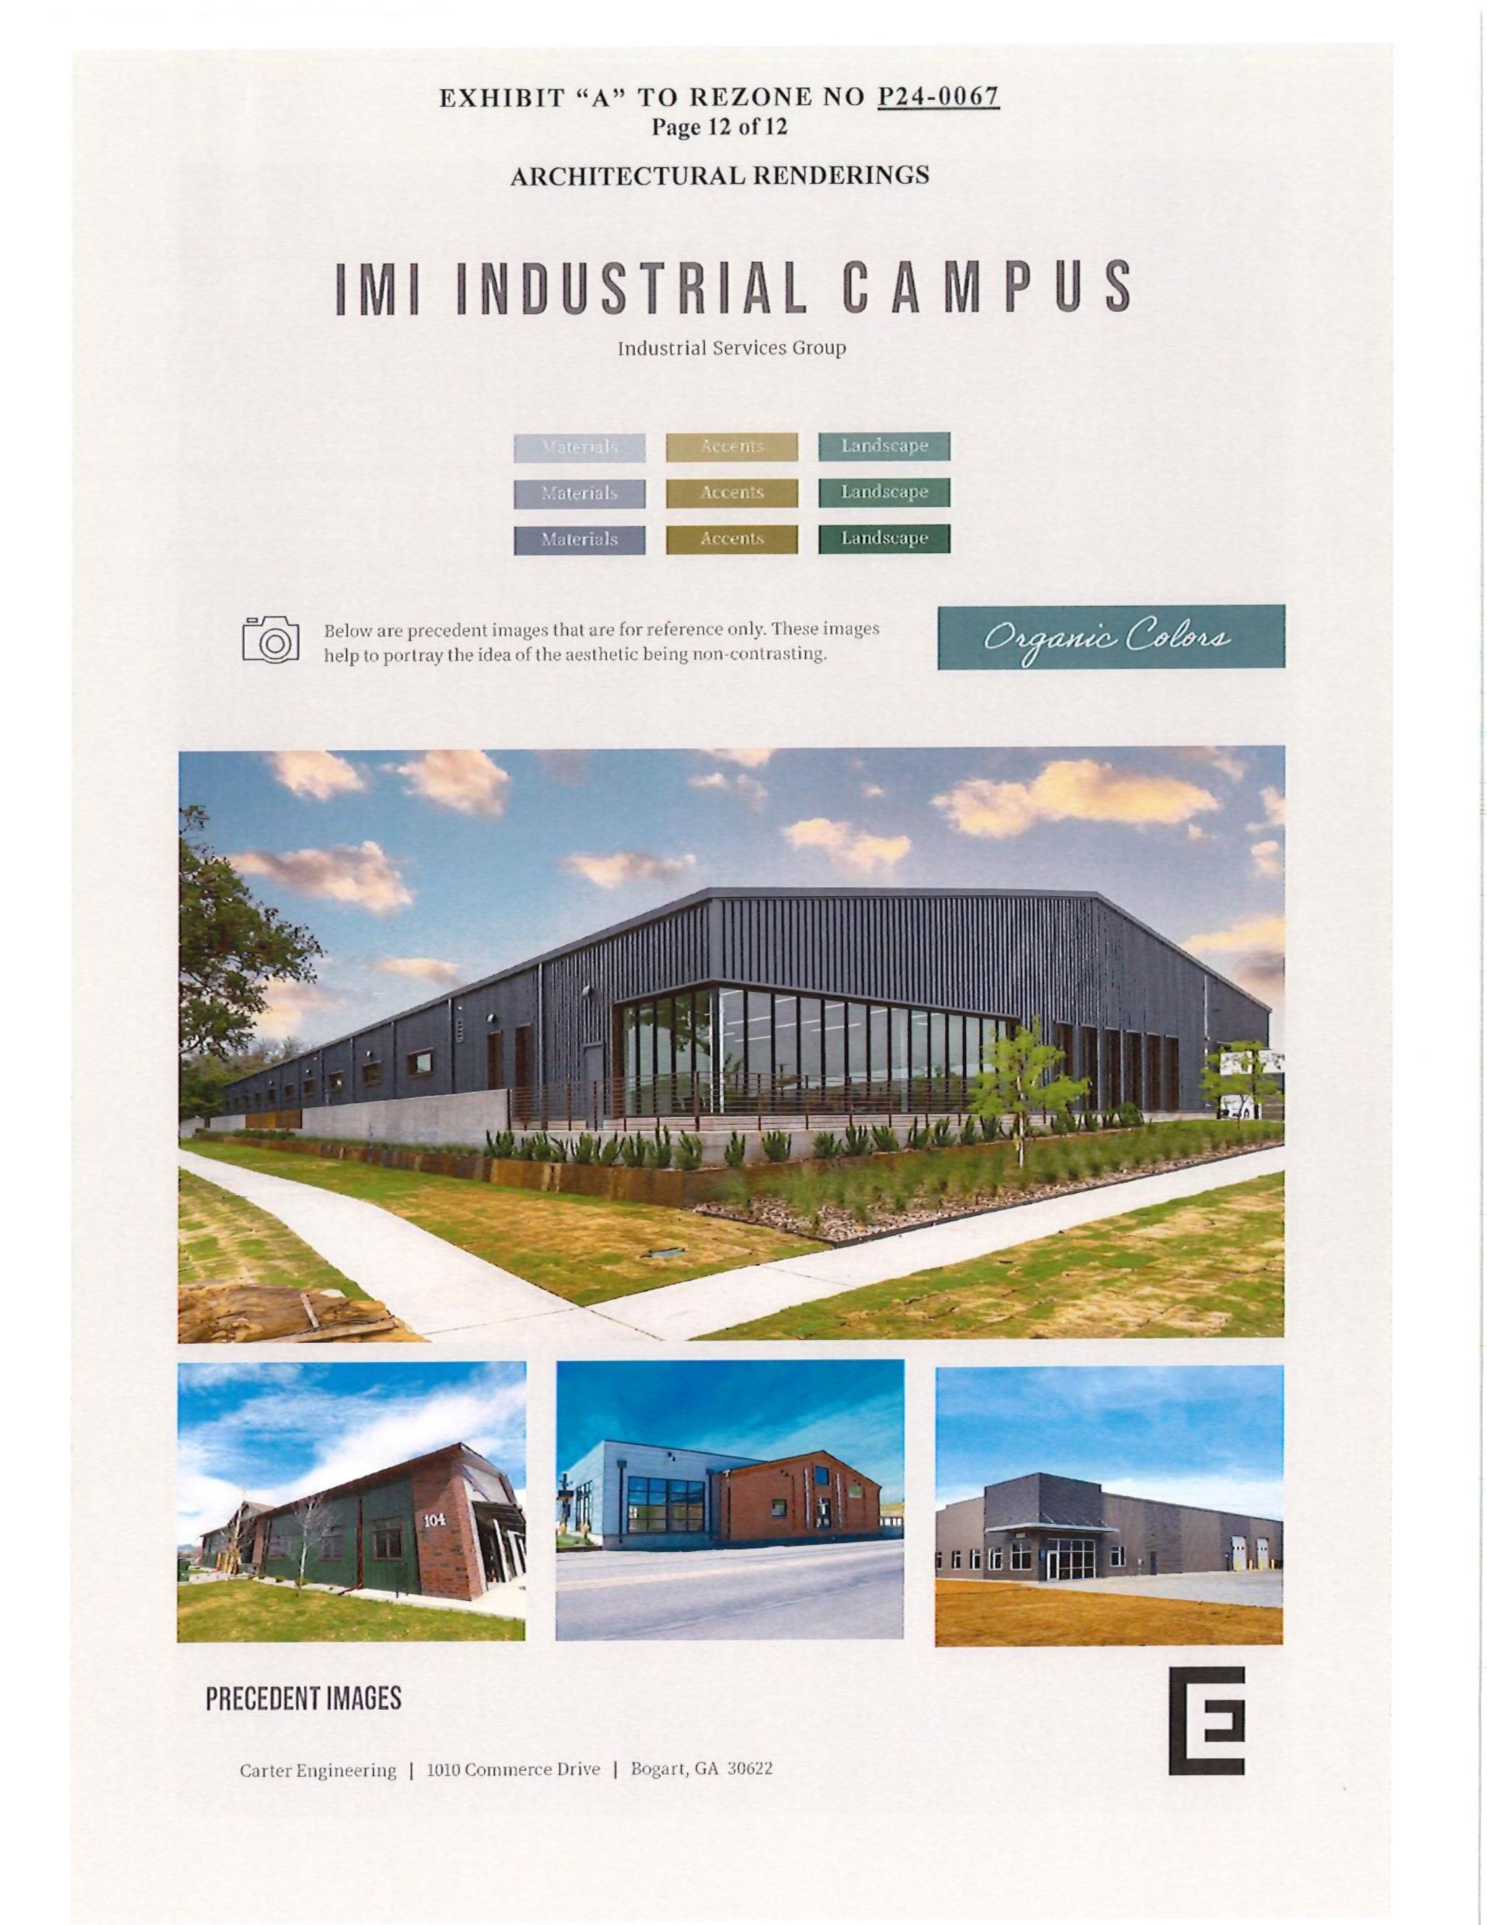
Architectural Images

Slide 14
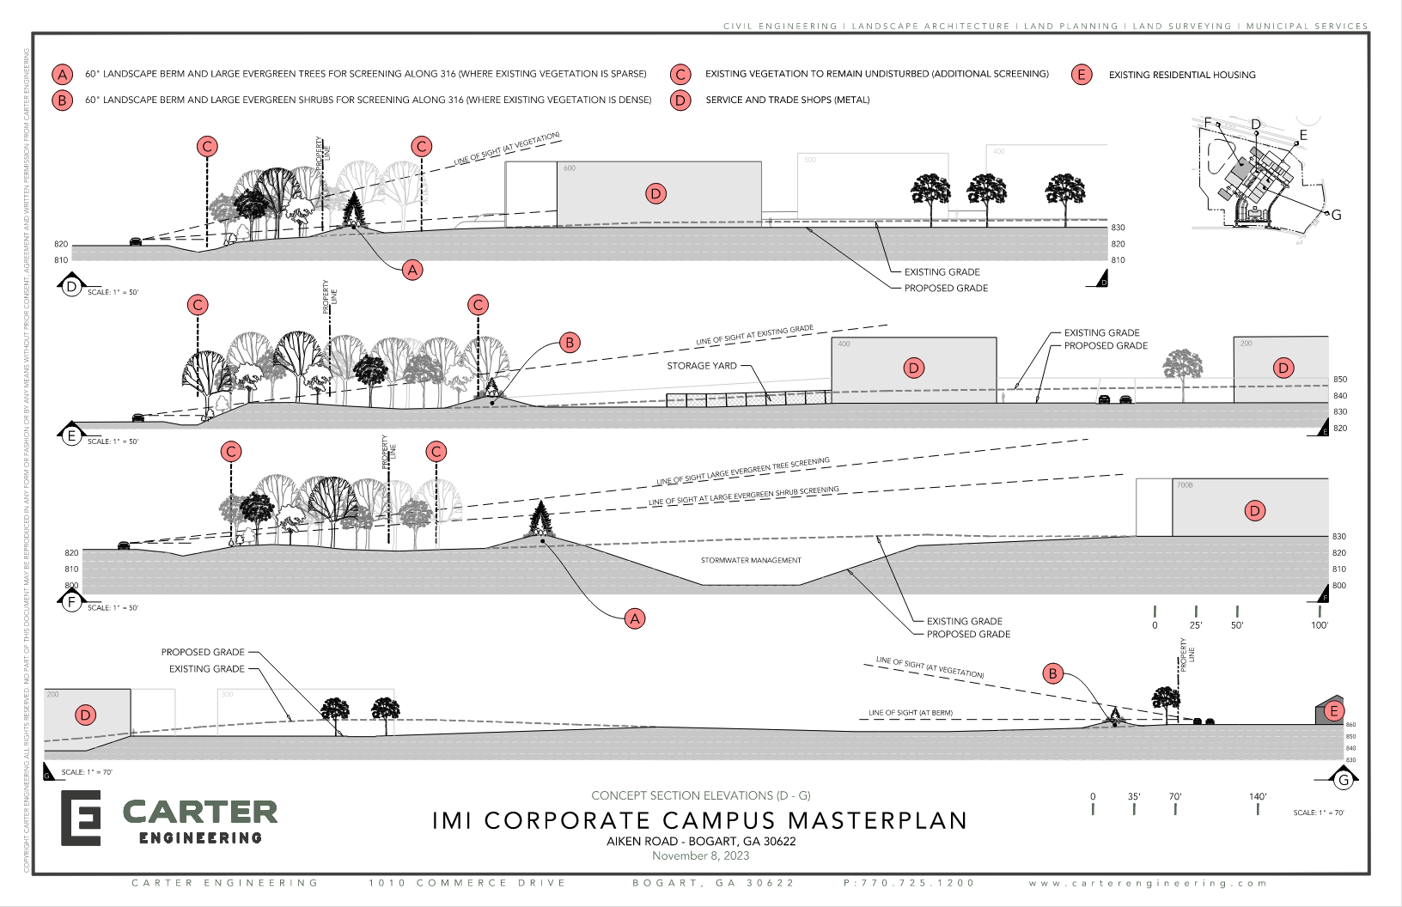
Architectural Images

Slide 15
Staff Recommendation
Based on Board of Commissioners policies, decision-making criteria, and standards outlined in the development codes of Oconee County, staff recommends conditional approval of the request to amend previous conditions of rezoning P24-0067 for areas within unincorporated Oconee County being ±45.6 acres subject to the following conditions to be fulfilled at the expense of the owner/developer:
1. Development design and structures shall meet or exceed the standards indicated on the concept plan, narrative, representative architectural sketches, and other documents submitted with the zoning application and attached hereto. This condition shall not construe approval of any standard that is not in conformity with the Unified Development Code.
2. The owner at their own expense shall construct the improvements required by the County for public water for the subject property and shall convey the same to the County, free of all liens. Said improvements shall include all on-site improvements and such off-site improvements as are required by the County to provide service to subject property.
3. At its expense, Owner shall make all right of way improvements and shall dedicate all rights of way which are required by the County after the County’s review of Owner's development plans pursuant to the County’s ordinances and regulations. All such improvements shall be shown on the preliminary site plan and site development plans for the project and no development permit shall be issued until Owner has agreed to such improvements and dedication.

Slide 16
Staff Recommendation
Based on Board of Commissioners policies, decision-making criteria, and standards outlined in the development codes of Oconee County, staff recommends conditional approval of the request to amend previous conditions of rezoning P24-0067 for areas within unincorporated Oconee County being ±45.6 acres subject to the following conditions to be fulfilled at the expense of the owner/developer:
4. In addition to vehicle use areas landscaping, buffers and Landscape Strips as required by Article 8, Landscaping and Buffers, the applicant shall install the following buffers:
  A. Along the GA 316 ROW, install an enhanced buffer measuring 50’ wide meeting the requirements of Sec. 808 to include a 10’ high berm, 6’ Imitation Wood/ Vinyl fence on top of the berm, and staggered rows of 6’ evergreen trees on top of the berm. The enhanced buffer with berm shall not disturb the areas of existing vegetation as indicated on the concept plan and no stormwater facilities or drainage easements shall be within the buffer area. The enhanced buffer shall be outside of any area required to be set aside by GDOT for future GA 316 ROW.
  B. Along the west side of the proposed driveway facing Pete Dickens Rd. install a buffer meeting the requirements of Sec. 808 to include a 5’ high berm, 6’ Imitation Wood/ Vinyl fence on top of the berm, and staggered rows of 6’ evergreen trees on top of the berm. This berm shall be outside of and not conflict with any proposed utilities or utility easement and shall extend from Aiken Road to the connecting buffer along GA 316.
  C. Along all property lines adjacent to existing residential uses or zoning, install an 80’ wide buffer meeting the requirements of section 808 with a 10’ high berm, 6’ Imitation Wood/ Vinyl fence on top of the berm, and staggered rows of 6’ evergreen trees on top of the berm.
  D. On the site development plan and landscape plan, the buffer or landscape strip widths shall be expanded to accommodate the berms as indicated.
  E. All berms shall have a minimum slope of approximately 2:1.
  F. No septic area or stormwater ponds and associated stormwater easements shall be allowed within buffer areas.
  G. All indicated buffer areas shall have irrigation systems.

Slide 17
Staff Recommendation
Based on Board of Commissioners policies, decision-making criteria, and standards outlined in the development codes of Oconee County, staff recommends conditional approval of the request to amend previous conditions of rezoning P24-0067 for areas within unincorporated Oconee County being ±45.6 acres subject to the following conditions to be fulfilled at the expense of the owner/developer:
5. All required and enhanced buffers, landscaping and berms shall be installed prior to the first building Certificate of Occupancy.
6. No structural buffers may be placed within required stream buffers or conservation corridors.
7. The “Main Office” shall have 80% brick and stone facades, with up to 20% metal accent materials.
8. The architectural standards for all other buildings shall meet or exceed the standards as indicated in the Oconee County Board of Commissioners zoning resolution P24-0067.

Slide 18
Planning Commission Recommendation
Planning Commission recommends approval subject to the conditions recommended by staff.

Slide 19
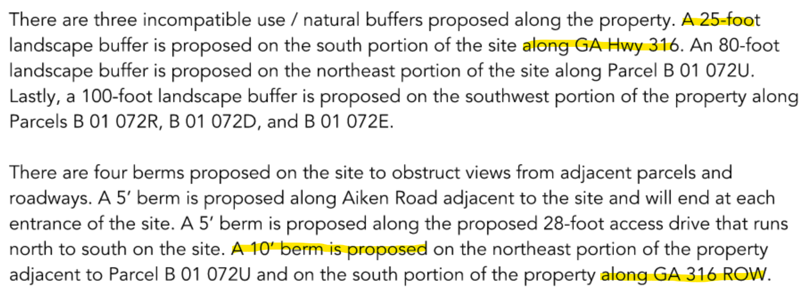
Narrative exhibit

Slide 20
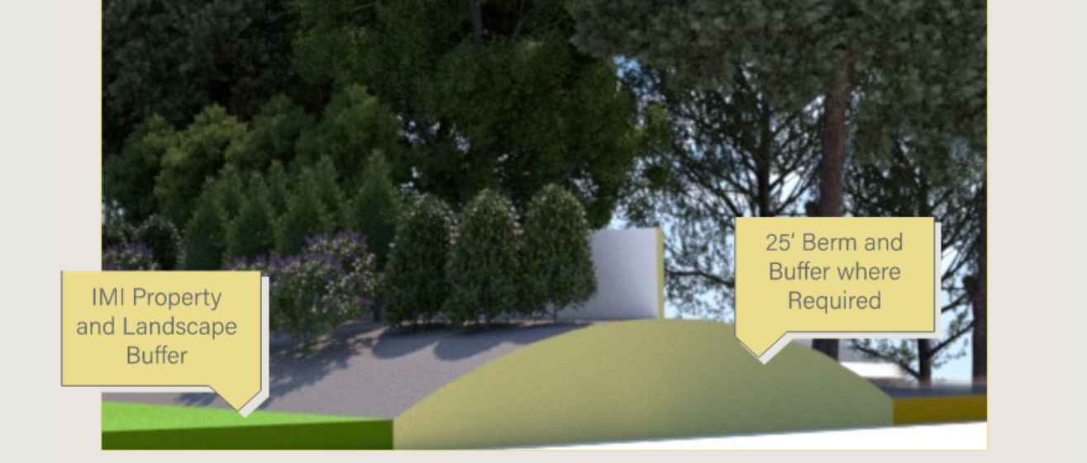
Current Narrative exhibit vs Original application exhibit

Slide 21
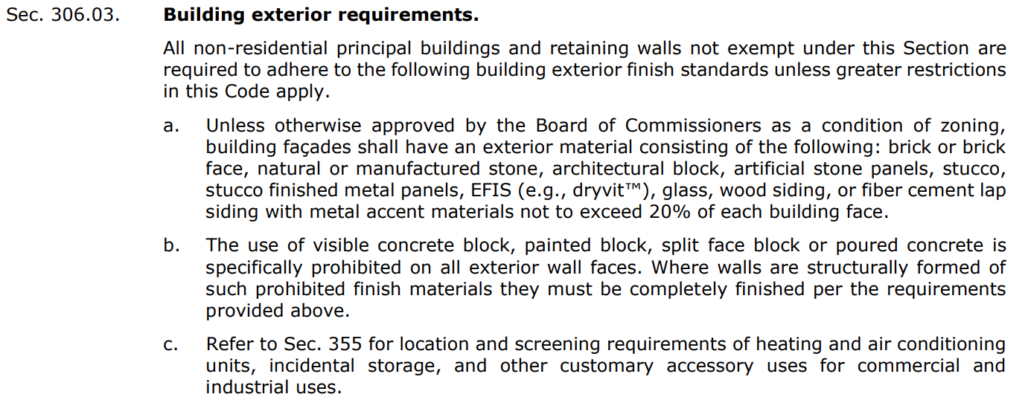

Slide 22
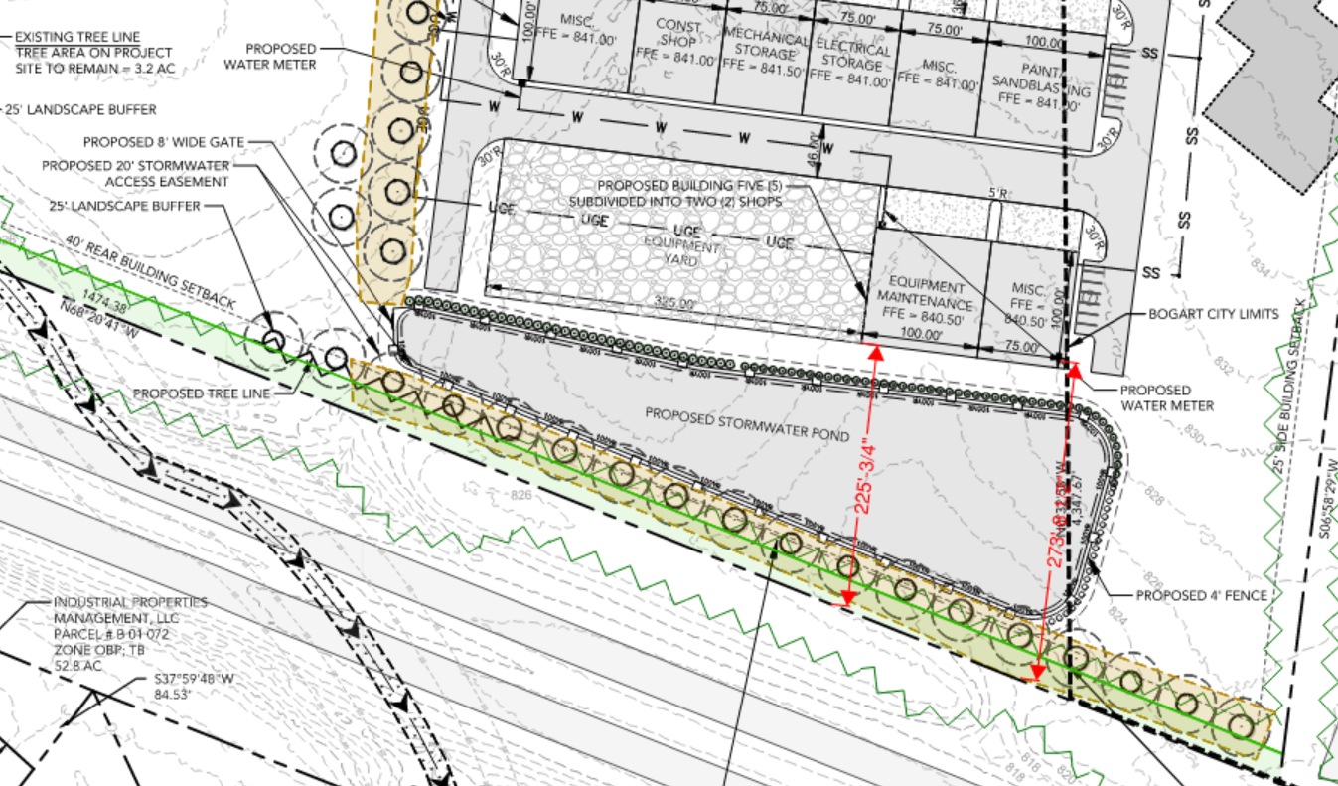
Current Concept Plan

Slide 23
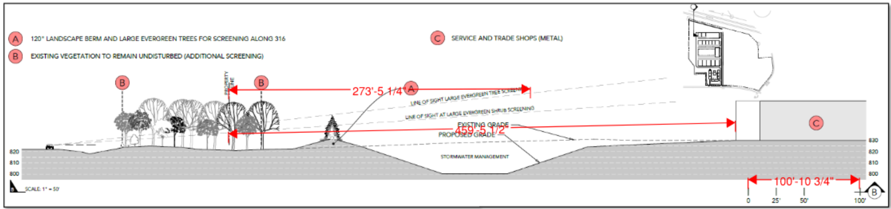
Berm Detail

