Slide 1


Slide 2
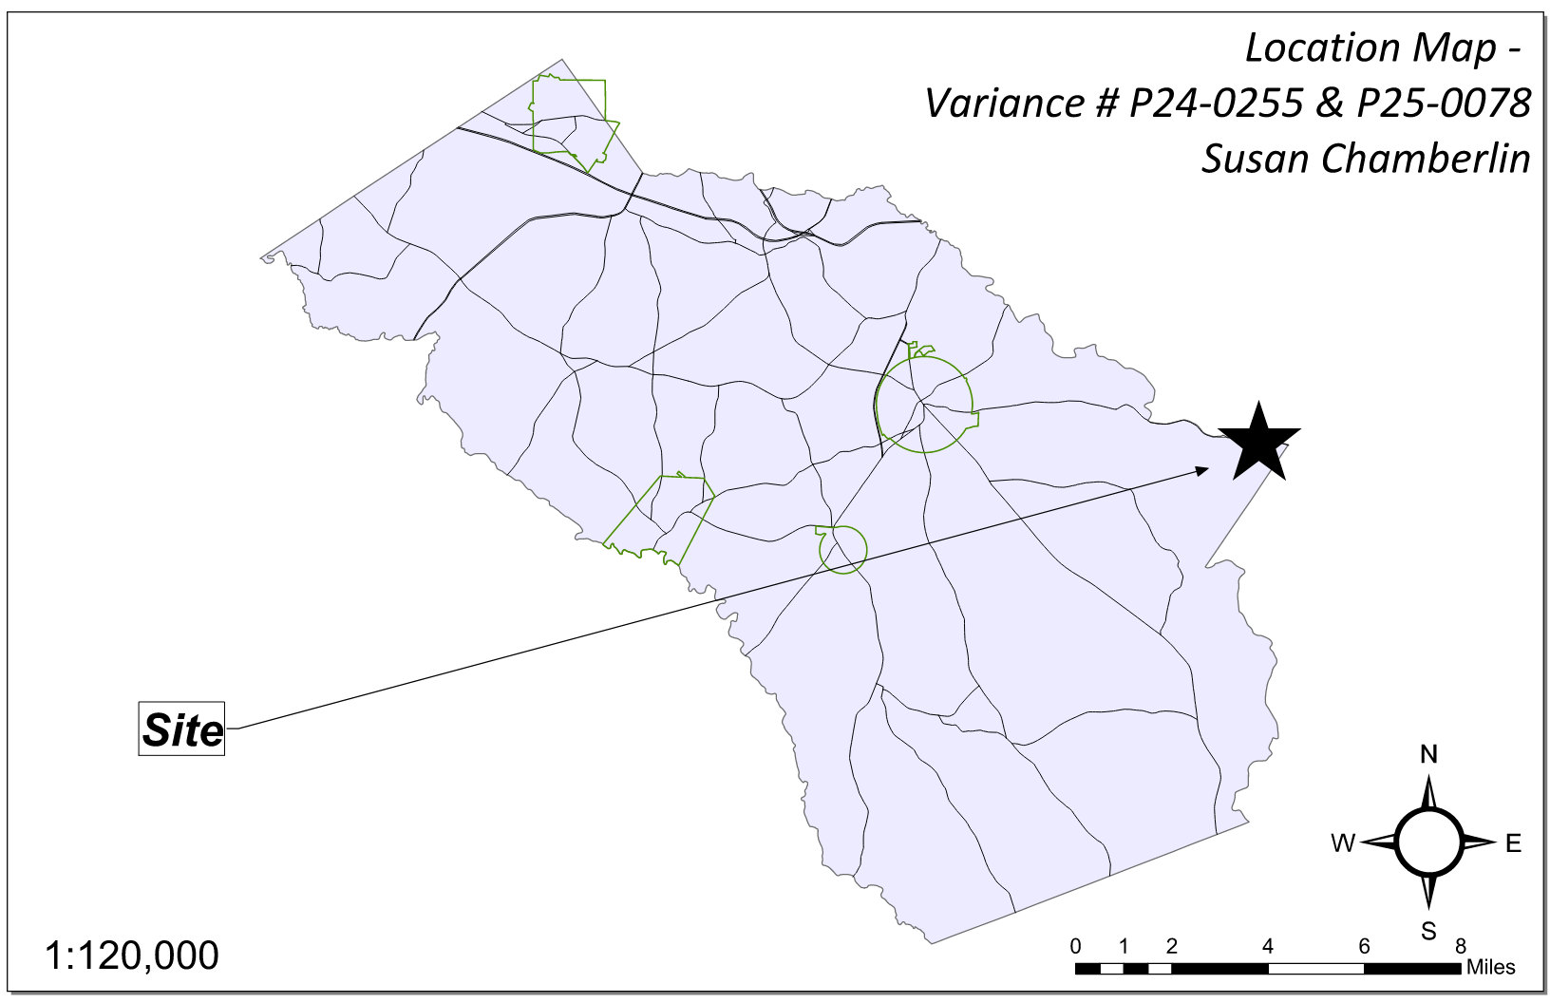
Site Location

Slide 3
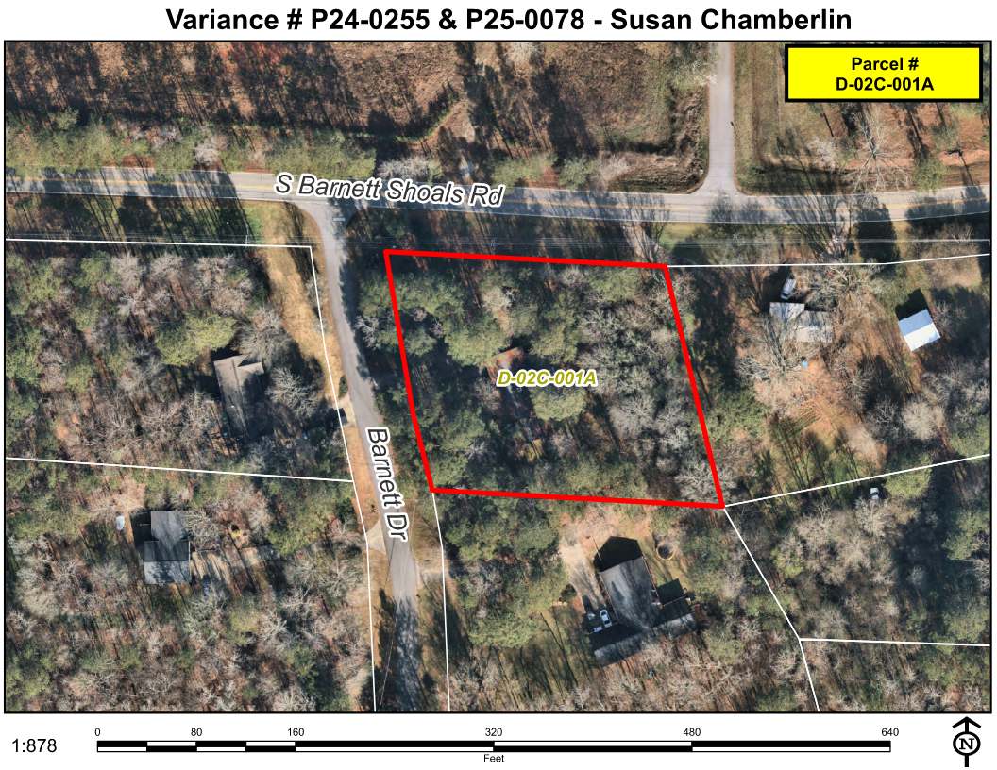
Aerial Imagery

Slide 4
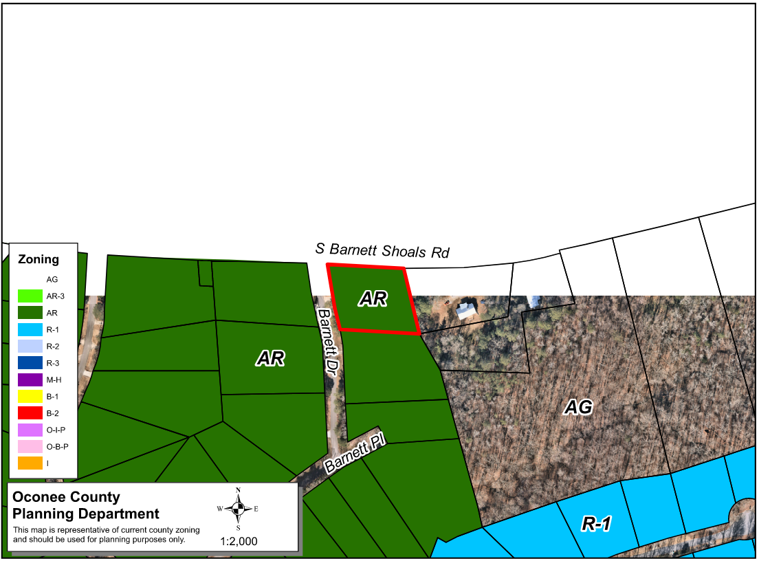
Zoning
AG

Slide 5
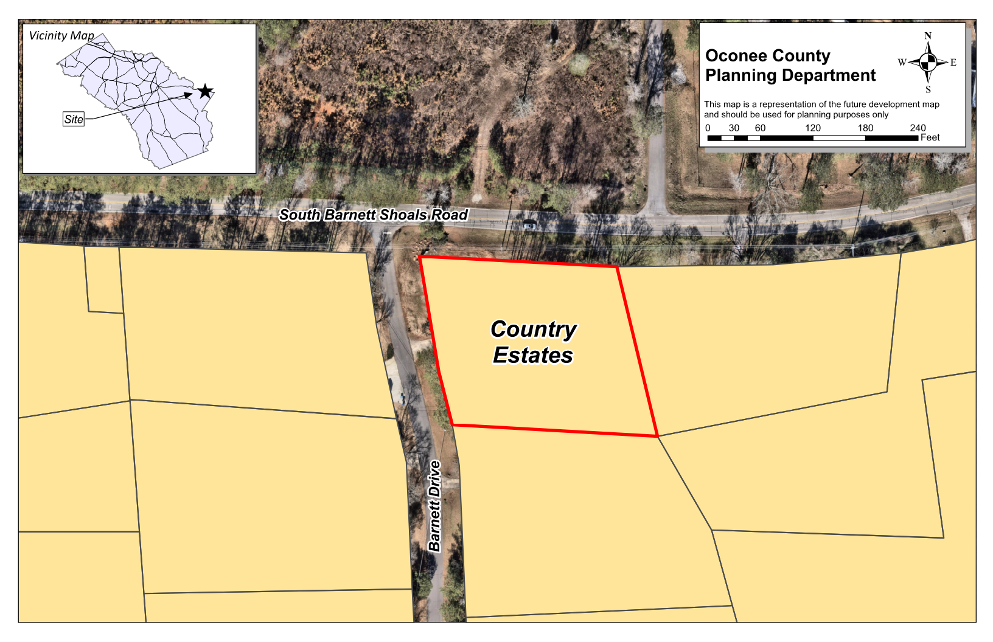
Future Development

Slide 6
Summary of Request
P24-0255
A special exception variance from Oconee County Unified Development Code Section 348.a, to reduce the required private freestanding garage setback from 200 feet to 34.4 feet along Barnett Shoals Dr. and 38.1 feet along Barnett Dr. P25-0078 A special exception variance from Oconee County Unified Development Code Article 4 Section 410.01 and Table 4.1 to reduce the front yard setback along South Barnett Shoals Road from 40 feet to 34.4 feet.

Slide 7
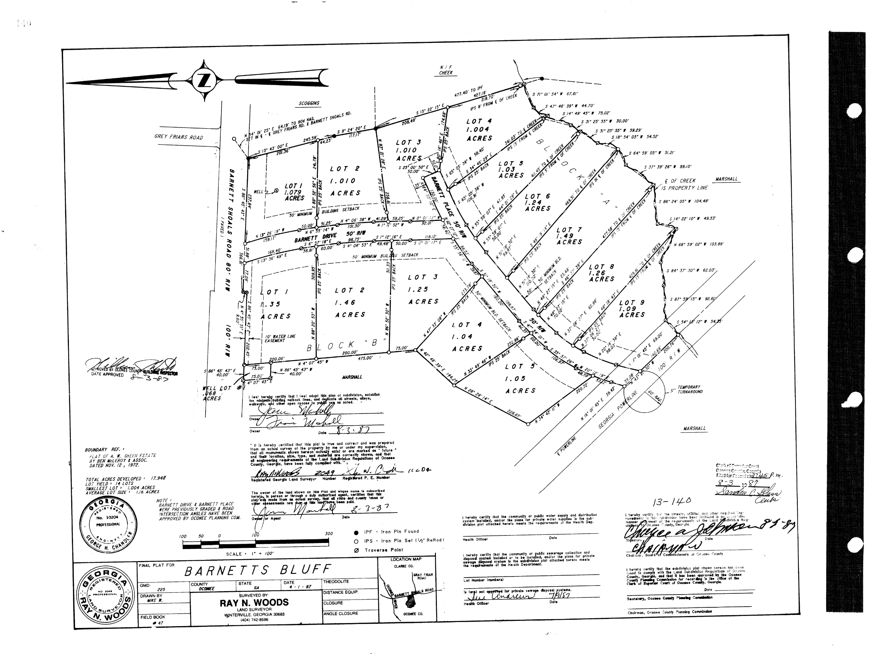
Recorded Plat

Slide 8
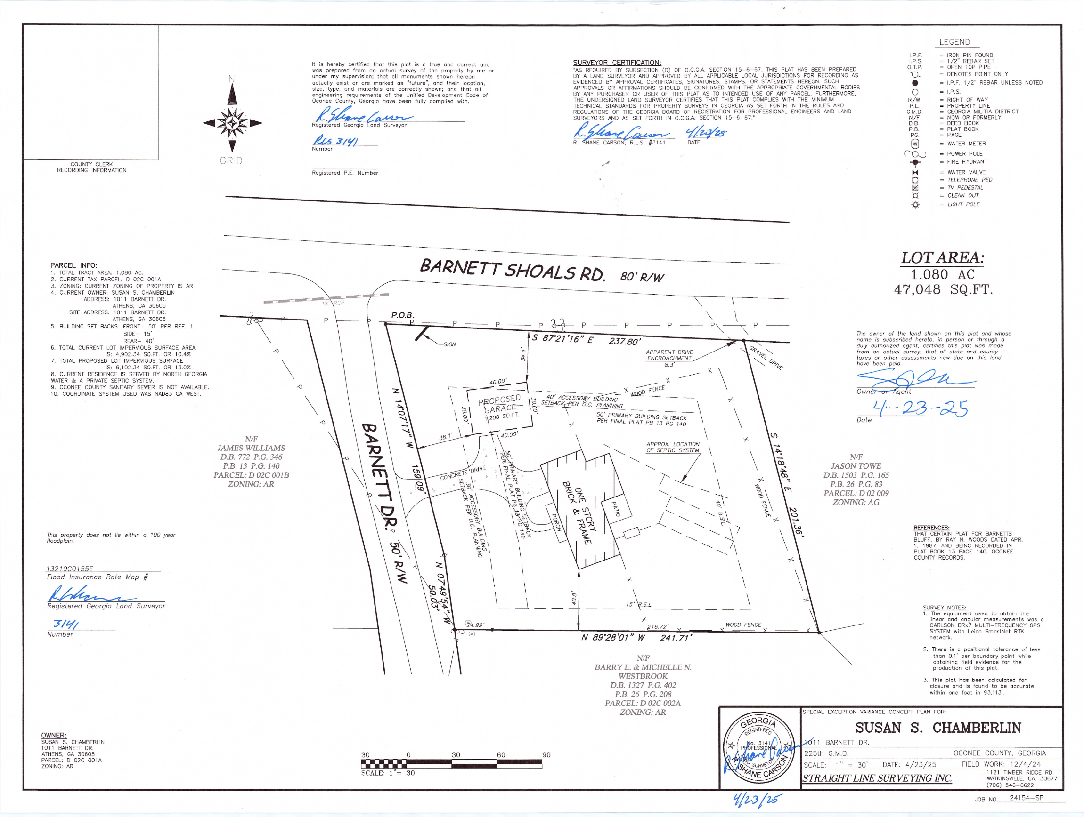
Concept Plan

Slide 9
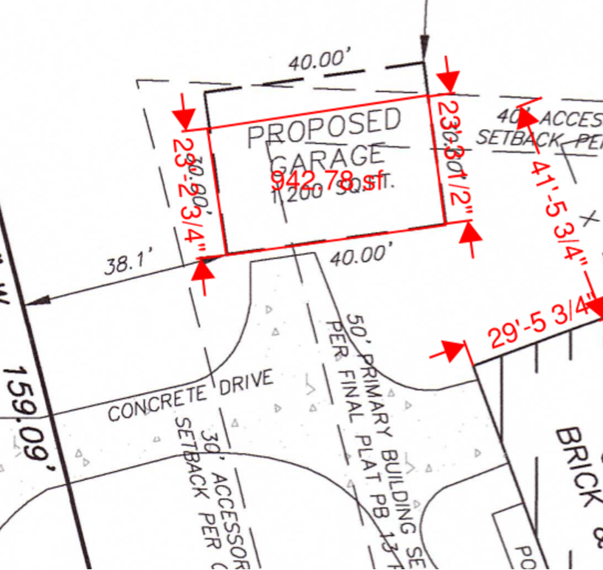

Slide 10
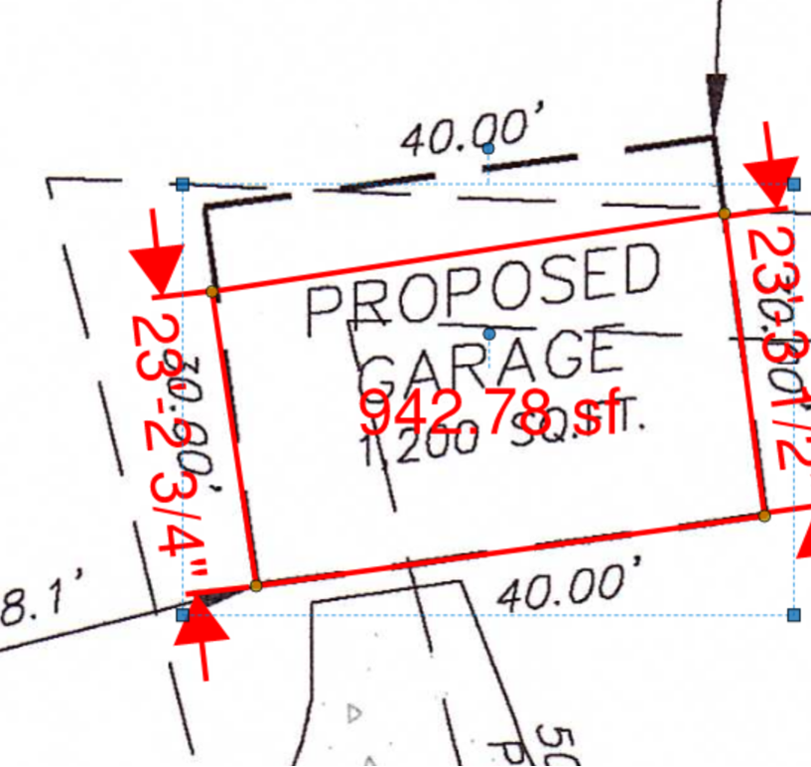

Slide 11
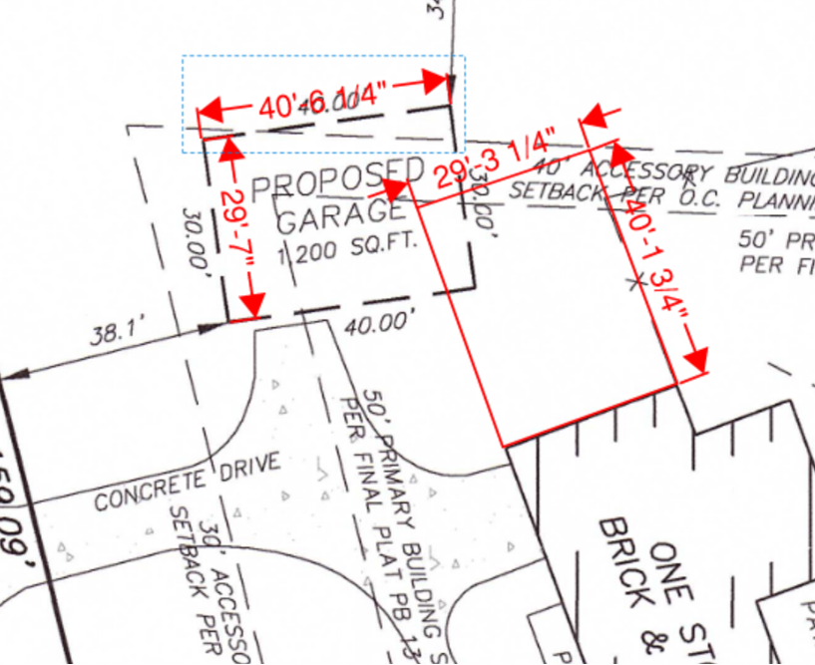

Slide 12
Staff Recommendation – P24-0255 & P25-0078
Based upon the standards and limitations for special exception variance approval, these requests do meet all necessary conditions to grant special exception variances to the garage setback standards. Should the present requests be approved, staff recommends the following conditions to be fulfilled at the owner/developer’s expense.
1. Development design and structures shall meet or exceed the standards indicated on the concept plan, narrative, representative architectural sketches, and other documents submitted with the variance application and attached hereto. This condition shall not construe approval of any standard that is not in conformity with the Unified Development Code.
2. The property owner shall restore the roadside swale along Barnett Dr. that was re-graded after January 2024 during the tree removal. The swale restoration shall be completed to the satisfaction of Public Works, prior to the issuance of a building permit.

