Slide 1


Slide 2
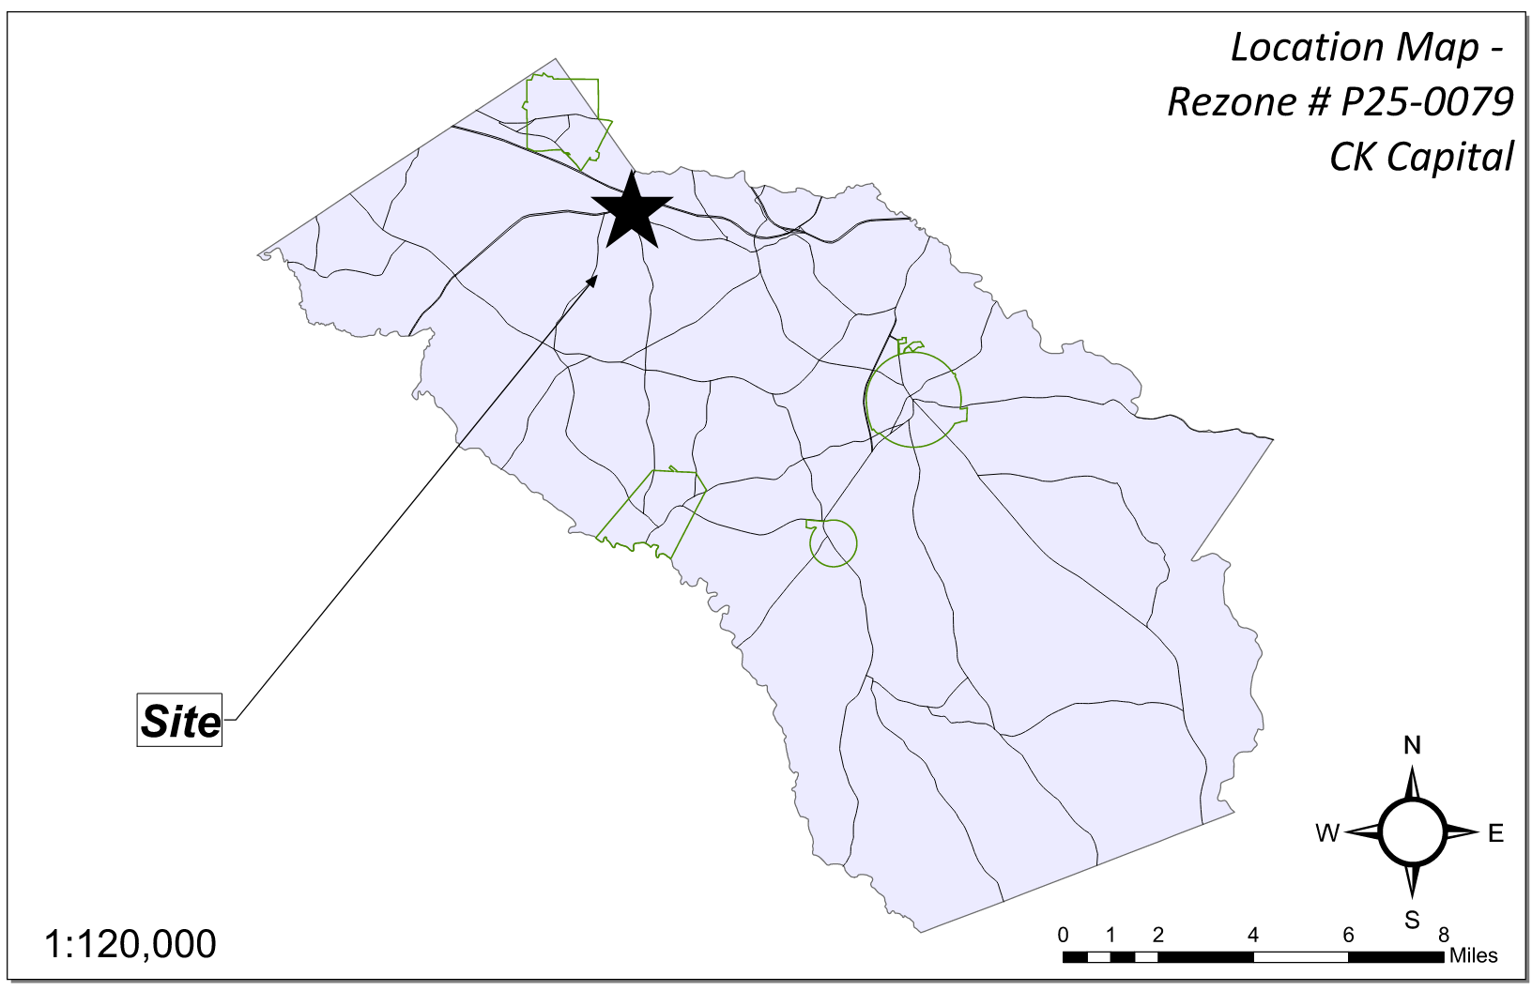
Site Location

Slide 3
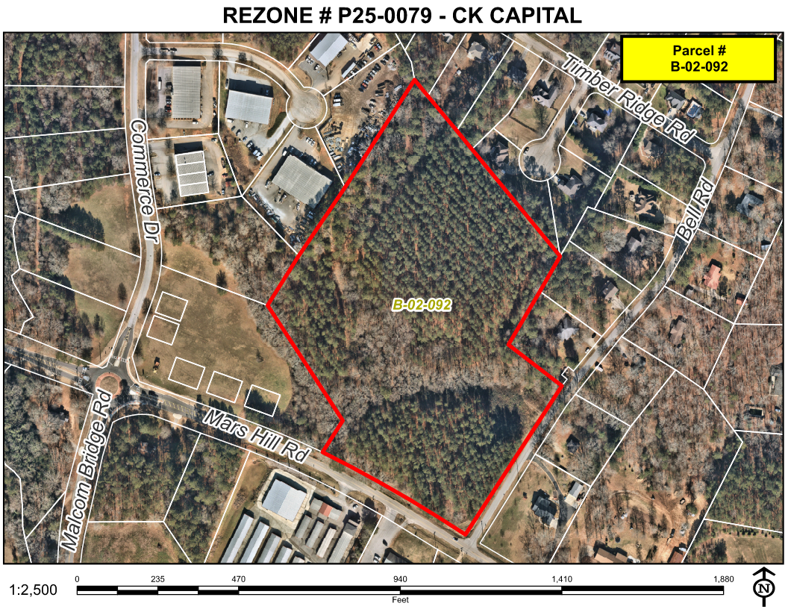
Aerial Imagery

Slide 4
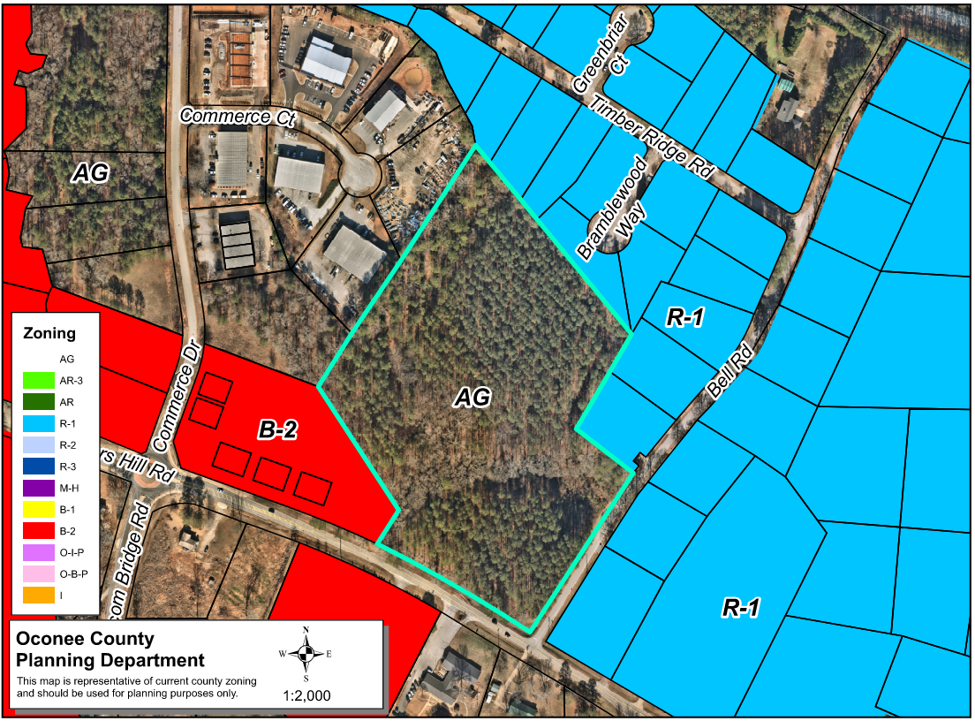
Zoning
AG

Slide 5
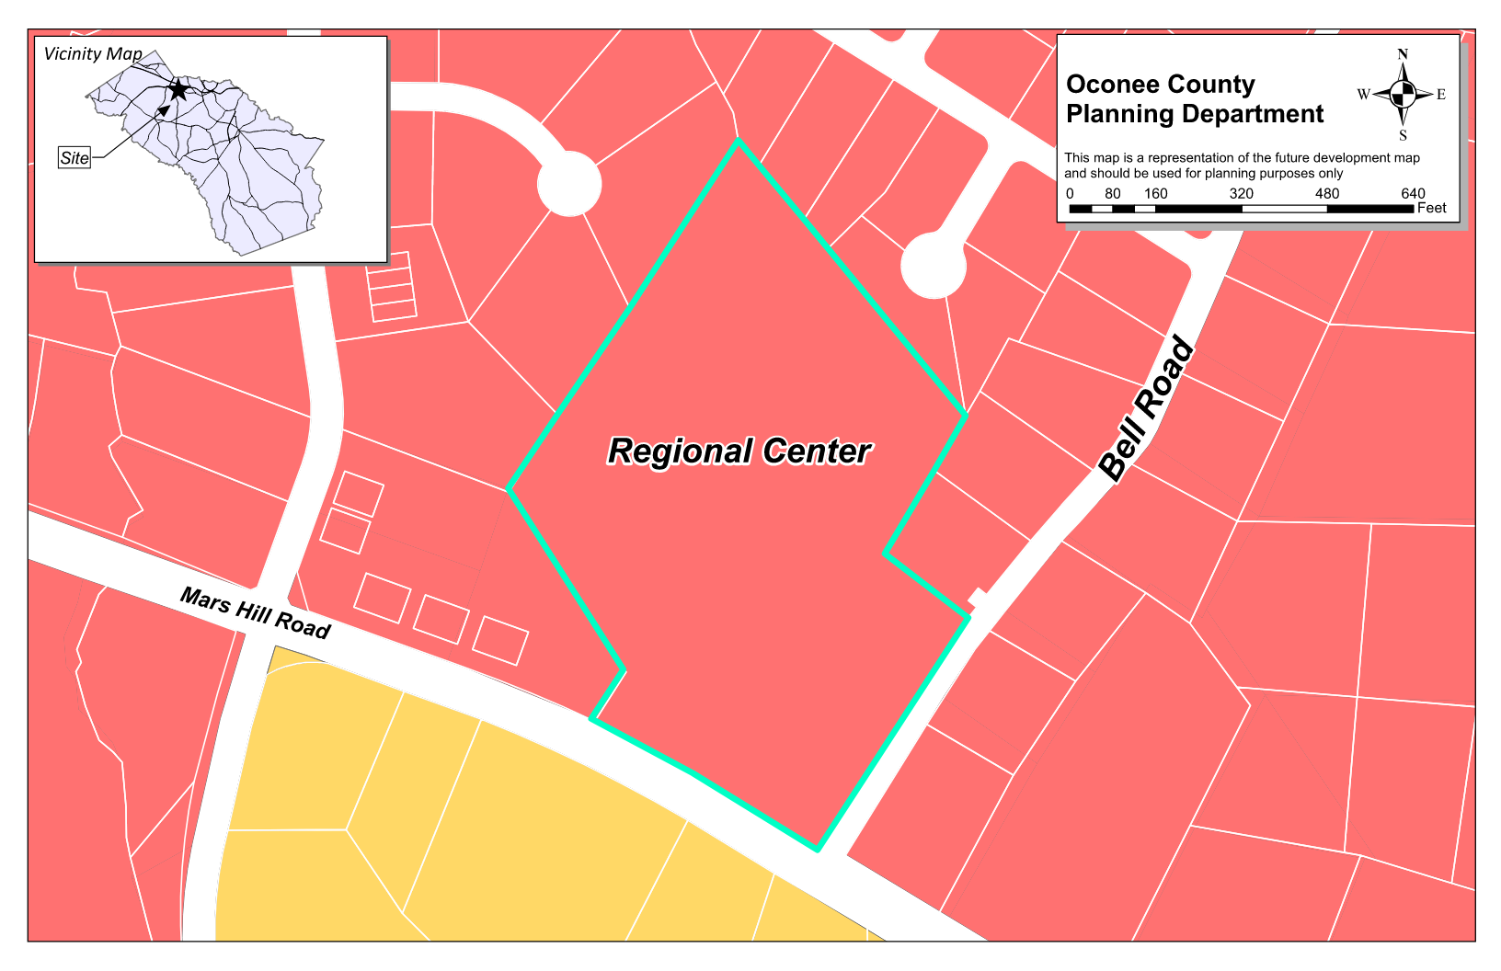
Future Development

Slide 6
Summary of Request
Rezoning from AG (Agricultural) to a mix of B-2 (Highway Business), OBP (Office-Business Park) and OIP (Office-Institutional-Professional)

Slide 7
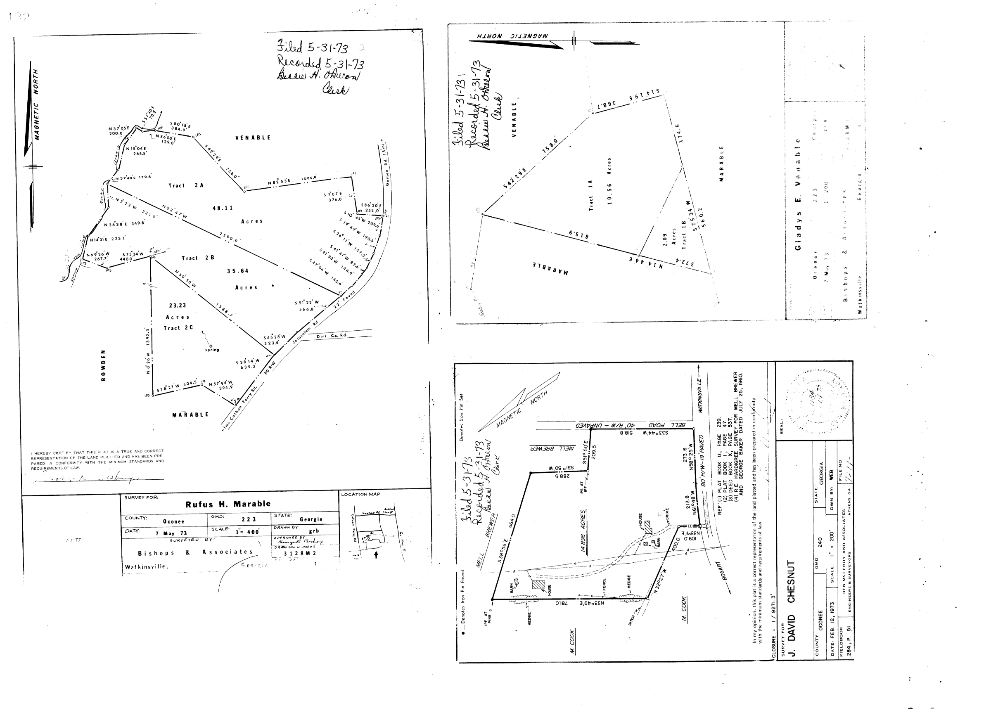
Recorded Plat

Slide 8
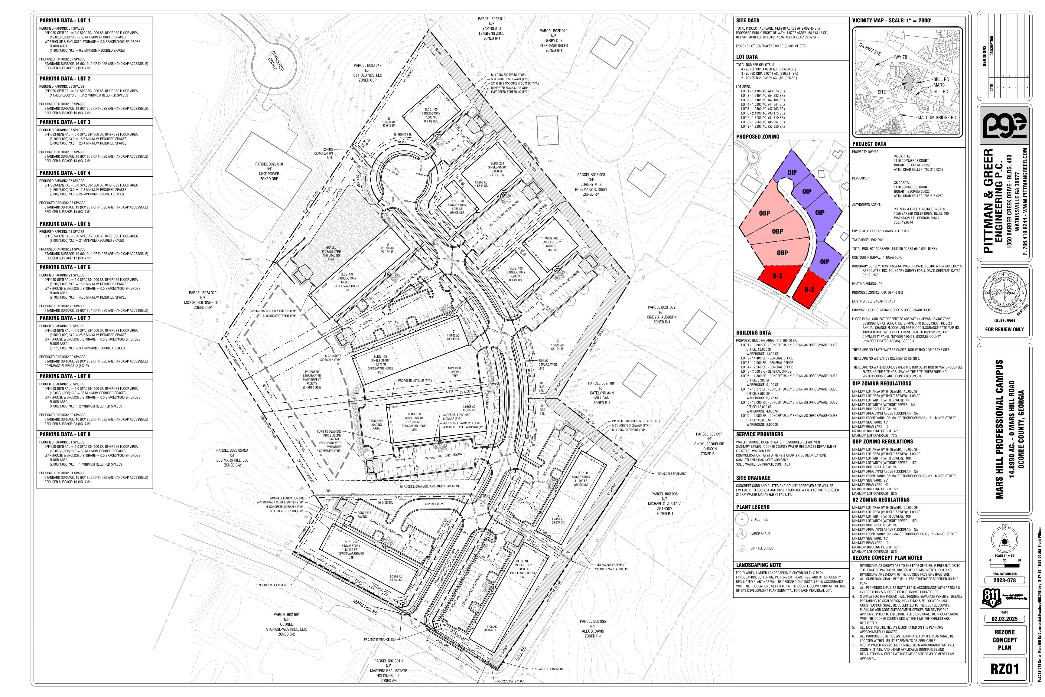
Concept Plan

Slide 9
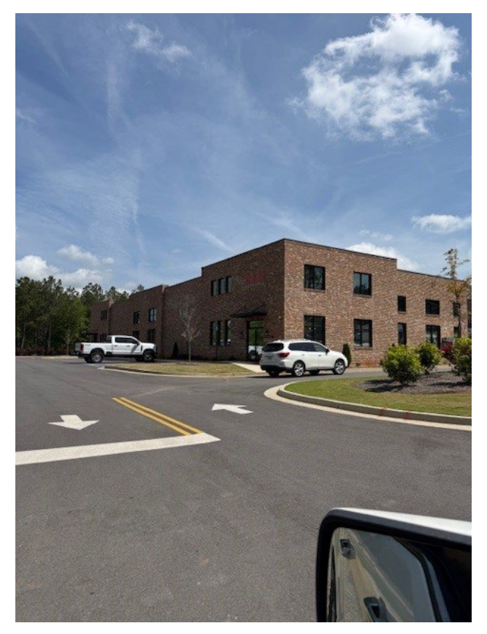
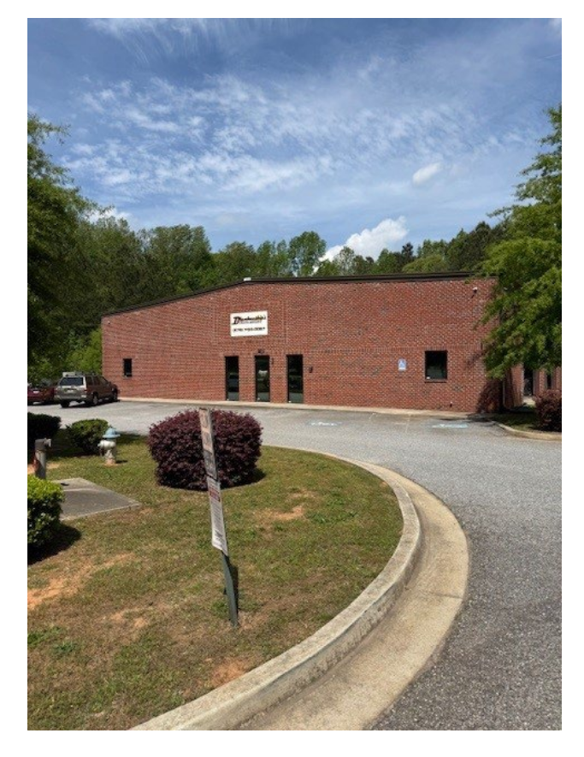
Architectural Images

Slide 10
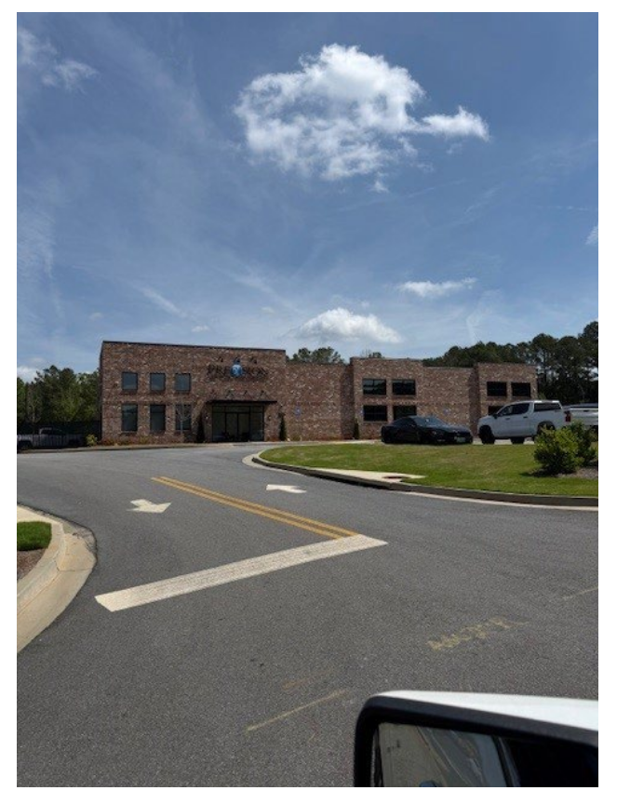
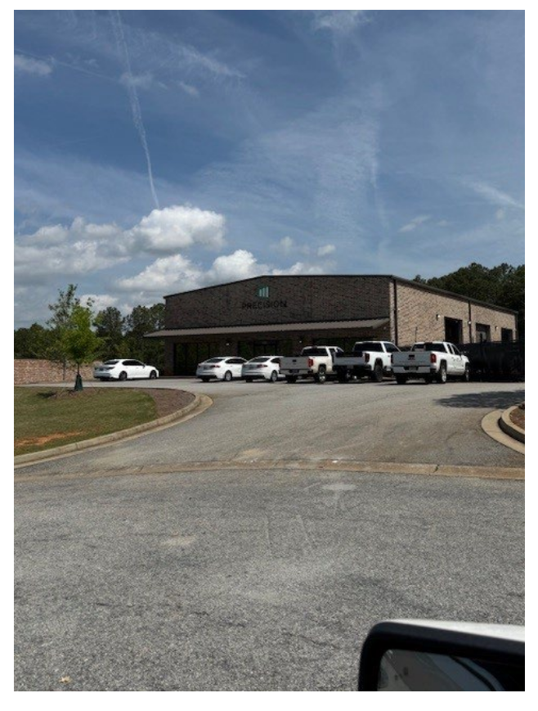
Architectural Images

Slide 11
Staff Recommendation
Based on Board of Commissioners policies, decision-making criteria, and standards outlined in the development codes of Oconee County, staff recommends conditional approval of this request to rezone to OBP and OIP subject to the following conditions to be fulfilled at the expense of the owner/developer:
1. Development design and structures shall meet or exceed the standards indicated on the concept plan, narrative, representative architectural sketches, and other documents submitted with the zoning application and attached hereto. This condition shall not construe approval of any standard that is not in conformity with the Unified Development Code.
2. The owner at their own expense shall construct the improvements required by the County for public water and public waste services for the subject property shall convey same to the County, free of all liens. Said improvements shall include all on-site improvements and such off-site improvements as are required by the County to provide service to subject property.
3. At its expense, Owner shall make all right of way improvements and shall dedicate all rights of way which are required by the County after the County’s review of Owner's development plans pursuant to the County’s ordinances and regulations. All such improvements shall be shown on the preliminary site plan and site development plans for the project and no development permit shall be issued until Owner has agreed to such improvements and dedication.

Slide 12
Staff Recommendation
Based on Board of Commissioners policies, decision-making criteria, and standards outlined in the development codes of Oconee County, staff recommends conditional approval of this request to rezone to OBP and OIP subject to the following conditions to be fulfilled at the expense of the owner/developer:
4. The zoning for the proposed 9 lots shall be as follows:
Proposed Lot # Zoning
1 OIP
2 OIP
3 OIP
4 OIP
5 OIP
6 OBP
7 OBP
8 OBP
9 OBP
5. At least 80 percent of exterior wall surfaces of all buildings and structures shall be either brick, stone, brick veneer, stone veneer or glass, or combination thereof. Additional primary and accent materials are allowed as indicated in UDC Section 306.03.
6. The total building square footage shall not exceed 114,035 square feet as shown on the concept plan dated February 3, 2025, and revised May 27, 2025.

Slide 13
Staff Recommendation
Based on Board of Commissioners policies, decision-making criteria, and standards outlined in the development codes of Oconee County, staff recommends conditional approval of this request to rezone to OBP and OIP subject to the following conditions to be fulfilled at the expense of the owner/developer:
7. A 1’ no access easement along the ROW of Bell Road shall be indicated on the Final Plat.
8. Service areas and dumpsters shall be visually screened from public view by a six-foot masonry wall with façade materials matching the exterior of principal structures with black painted metal/steel enclosure doors. Enclosure doors made of wood or chain link are prohibited.
9. A revised traffic impact statement that meets the requirements of the UDC shall be submitted prior to the Site Development Plan application and indicate the required improvements to achieve a LOS-C for intersections and traffic movements in the study area as defined in the initial TIS, Table 6, dated April 18, 2025, by A&R Engineering, Inc. All road improvements shall be made at the expense of the Owner.

Slide 14
Planning Commission Recommendation
Planning Commission recommends approval subject to the conditions recommended by staff, along with an additional Condition #10: 10. The applicant shall maintain a 50’ buffer and an 8’ privacy fence along Bell Rd & the adjacent R-1 properties.

