Slide 1


Slide 2
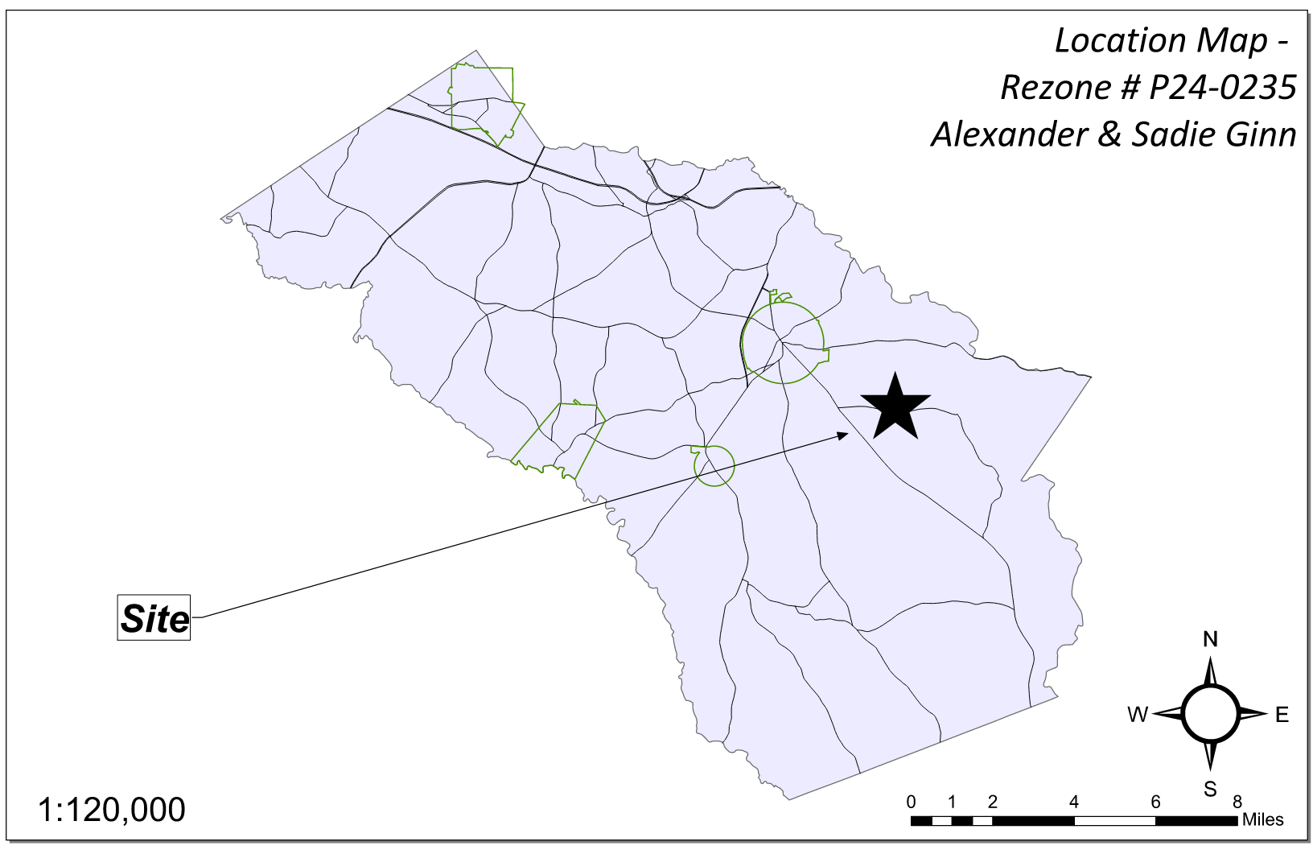
Site Location

Slide 3
Aerial Imagery

Slide 4
Zoning
AG

Slide 5
Future Development

Slide 6
Summary of Request
Rezone ±6.221 acres from AR (Agricultural Residential District) to AG (Agricultural District) with ±2.0 acres to remain AR.

Slide 7
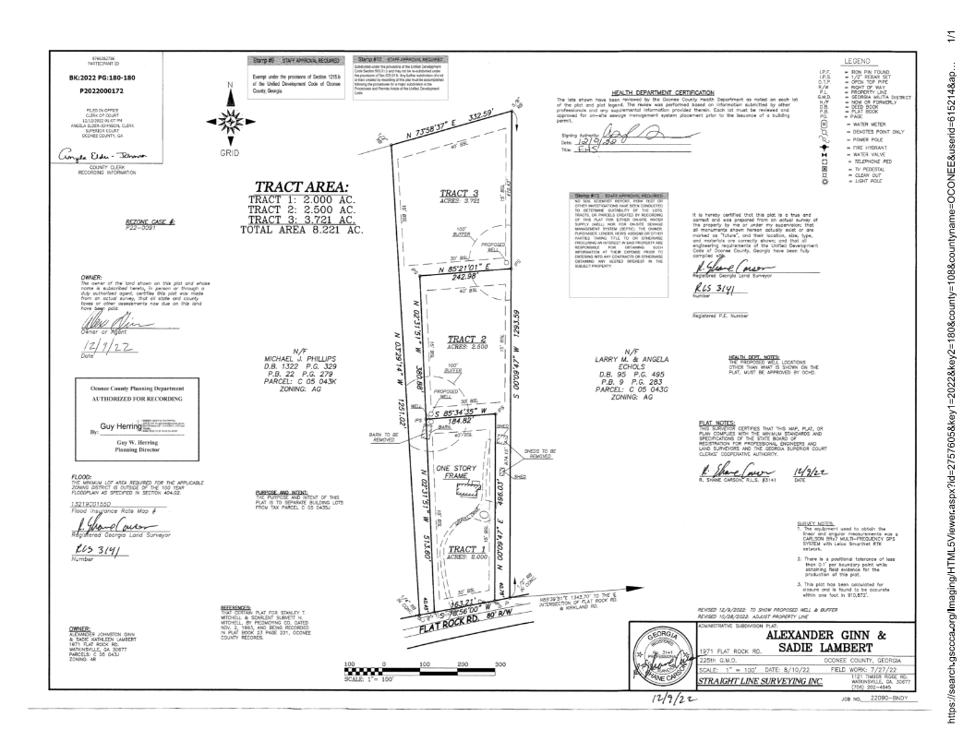
Recorded Plat

Slide 8
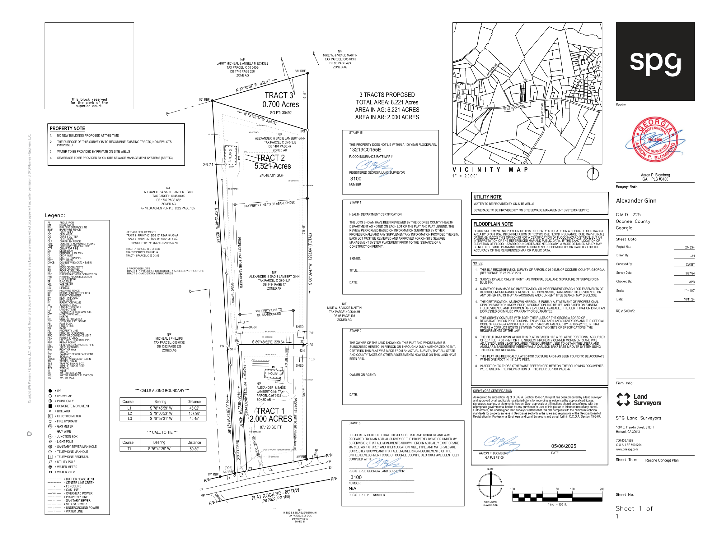
Concept Plan

Slide 9
Staff Recommendation
Based on Board of Commissioners policies, decision-making criteria, and standards outlined in the development codes of Oconee County, staff recommends conditional approval of this request to rezone to AG subject to the following conditions to be fulfilled at the expense of the owner/developer:
1. Development design and structures shall meet or exceed the standards indicated on the concept plan, narrative, representative architectural sketches, and other documents submitted with the zoning application and attached hereto. This condition shall not construe approval of any standard that is not in conformity with the Unified Development Code.
2. Any new driveway location shall be subject to approval by the Public Works Director.

Slide 10
Planning Commission Recommendation
Planning Commission recommends approval subject to the conditions recommended by staff.

