Slide 1
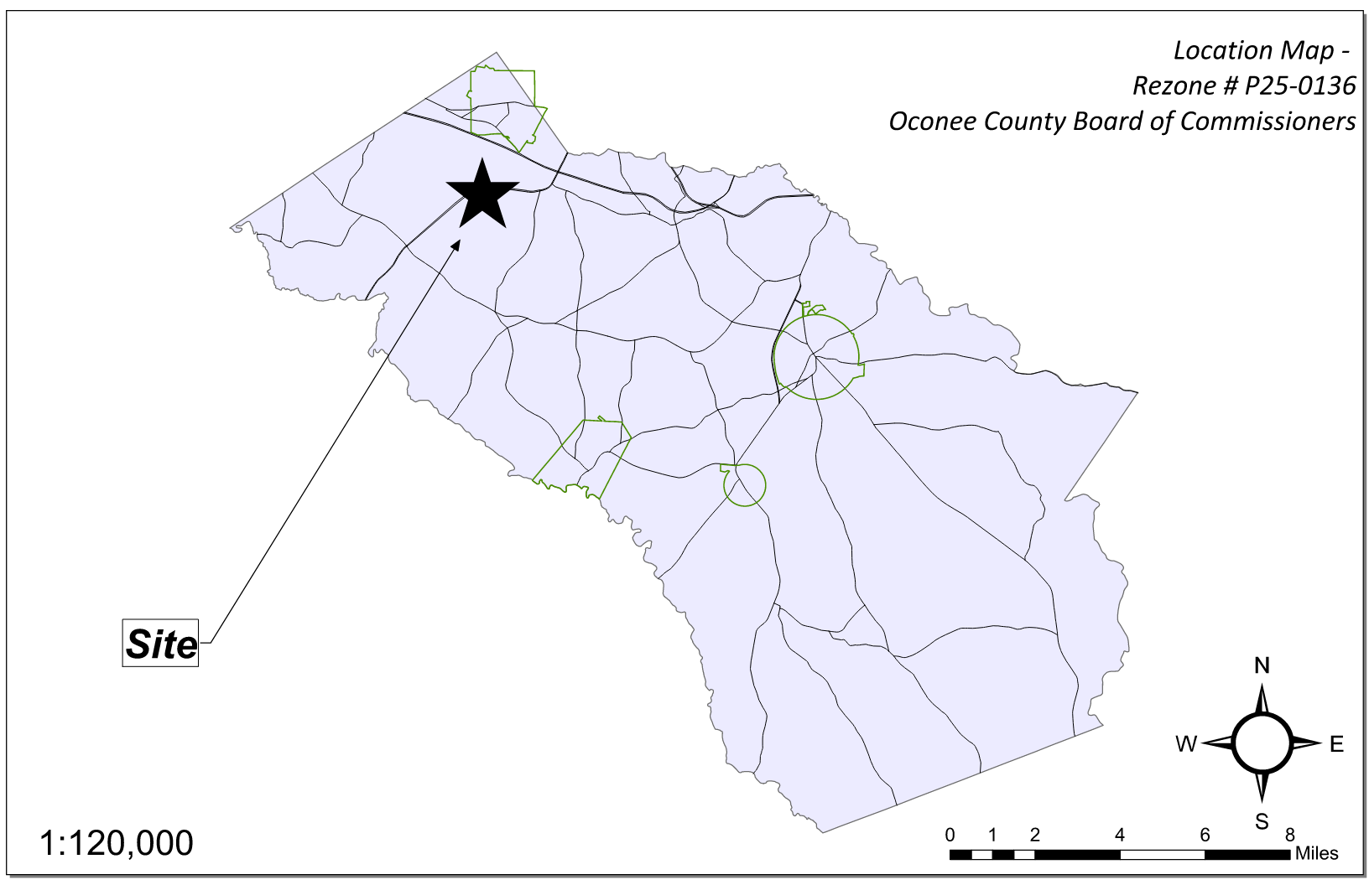
Site Location

Slide 2
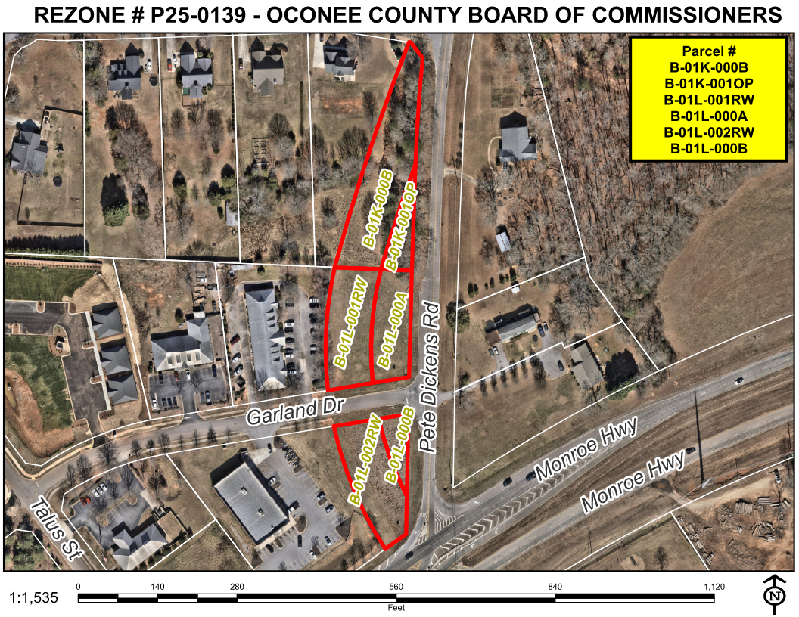
Aerial Imagery

Slide 3
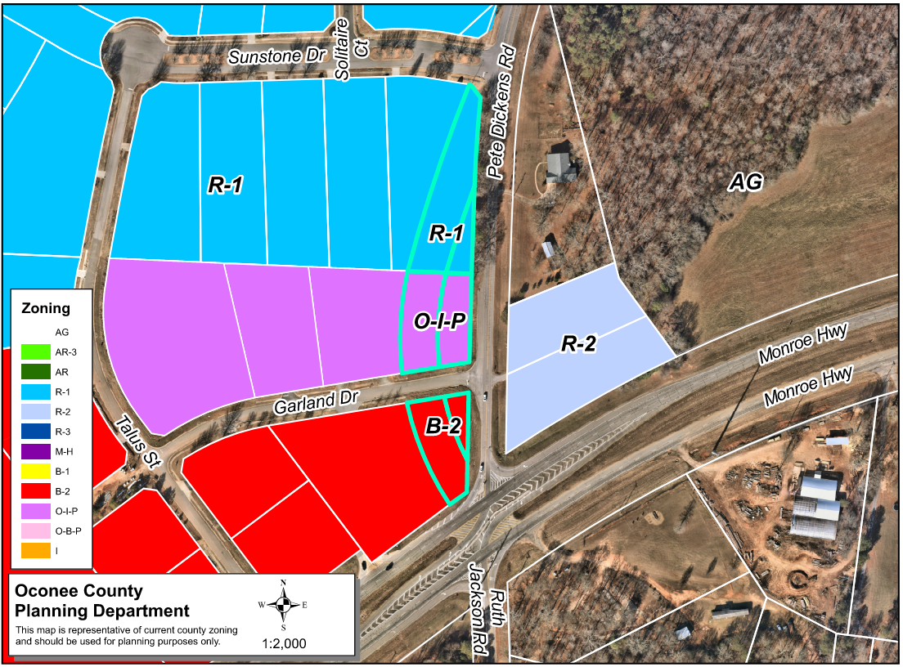
Zoning
AG

Slide 4
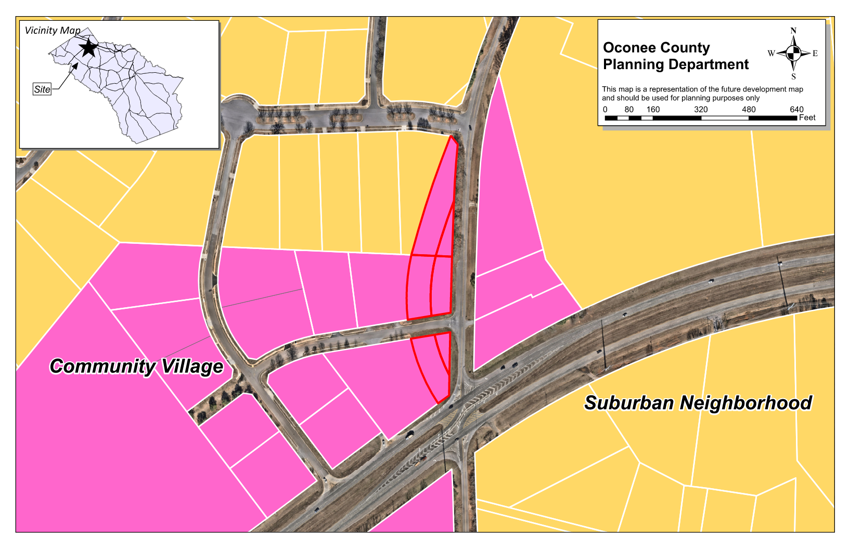
Future Development

Slide 5
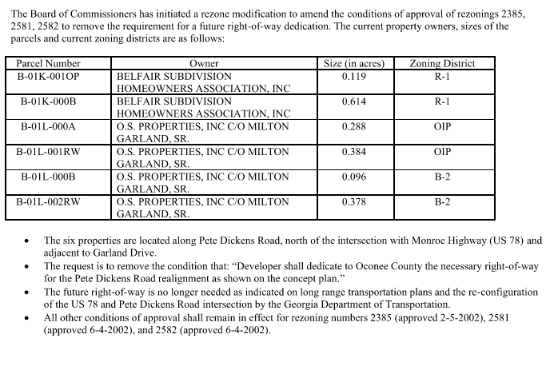
Summary of Request

Slide 6
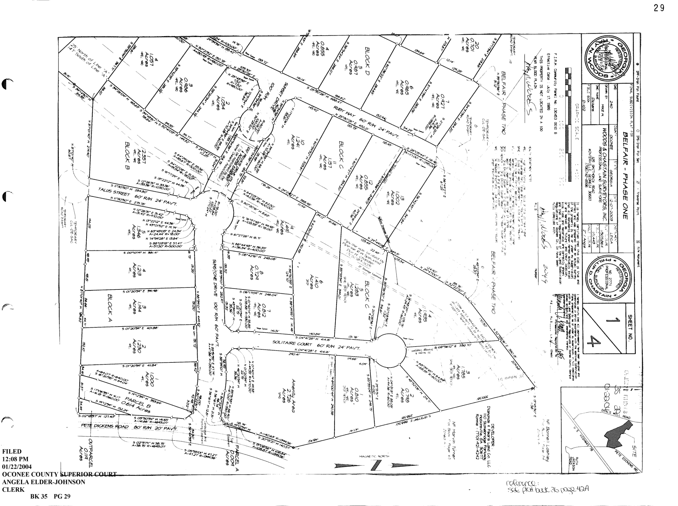
Recorded Plat

Slide 7
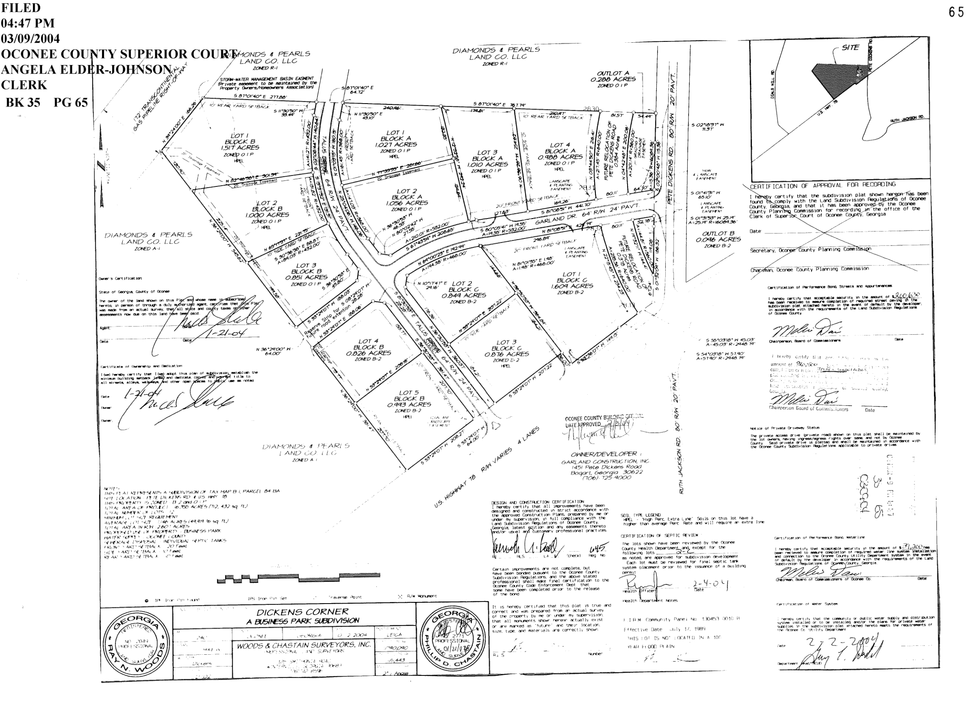
Recorded Plat

Slide 8
Staff Recommendation
Staff recommends approval of the request to amend the conditions of zoning as follows:
1. For properties zoned R-1 (parcels B-01K-001OP and B-01K-000B) from rezoning number 2385, remove condition #6: “Developer shall dedicate to Oconee County the necessary right-of-way for the Pete Dickens Road realignment as shown on the concept plan.” All other conditions of zoning shall remain in effect.
2. For properties zoned OIP (parcels B-01L-000A and B-01L-001RW) from rezoning number 2581, remove condition #5: “Developer shall dedicate to Oconee County the necessary right-of-way for the Pete Dickens Road realignment as shown on the concept plan.” All other conditions of zoning shall remain in effect.
3. For properties zoned B-2 (parcels B-01L-000B and B-01L-002RW) from rezoning number 2382, remove condition #5: “Developer shall dedicate to Oconee County the necessary right-of-way for the Pete Dickens Road realignment as shown on the concept plan.” All other conditions of zoning shall remain in effect.

