Slide 1


Slide 2
Site Location

Slide 3
Aerial Imagery

Slide 4
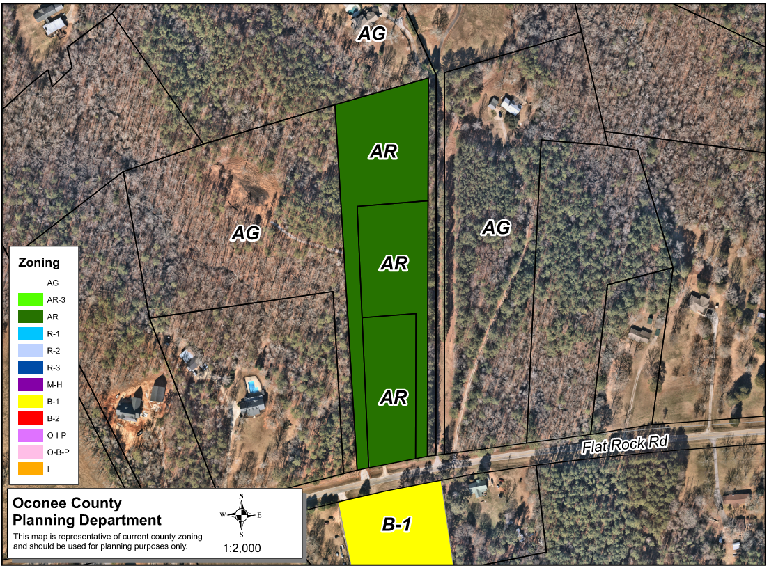
Zoning
AG

Slide 5
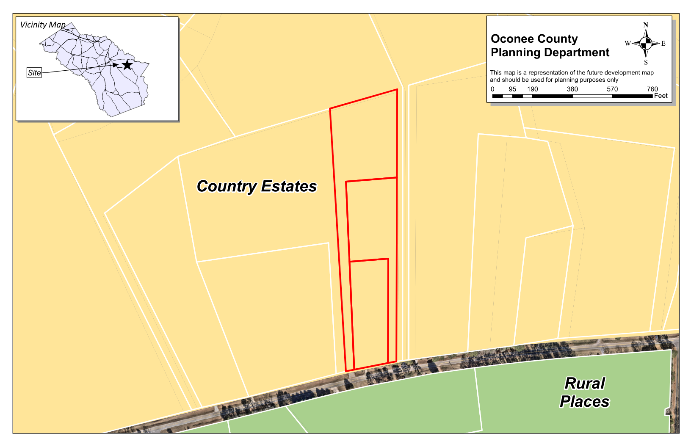
Future Development

Slide 6
Summary of Request
A special exception variance from Oconee County Unified Development Code Article 4 Section 410.01 & Table 4.1, to reduce the required front yard setback from 30 feet to 22.1 feet and to reduce the required side yard setback from 15 feet to 7.6 feet.

Slide 7
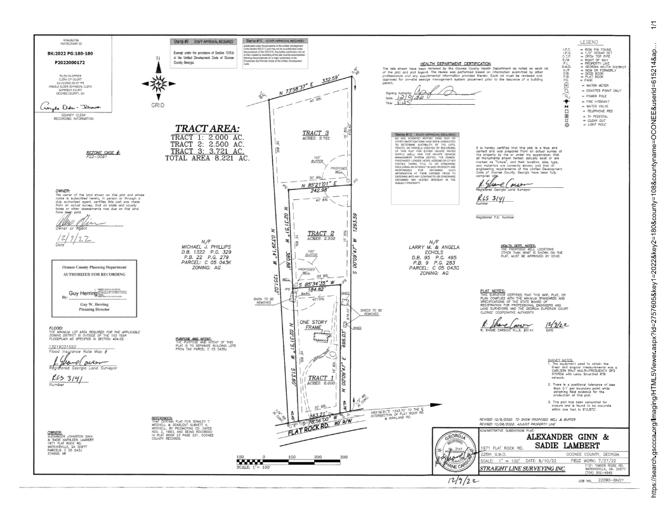
Recorded Plat

Slide 8
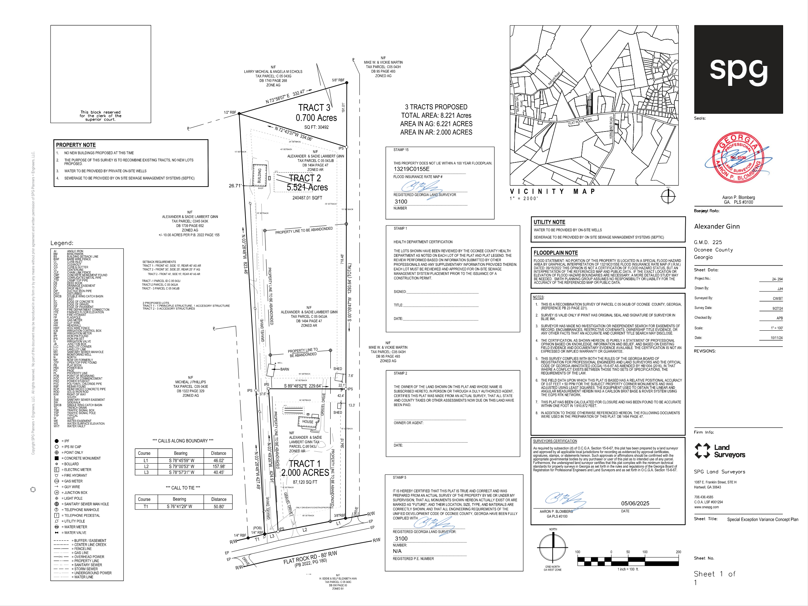
Concept Plan

Slide 9
Staff Recommendation
Based upon the standards and limitations for special exception variance approval, this request does meet all necessary conditions to grant a special exception variance to the setback standards. Should the present request be approved, staff recommends the following condition to be fulfilled at the owner/developer’s expense.
1. Development design and structures shall meet or exceed the standards indicated on the concept plan, narrative, representative architectural sketches, and other documents submitted with the variance application and attached hereto. This condition shall not construe approval of any standard that is not in conformity with the Unified Development Code.

