Slide 1


Slide 2
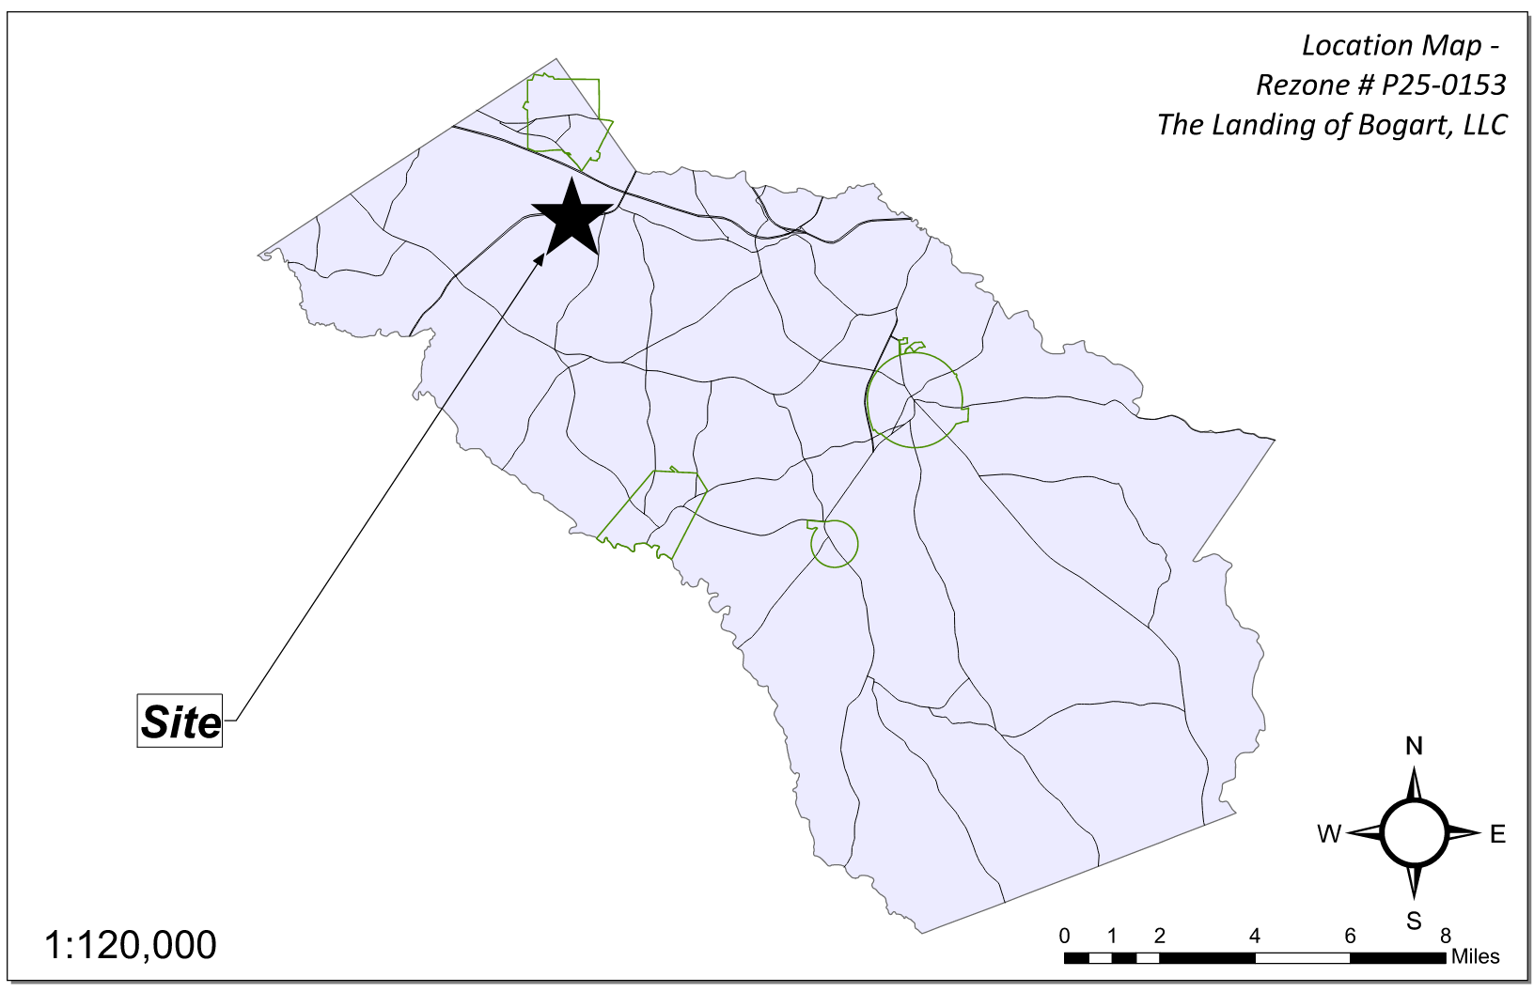
Site Location

Slide 3
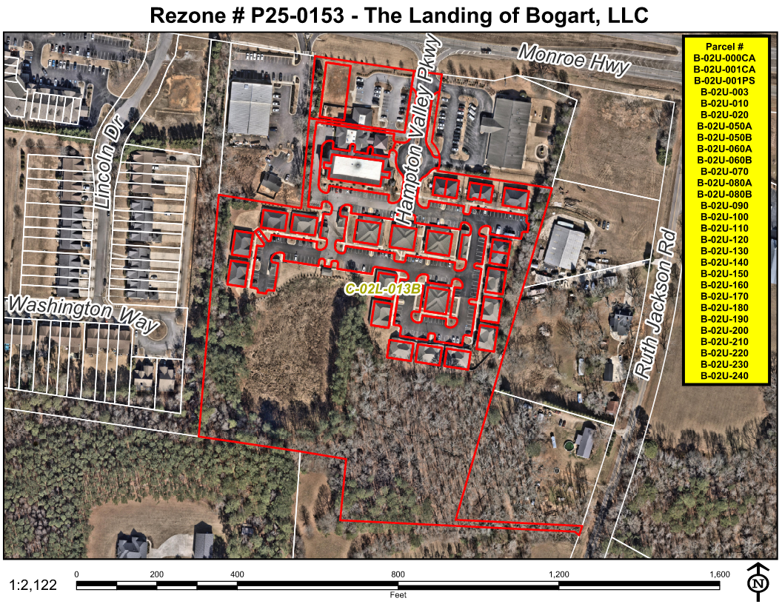
Aerial Imagery

Slide 4
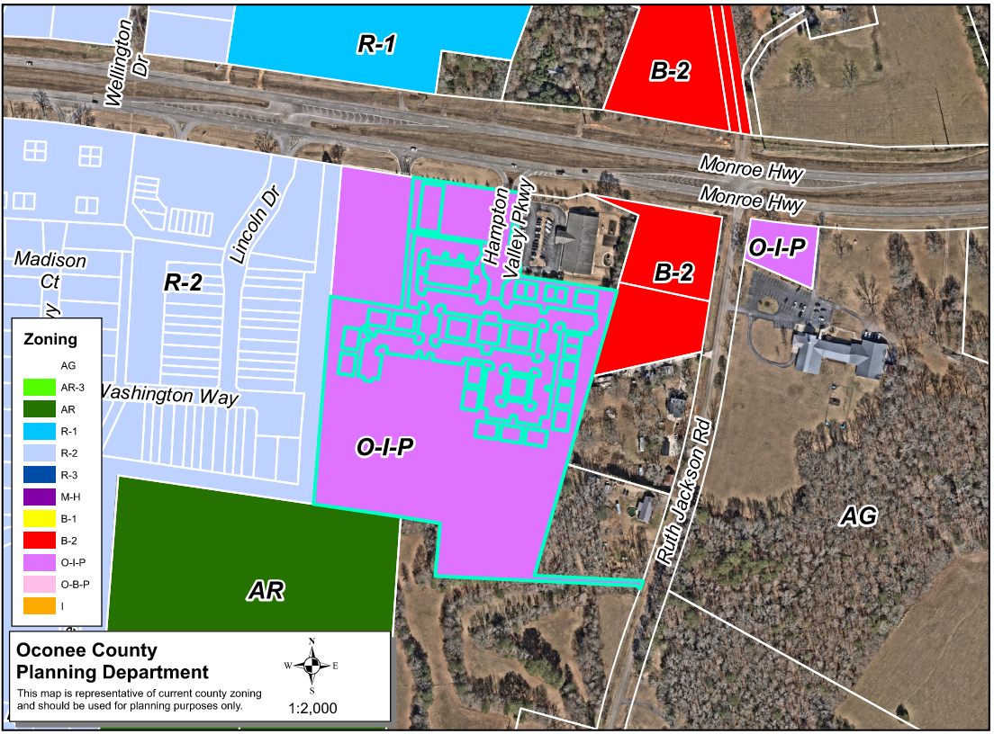
Zoning
AG

Slide 5
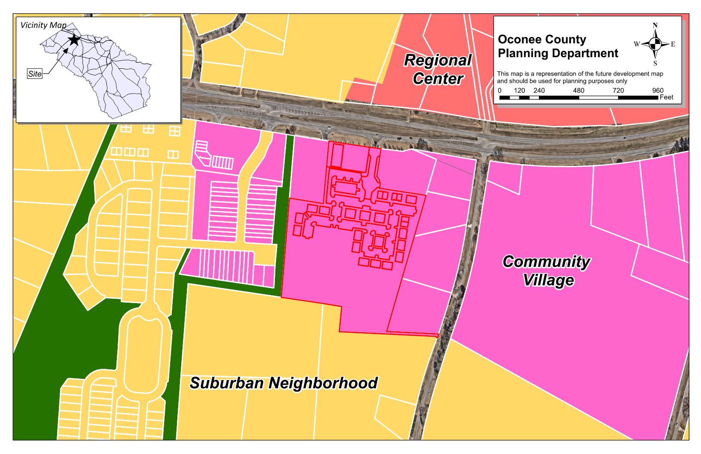
Future Development

Slide 6
Summary of Request
Change the conditions of the previous zoning (case # P20-0238), zoned OIP. The requested change is to increase the allowed total square feet of all structures to 138,422 SF.

Slide 7
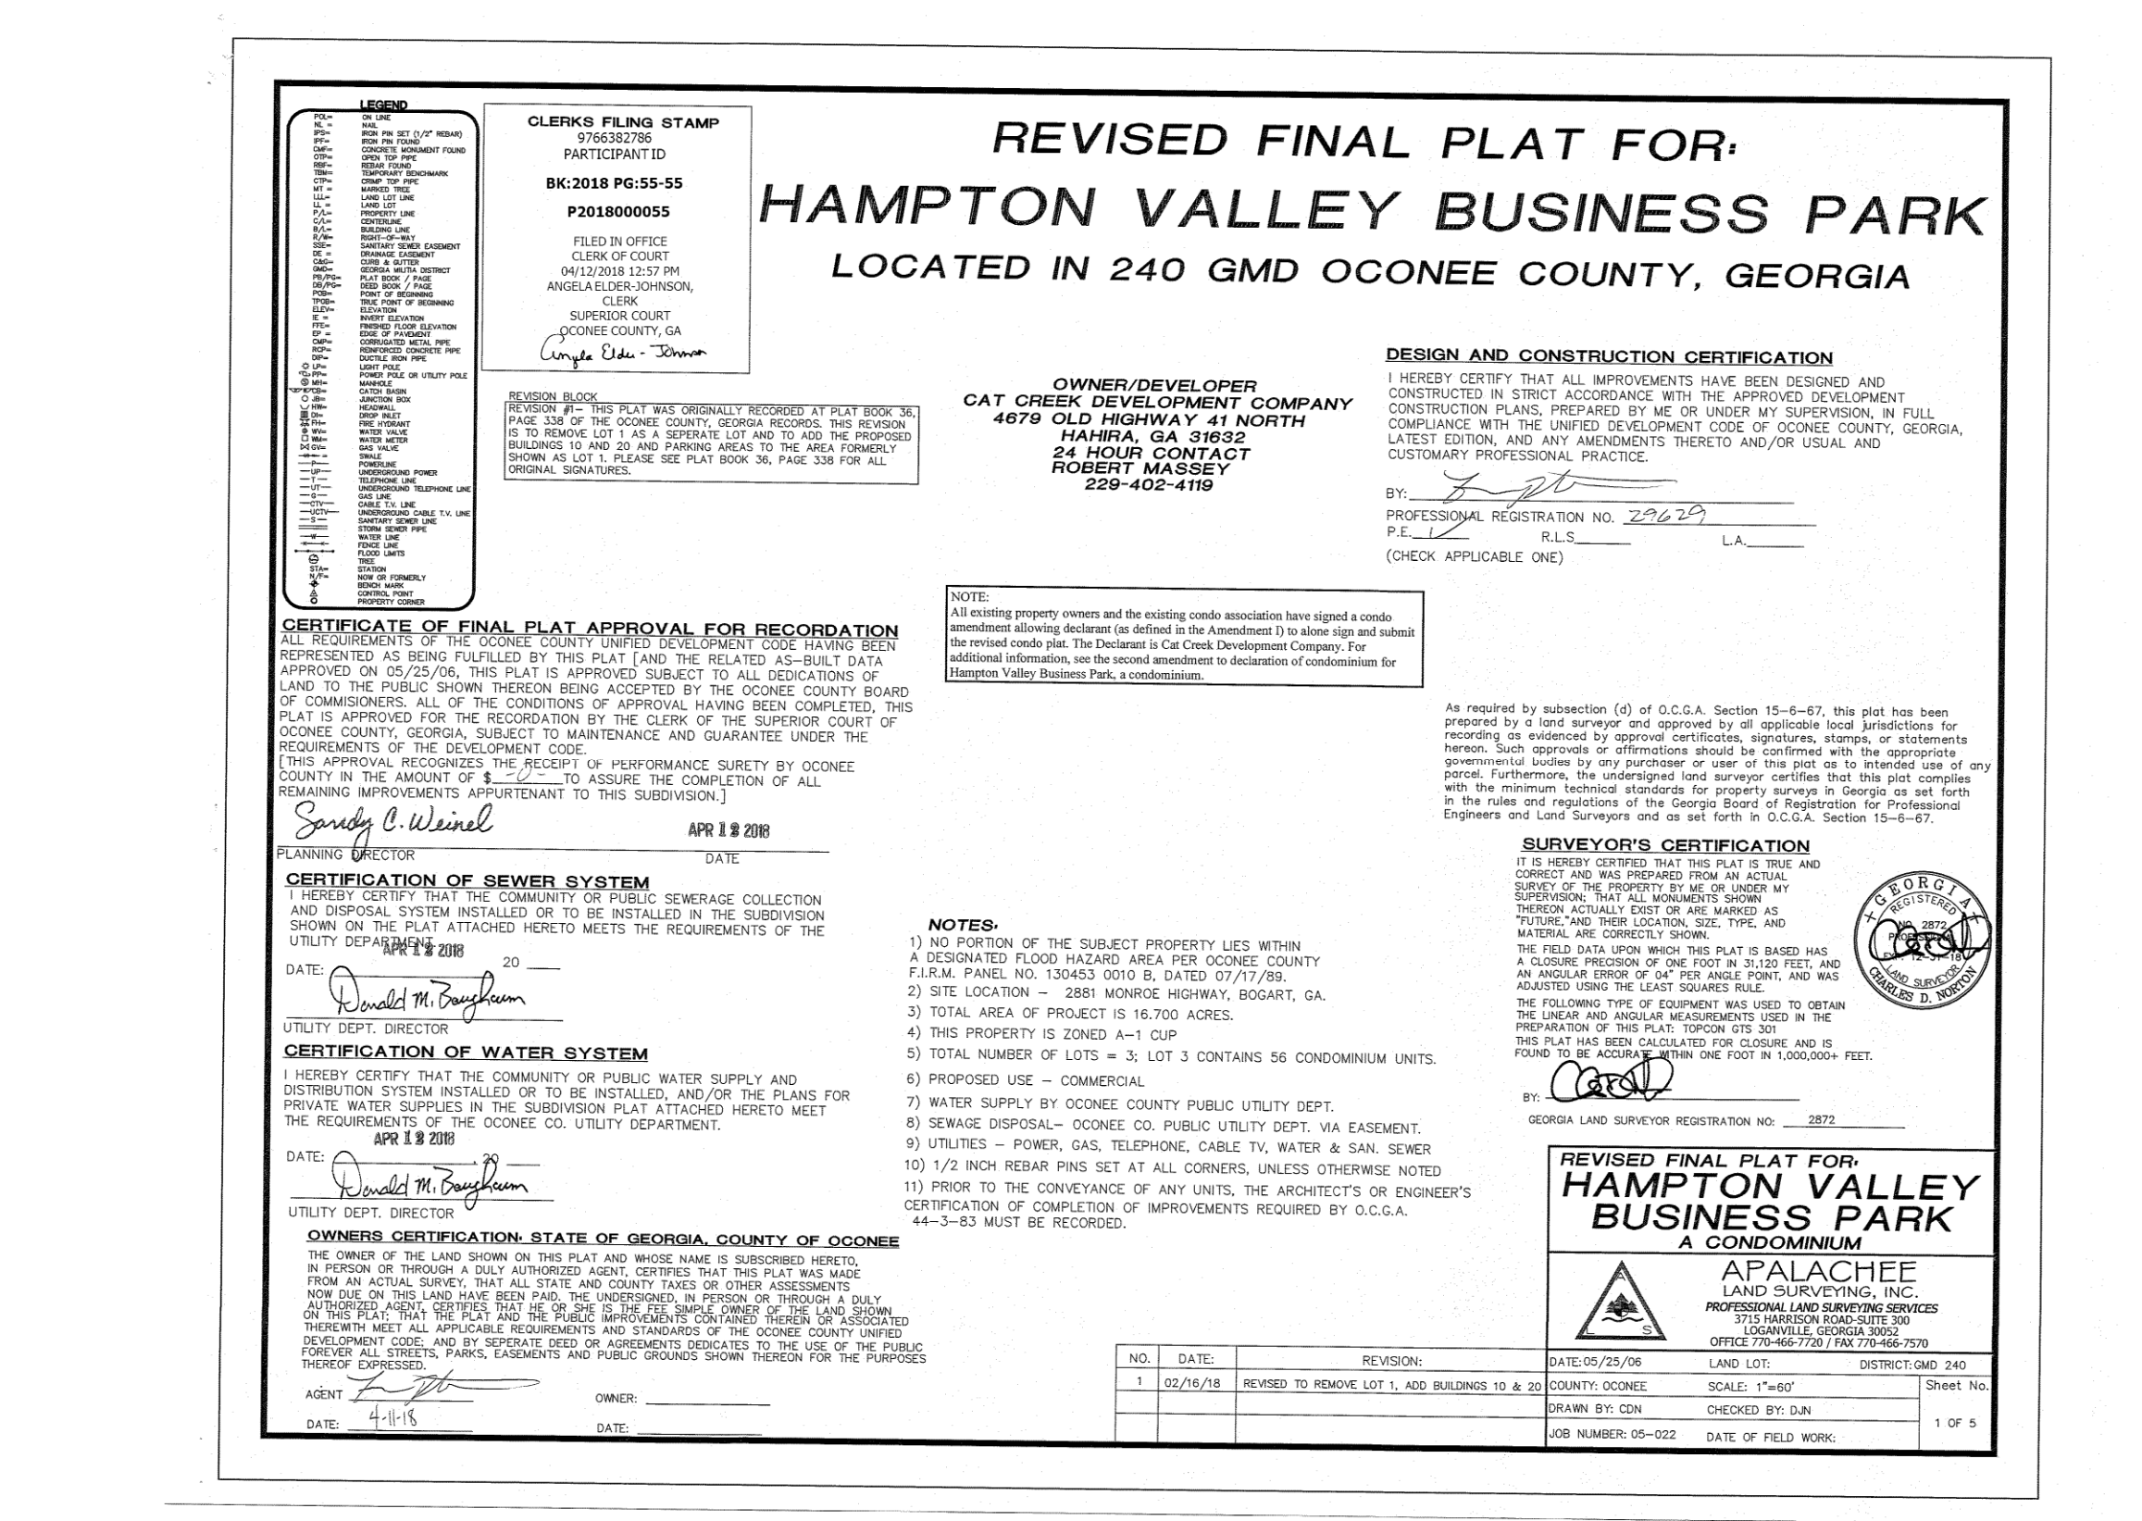
Recorded Plat

Slide 8
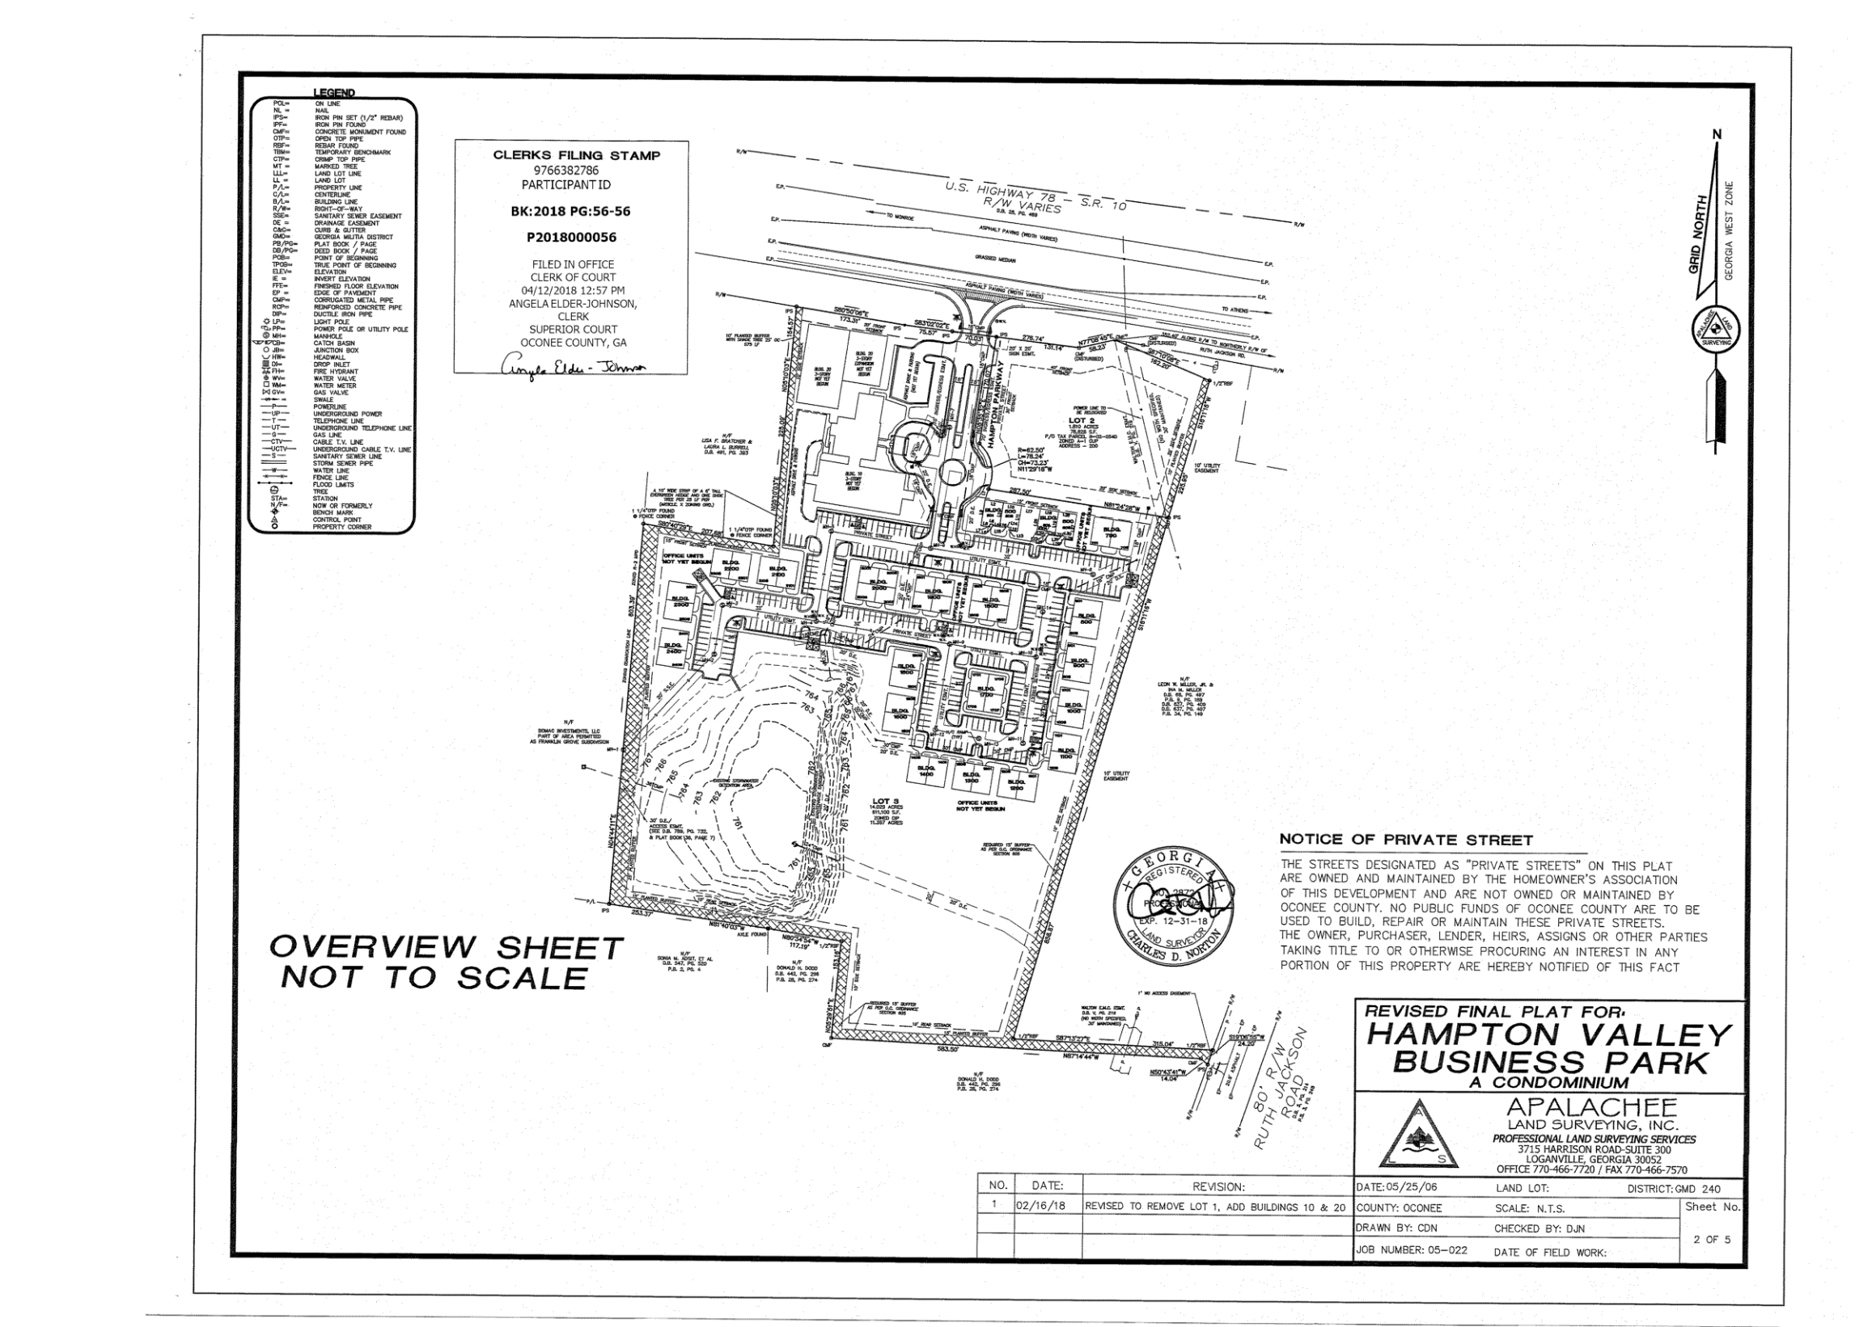
Recorded Plat

Slide 9
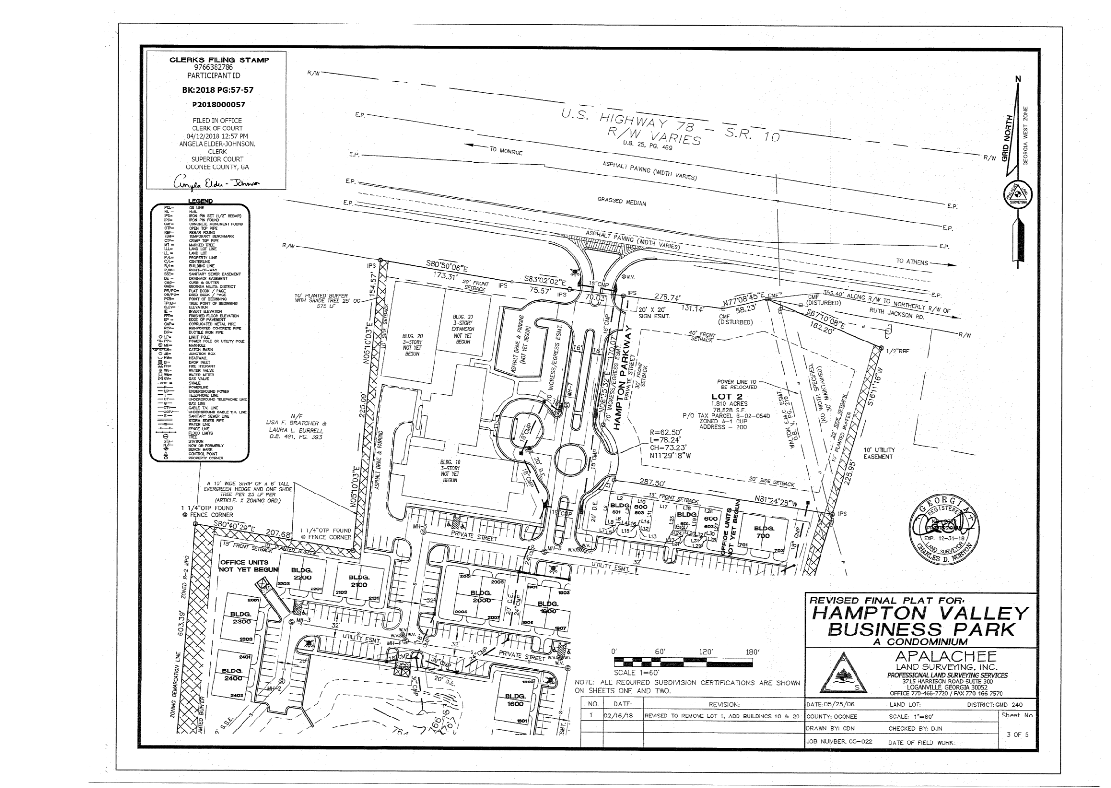
Recorded Plat

Slide 10
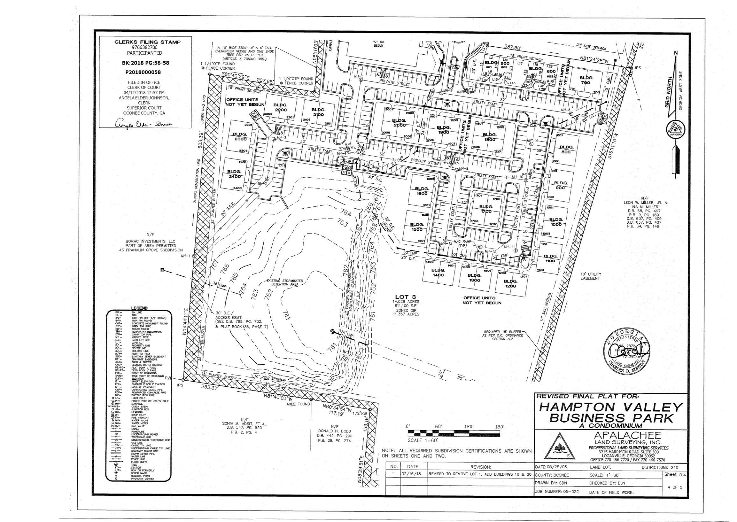
Recorded Plat

Slide 11
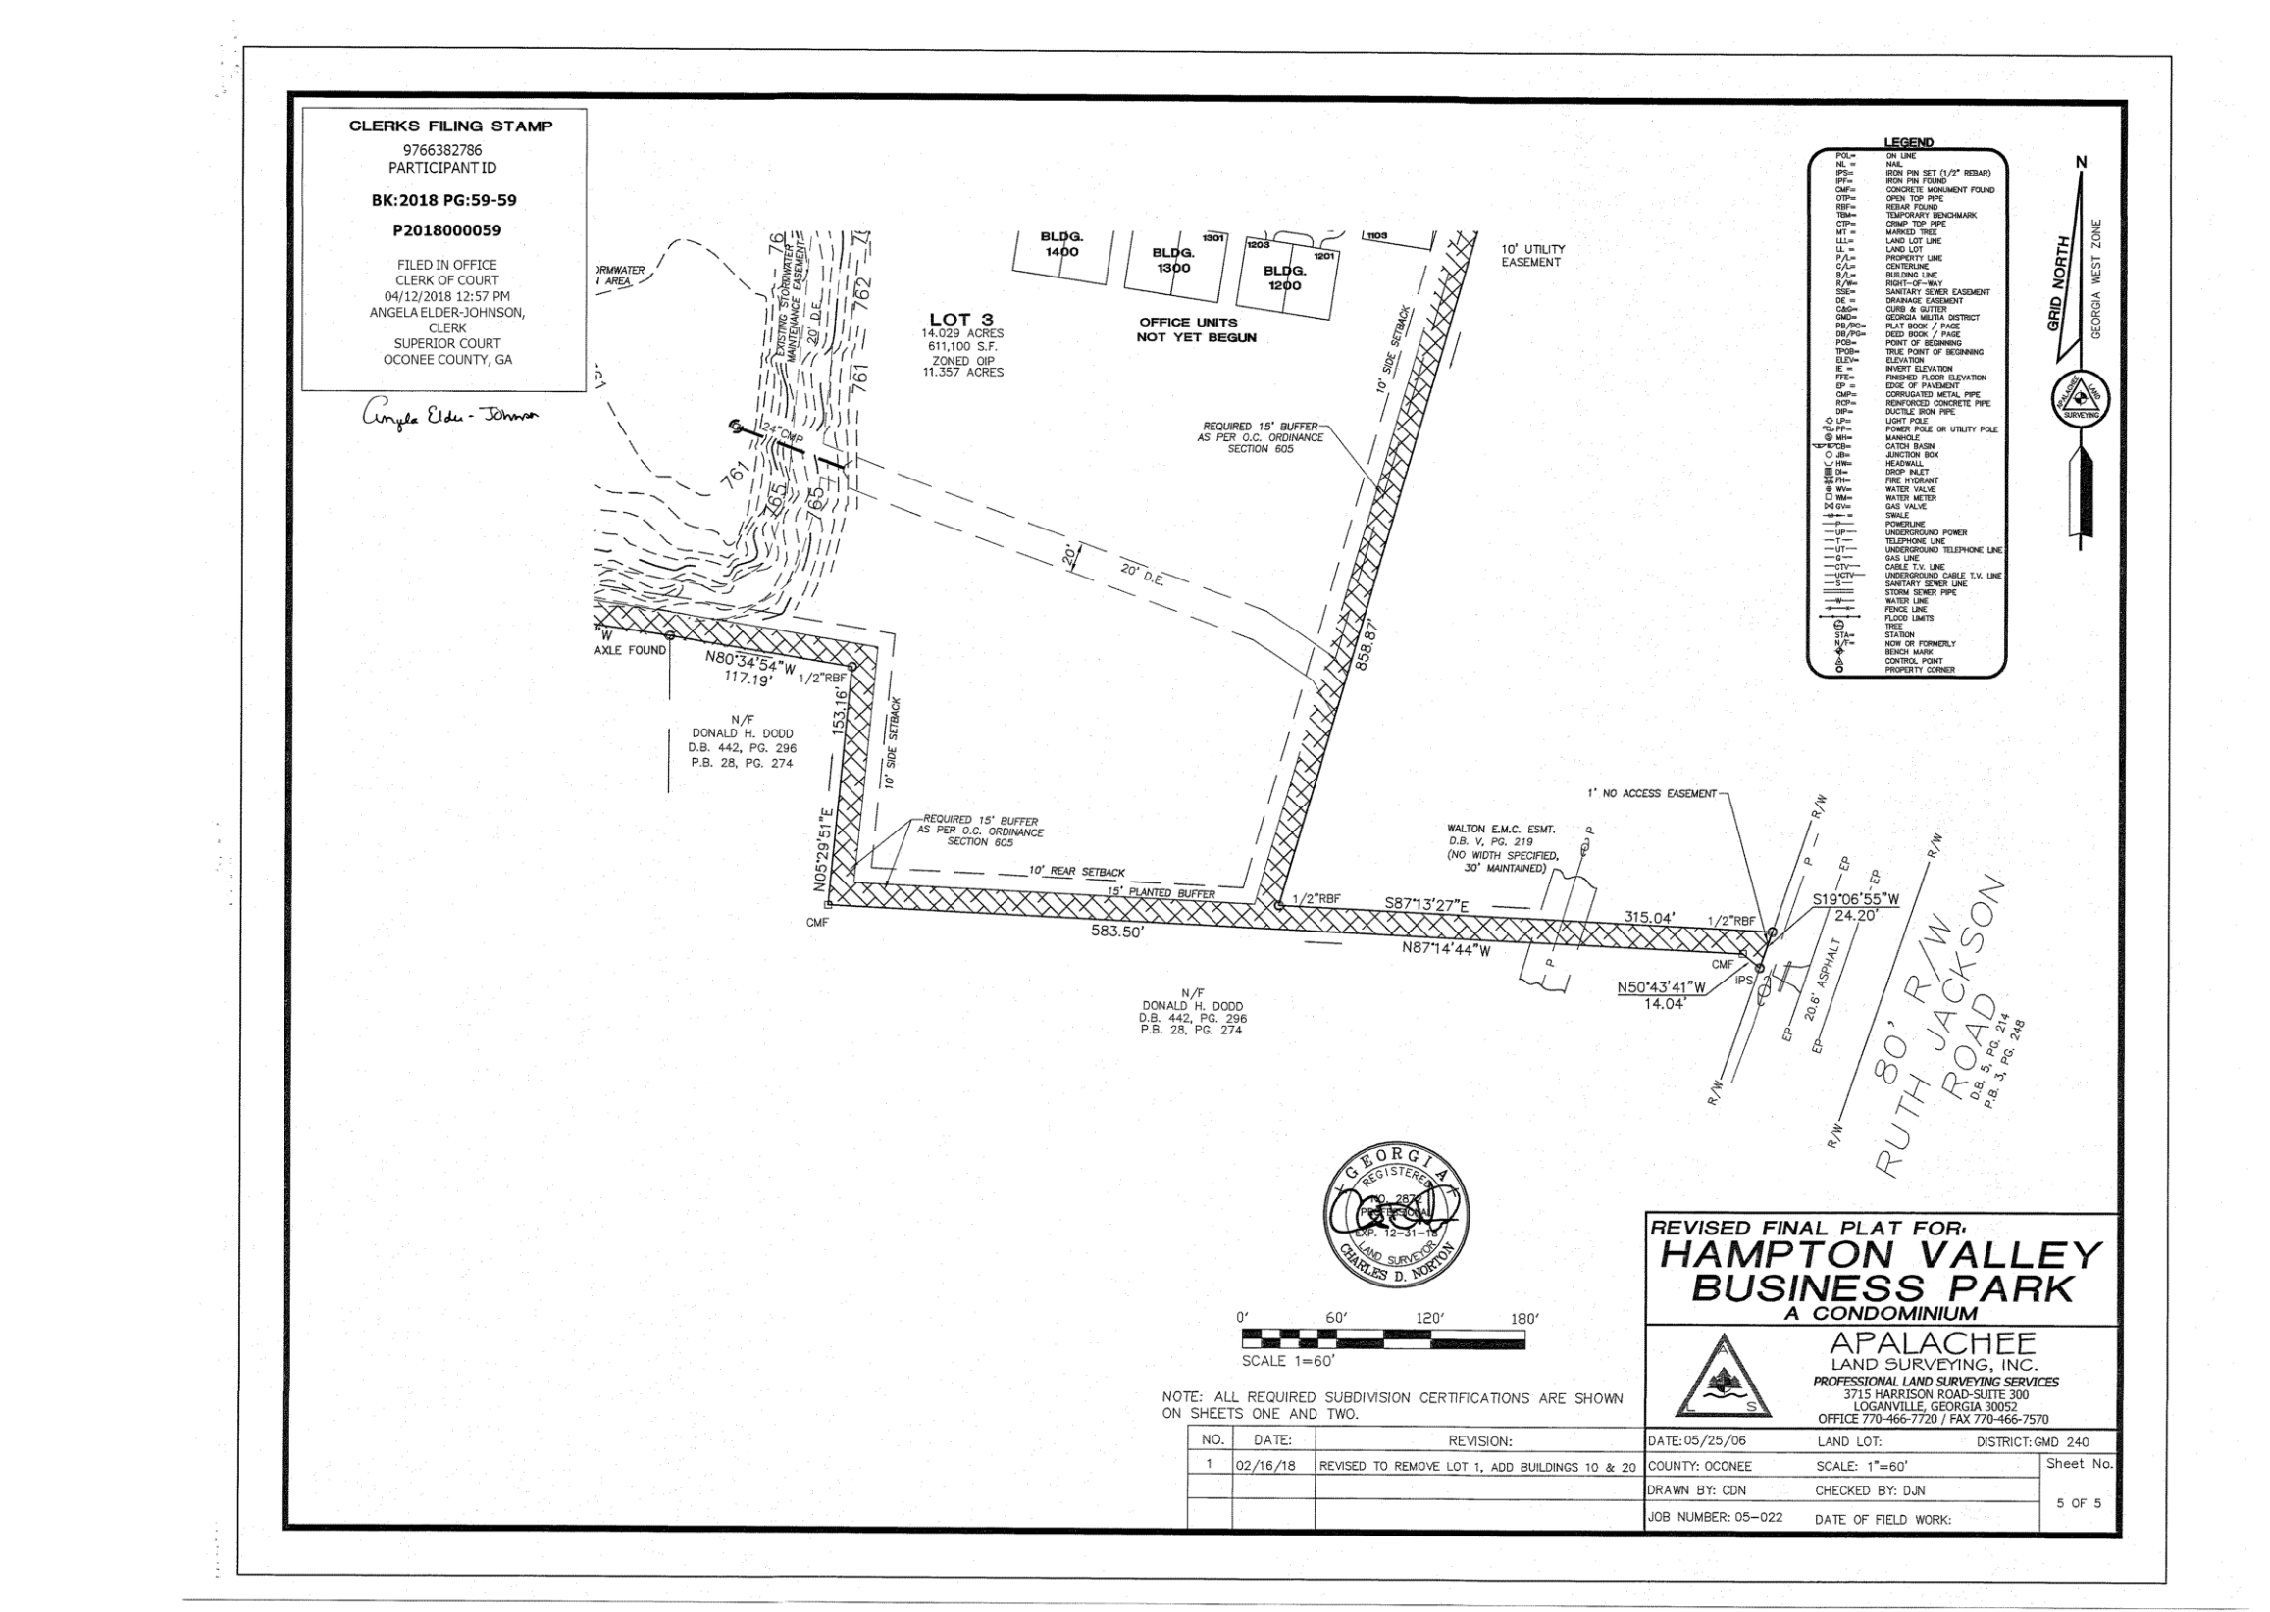
Recorded Plat

Slide 12
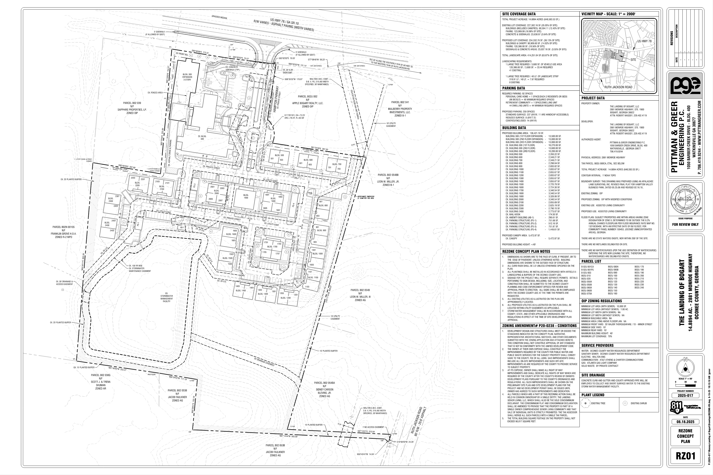
Concept Plan

Slide 13
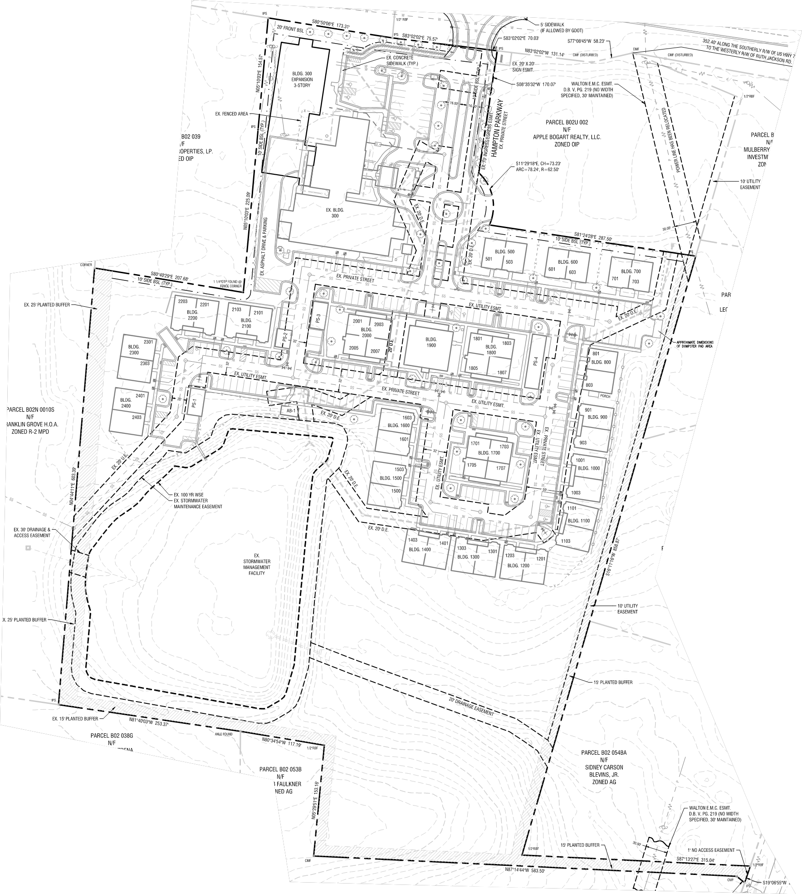
Concept Plan (Enlarged)

Slide 14
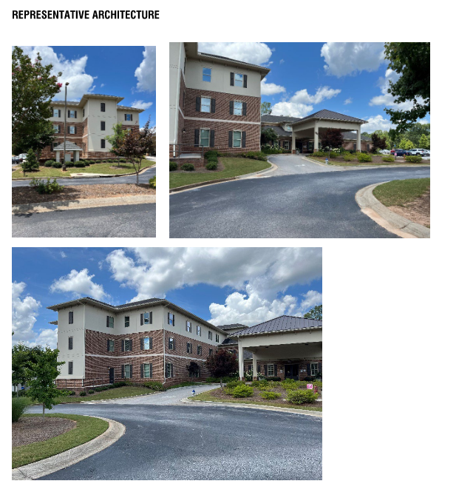
Architectural Images

Slide 15
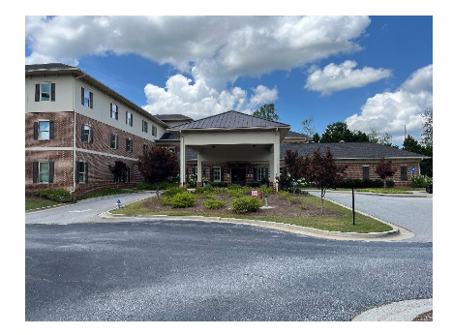
Architectural Images

Slide 16
Staff Recommendation
Based on Board of Commissioners policies, decision-making criteria, and standards outlined in the development codes of Oconee County, staff recommends conditional approval of this request subject to the following conditions to be fulfilled at the expense of the owner/developer:
1. Development design and structures shall meet or exceed the standards indicated on the concept plan, narrative, representative architectural sketches, and other documents submitted with the zoning application and attached hereto. This condition shall not construe approval of any standard that is not in conformity with the Unified Development Code.
2. The owner at their own expense shall construct the improvements required by the County for public water and public waste services for the subject property shall convey same to the County, free of all liens. Said improvements shall include all on-site improvements and such off-site improvements as are required by the County to provide service to subject property.
3. At its expense, Owner shall make all right of way improvements and shall dedicate all rights of way which are required by the County after the County’s review of Owner's development plans pursuant to the County’s ordinances and regulations. All such improvements shall be shown on the preliminary site plan and site development plans for the project and no development permit shall be issued until Owner has agreed to such improvements and dedication.

Slide 17
Staff Recommendation
Based on Board of Commissioners policies, decision-making criteria, and standards outlined in the development codes of Oconee County, staff recommends conditional approval of this request subject to the following conditions to be fulfilled at the expense of the owner/developer:
4. All parcels which are a part of this rezoning action shall be held in common ownership by a single entity, The Landing Senior Living, LLC, which shall also be the sole condominium declarant. The condominium plat and condominium declaration shall be amended to provide that the property is part of a single owner comprehensive senior living community and that sale of individual units is strictly prohibited. The tax assessor shall merge all such parcels into a single tax parcel. Prior to application for the Site Development Permit, the owner shall submit for a review and to be recorded a recombination plat that abandons all existing condominium lines to combine the property into a single parcel.
5. Total building square footage on the property shall not exceed 138,422 square feet.

Slide 18
Planning Commission Recommendation
Planning Commission recommends approval subject to the conditions recommended by staff.

