Slide 1


Slide 2
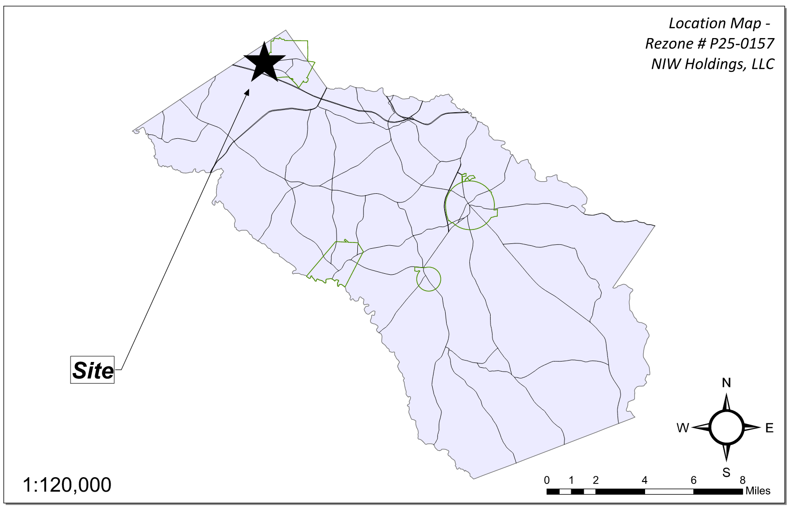
Site Location

Slide 3
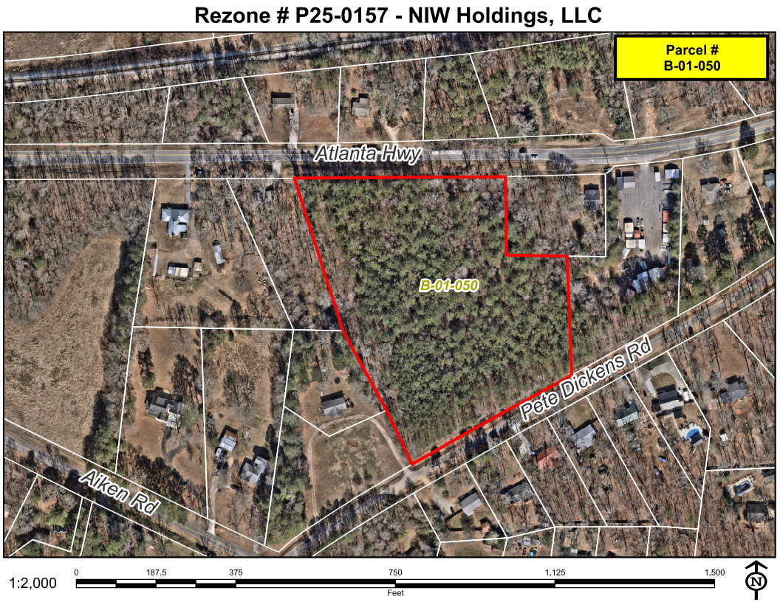
Aerial Imagery

Slide 4
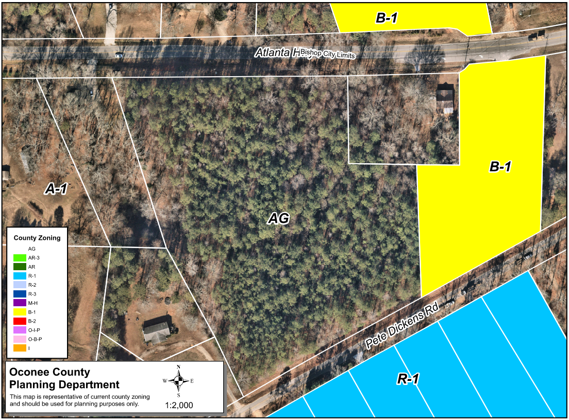
Zoning
AG

Slide 5
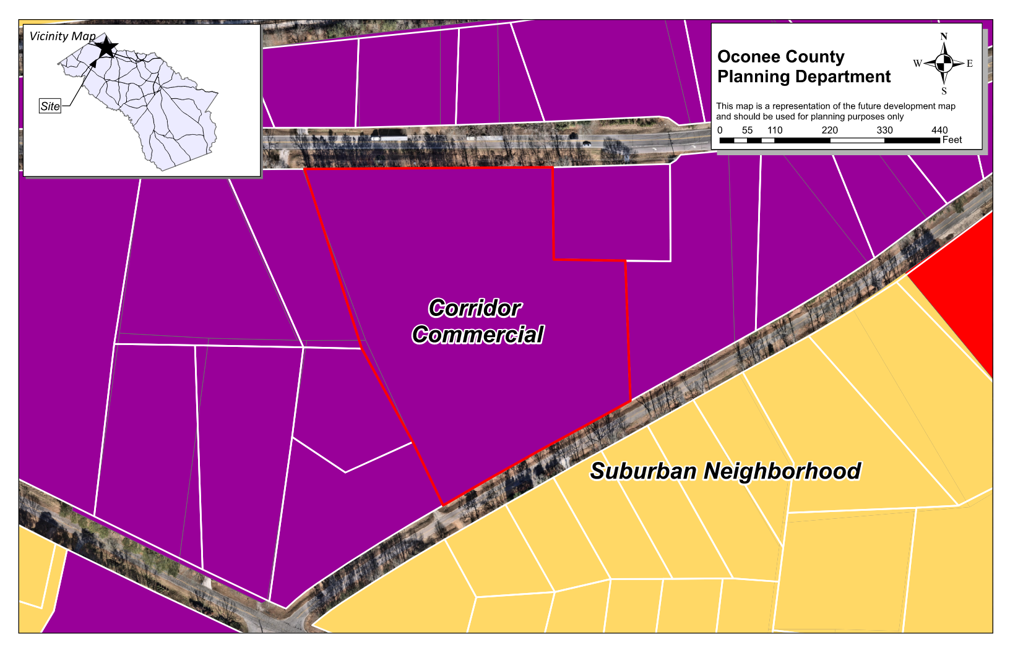
Future Development

Slide 6
Summary of Request
Rezone ±7.0 acres from AG (Agricultural) to R-1 (Single-Family Residential District)

Slide 7
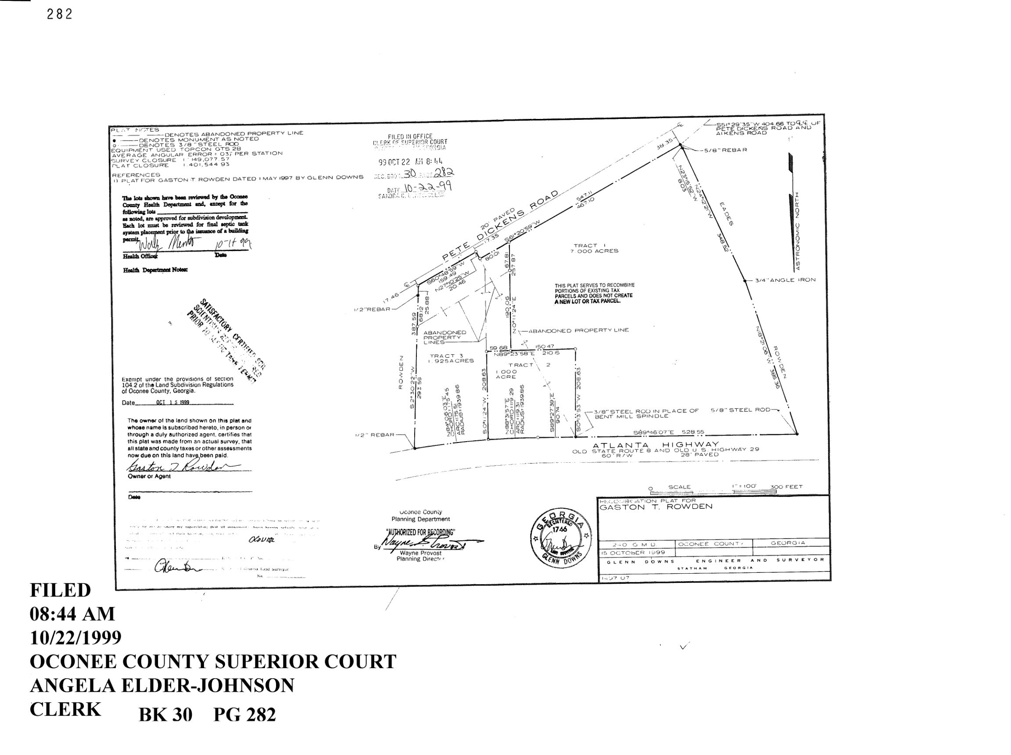
Recorded Plat

Slide 8
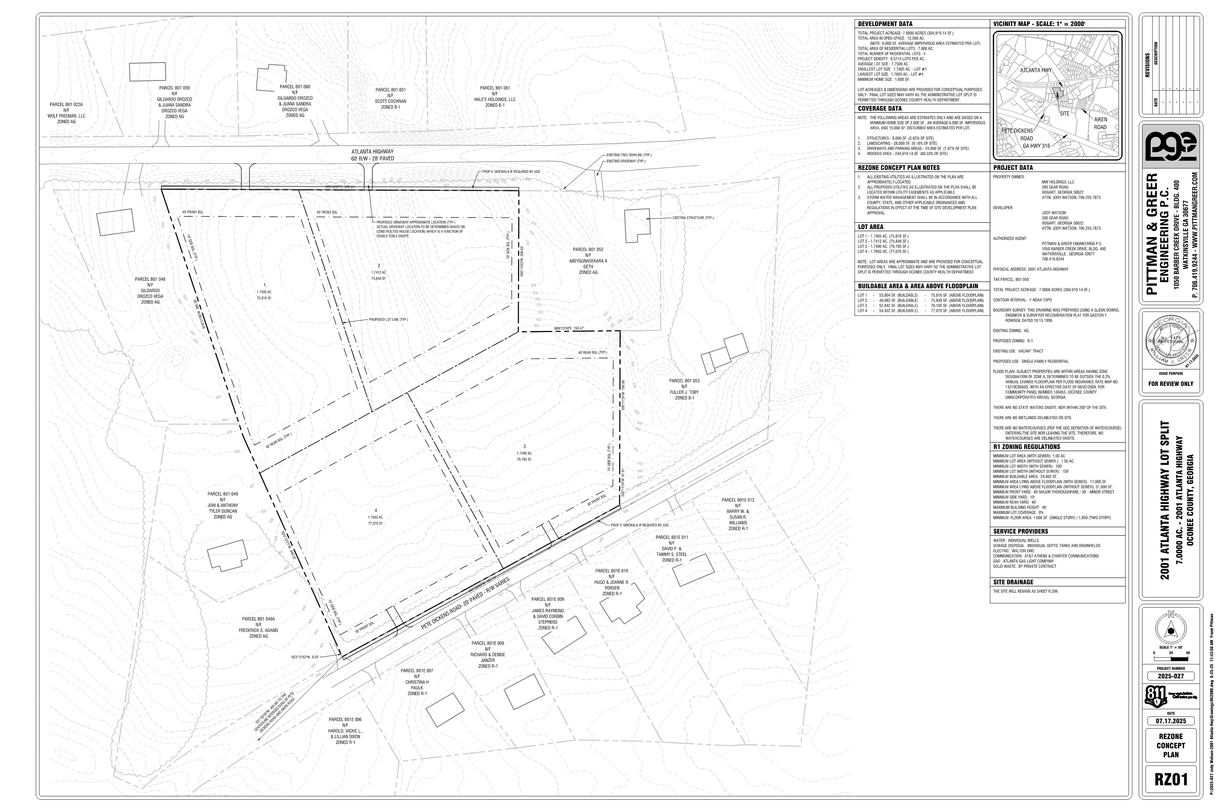
Concept Plan

Slide 9
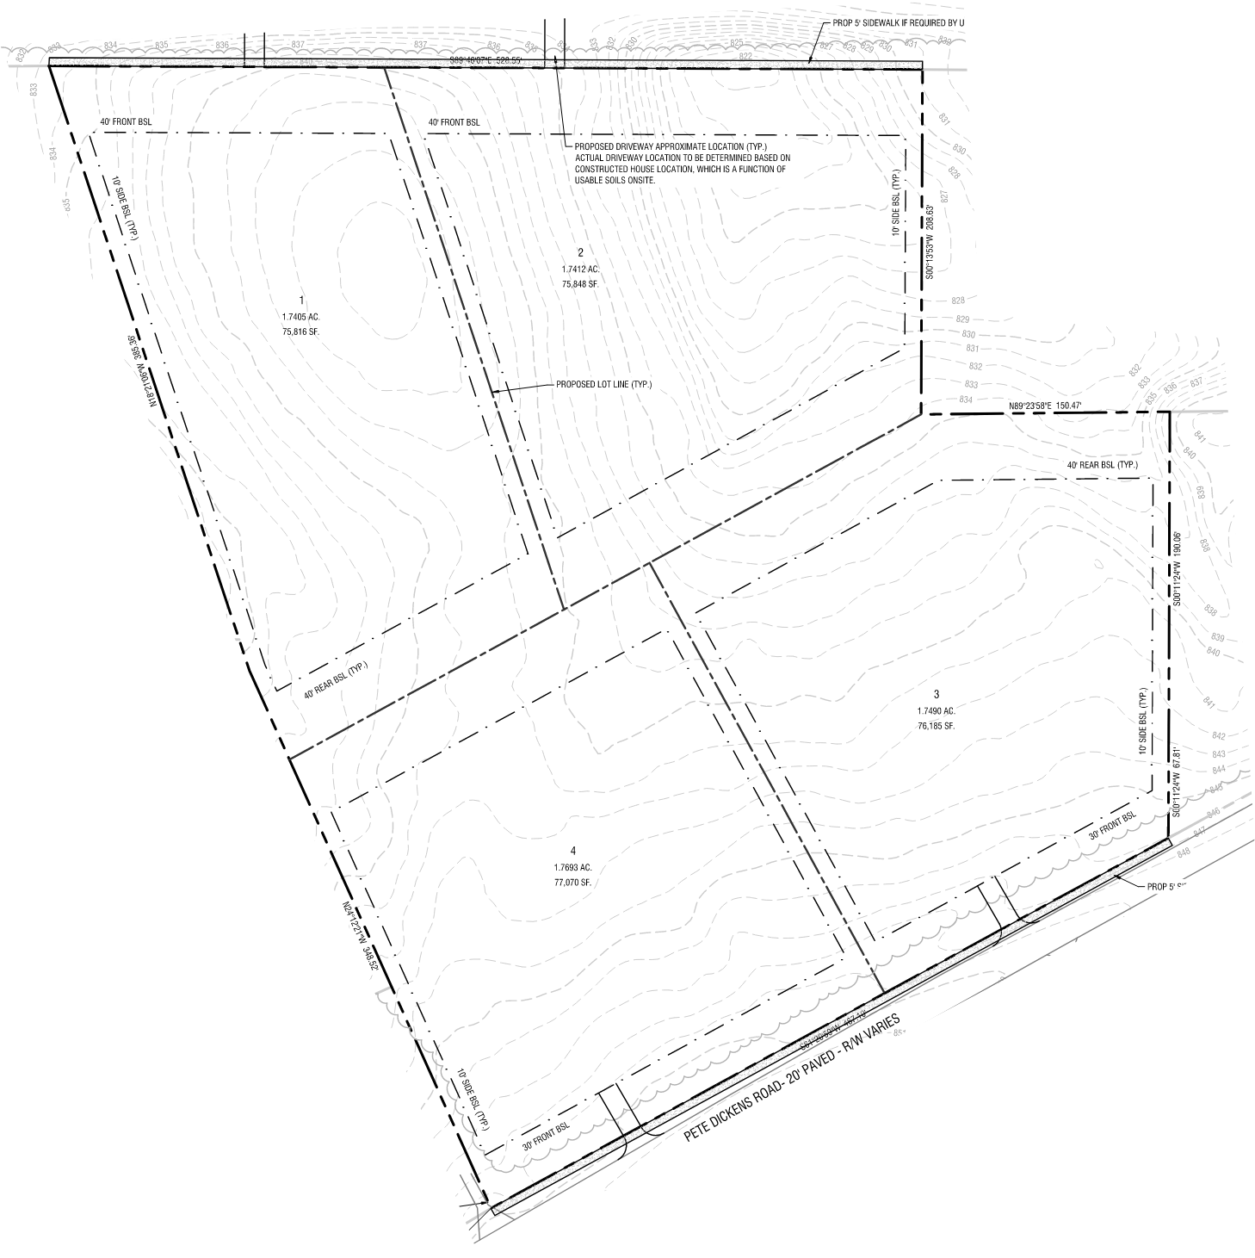
Concept Plan (Enlarged)

Slide 10
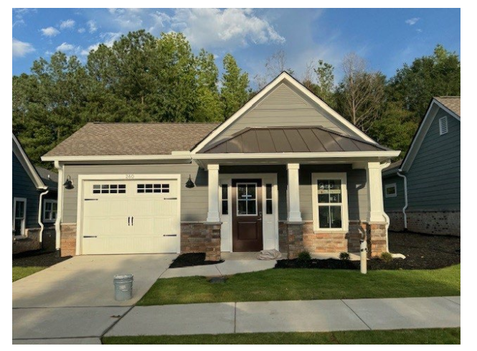
Architectural Images

Slide 11
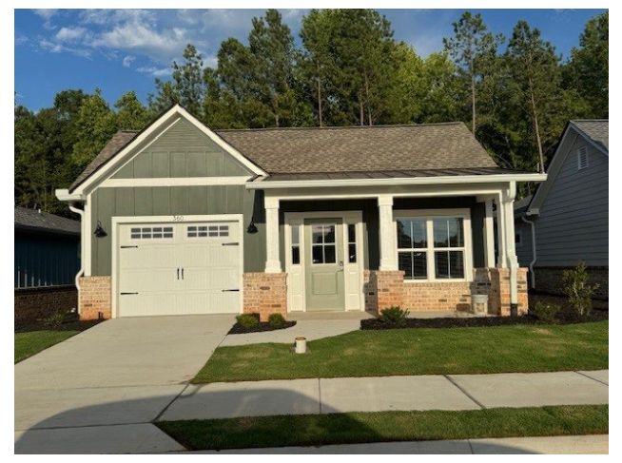
Architectural Images

Slide 12
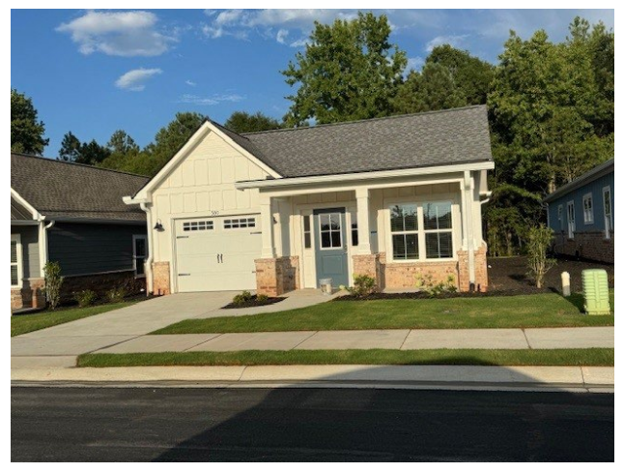
Architectural Images

Slide 13
Staff Recommendation
Based on Board of Commissioners policies, decision-making criteria, and standards outlined in the development codes of Oconee County, staff recommends conditional approval of the request to rezone ±7.0 acres to R-1 subject to the following conditions to be fulfilled at the expense of the owner/developer:
1. Development design and structures shall meet or exceed the standards indicated on the concept plan, narrative, representative architectural sketches, and other documents submitted with the zoning application and attached hereto. This condition shall not construe approval of any standard that is not in conformity with the Unified Development Code.
2. The owner at their own expense shall construct the improvements required by the County for public water for the subject property and shall convey the same to the County, free of all liens. Said improvements shall include all on-site improvements and such off-site improvements as are required by the County to provide service to subject property.
3. At its expense, Owner shall make all right of way improvements and shall dedicate all rights of way which are required by the County after the County’s review of Owner's development plans pursuant to the County’s ordinances and regulations. All such improvements shall be shown on the preliminary site plan and site development plans for the project and no development permit shall be issued until Owner has agreed to such improvements and dedication.

Slide 14
Planning Commission Recommendation
Planning Commission recommends approval subject to the conditions recommended by staff.

