Slide 1


Slide 2
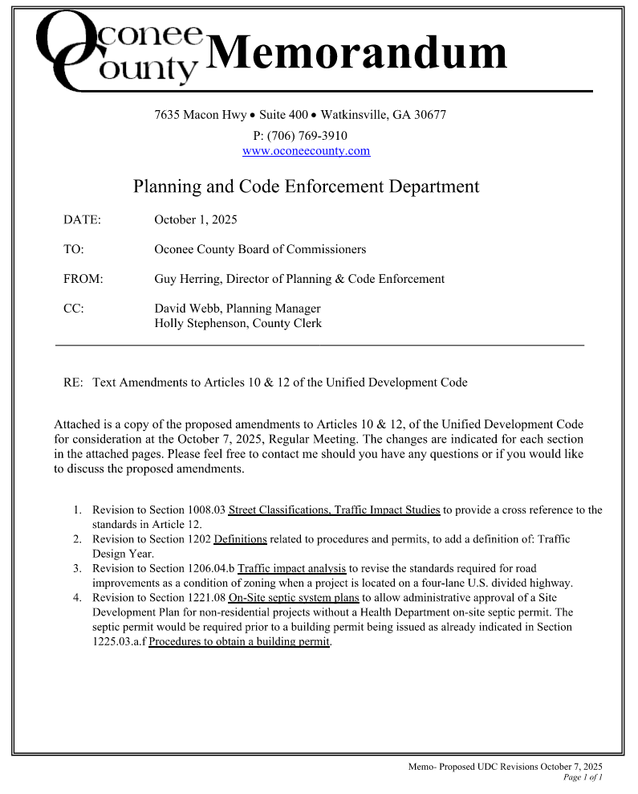
Memo to BOC

Slide 3
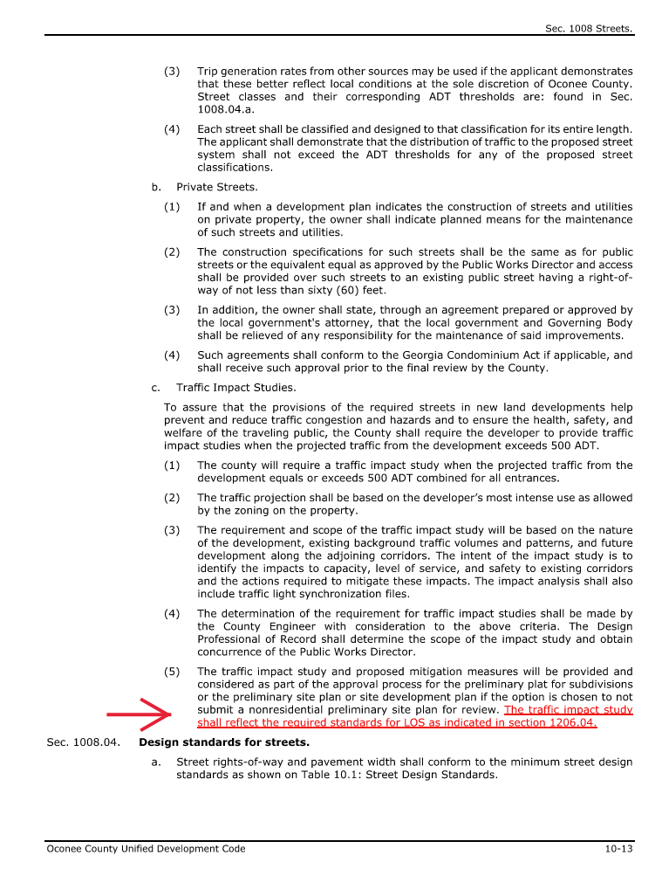
Memo to BOC

Slide 4
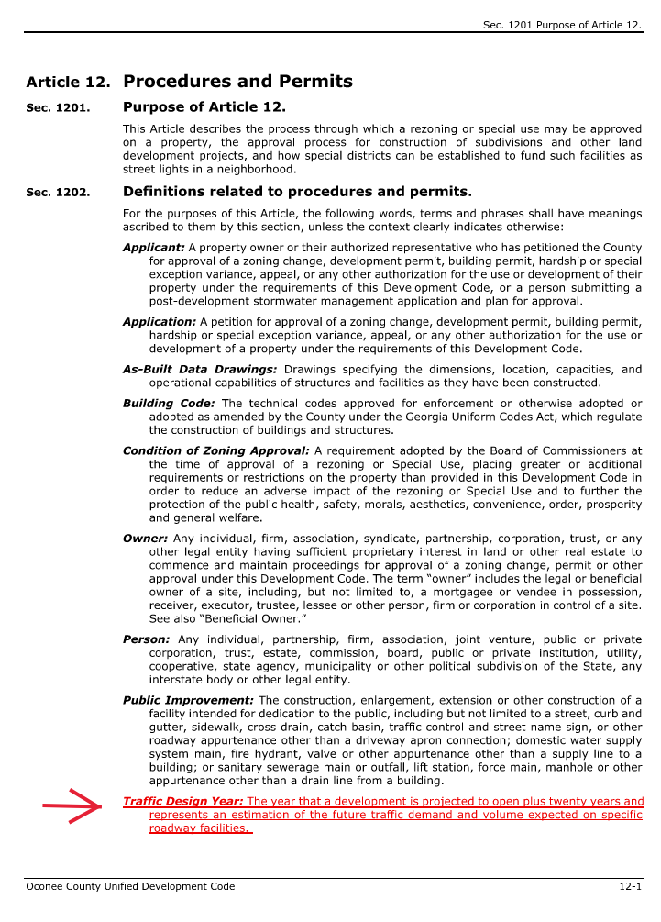
Memo to BOC

Slide 5
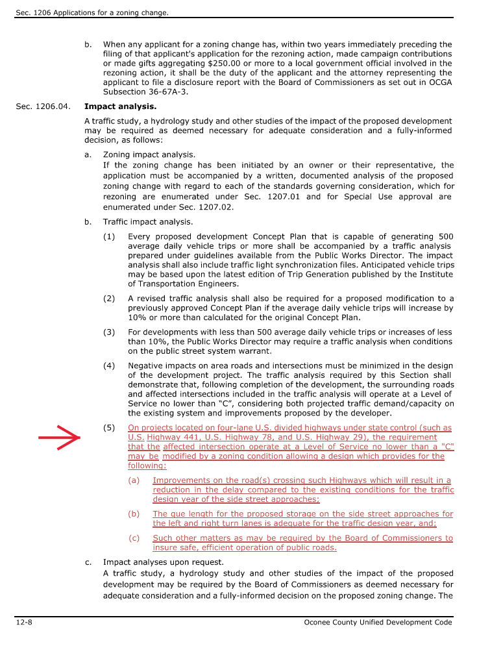
Memo to BOC

Slide 6
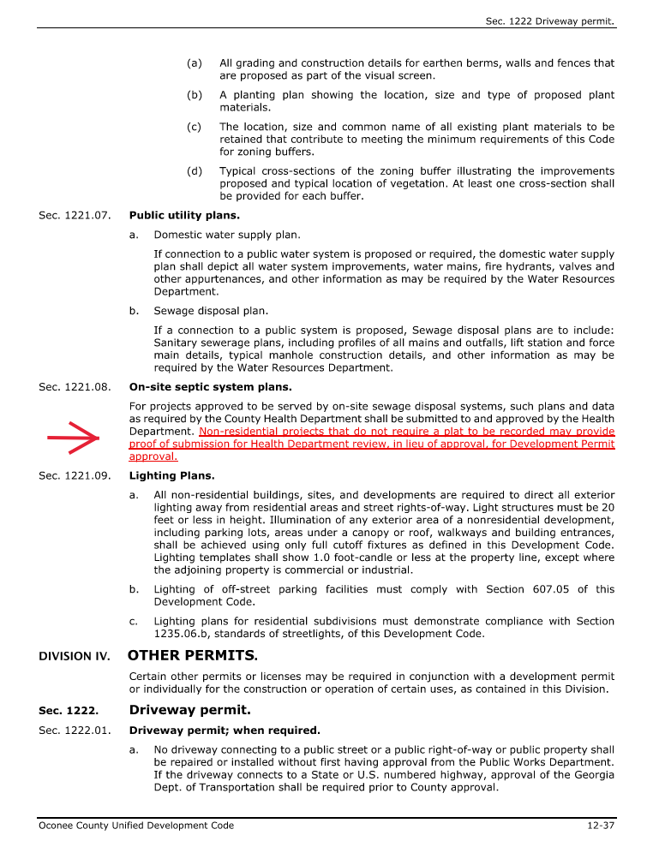
Memo to BOC

Slide 7
UDC Draft Amendments January 28, 2025
Below is a summary of the proposed amendments to Articles 10 & 12 of the Unified Development Code for consideration at the October 7, 2025 Regular BOC Meeting. The changes are indicated below grouped by subject with the amended code sections noted.

Slide 8
List of Amendments
Revision to Section 1008.03 Street Classifications, Traffic Impact Studies to provide a cross reference to the standards in Article 12.
Revision to Section 1202 Definitions related to procedures and permits, to add a definition of: Traffic Design Year.
Revision to Section 1206.04.b Traffic impact analysis to revise the standards required for road improvements as a condition of zoning when a project is located on a four-lane U.S. divided highway.
Revision to Section 1221.08 On-Site septic system plans to allow administrative approval of a Site Development Plan for non-residential projects without a Health Department on-site septic permit. The septic permit would be required prior to a building permit being issued as already indicated in Section 1225.03.a.f Procedures to obtain a building permit.

