Slide 1


Slide 2
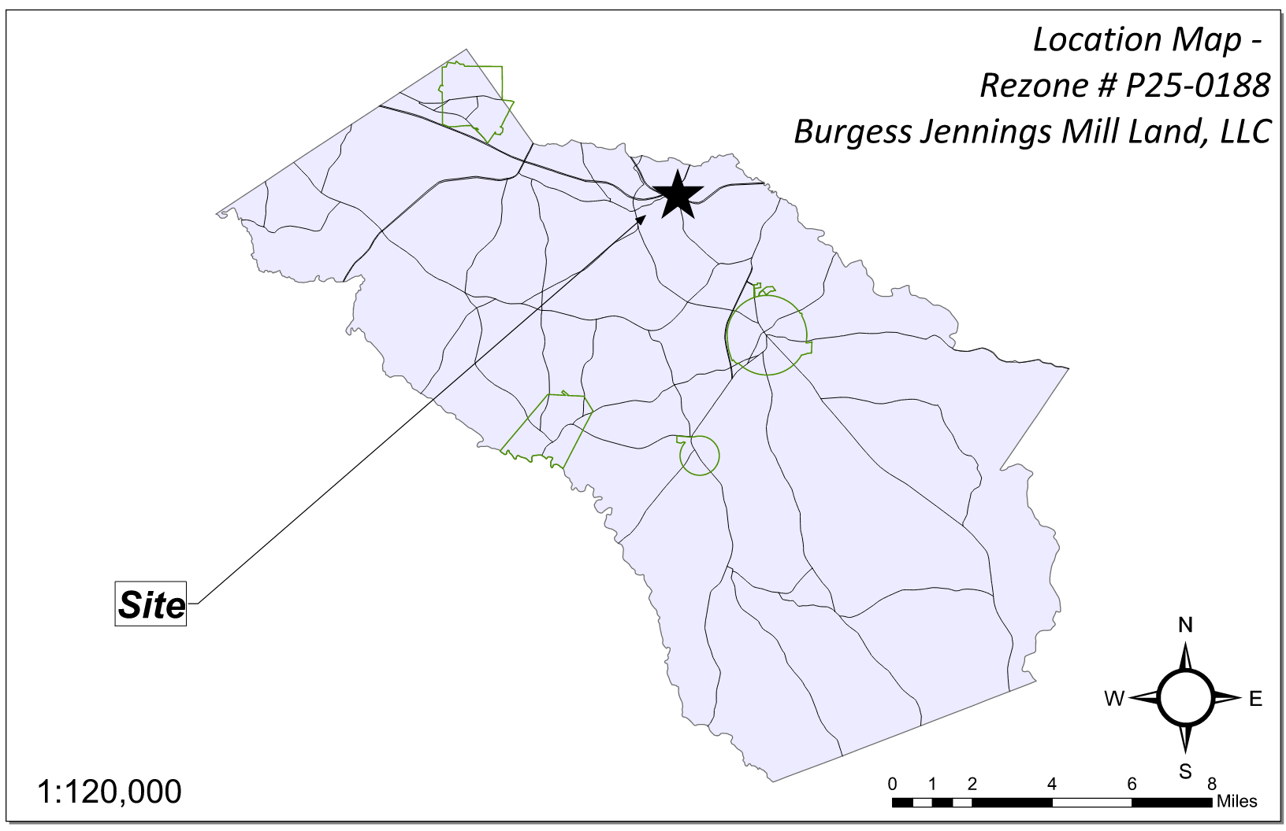
Site Location

Slide 3
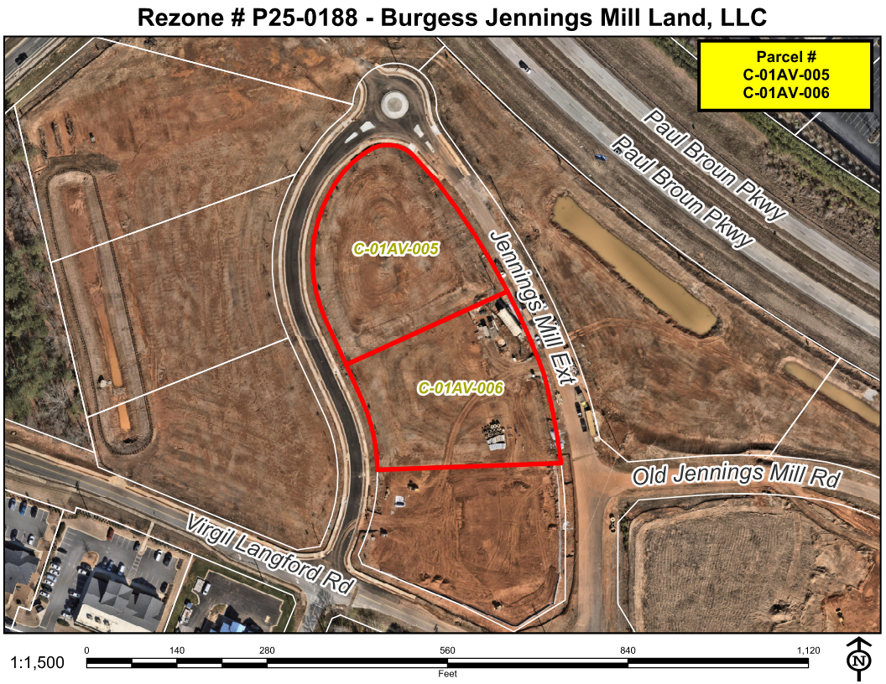
Aerial Imagery

Slide 4
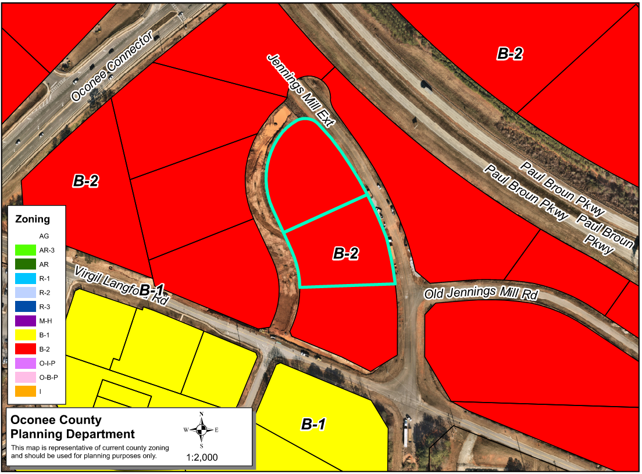
Zoning
AG

Slide 5
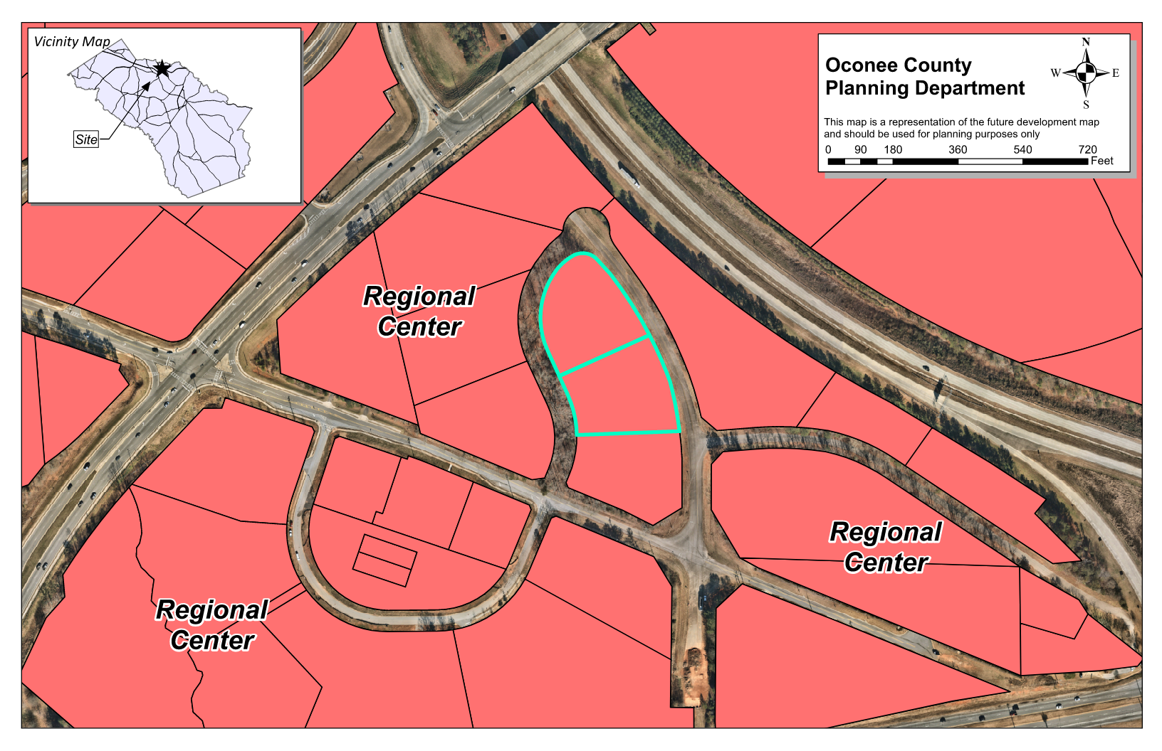
Future Development

Slide 6
Summary of Request
1. Combine lots 5 and 6 into one lot
2. Revised Concept Plan approval for a retail center to develop a two-building shopping center with parking, driveways, utilities, stormwater management, landscaping, lighting and related items.

Slide 7
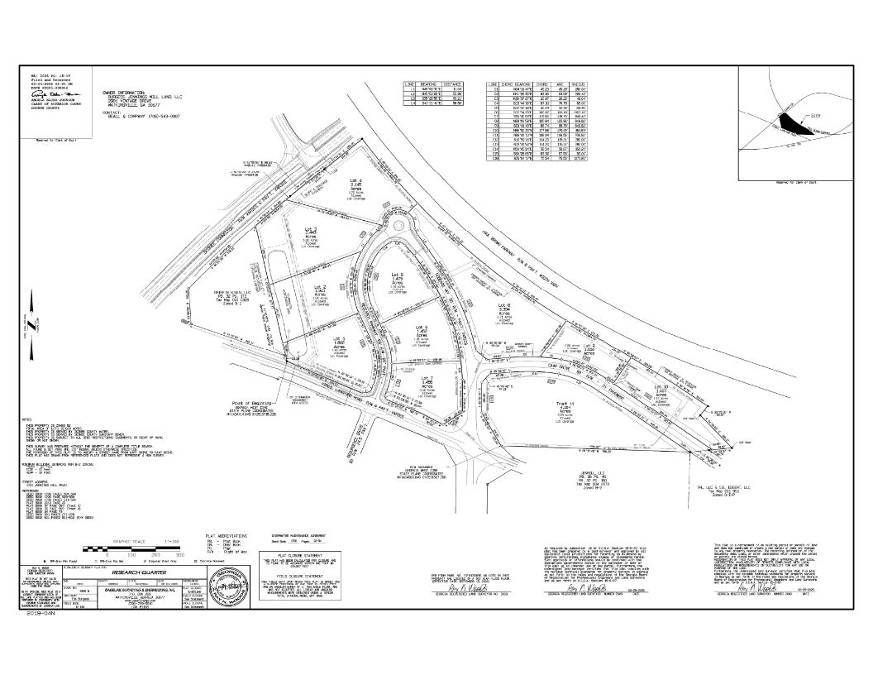
Recorded Plat

Slide 8
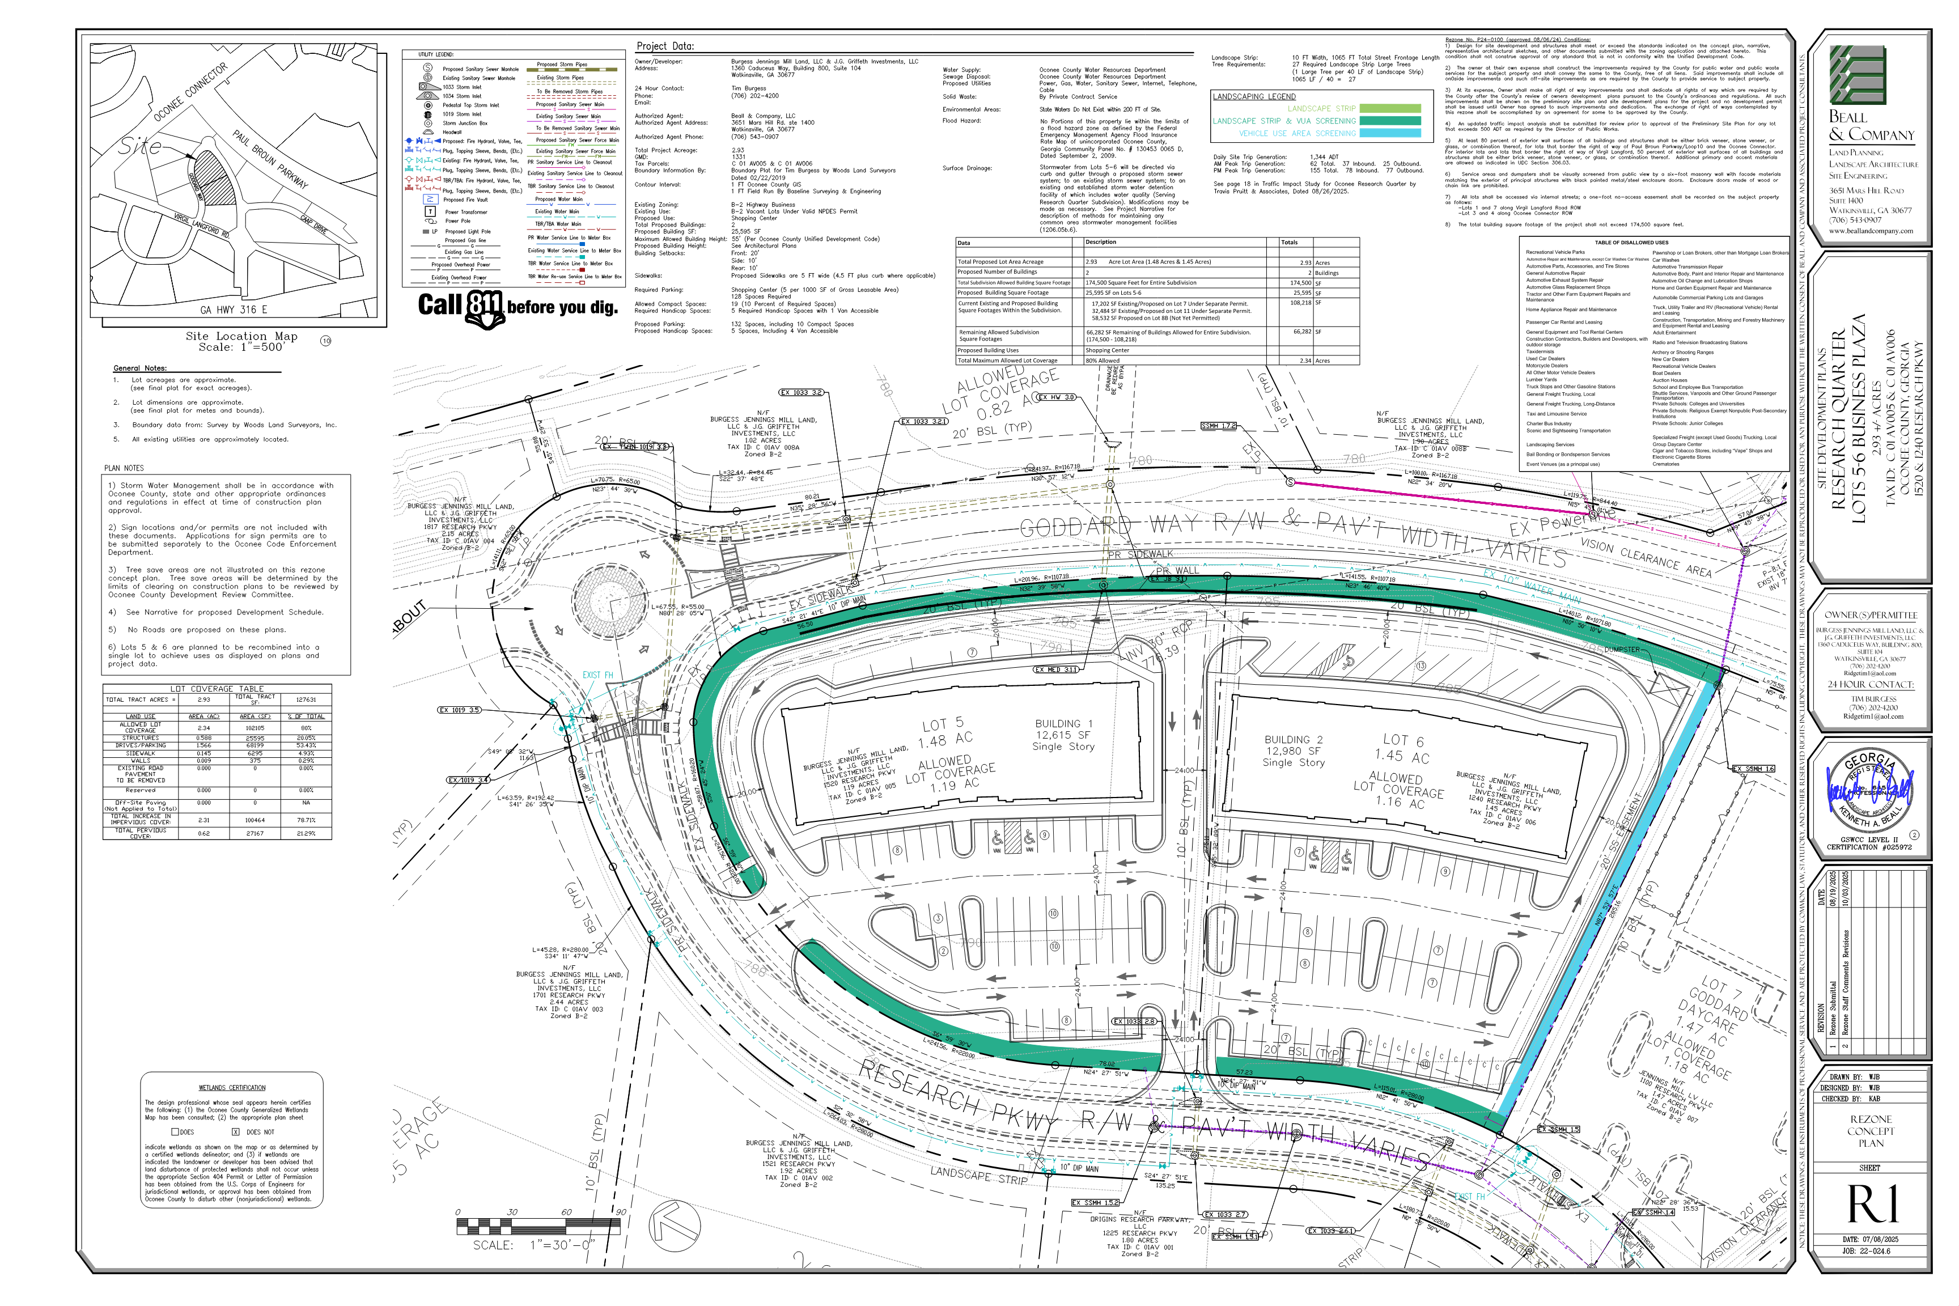
Concept Plan

Slide 9
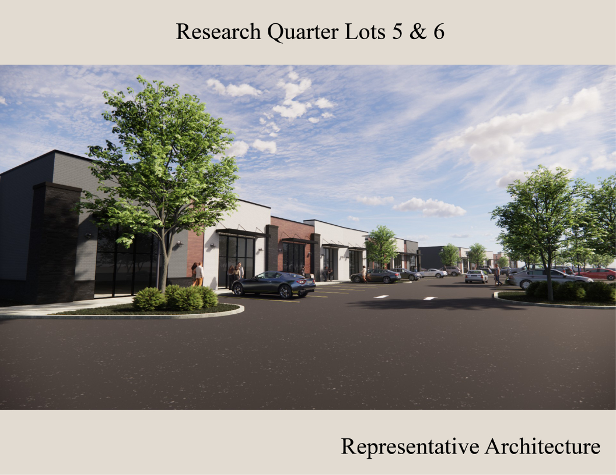
Architectural Images

Slide 10
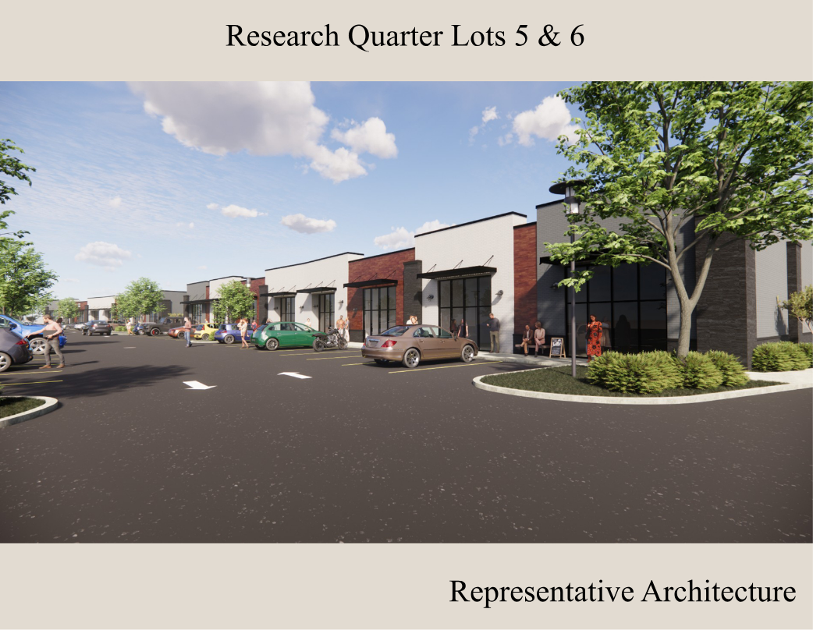
Architectural Images

Slide 11
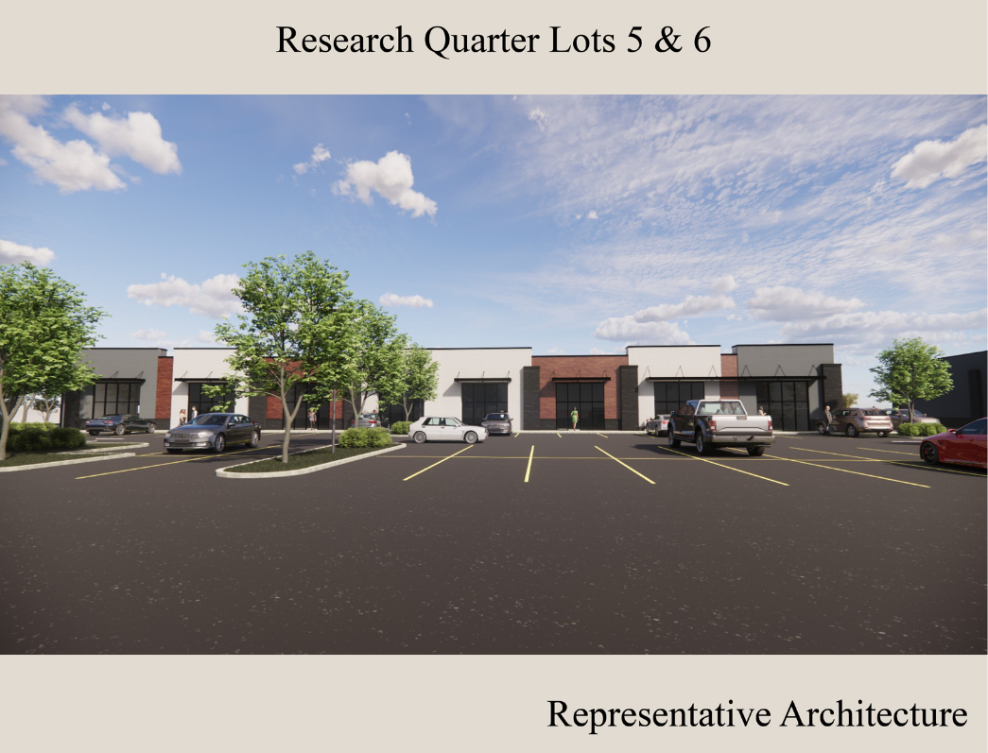
Architectural Images

Slide 12
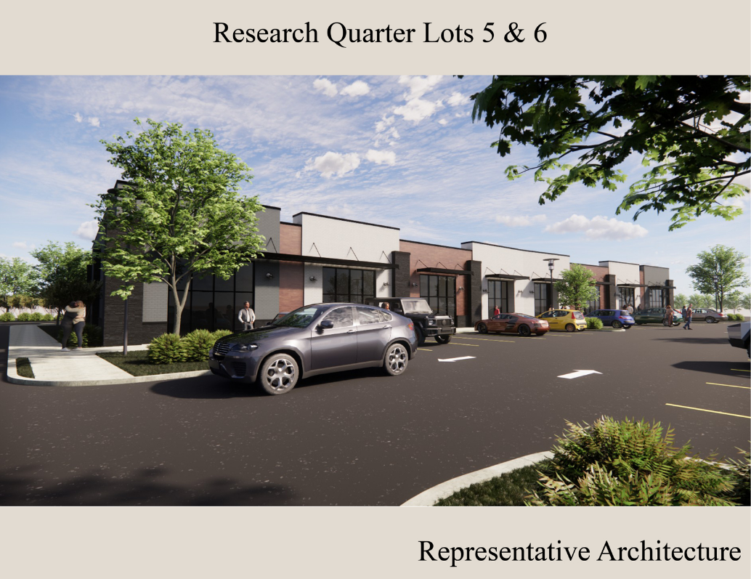
Architectural Images

Slide 13
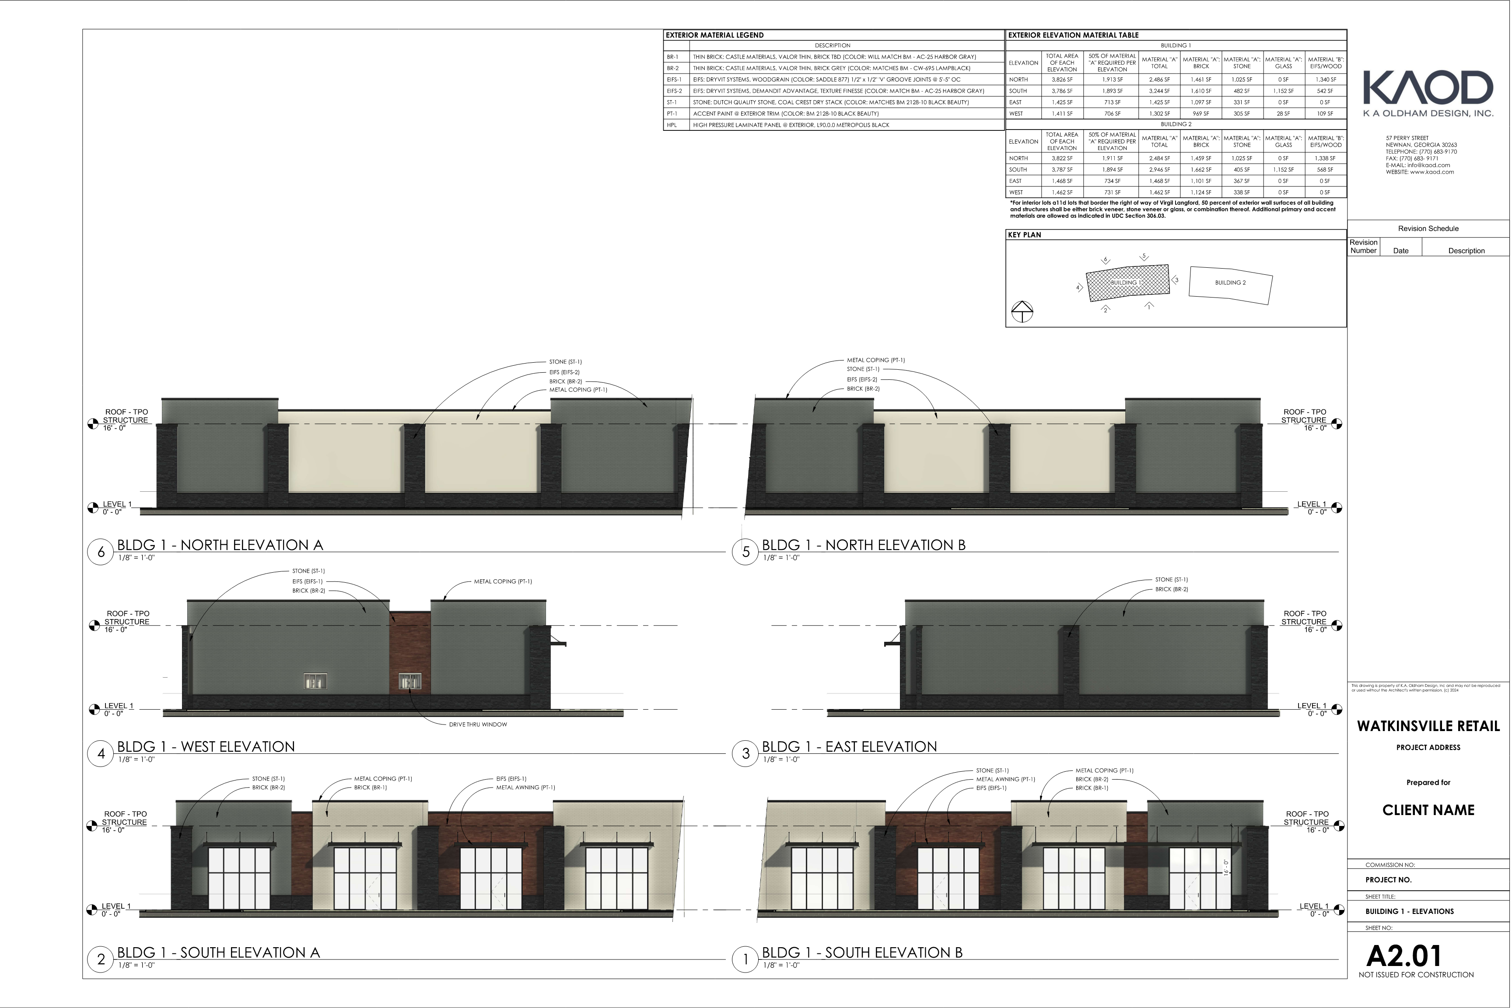
Architectural Images

Slide 14
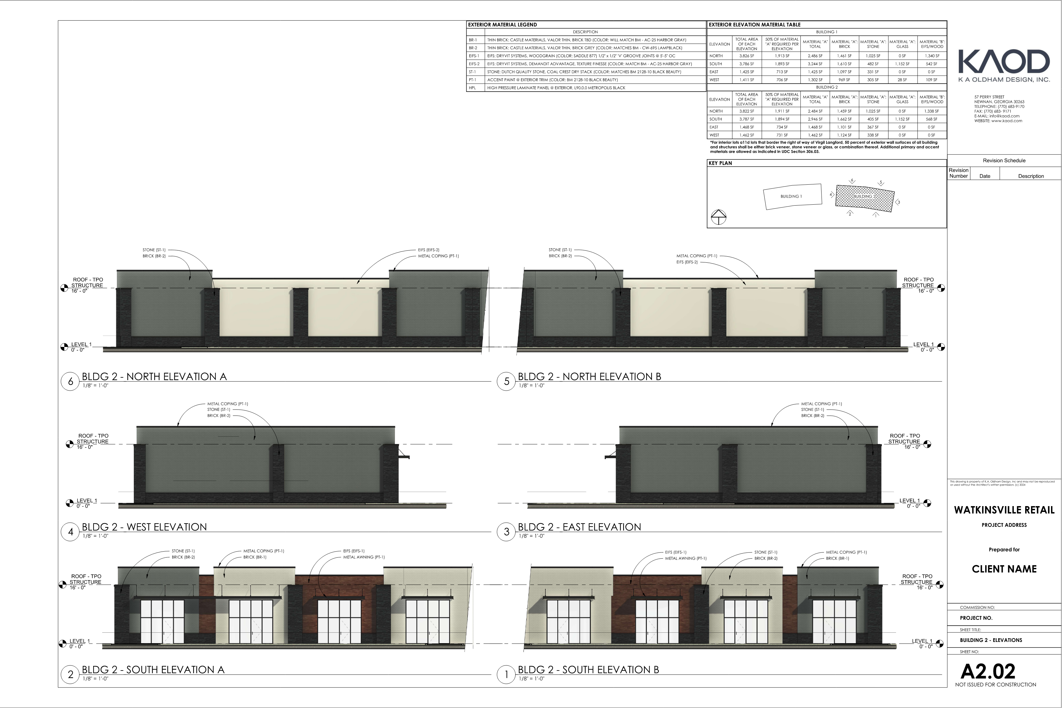
Architectural Images

Slide 15
Staff Recommendation
Based on Board of Commissioners policies, decision-making criteria, and standards outlined in the development codes of Oconee County, staff recommends conditional approval of this request subject to the following conditions to be fulfilled at the expense of the owner/developer:
1. Design for site development and structures shall meet or exceed the standards indicated on the concept plan, narrative, representative architectural sketches, and other documents submitted with the zoning application and attached hereto. This condition shall not construe approval of any standard that is not in conformity with the Unified Development Code.
2. The owner at their own expense shall construct the improvements required by the County for public water and public waste services for the subject property and shall convey the same to the County, free of all liens. Said improvements shall include all on-site improvements and such off-site improvements as are required by the County to provide service to subject property.
3. At its expense, Owner shall make all right of way improvements and shall dedicate all rights of way which are required by the County after the County’s review of Owner's development plans pursuant to the County’s ordinances and regulations. All such improvements shall be shown on the preliminary site plan and site development plans for the project and no development permit shall be issued until Owner has agreed to such improvements and dedication.
4. An updated traffic impact analysis shall be submitted for review prior to submission of the Site Development Plans to address comments from the Traffic Consultant. Required traffic improvements to meet the UDC shall be incorporated into the Development Plans for lots 5 and 6 development.

Slide 16
Staff Recommendation
Based on Board of Commissioners policies, decision-making criteria, and standards outlined in the development codes of Oconee County, staff recommends conditional approval of this request subject to the following conditions to be fulfilled at the expense of the owner/developer:
5. The Goddard Way road along the frontage of lots 5 and 6 shall be updated to curb and gutter.
6. An administrative plat shall be submitted for review and approved/recorded prior to submission of the Site Development Plans.
7. Service areas and dumpsters shall be visually screened from public view by a six-foot masonry wall with façade materials matching the exterior of principal structures with black painted metal/steel enclosure doors. Enclosure doors made of wood or chain link are prohibited.
8. No outdoor display or storage of merchandise shall be allowed, including seasonal items. This shall include seasonal items sold from a trailer.
9. No merchandise or displays are allowed to be stored in parking or drive aisle areas. This includes any use of tractor trailers or shipping containers used for excess storage.
10. The total building square footage of all lots in the Research Quarter subdivision shall not exceed 174,500 square feet.

Slide 17
Staff Recommendation
11. The following uses, allowed by right in the B-2 zoning district, shall not be allowed:

Slide 18
Planning Commission Recommendation
Planning Commission recommends approval subject to the conditions recommended by staff.

