Slide 1


Slide 2
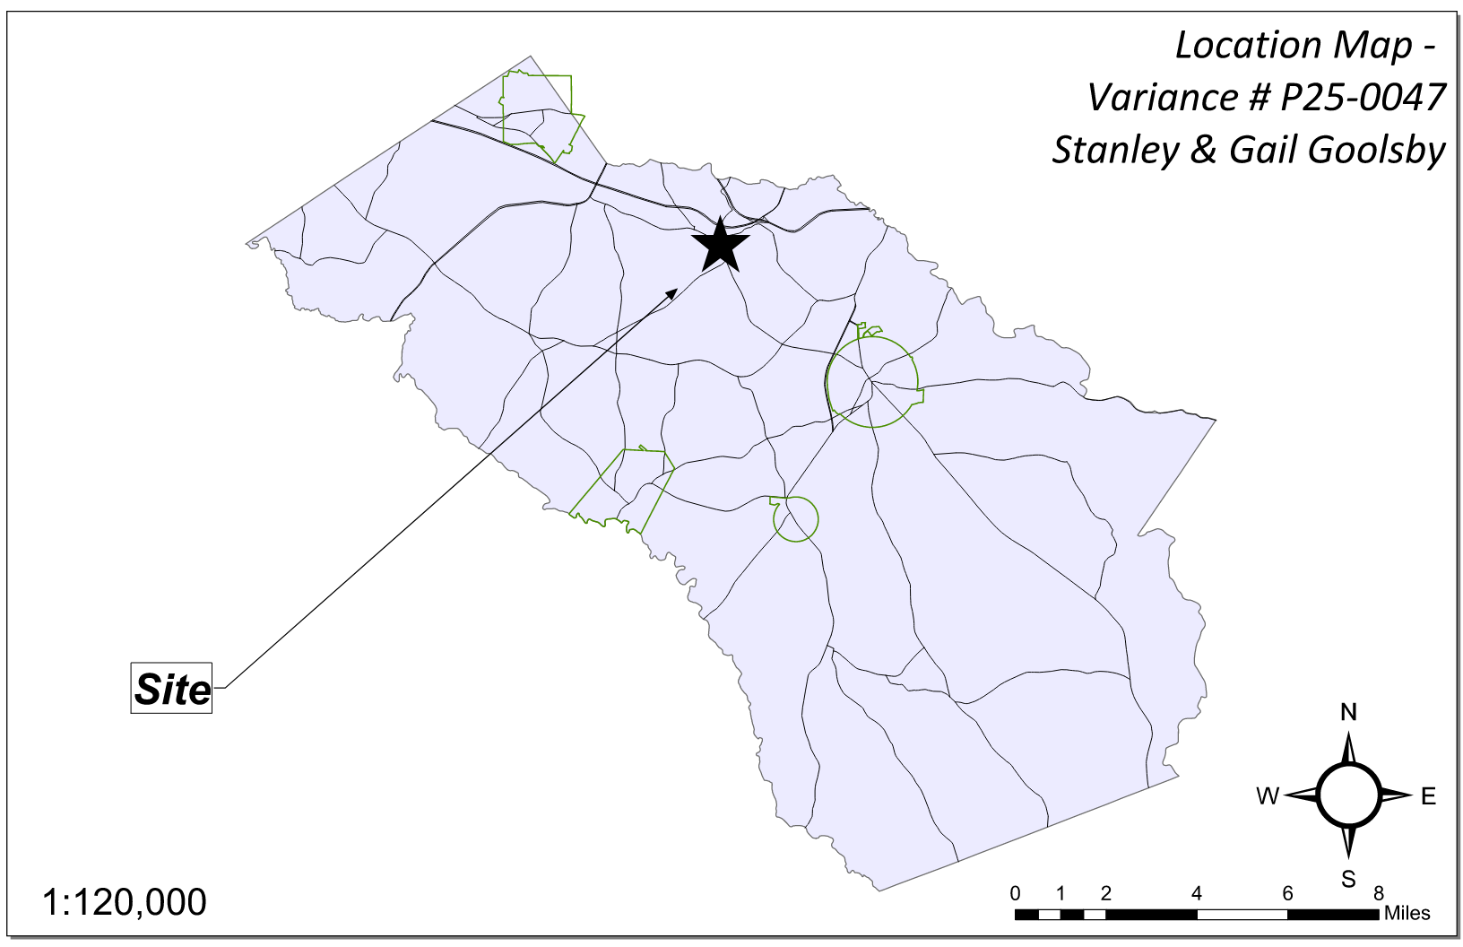
Site Location

Slide 3
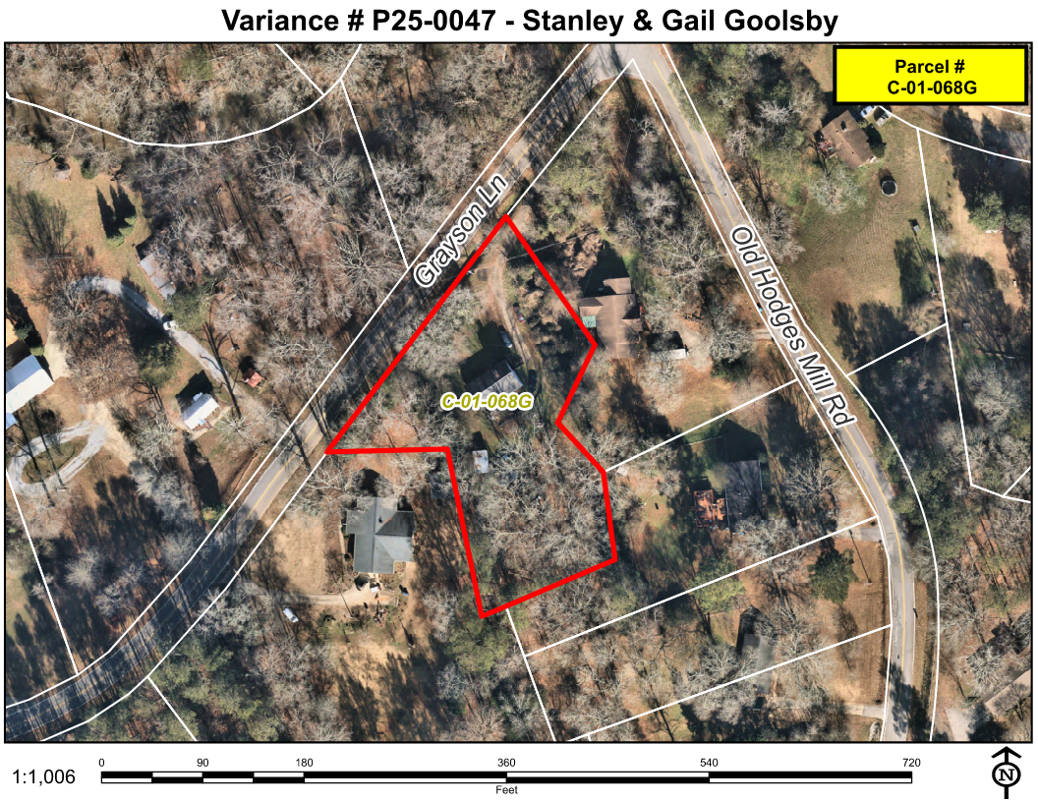
Aerial Imagery

Slide 4
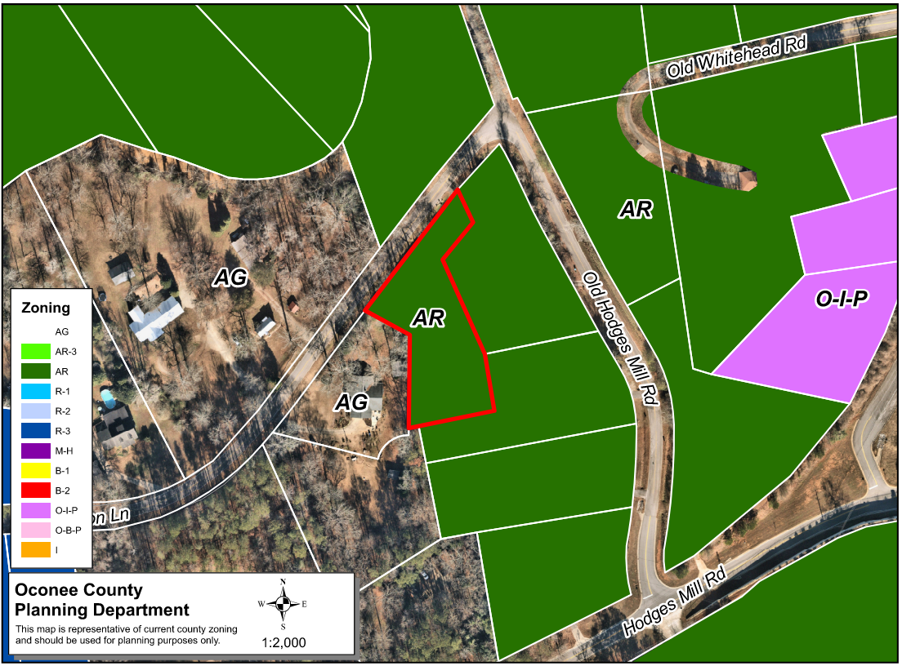
Zoning
AG

Slide 5
Future Development

Slide 6
Summary of Request
Variance for a metal accessory building constructed without permits from Oconee County Unified Development Code Section 410.01.c (1) and Table 4.1 to allow an accessory structure to encroach 32.6 feet into the rear 40-foot setback.

Slide 7
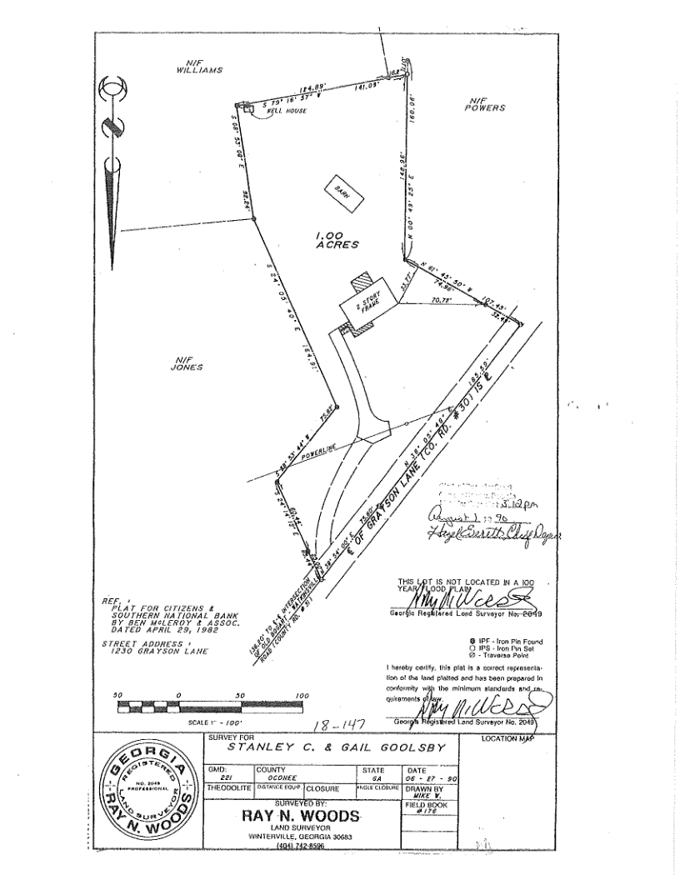
Recorded Plat

Slide 8
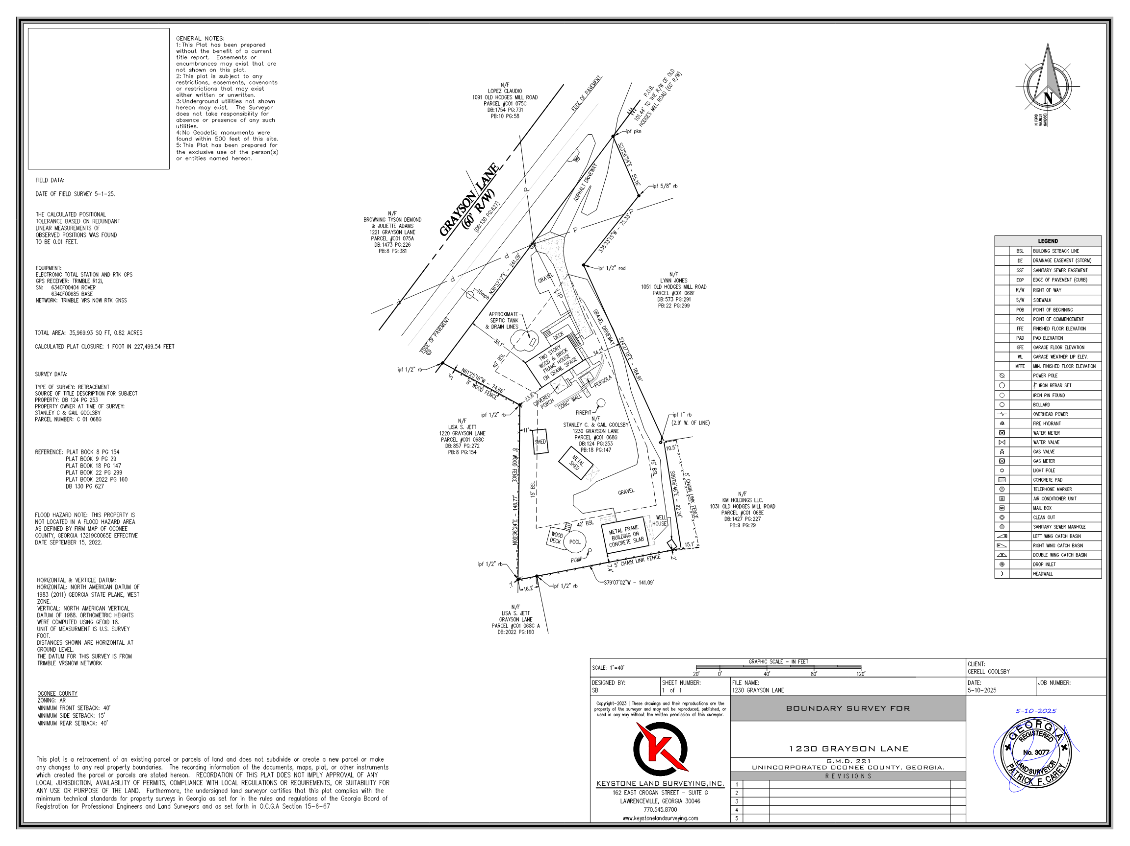
Concept Plan

Slide 9
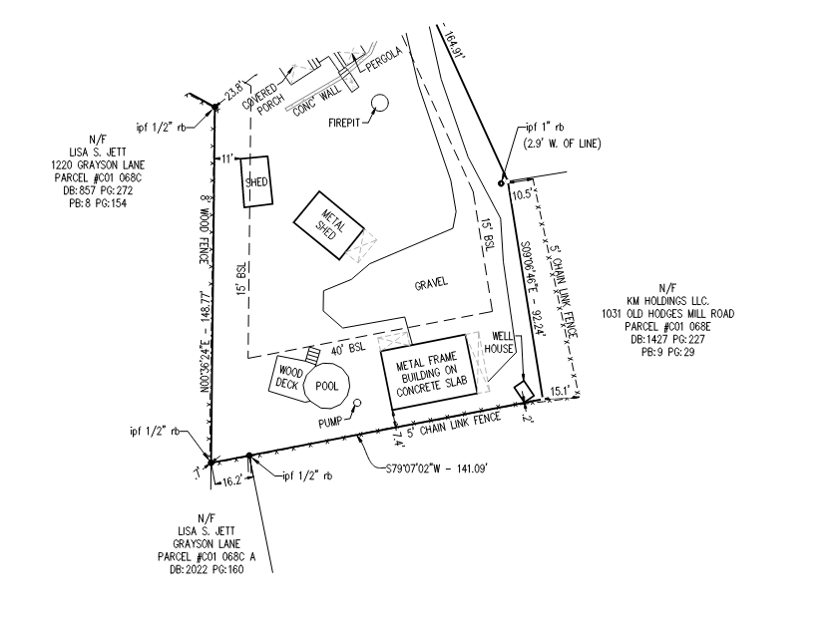
Concept Plan

Slide 10
EH Current Septic Location

Slide 11
EH Site Plan with Well Setbacks

Slide 12
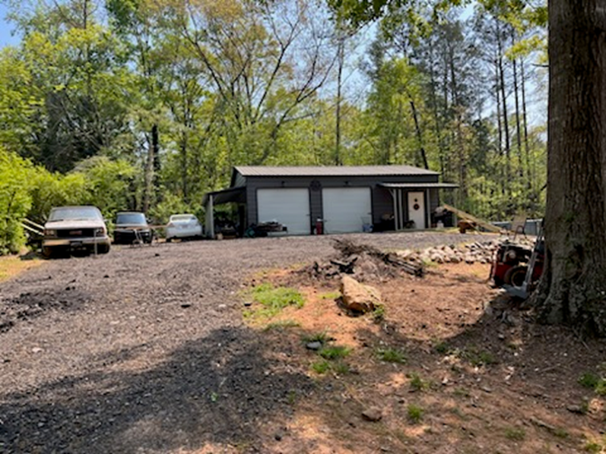
Architectural Renderings

Slide 13
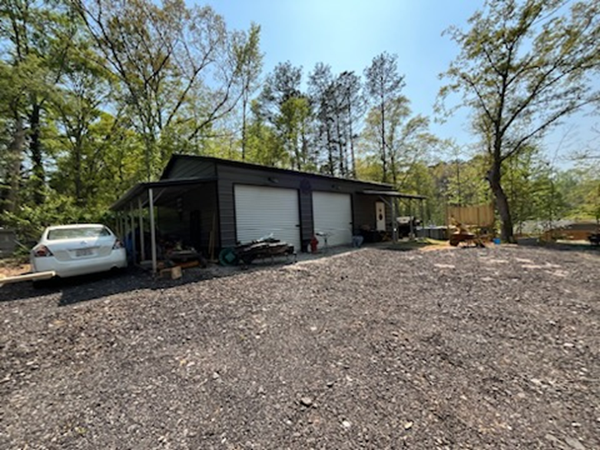
Architectural Renderings

Slide 14
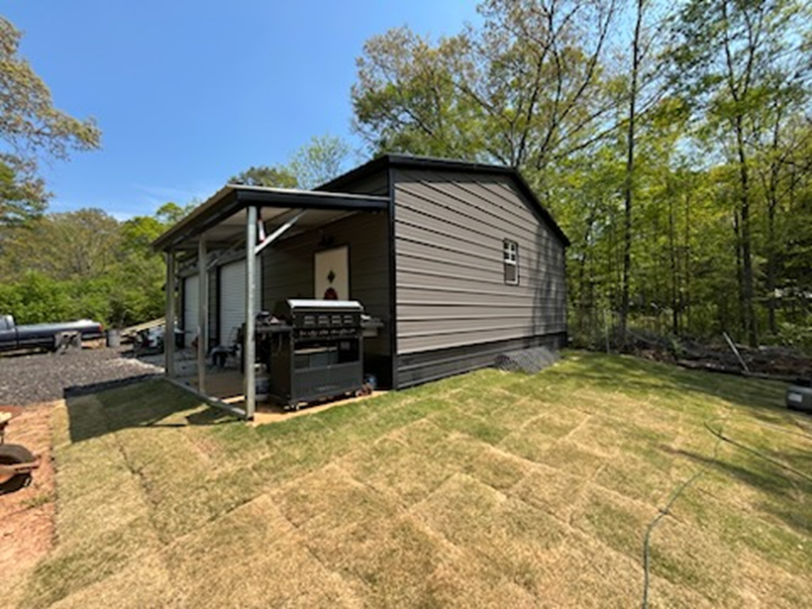
Architectural Renderings

Slide 15
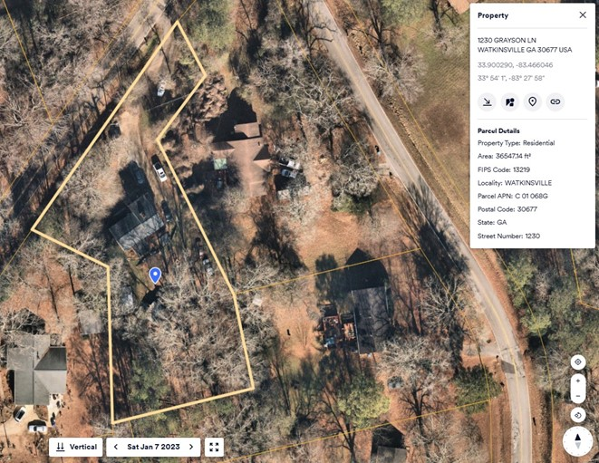
Site in 2023 prior to construction of the accessory building built without permits

Slide 16
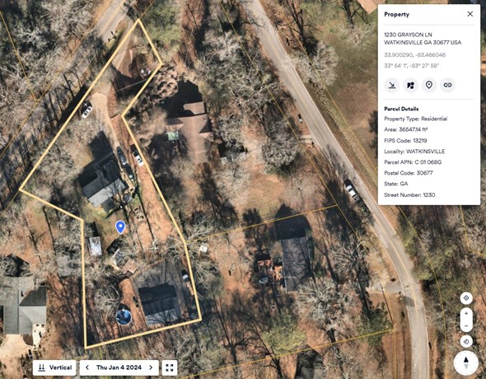
Site as of January 4, 2024, showing the accessory building built without permits

Slide 17
Staff Recommendation
Based upon the standards and limitations for special exception variance approval, this request does NOT meet all necessary conditions to grant a special exception variance as the hardship was created by the property owner with the construction of an unpermitted structure. Staff recommends denial of the request as the applicant did not indicate why the setback requirements could not be met.

Slide 18
BACKGROUND INFORMATION & FINDINGS OF FACT
HISTORY
The 1.0-acre property was created by deed and reflected on a plat recorded July 2, 1982, that was not signed by
the county.
The recorded plat was filed August 1, 1990, that was not signed by the county.
This property was rezoned to A-2 on April 1, 1969.
According to Tax Assessor records a 1,450 square foot single family dwelling was built in 1990.
A complaint was filed on Friday, March 31, 2023, that an accessory building was constructed without a permit.
Site was visited by BV on March 31, 2023, and owner told to stop work and apply for a permit.
Stop Work Order was issued on Monday April 4, 2023.
Owner submitted incomplete application. EH approval and setback variance required.
Aerial photography shows the accessory structure between January 7, 2023, and January 4, 2024, without a permit.
Another complaint was filed April 3, 2024, that an accessory structure/deck/pool was constructed without a permit.
April 4, 2024, the applicant was found to have a deck under construction without a permit and the owner was notified to stop work on the deck and apply for deck permit.
A notice of violation was issued April 8, 2024, by Planning and Code Enforcement for building an accessory structure/deck without first obtaining a permit, a violation of UDC section 1225.01(a).
The deck structure was permitted and triple permit fee applied.
The applicant did not take steps to rectify the violation on the accessory structure, and a summons was issued to appear before Magistrate Court on February 7, 2025.
The court date was delayed as the applicant applied for a variance on April 18, 2025, but the application was not complete.
The case has not been dismissed from Magistrate Court.
The survey submitted shows the accessory structure is ± 1,117.6 square feet. In the AR zoning district the size of accessory structures are not restricted.
The survey also shows the structure encroaches 32.6 feet into the rear 40-foot setback.

