Slide 1


Slide 2
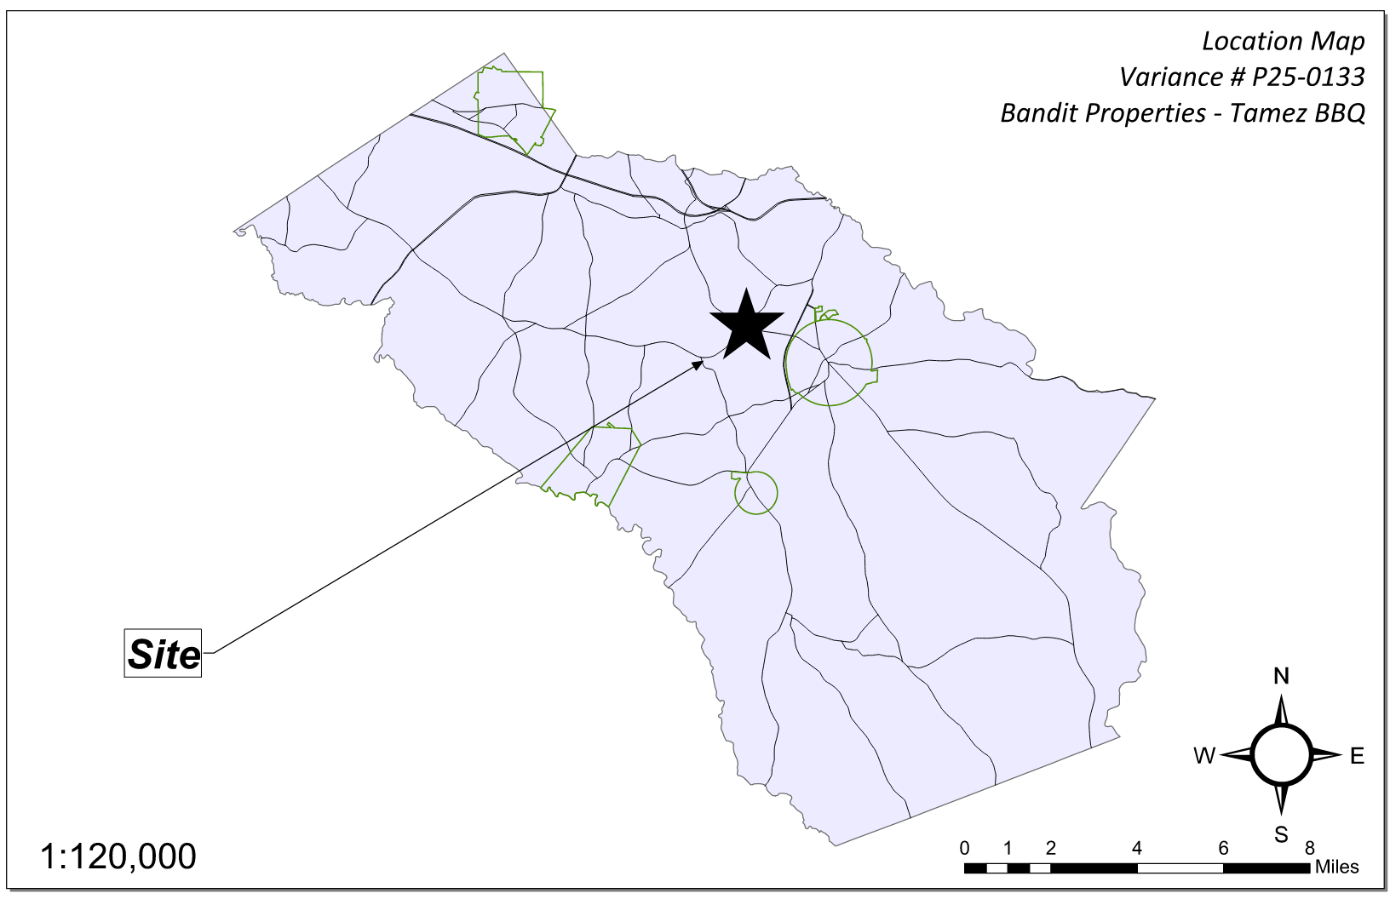
Site Location

Slide 3
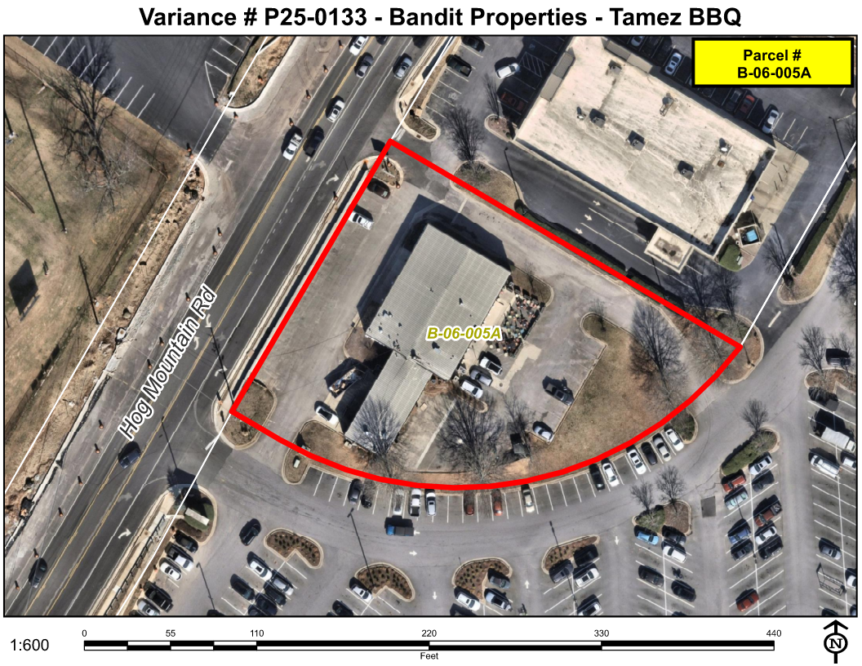
Aerial Imagery

Slide 4
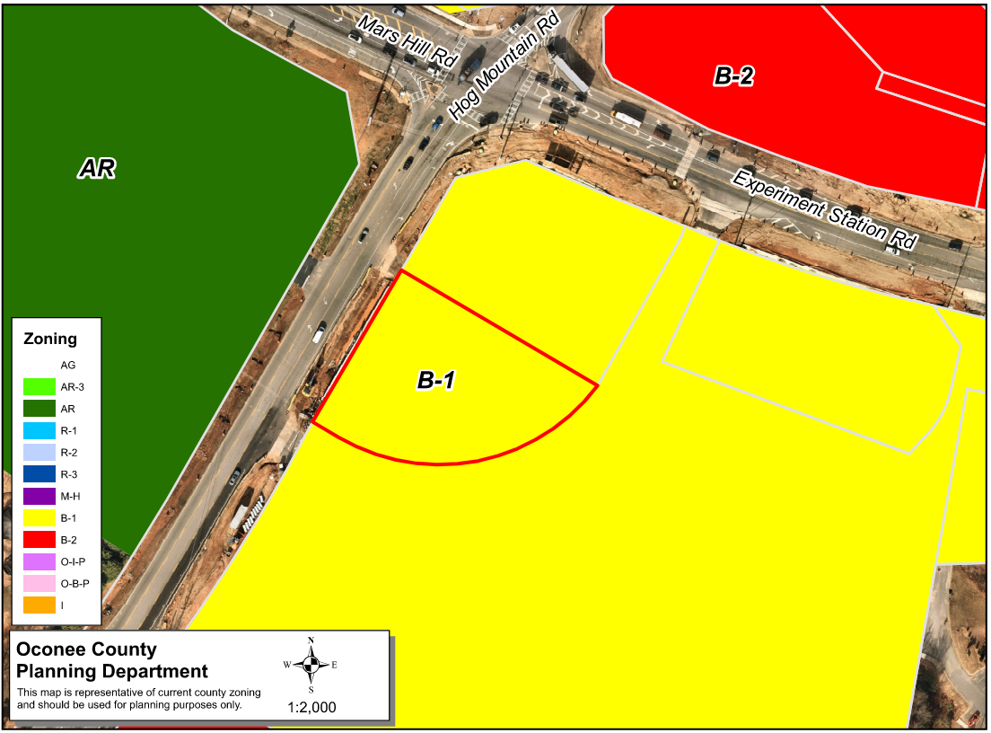
Zoning
AG

Slide 5
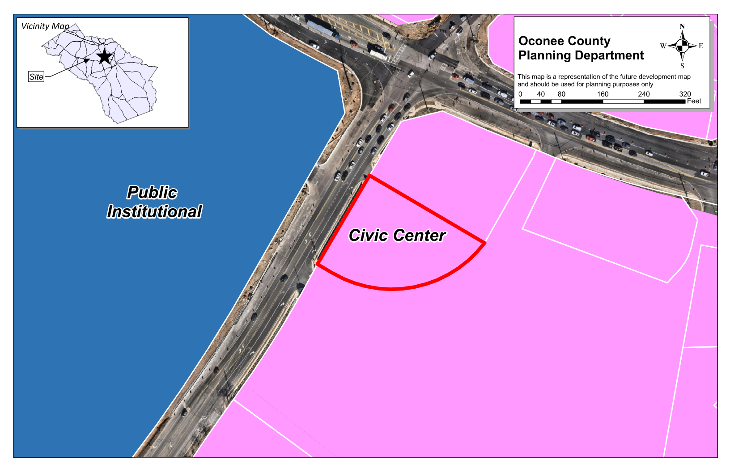
Future Development

Slide 6
Summary of Request
A special exception variance from Oconee County Unified Development Code Article 6 Section 604.01.b. and Table 6.1 to reduce the minimum required off-street parking spaces from 73 to 34 (53% reduction) to add an outdoor seating area that would require an additional 5 parking spaces.

Slide 7
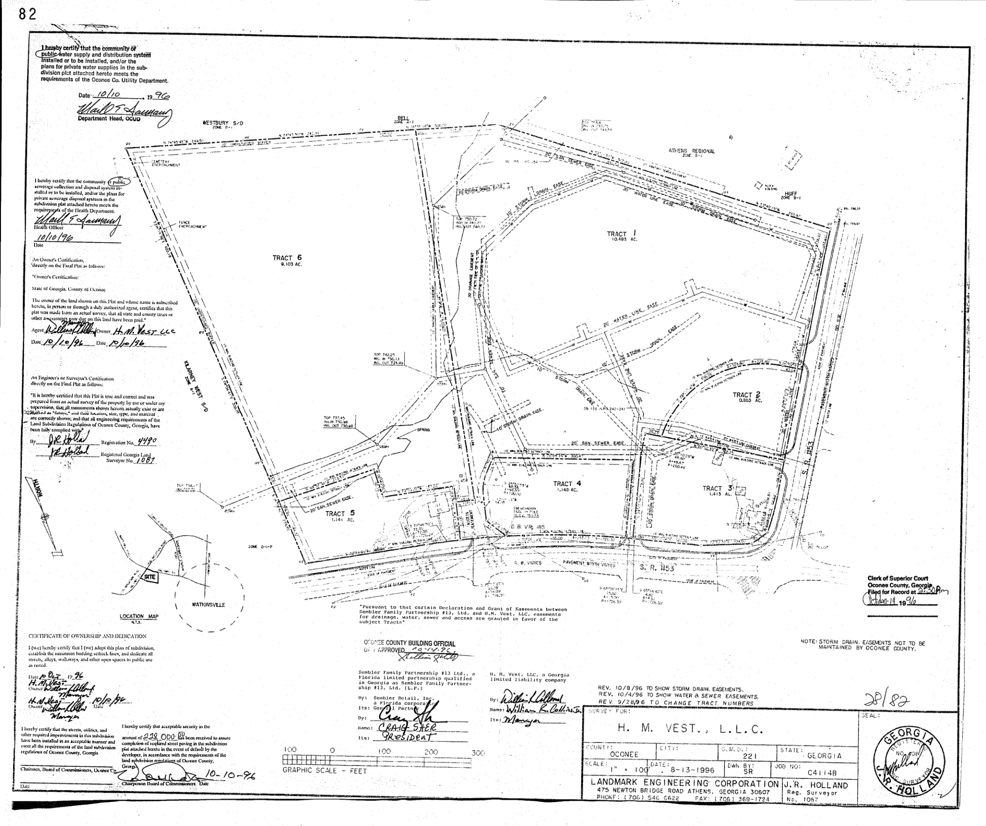
Recorded Plat

Slide 8
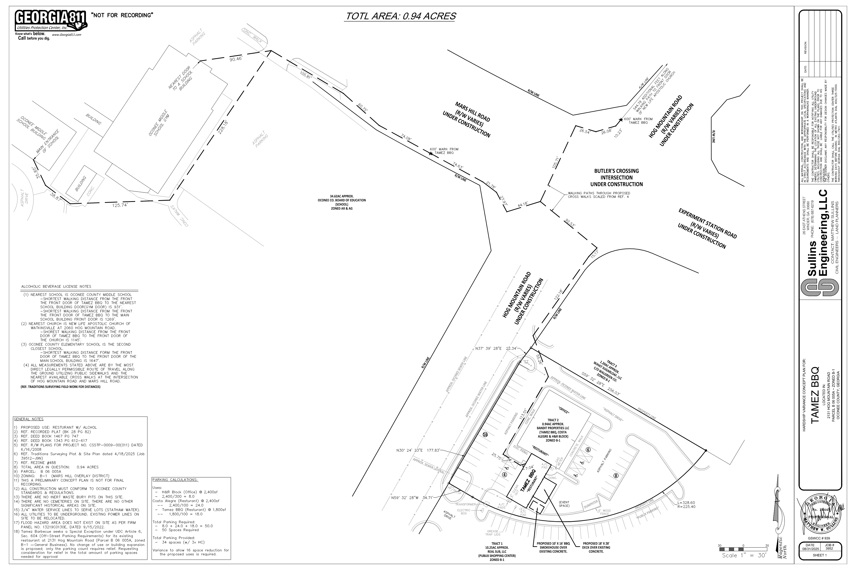
Concept Plan

Slide 9
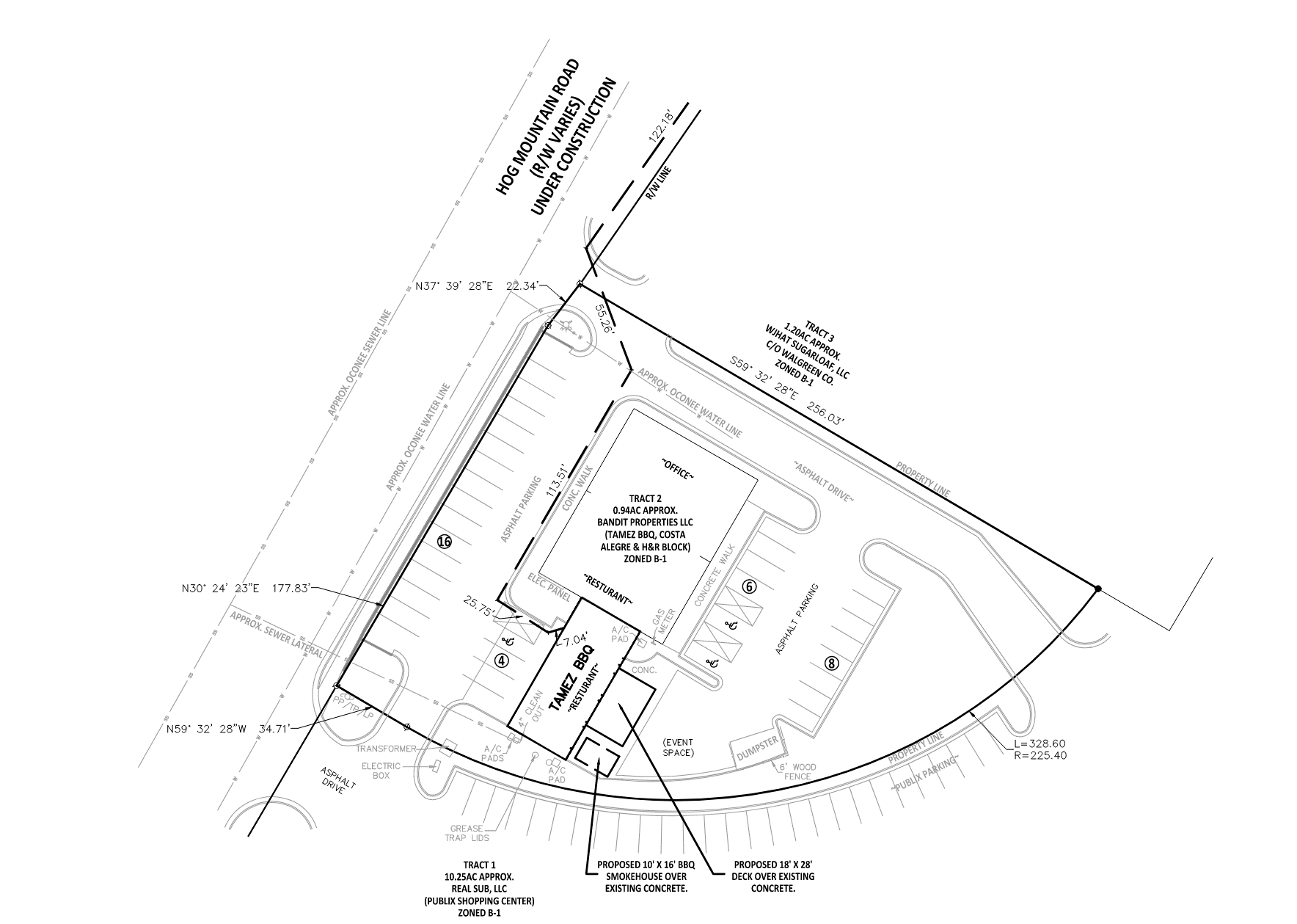
Concept Plan

Slide 10
Staff Recommendation
Based upon the standards and limitations for special exception variance approval, this request does NOT meet all necessary conditions to grant a special exception variance as the hardship would be created by the applicant by the expansion of an existing non-conforming site. Staff recommends denial of the request.
If the Board chooses to grant the variance to reduce the required parking from 73 to 34 spaces, staff recommends the following conditions:
1. Development design and structures shall meet or exceed the standards indicated on the concept plan, narrative, representative architectural sketches, and other documents submitted with the variance application and attached hereto. This condition shall not construe approval of any standard that is not in conformity with the Unified Development Code.
2. The proposed outdoor seating area shall be limited to 18’ x 28’ (504 SF).
3. No existing parking space may be used for outdoor seating or a loading area.
4. There shall be no amplified sound generated in the outdoor seating area.
5. No other outside events shall be allowed, and the applicant shall not erect any temporary structures or tents outside of the approved outdoor seating area.
6. There shall be no outside cooking facilities allowed that are not in compliance with the UDC standards.
7. The applicant shall submit plans within 30 days and complete the construction of an enclosed cooking area within six months of approval to remain in operation. The temporary certificate of occupancy may remain in effect until the additional construction is completed.

