Slide 1


Slide 2
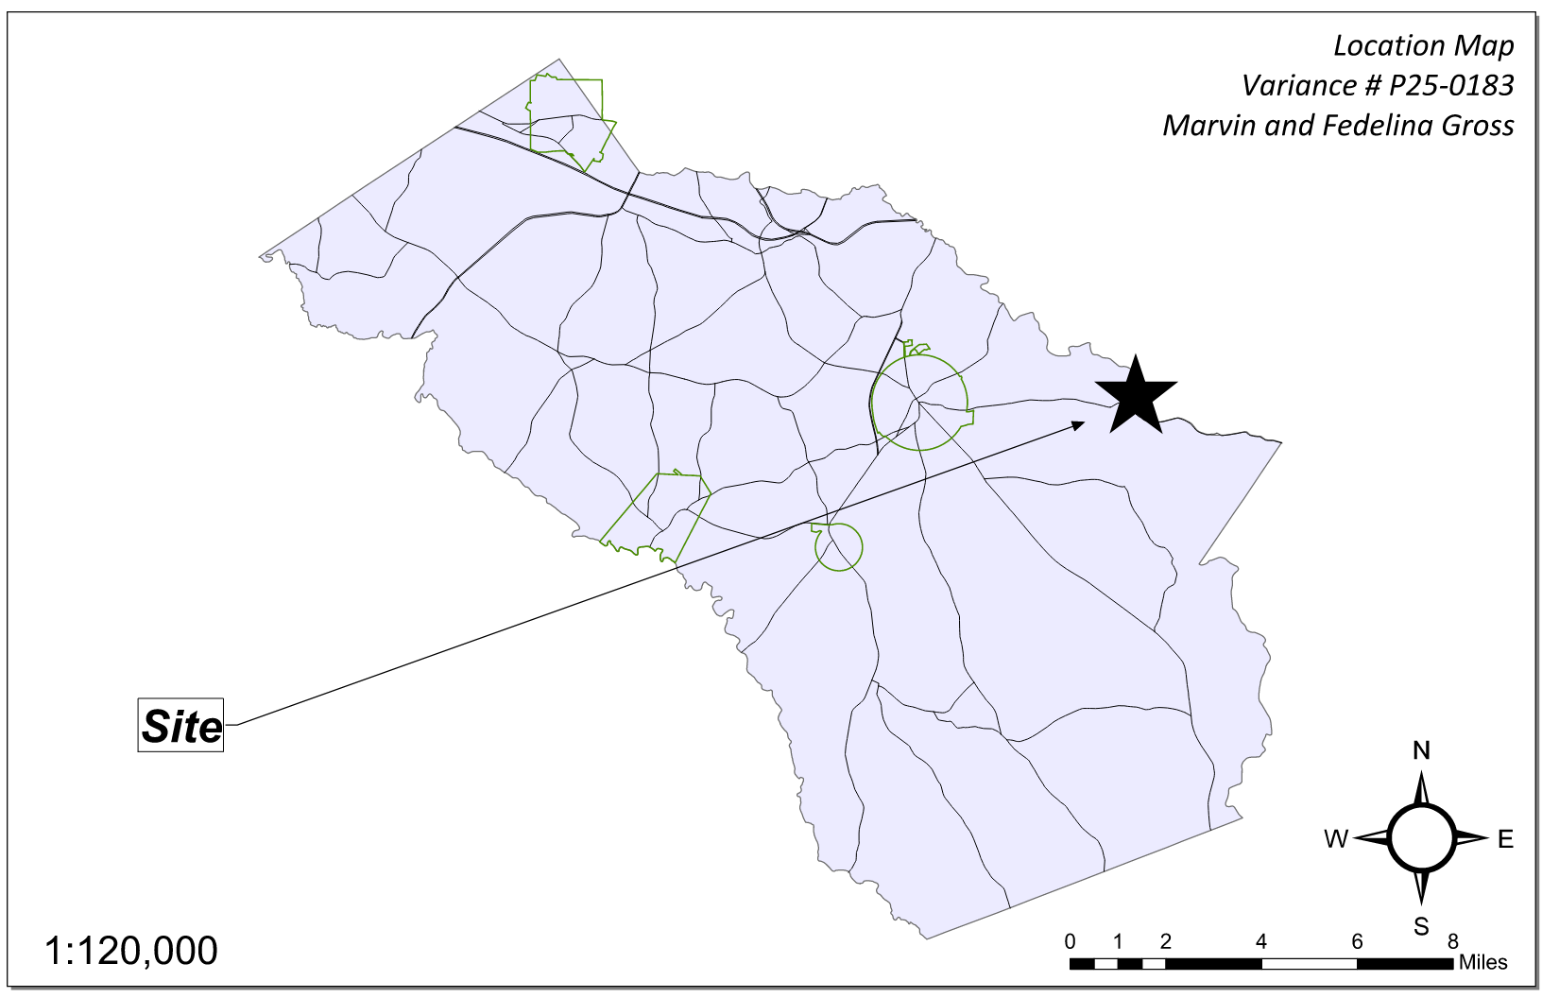
Site Location

Slide 3
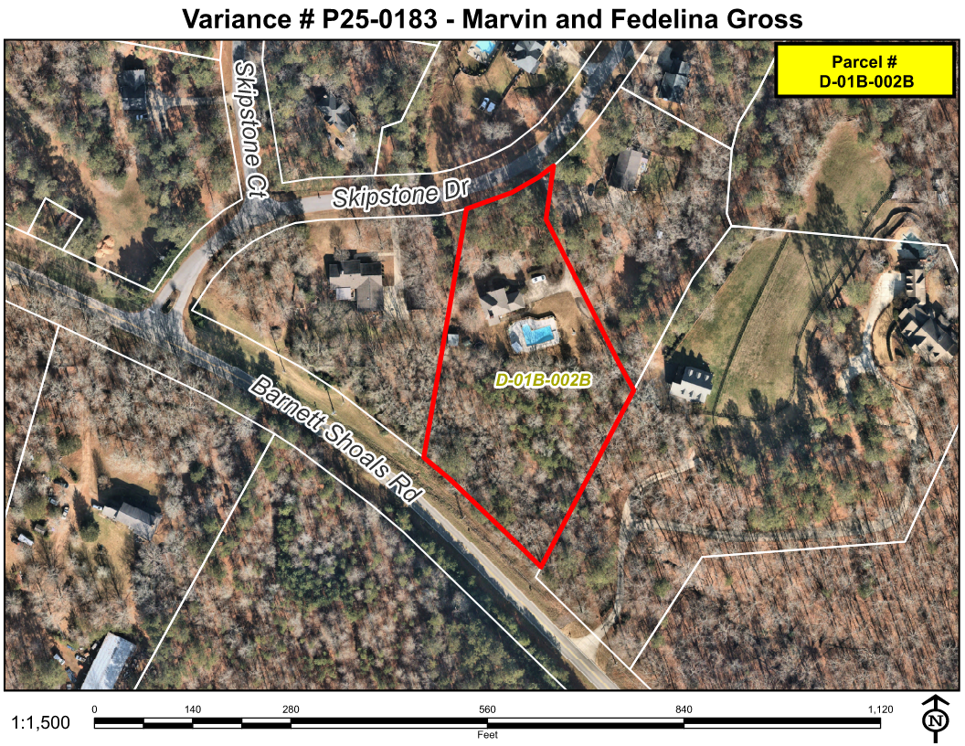
Aerial Imagery

Slide 4
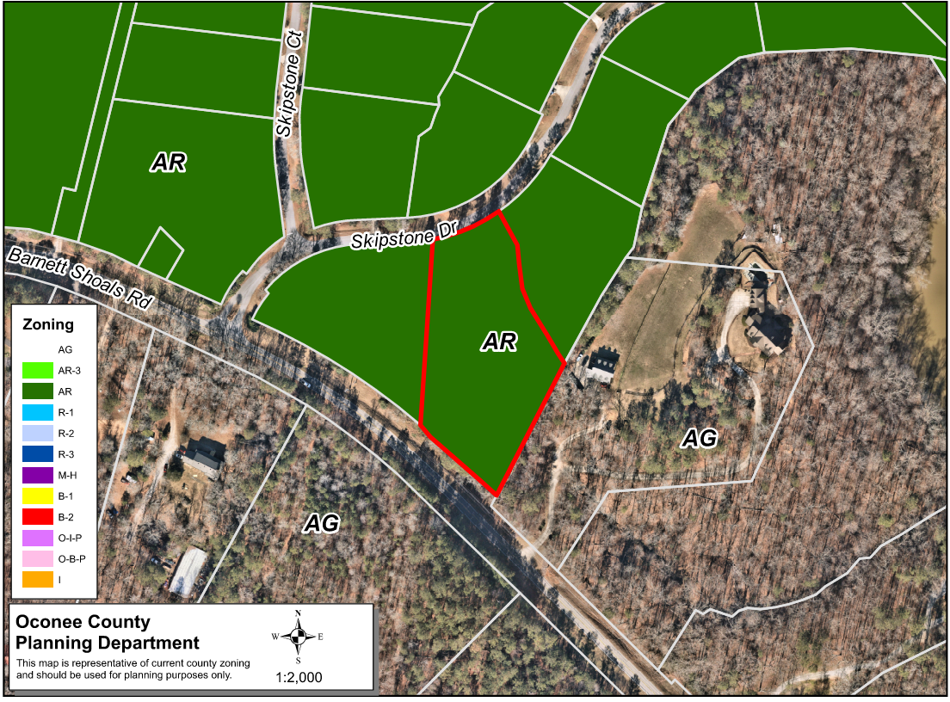
Zoning
AG

Slide 5
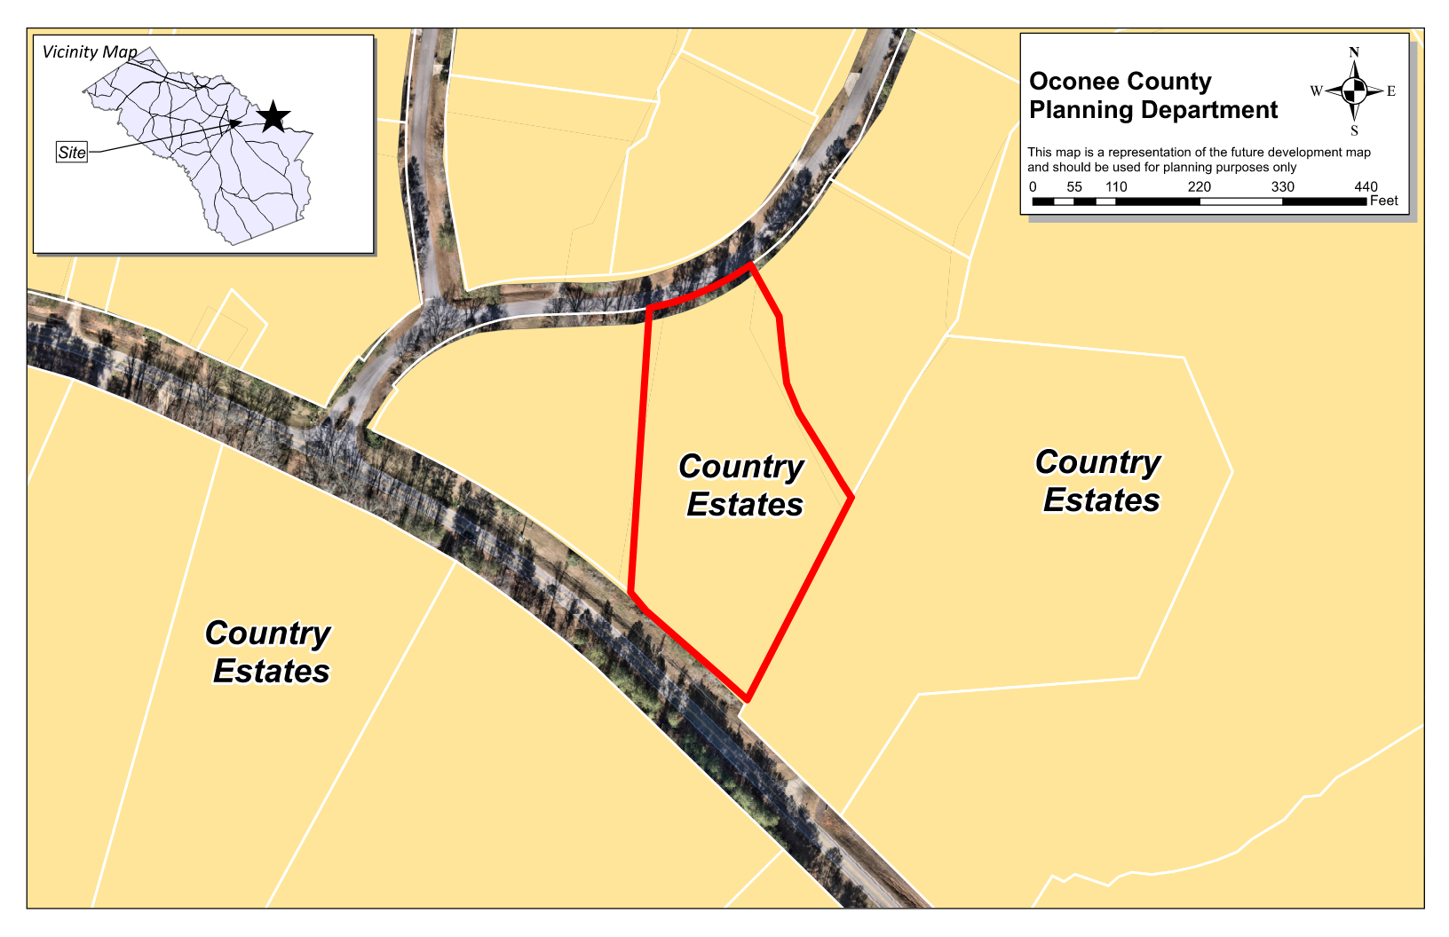
Future Development

Slide 6
Summary of Request
A special exception variance from Oconee County Unified Development Code Article 3 Section 351.02.c. to place a guest house in the front yard.

Slide 7
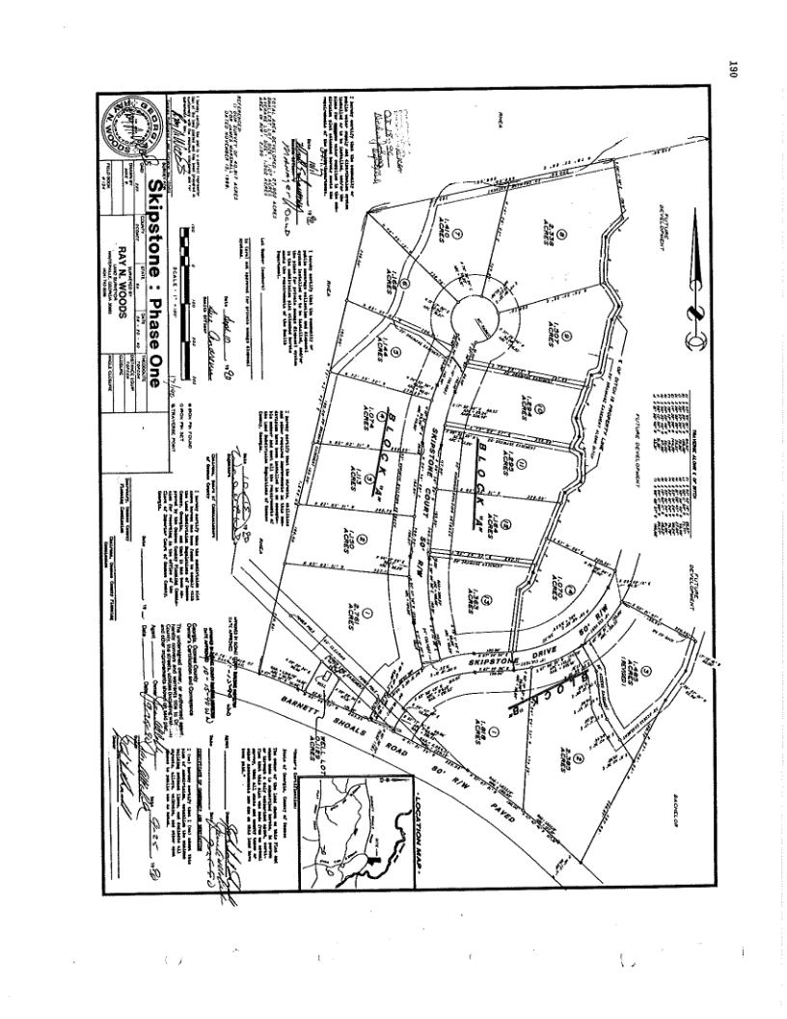
Recorded Plat

Slide 8
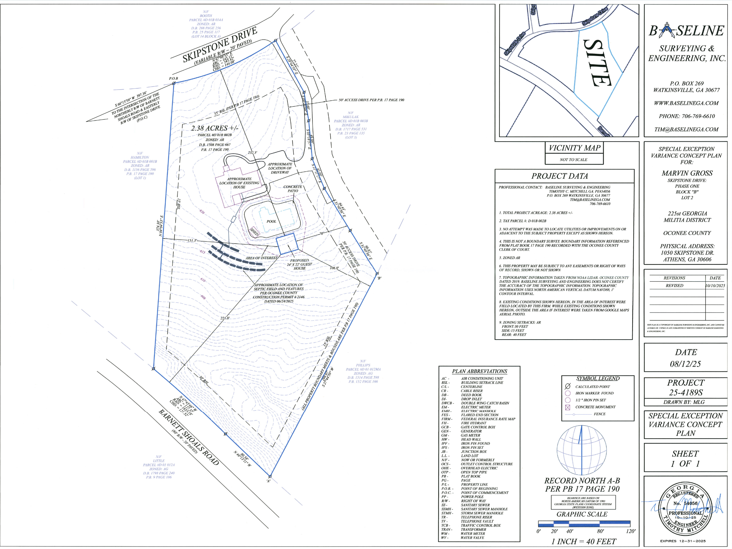
Concept Plan

Slide 9
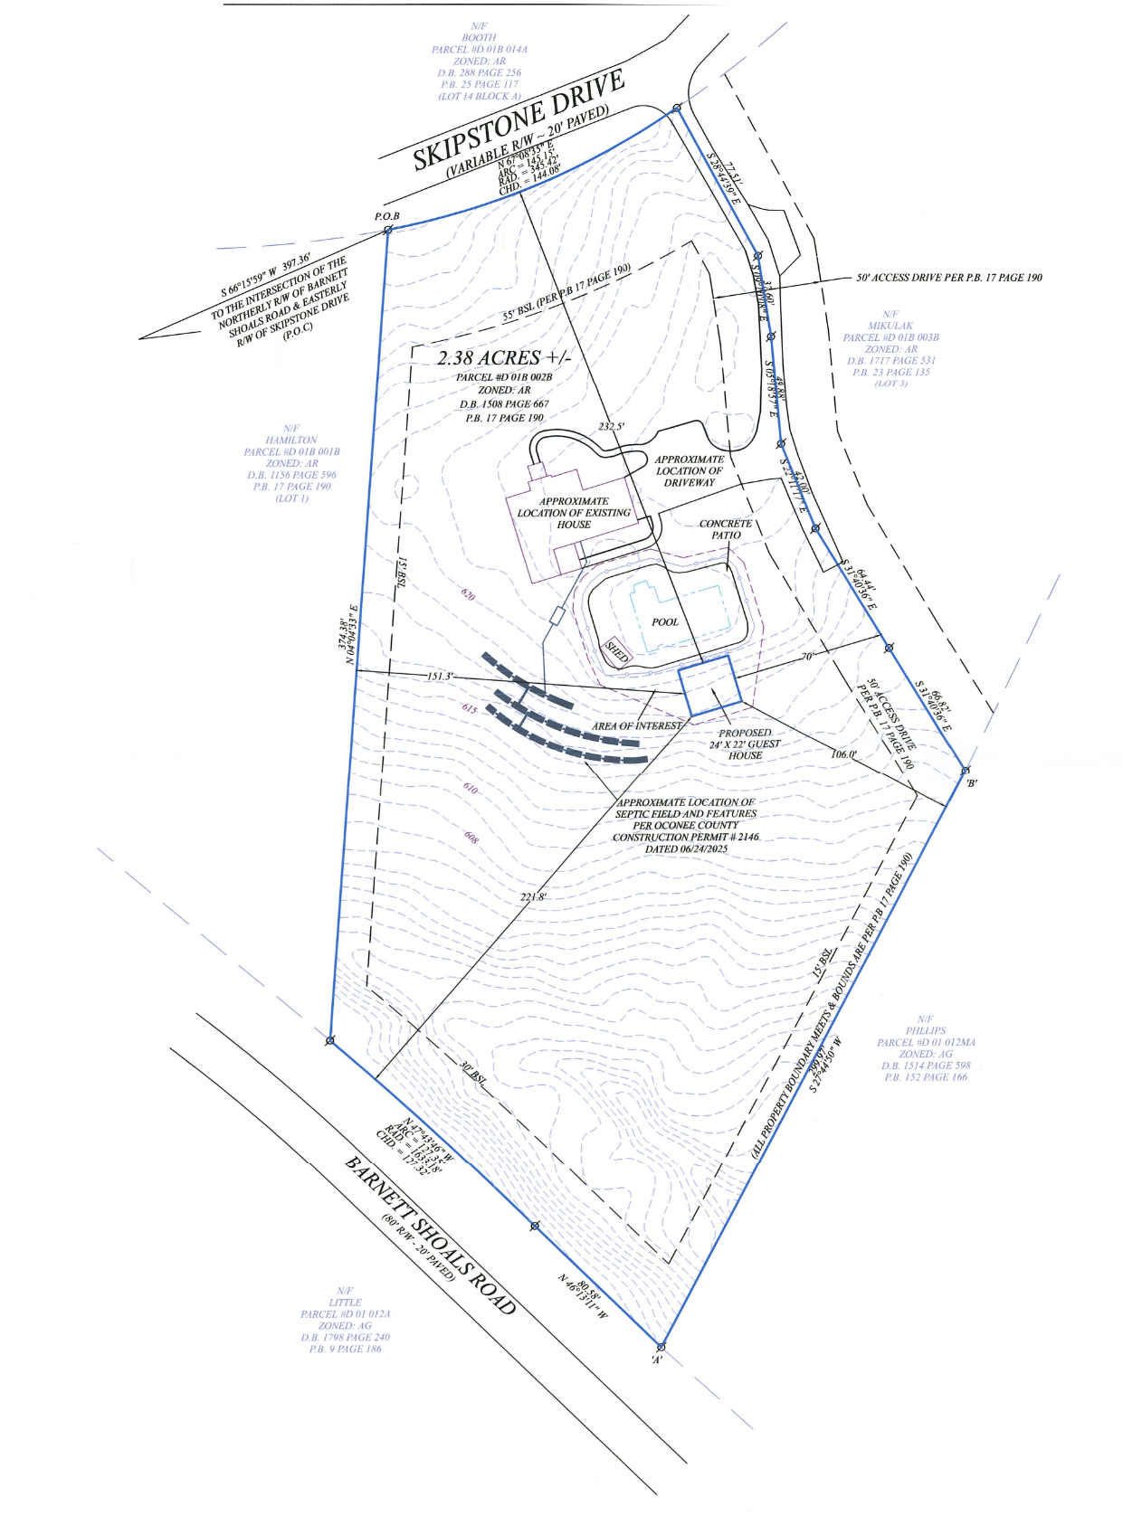
Concept Plan

Slide 10
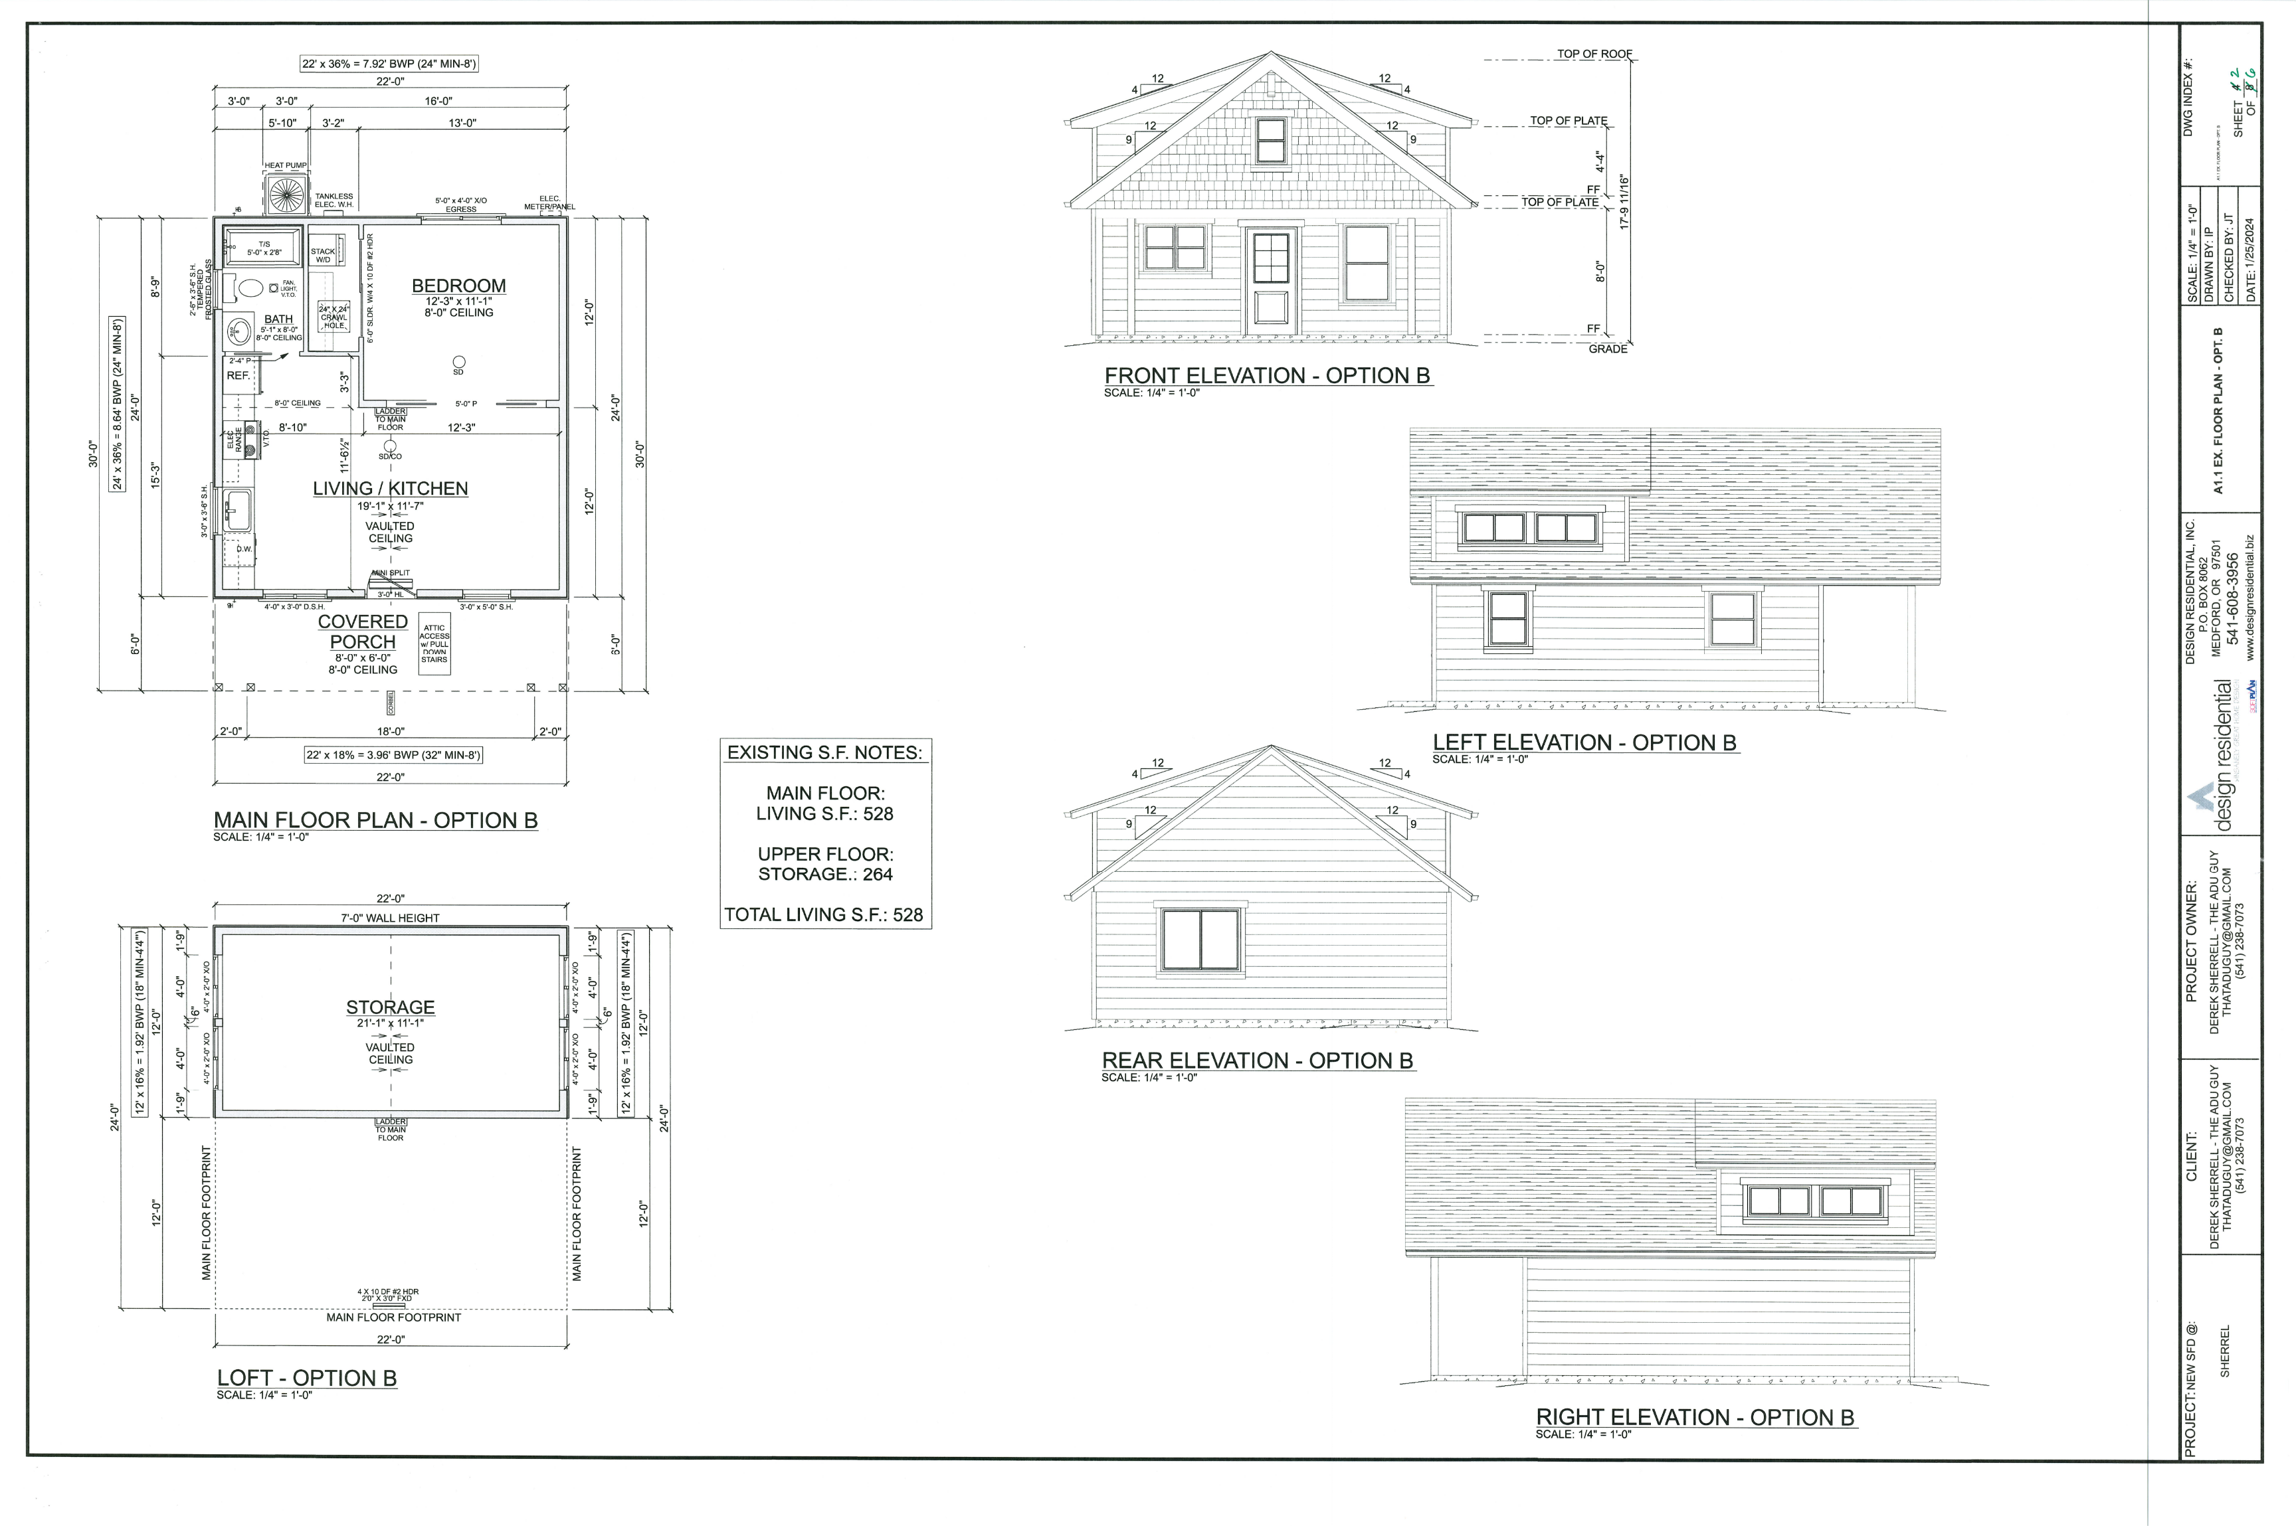
Architectural Renderings

Slide 11
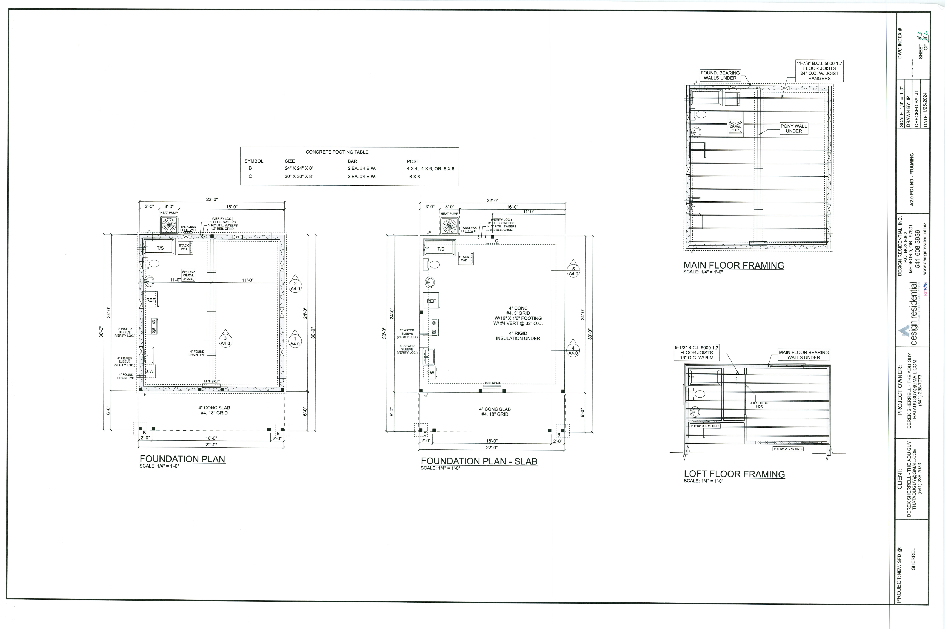
Architectural Renderings

Slide 12
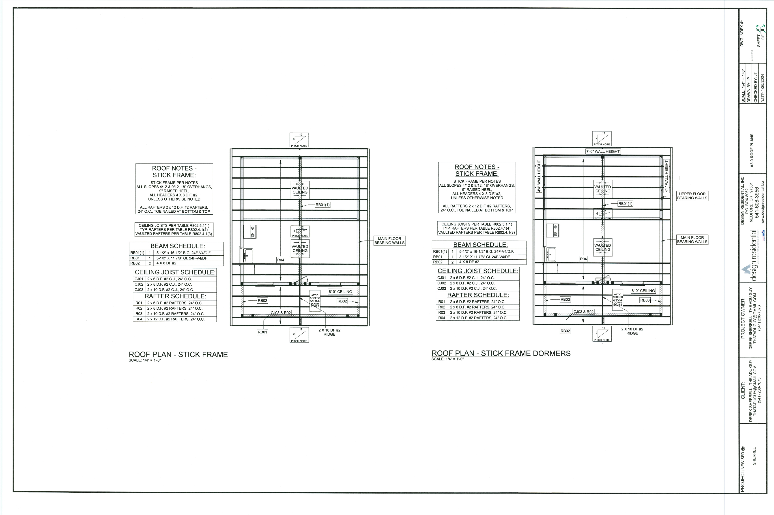
Architectural Renderings

Slide 13
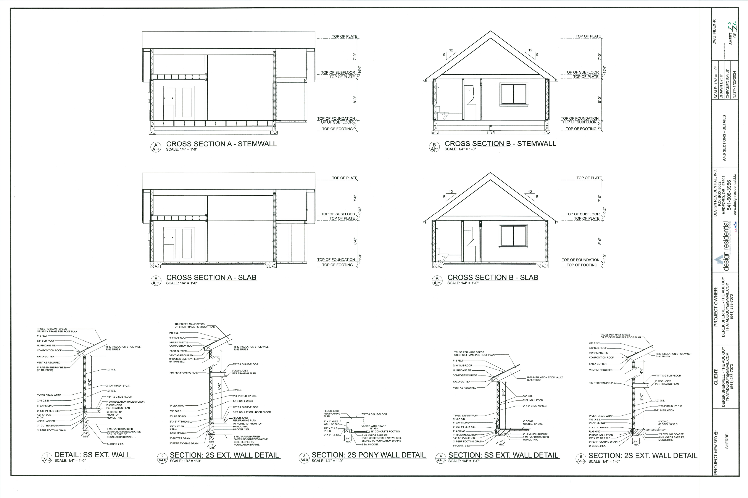
Architectural Renderings

Slide 14
Staff Recommendation
Based upon the standards and limitations for special exception variance approval, this request does meet all necessary conditions to grant a special exception variance to the Guest House standards. Should the present request be approved, staff recommends the following conditions be fulfilled at the owner/developer’s expense.
1. Development design and structures shall meet or exceed the standards indicated on the concept plan, narrative, representative architectural sketches, and other documents submitted with the variance application and attached hereto. This condition shall not construe approval of any standard that is not in conformity with the Unified Development Code.
2. There shall be no driveway access to Barnett Shoals Road. The guest house shall utilize the existing residential driveway for parking and access, connecting to Skipstone Dr.

