Slide 1


Slide 2
Site Location

Slide 3
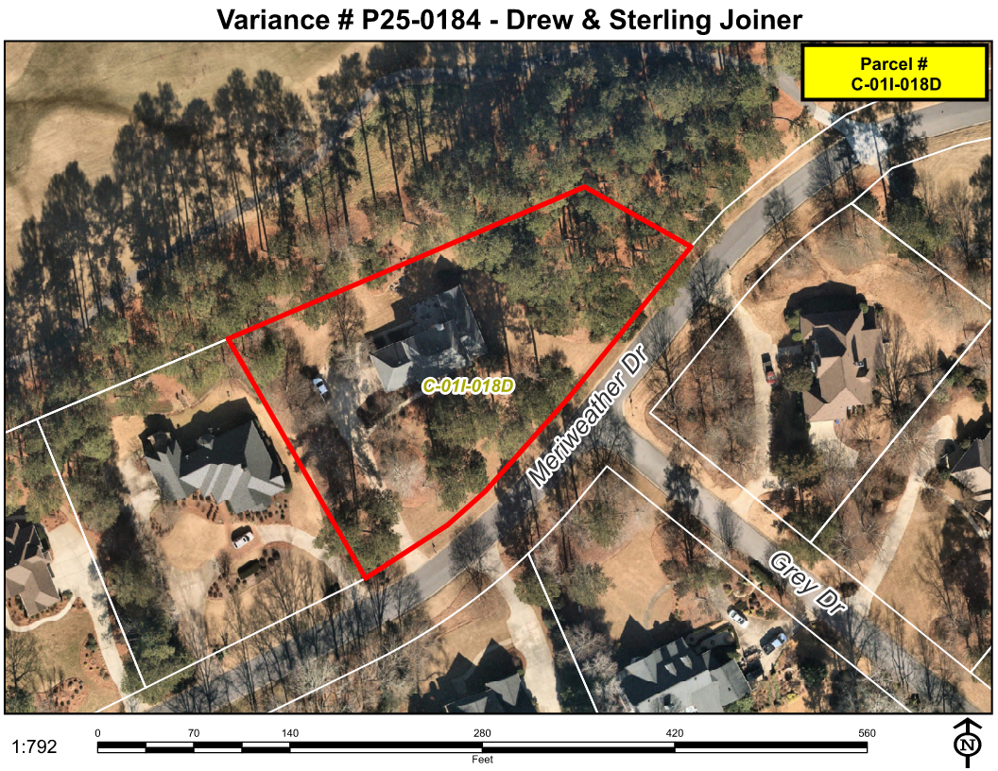
Aerial Imagery

Slide 4
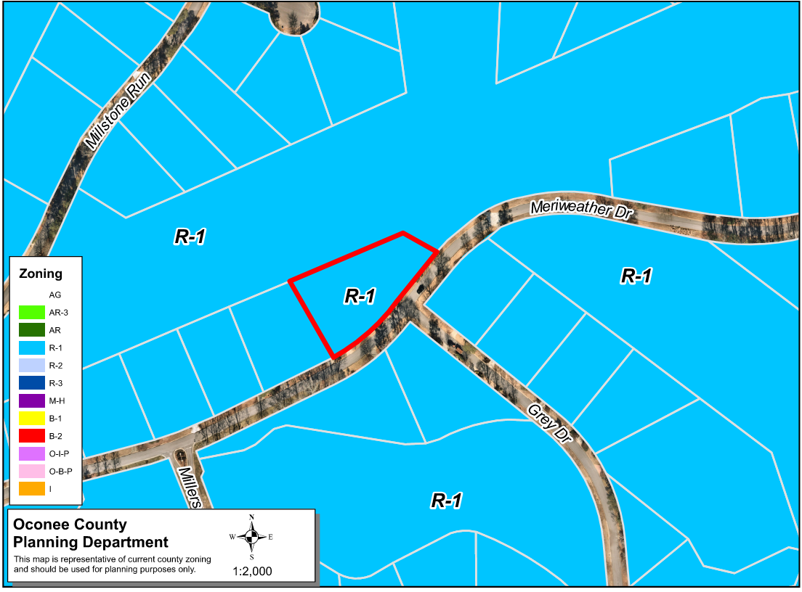
Zoning
AG

Slide 5
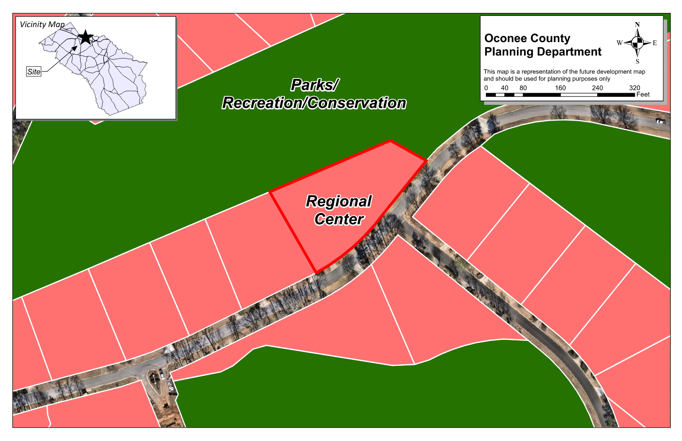
Future Development

Slide 6
Summary of Request
A request for a special exception variance from Oconee County Unified Development Code Article 4 Section 410.01.c.(2) to place an accessory building with a floor area greater than 144 square feet in the front yard.

Slide 7
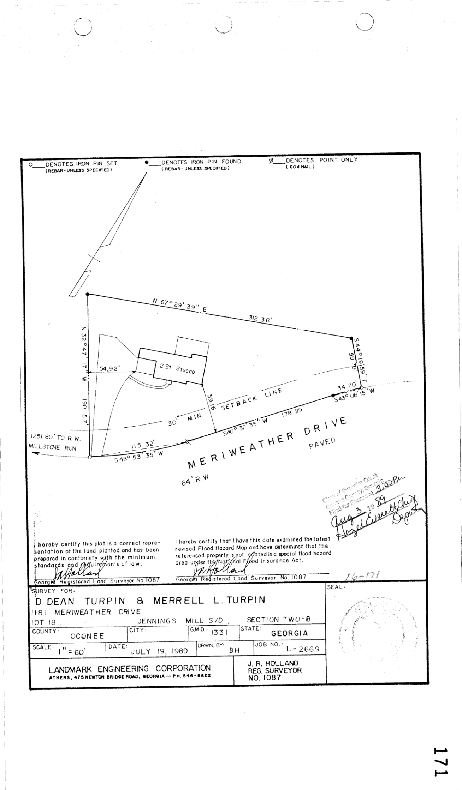
Recorded Plat

Slide 8
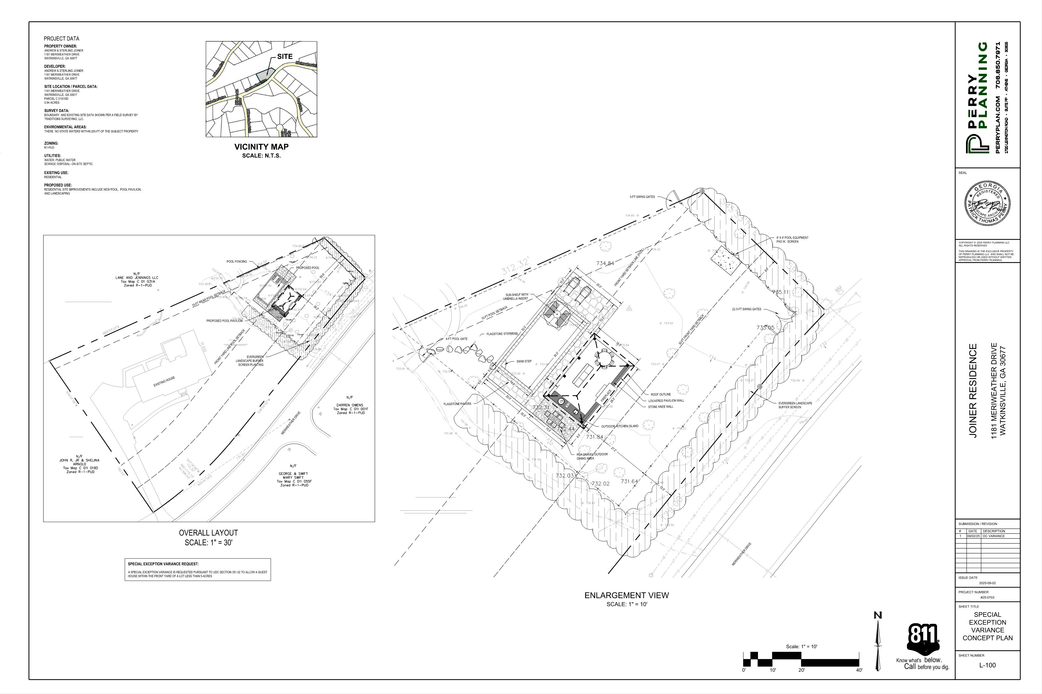
Concept Plan

Slide 9
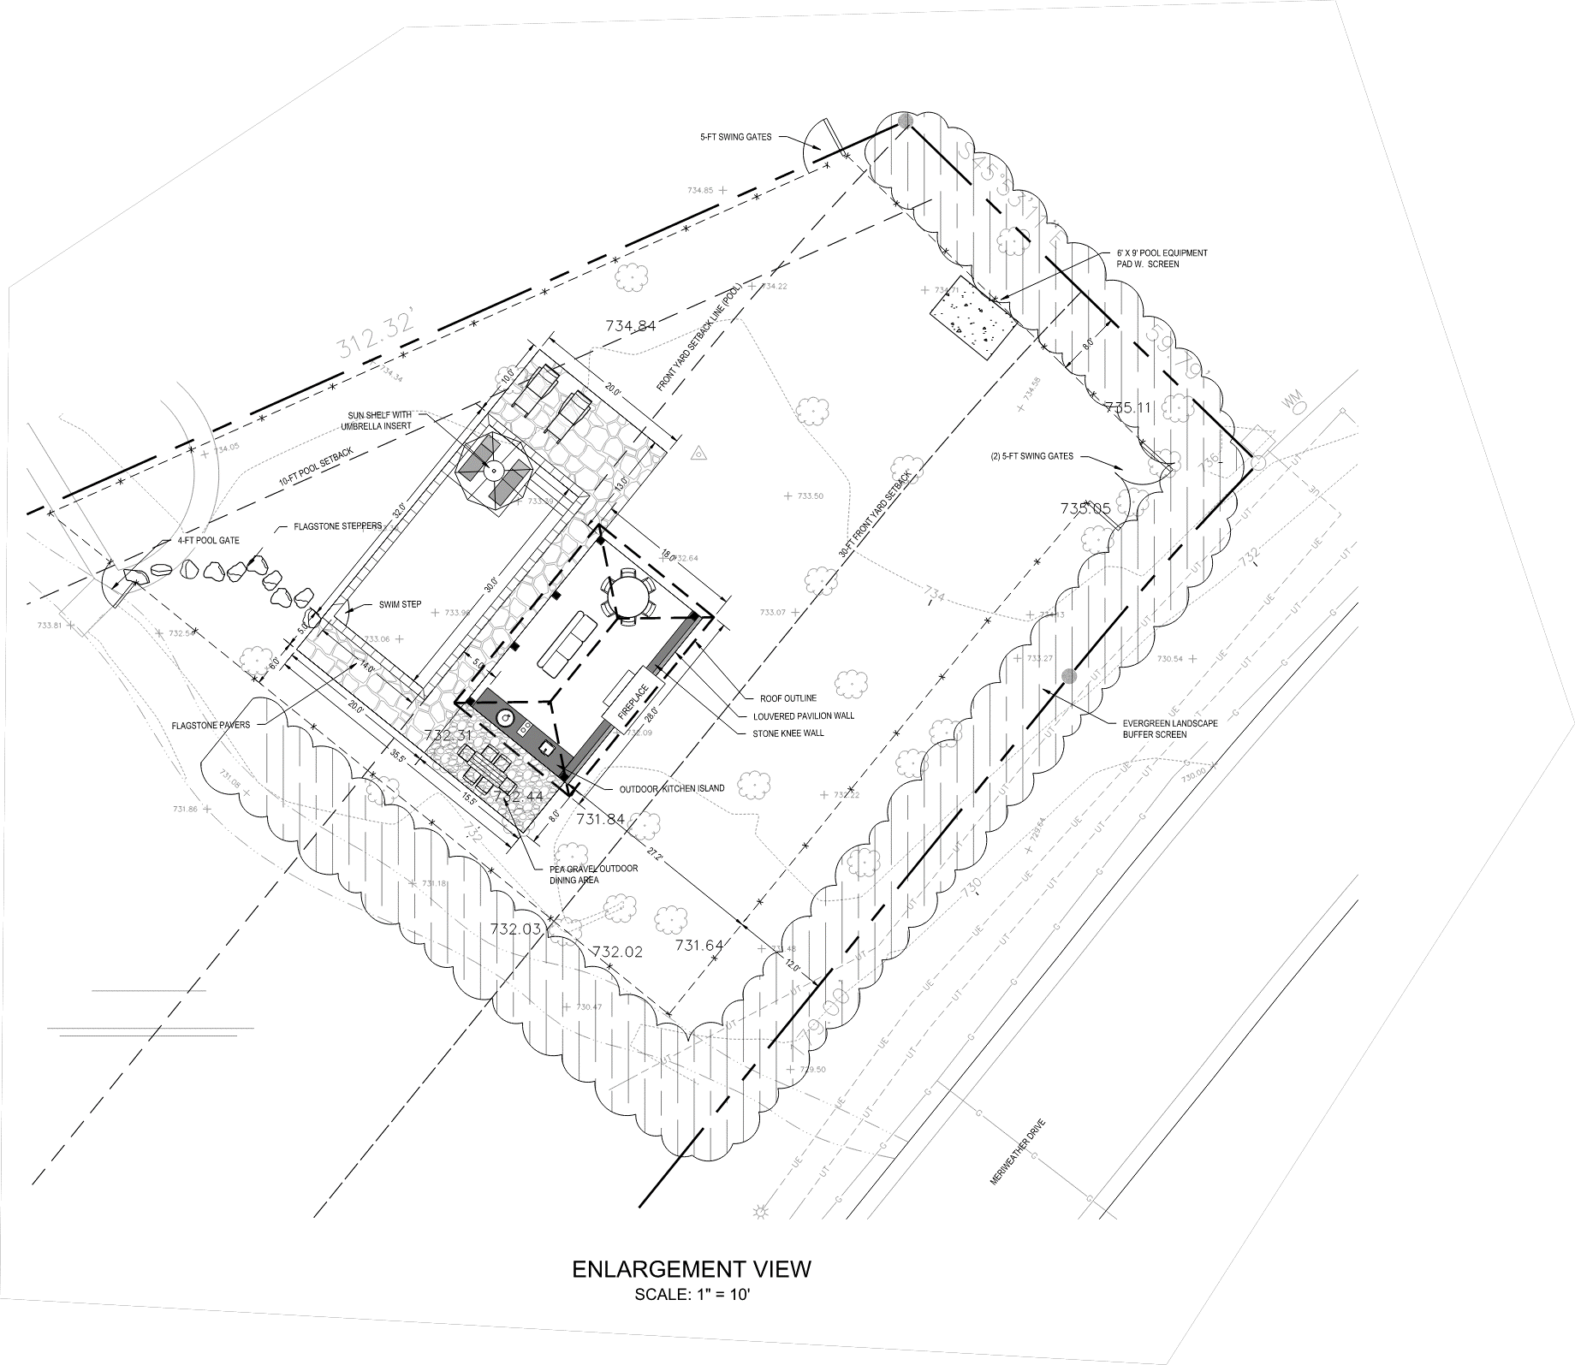
Concept Plan

Slide 10
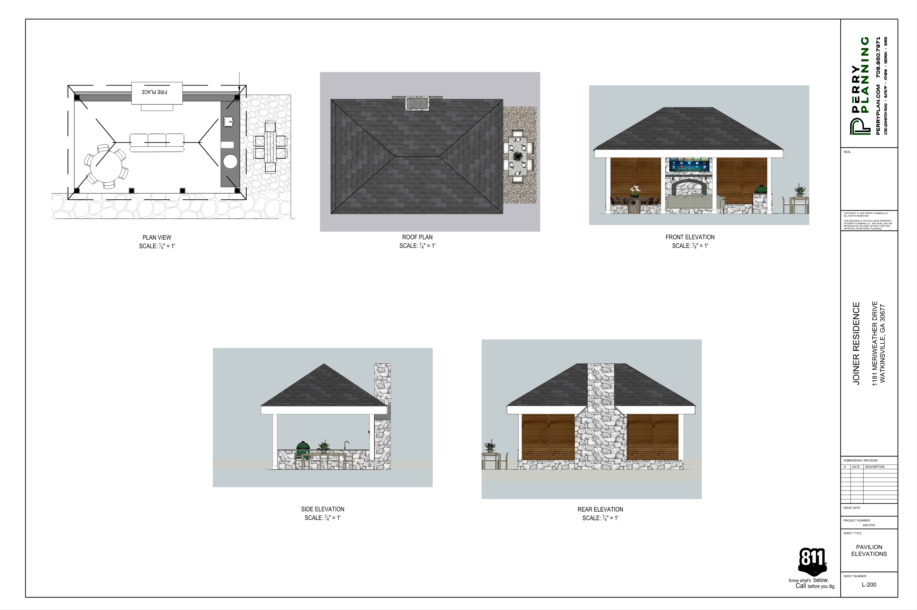
Architectural Renderings

Slide 11
Staff Recommendation
Based upon the standards and limitations for special exception variance approval, this request does meet all necessary conditions to grant a special exception variance to the garage setback standards. Should the present request be approved, staff recommends the following condition to be fulfilled at the owner/developer’s expense.
1. Development design and structures shall meet or exceed the standards indicated on the concept plan, narrative, representative architectural sketches, and other documents submitted with the variance application and attached hereto. This condition shall not construe approval of any standard that is not in conformity with the Unified Development Code.

