Slide 1


Slide 2
Site Location

Slide 3
Aerial Imagery

Slide 4
Zoning
AG

Slide 5
Future Development

Slide 6
Summary of Request
The applicant is requesting to modify previous conditions of Special Use Approval #6983. The requested change is to modify the condition # 7 to not apply to the Robinhood Road side of the property.

Slide 7
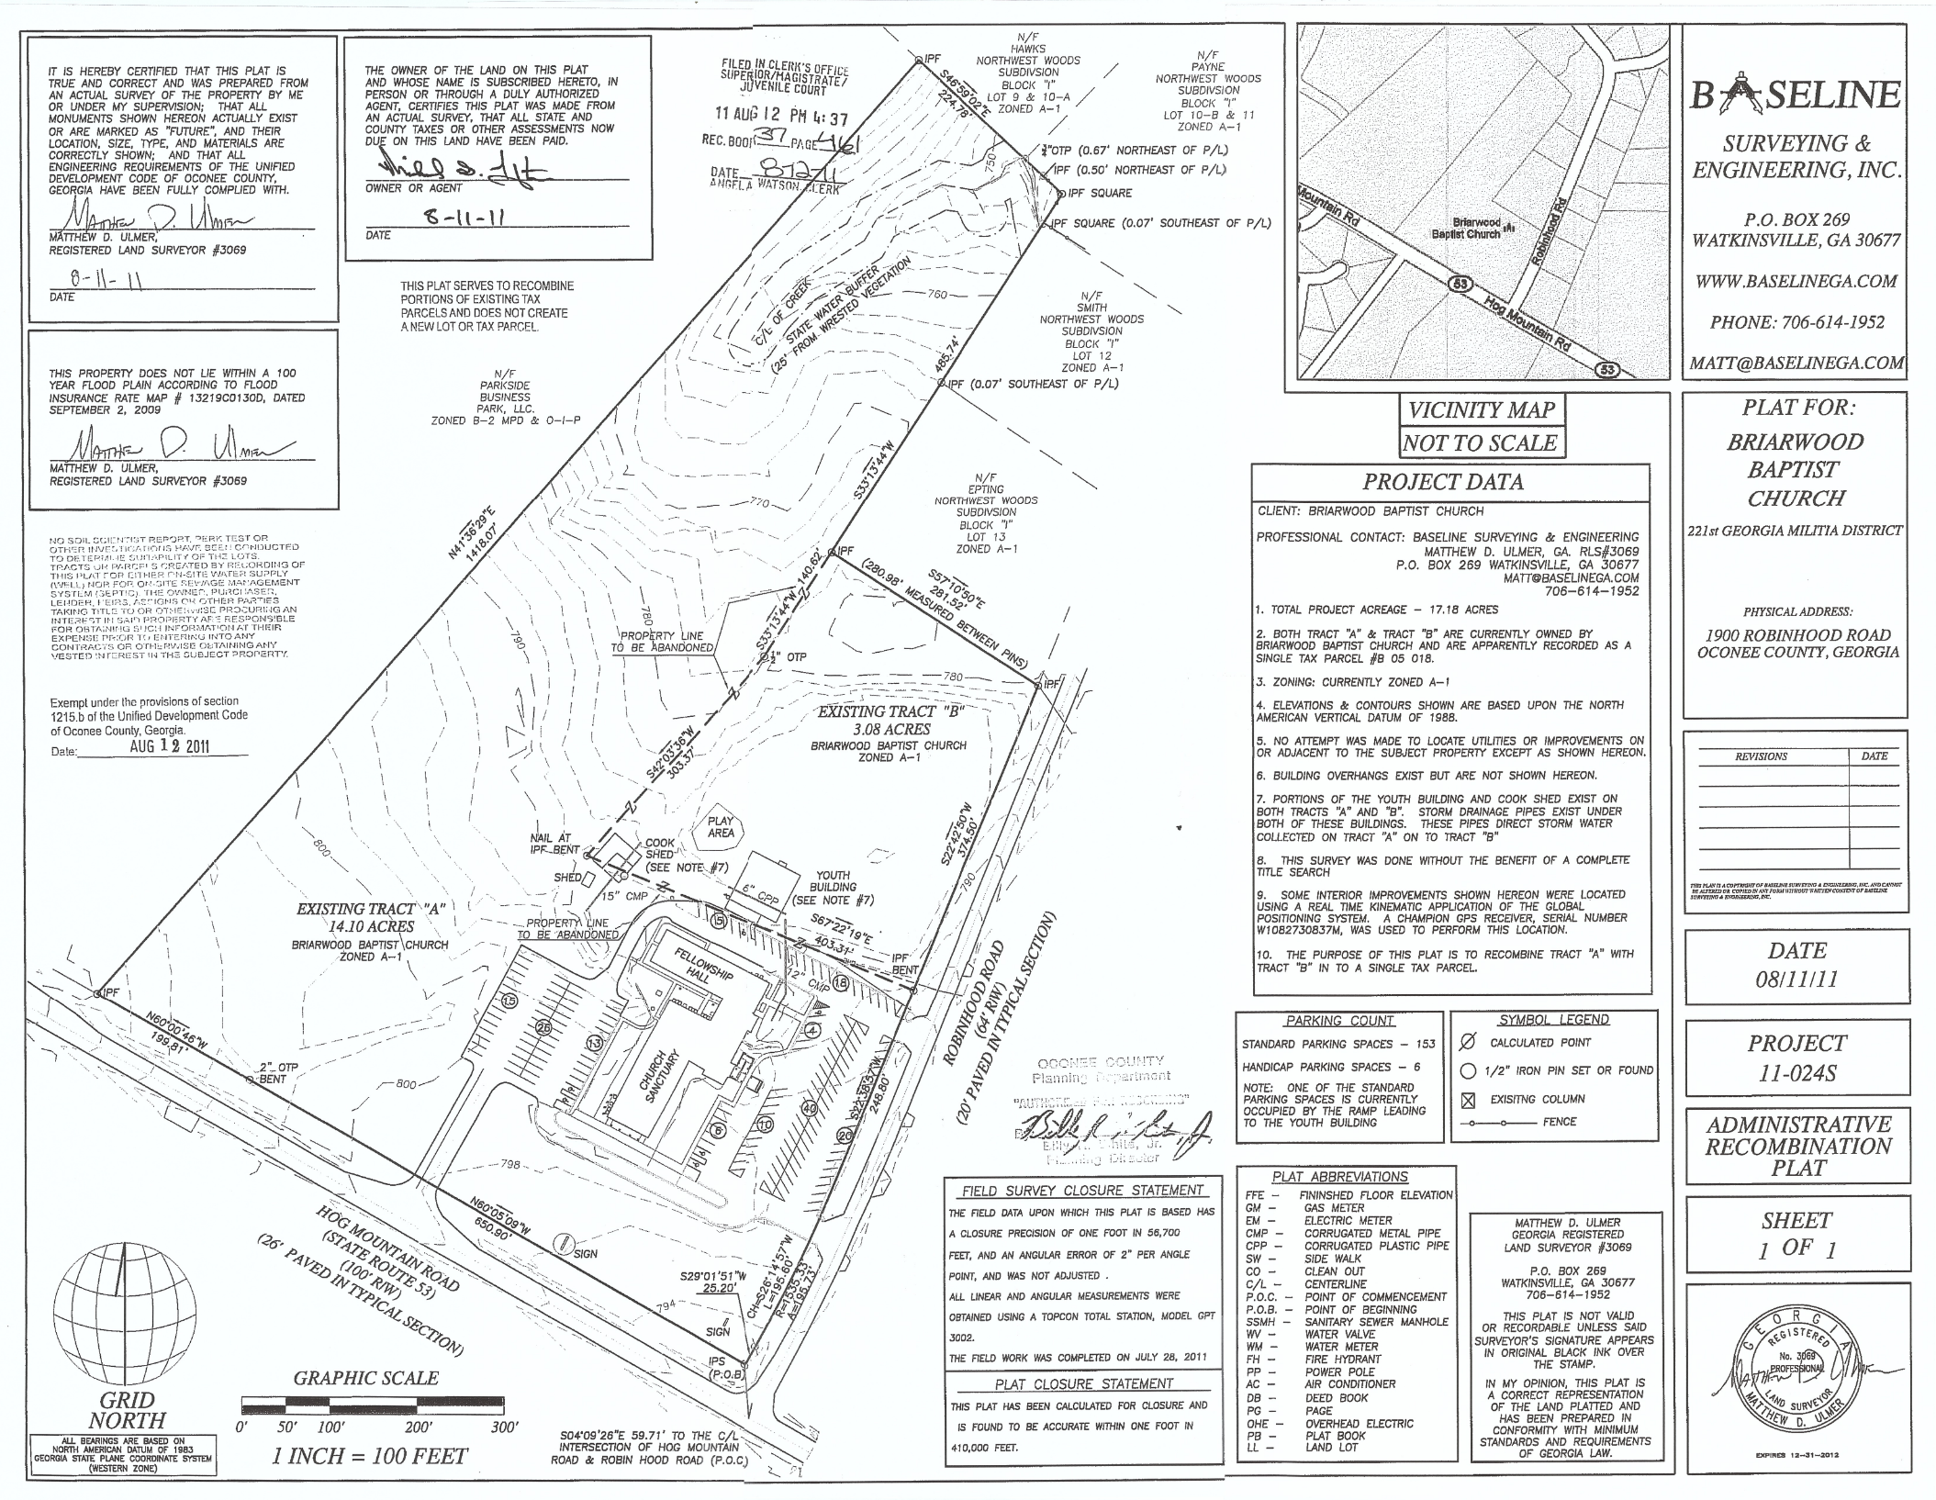
Recorded Plat

Slide 8
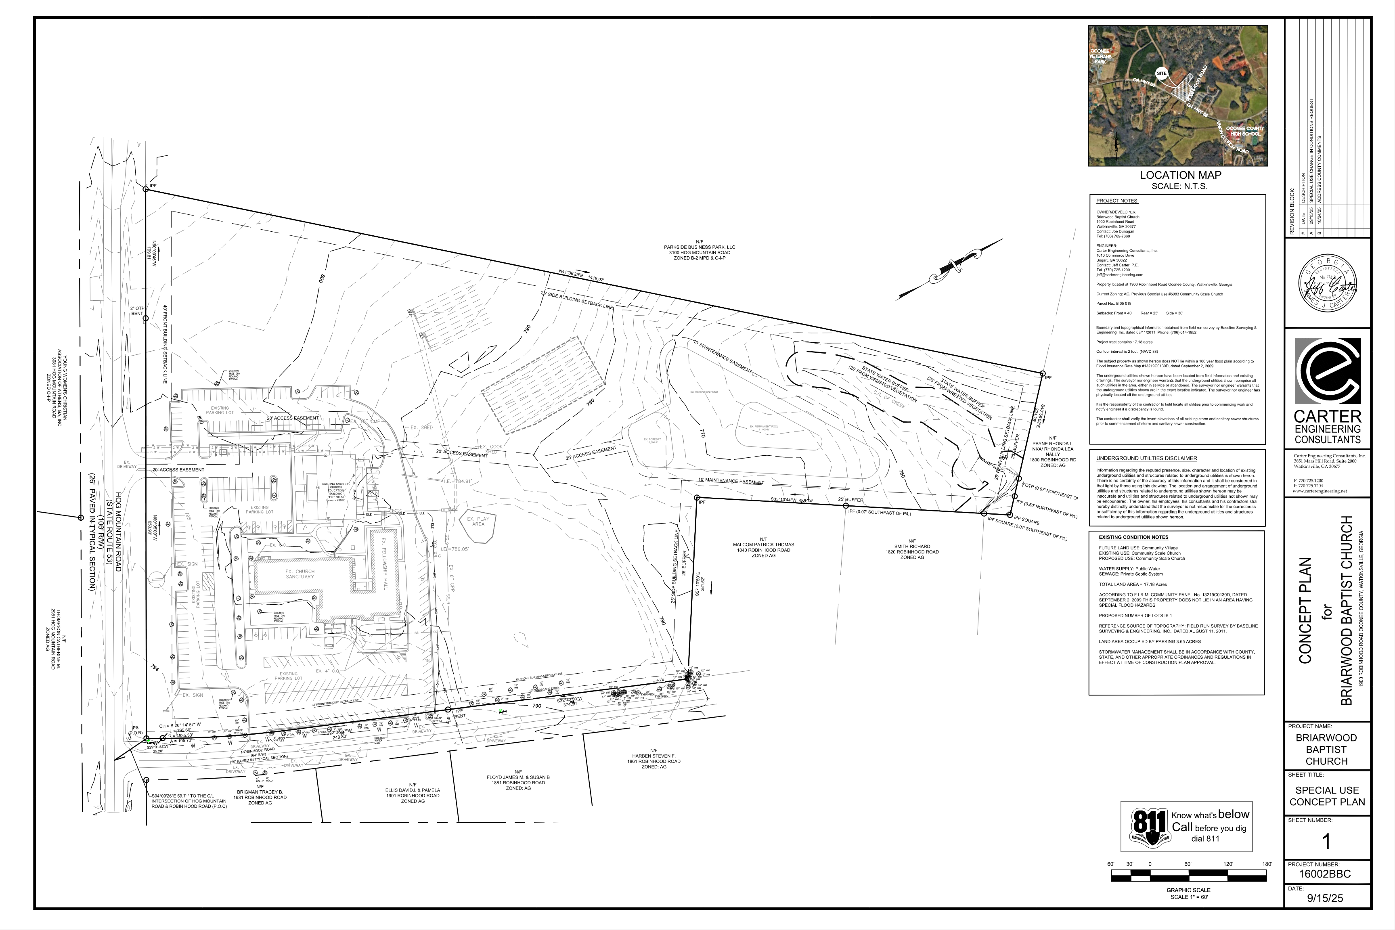
Concept Plan

Slide 9
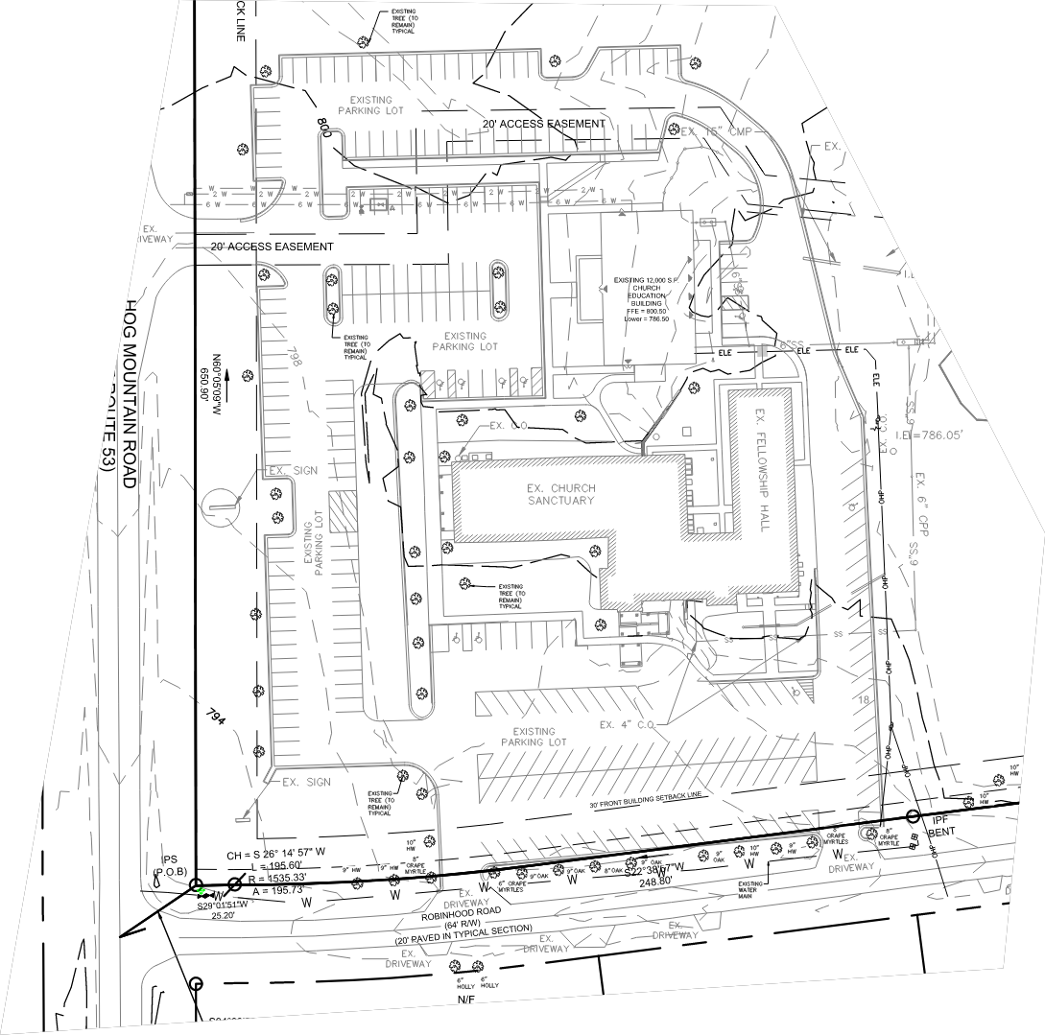
Concept Plan

Slide 10
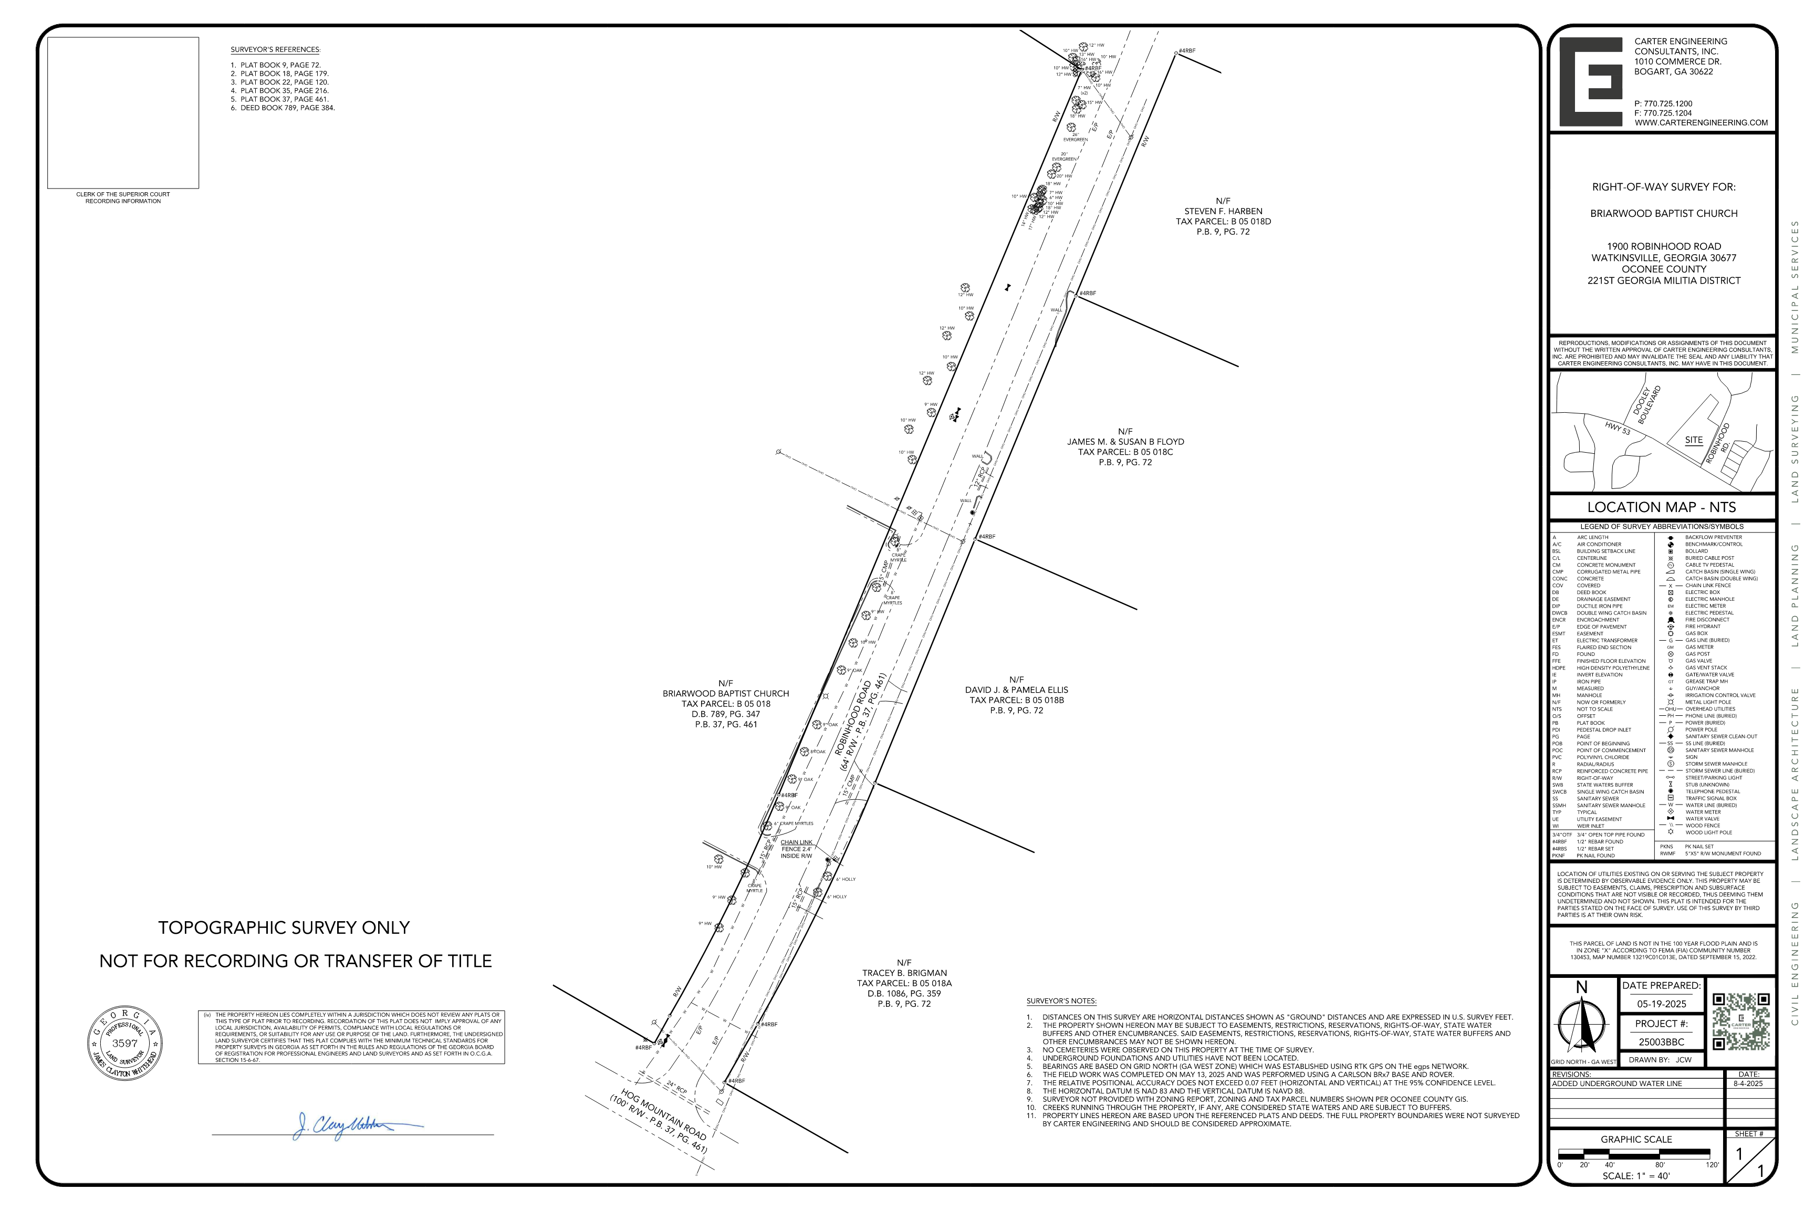
ROW Survey

Slide 11
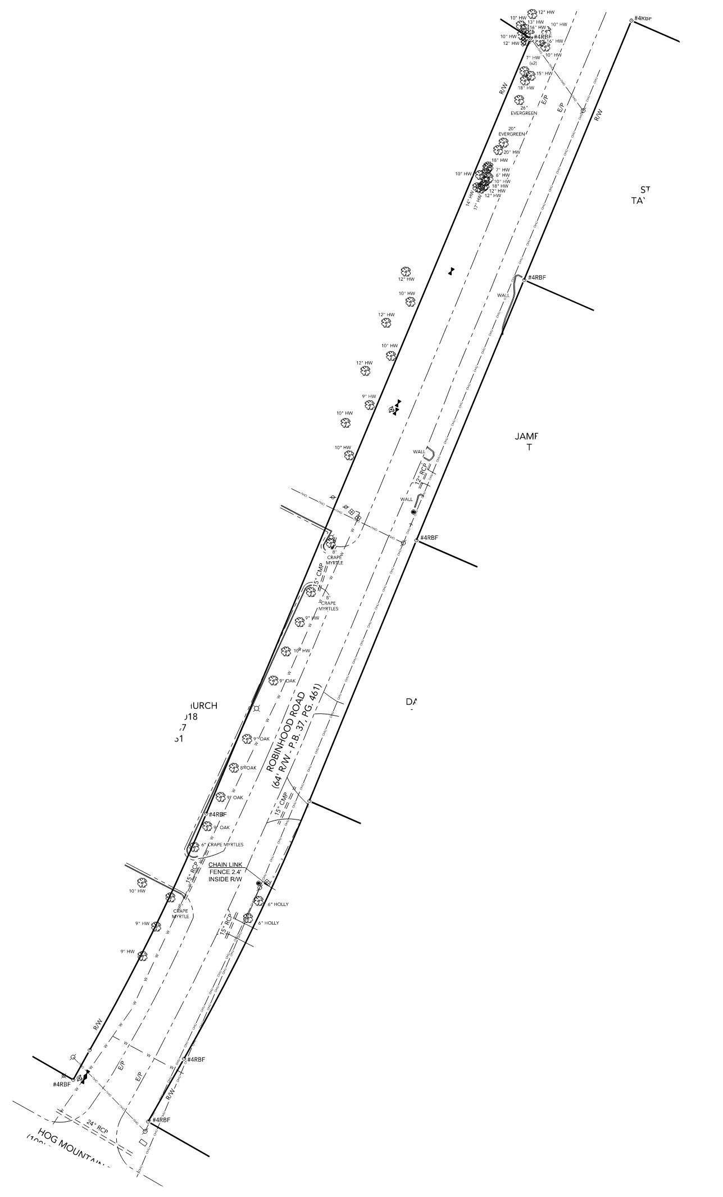
ROW Survey

Slide 12
Staff Recommendation
Based on Board of Commissioners policies, decision-making criteria, and standards outlined in the development codes of Oconee County, staff recommends approval of the special use request. Staff recommends it be subject to the following conditions to be fulfilled by the developer/owner at their expense:
1. Development design and structures shall meet or exceed the standards indicated on the concept plan, narrative, representative architectural sketches, and other documents submitted with the zoning application and attached hereto. This condition shall not construe approval of any standard that is not in conformity with the Unified Development Code.
2. Condition #7 of Special Use Permit #6983 is amended for existing parking lots as follows:
  The developer shall install Vehicle Use Area Screening to bring the existing parking lot into compliance with the UDC Article 8, along the Right of Way of Robinhood Road with evergreen shrubs as required. The existing trees along Robinhood Road will meet the requirements for the required Landscape Strip. The shrubs may be installed at the back of existing curb, within the Right of Way as needed.

Slide 13
Planning Commission Recommendation
Planning Commission recommends approval subject to the conditions recommended by staff.

