Slide 1


Slide 2
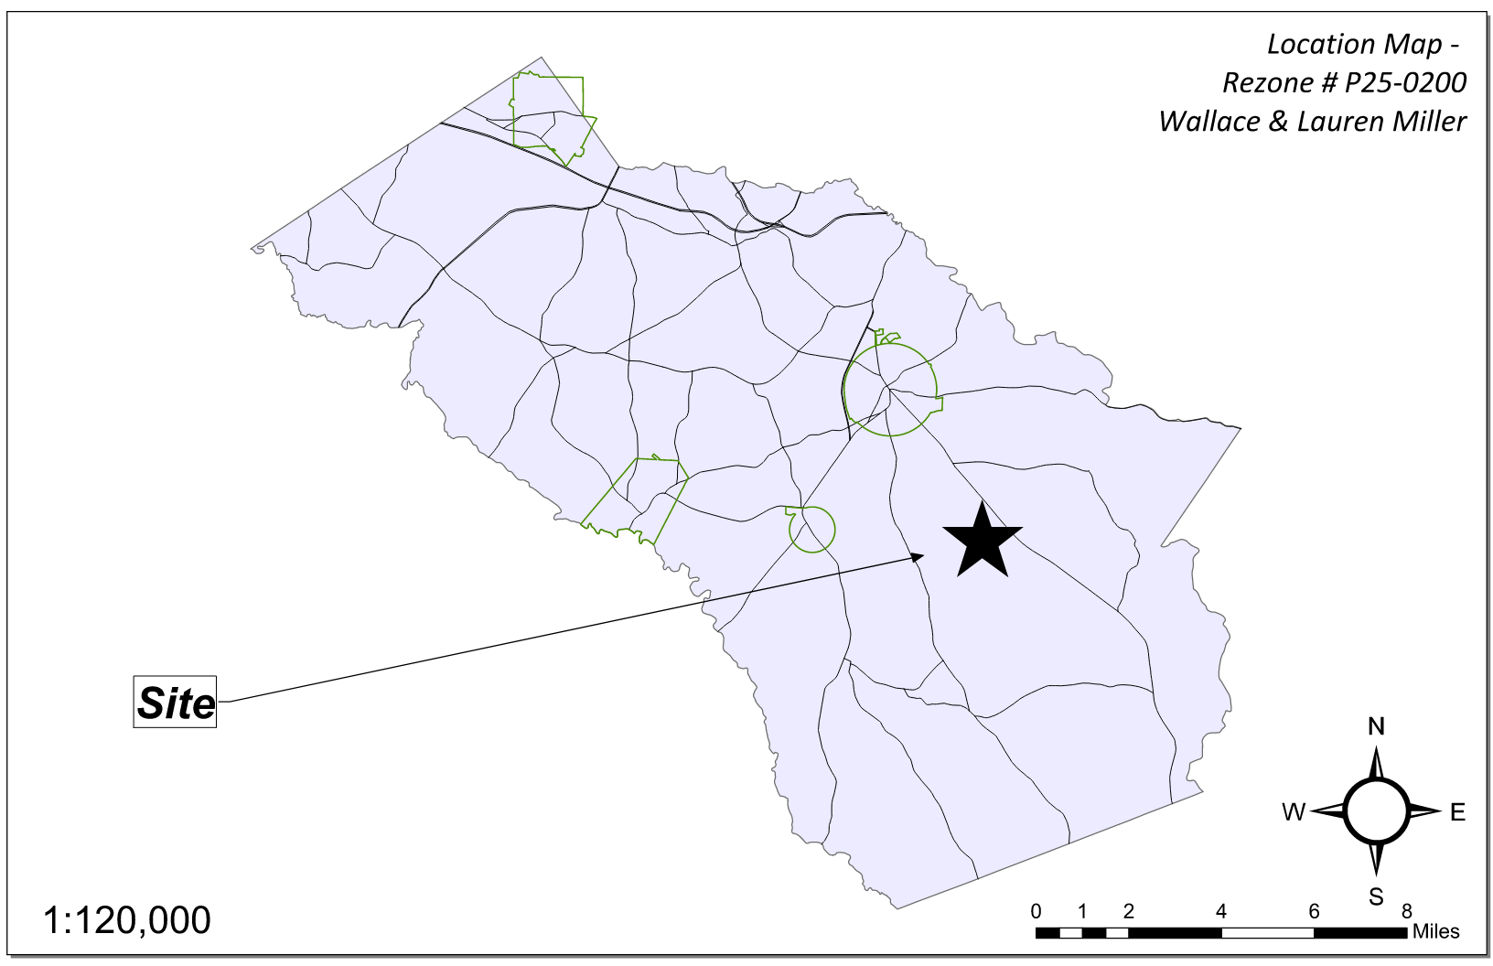
Site Location

Slide 3
Aerial Imagery

Slide 4
Zoning
AG

Slide 5
Future Development

Slide 6
Summary of Request
Change the conditions of the previous zoning (case # 3903), zoned AR-3, to modify conditions. The changes requested are:
1. Modify condition #4 to revise/ remove the rear platted buffer that had a radius of 400’ from active poultry houses.

Slide 7
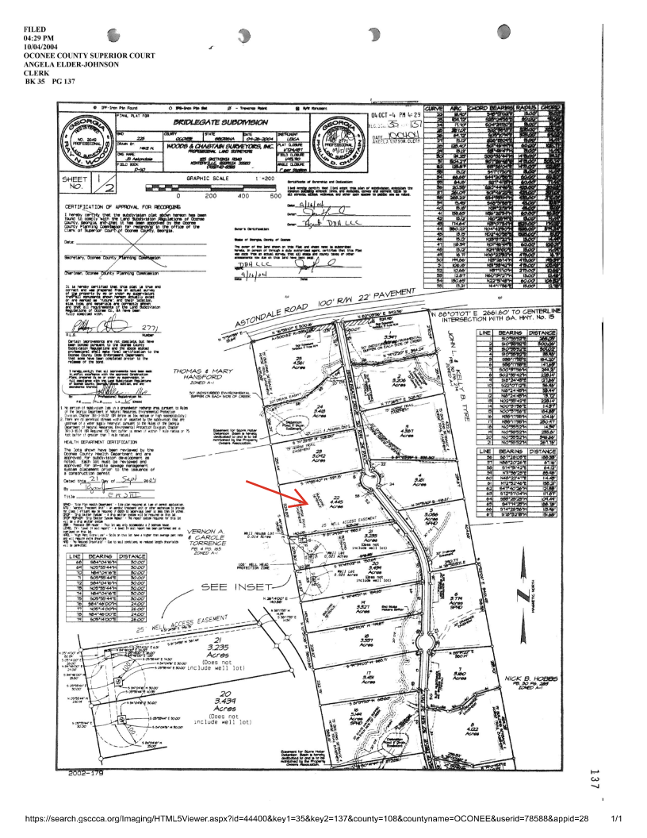
Recorded Plat

Slide 8
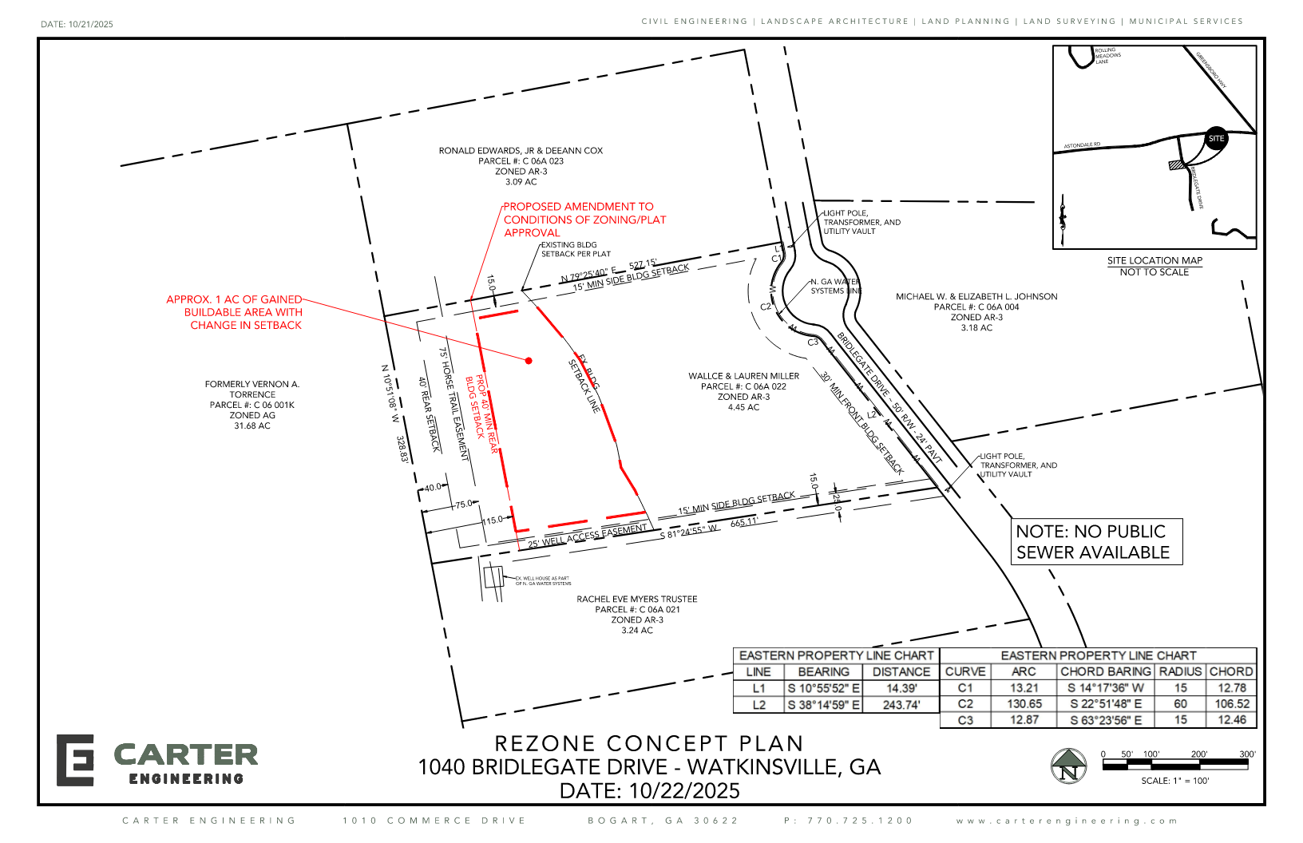
Concept Plan

Slide 9
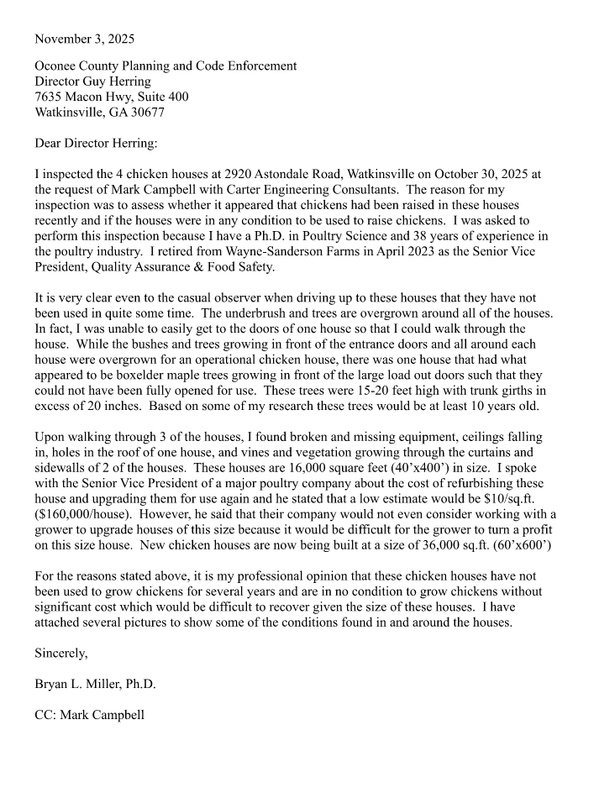
Letter

Slide 10
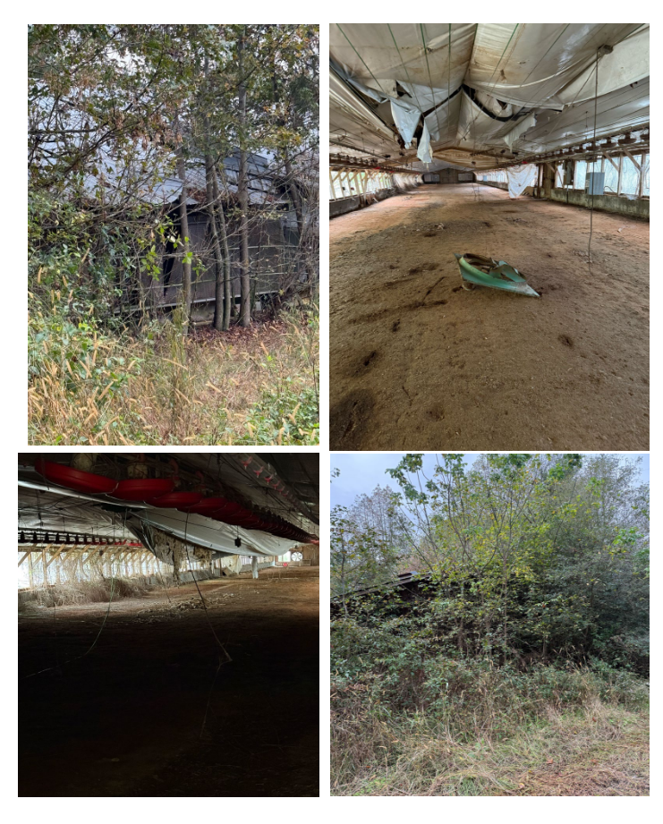
Pictures of Adjacent Poultry Houses

Slide 11
Staff Recommendation
Based on Board of Commissioners policies, decision-making criteria, and standards outlined in the development codes of Oconee County, staff recommends conditional approval of this request subject to the following conditions to be fulfilled at the expense of the owner/developer:
1. Design for site development and structures shall meet or exceed the standards indicated on the concept plan, narrative, representative architectural sketches, and other documents submitted with the zoning application and attached hereto. This condition shall not construe approval of any standard that is not in conformity with the Unified Development Code.
2. Condition # 4 of rezoning #3903 is revised as follows: A 75' wide building setback line shall be platted on all exterior boundaries of the subdivision.

Slide 12
Planning Commission Recommendation
Planning Commission recommends approval subject to the conditions recommended by staff.

