Slide 1


Slide 2
Site Location

Slide 3
Aerial Imagery

Slide 4
Zoning
AG

Slide 5
Future Development

Slide 6
Summary of Request
This is a Board Initiated Rezone for the +/- 33 acre site to modify a B-1 (General Business) PUD site plan specific zoning district, RZ 8340, that was impacted by right of way acquisition for SR 316/University Parkway/Mars Hill Road and the Virgil Langford/SR 316 bridge, as well as, a B-2 (Highway Business) zoning district, RZ 043, that was reduced by the right of way acquisition for Oconee Connector/Mars Hill Road/ Daniels Bridge Road realignment. The new modified rezoning concept plan will have an OIP (Office Institutional Professional) zoning district along Mars Hill Road and a B-1 (General Business) and B-2 (Highway Business) zoning district along SR 316.

Slide 7
Recorded Plat

Slide 8
Concept Plan

Slide 9
Rz #8340 and Rz #043
The original requested 19-acre B-2 rezone #8340 approved in 1988, allowed for 54,000 square feet of grocery, shopping center, office warehouse, bank, service station, nursery garden center and repair & supply center.
The original requested 50-acre B-1 PUD Rezone #043 approved in 1992, allowed 250,000 square feet of office, office/warehouse, restaurant, bank, fast food, and convenience store.

Slide 10
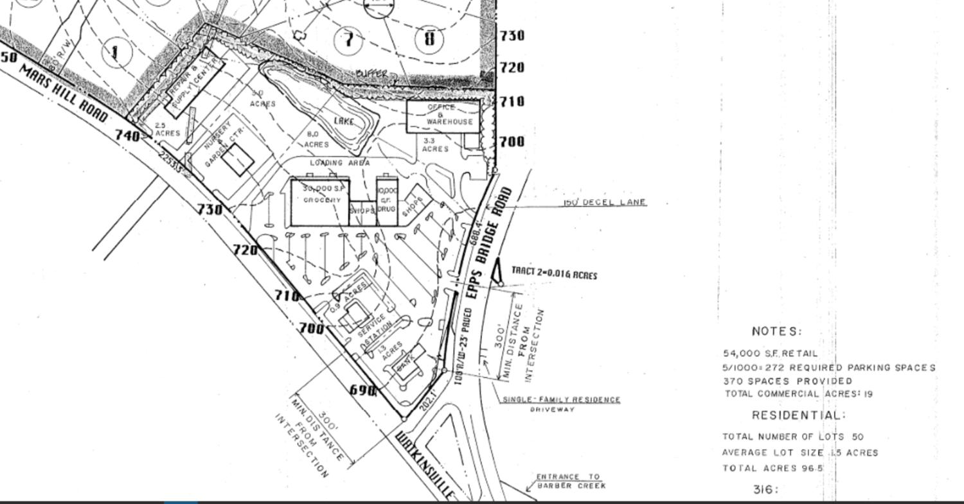
Original Site Plan Rz #8340
Original Site Plan Rz #8340 and Rz #043

Slide 11
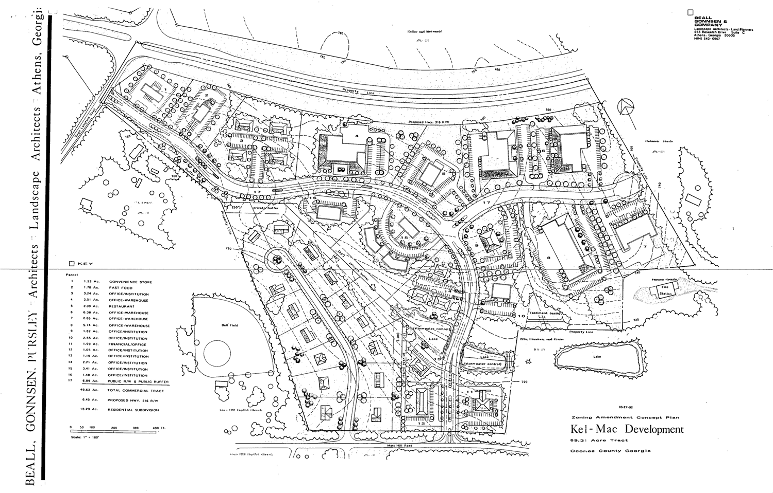
Original Site Plan Rz #043

Slide 12
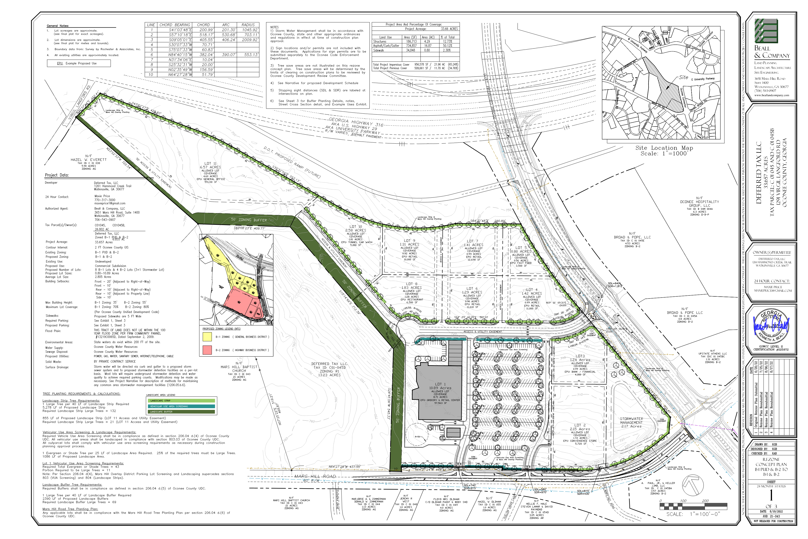
Developer Proposed Rezone Site Plan

Slide 13
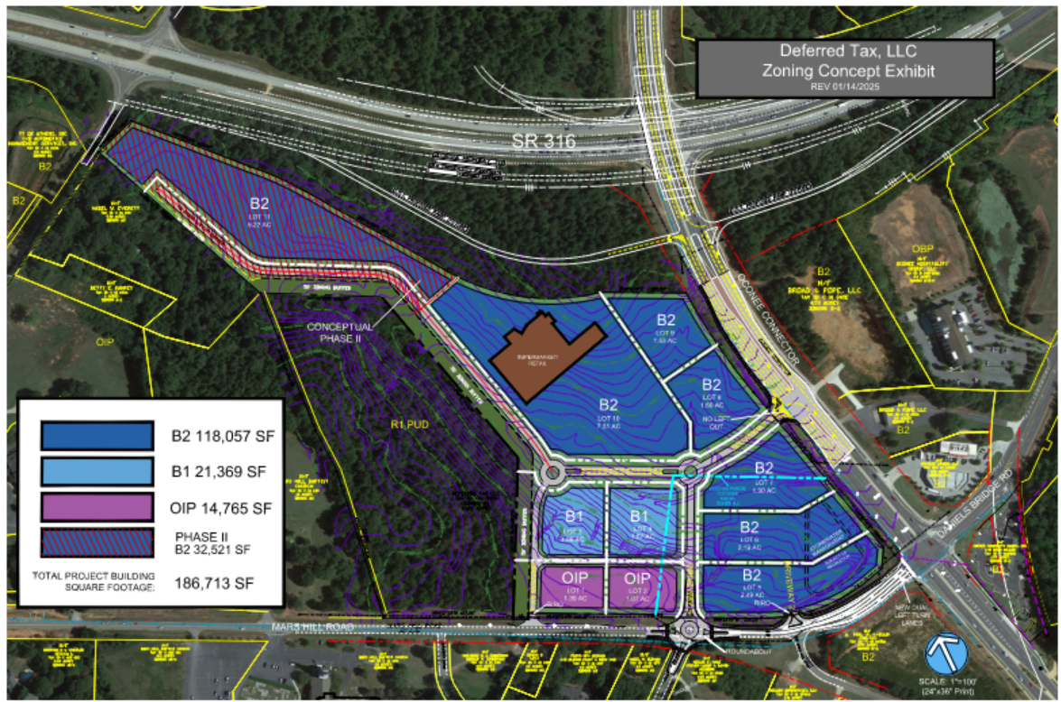
Developer Proposed Settlement Site Plan

Slide 14
Exhibit Comparison
Developer Settlement Exhibit |  |  | County Initiated RZ Concept Plan
Zoning | Acreage~ | Building SF | Zoning | Acreage~ | Building SF
OIP | 2.37 | 14,765 | OIP | 12.38 | 59,040
B1 | 3.43 | 21,369 | B1 Ph2 | 5.22 | 45,000
B2 | 22.24 | 150,578 | B2 | 10.44 | 65,785
Total | 28.04 | 186,712 | Total | 28.04 | 169,825
ADT |  | 13,965 |  |  | 11,391

Slide 15
Architectural Images

Slide 16
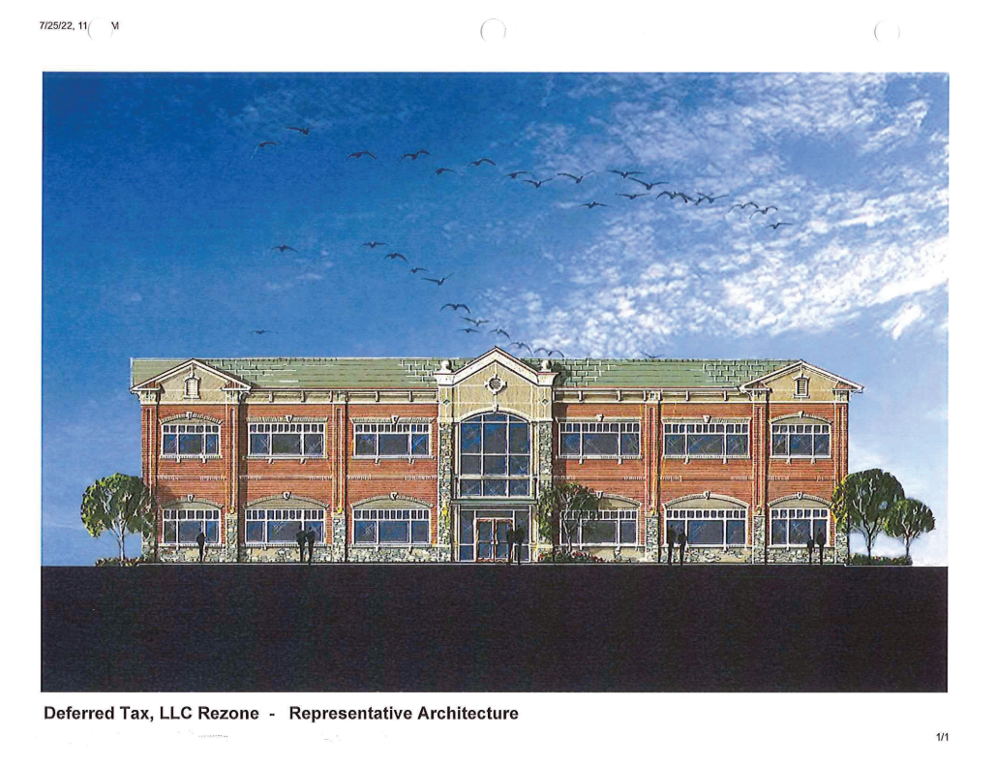
Architectural Images

Slide 17
Staff Recommendation
Based on Board of Commissioners policies, decision-making criteria, and standards outlined in the development codes of Oconee County, staff recommends conditional approval of this request subject to the following conditions to be fulfilled at the expense of the owner/developer:
1. Development design and structures shall meet or exceed the standards indicated on the concept plan, narrative, representative architectural sketches, and other documents submitted with the zoning application and attached hereto. This condition shall not construe approval of any standard that is not in conformity with the Unified Development Code.
2. The owner at their own expense shall construct the improvements required by the County for public water and public waste services for the subject property shall convey same to the County, free of all liens. Said improvements shall include all on-site improvements and such off-site improvements as are required by the County to provide service to subject property.
3. At its expense, Owner shall make all right of way improvements and shall dedicate all rights of way which are required by the County after the County’s review of Owner's development plans pursuant to the County’s ordinances and regulations. All such improvements shall be shown on the preliminary site plan and site development plans for the project and no development permit shall be issued until Owner has agreed to such improvements and dedication.
4. Service areas and dumpsters shall be visually screened from public view by a six-foot masonry wall with façade materials matching the exterior of principal structures with black painted metal/steel enclosure doors. Enclosure doors made of wood or chain link are prohibited.
5. All service and truck loading areas shall be screened from public view by a six-foot-tall masonry wall with façade material to match the exterior of the principal building.

Slide 18
Staff Recommendation
Based on Board of Commissioners policies, decision-making criteria, and standards outlined in the development codes of Oconee County, staff recommends conditional approval of this request subject to the following conditions to be fulfilled at the expense of the owner/developer:
6. In addition to the required 10-foot wide vehicle use area screening and landscape strip along Mars Hill Road, a 25-foot wide structural buffer shall be provided including trees as specified in UDC Sec. 808.04.b.1.b and evergreen plant material as specified in UDC Sec. 808.04.b.3.d.
7. An internal sidewalk network shall connect all uses within the development to sidewalks along Oconee Connector and Mars Hill Road. Pedestrian connectivity shall be provided throughout the development, including raised decorative crosswalks. Final design of the sidewalk network shall be subject to the approval of the Planning Director and shall be shown on the preliminary plat and site development plans for each phase of the development.
8. Pedestrian facilities shall be provided connecting the development to Hollow Creek Lane.
9. Along the full length of the private drives in both phases of the development, no sidewalks shall be located within the 10-foot wide landscape strip/vehicle use area screening.
10. All stormwater management ponds shall be enclosed by black vinyl coated chain link fencing and screened on all sides by a 25-foot-wide structural buffer including trees as specified in UDC Sec. 808.04.b.1.b and evergreen plant material as specified in UDC Sec. 808.04.b.3.d. Said buffer shall be provided in lieu of the required evergreen screening of UDC Sec. 116.03.b.5.

Slide 19
Staff Recommendation
Based on Board of Commissioners policies, decision-making criteria, and standards outlined in the development codes of Oconee County, staff recommends conditional approval of this request subject to the following conditions to be fulfilled at the expense of the owner/developer:
11. All proposed access design and traffic improvements shall be in accordance with the County Initiated Concept Plan and Traffic Impact Analysis- September 2025 (WSP Engineering).
12. For the entirety of the project’s frontage along Mars Hill Road, Mars Hill Road shall be upgraded to County street design standards for arterial roads as outlined in UDC Article 10. Road improvements shall be shown on the preliminary plat and site development plans for each phase of the development.
13. Inter-parcel access to adjacent properties shall be required in order to facilitate future access from the development to Virgil Langford Road. Said inter-parcel access shall comply with UDC Sec. 608.02 and shall be shown on the site development plans for Phase II. Phase 2 shall not receive a site development plan approval without access to Virgil Langford Road.
14. A new Traffic Impact Study for the Phase II, B-1 zoned area, shall be submitted for review and approval to the Director of Planning and Code Enforcement and Direcor of Public Works prior to submittal of the Site Development Plan for Phase II.
15. The total building square footage of the development shall not exceed 169, 825 square feet.
16. The development shall meet all standards of the Mars Hill Overlay District as outlined in UDC Sec. 206.04.

Slide 20
Staff Recommendation
Based on Board of Commissioners policies, decision-making criteria, and standards outlined in the development codes of Oconee County, staff recommends conditional approval of this request subject to the following conditions to be fulfilled at the expense of the owner/developer:
17. The architectural standards of all buildings shall meet or exceed the standards indicated in the elevations submitted by BDG Architects with P22-0155, dated 7/5/2022, to include at least 80 percent of exterior wall surfaces to be either brick veneer, stone veneer or glass. Additional primary and accent materials are allowed as indicated in UDC Section 306.03.

