Slide 1


Slide 2
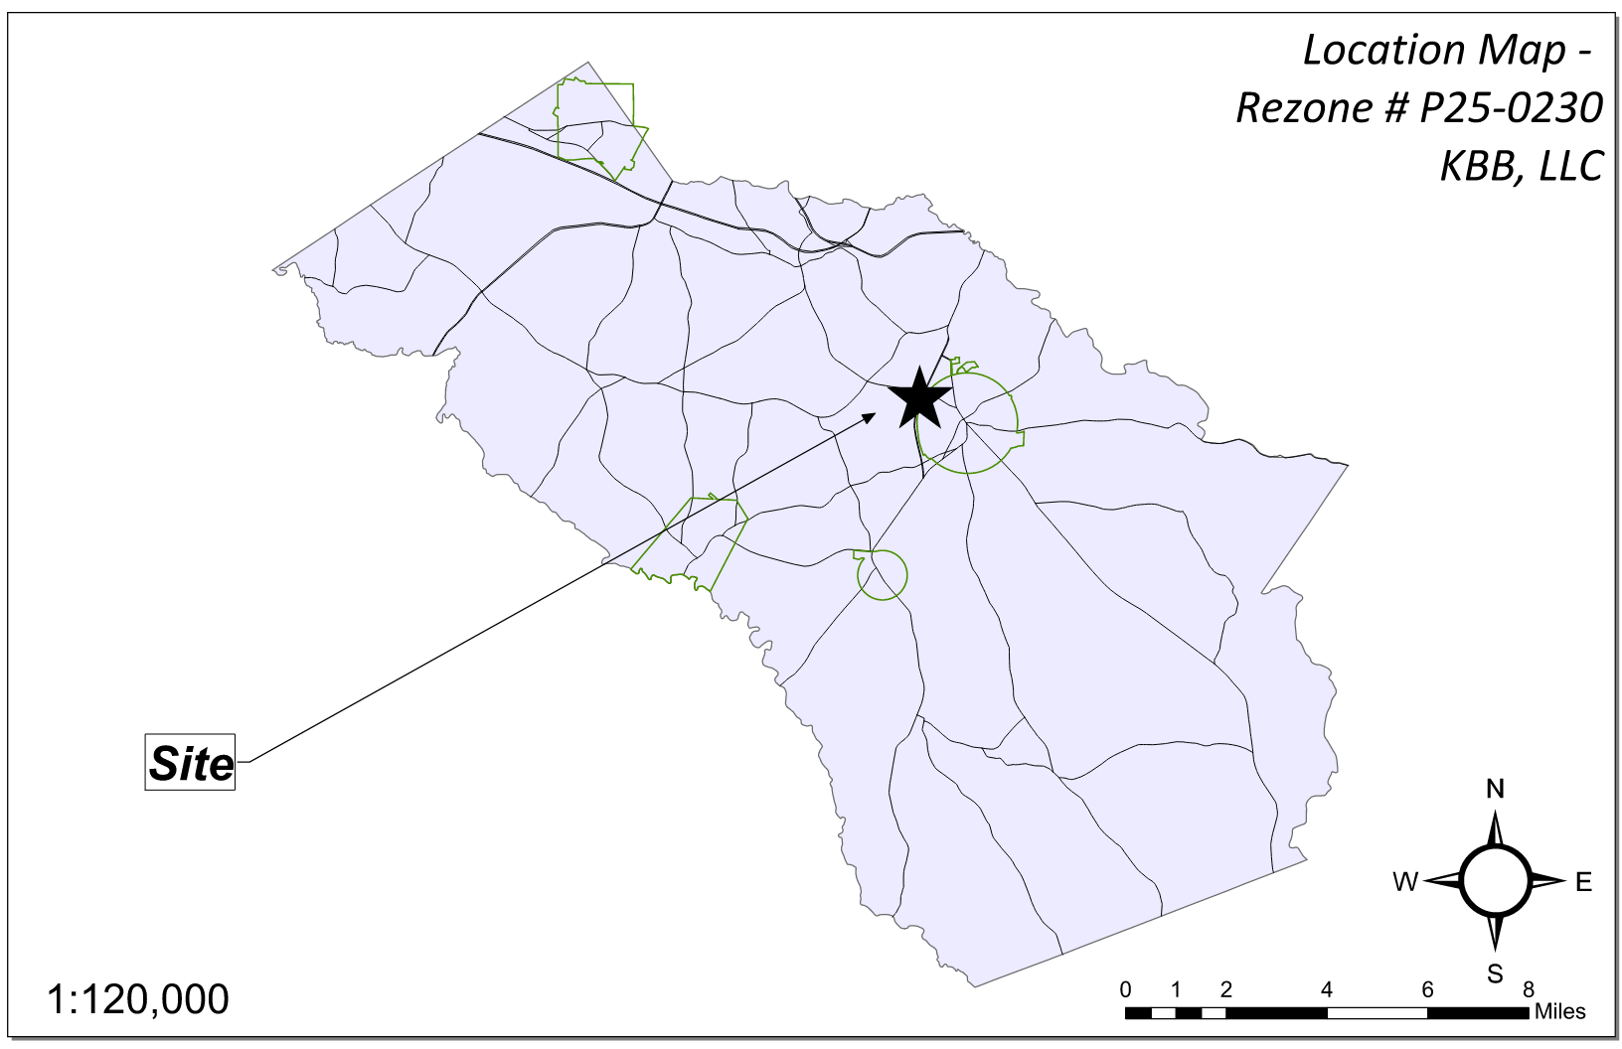
Site Location

Slide 3
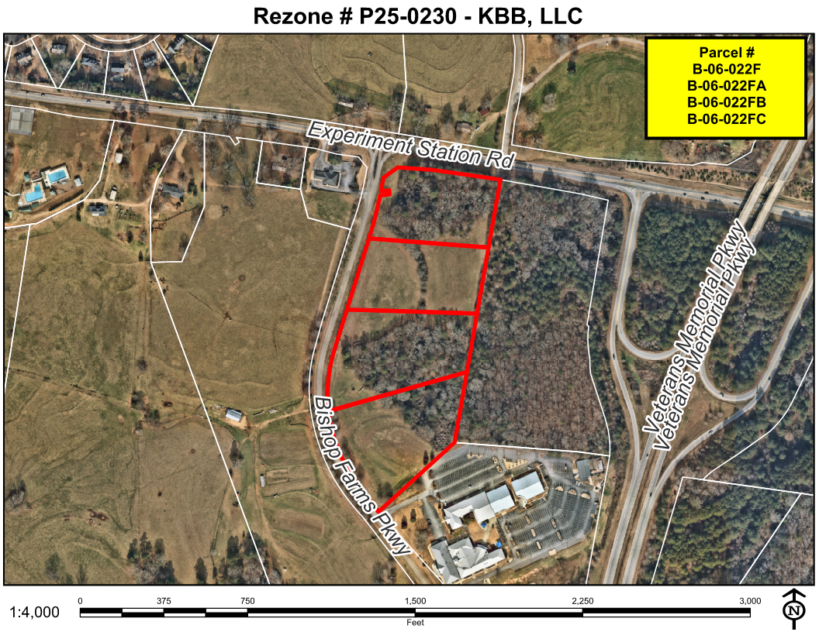
Aerial Imagery

Slide 4
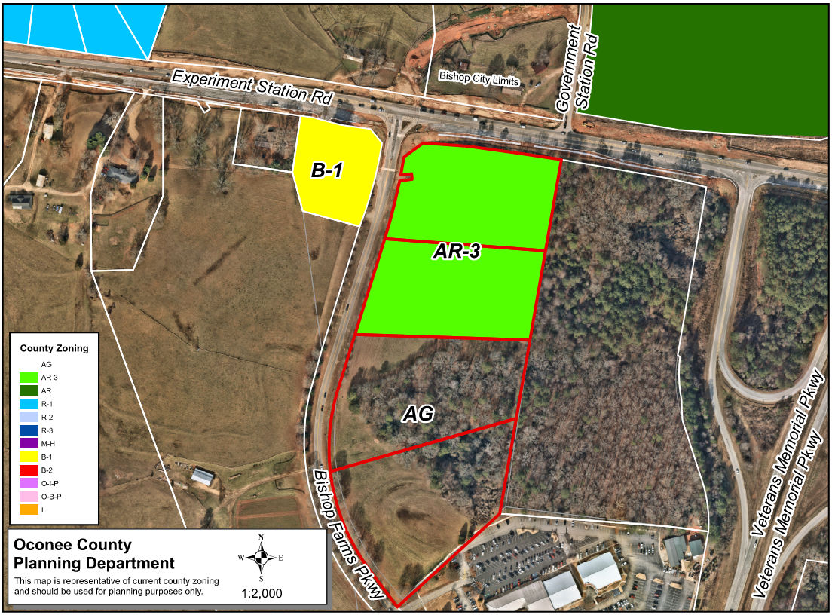
Zoning
AG

Slide 5
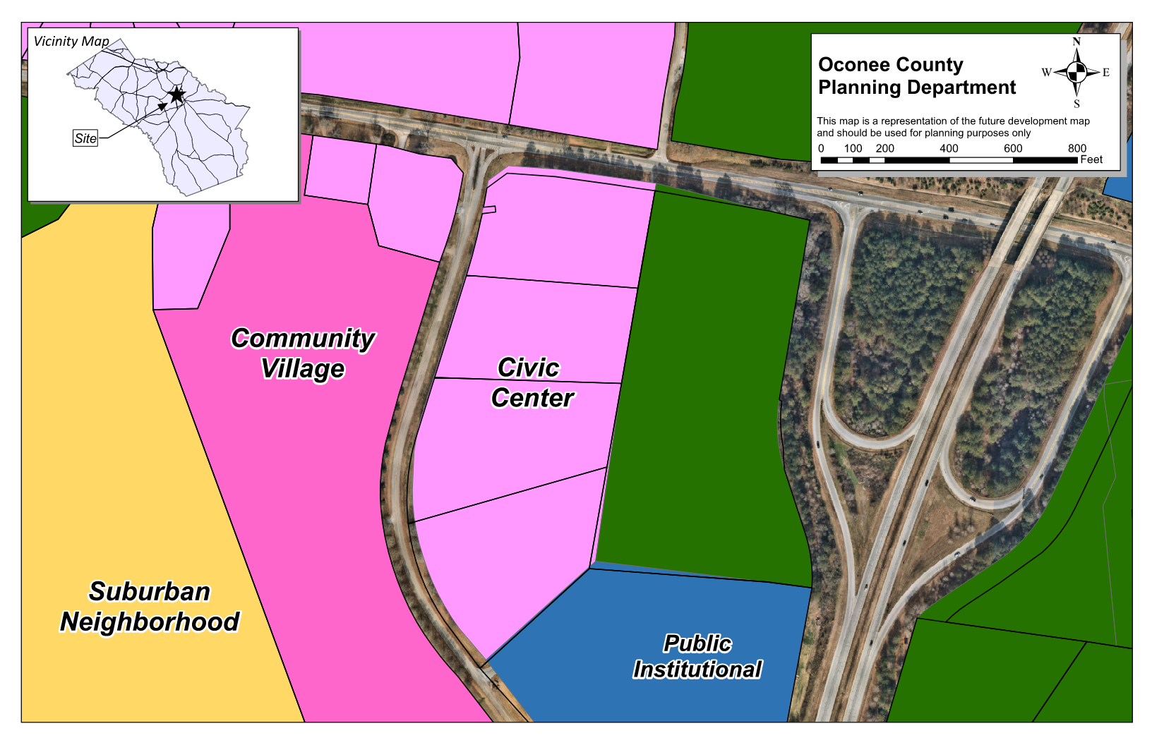
Future Development

Slide 6
Summary of Request
1. Rezone ±4.82 acres from AR-3 (Agricultural Residential Three Acre District) to B-1 (General Business District)
2. Rezone ± 10.0 acres from AG (Agricultural District) to AR-3 (Agricultural Residential Three Acre District)

Slide 7
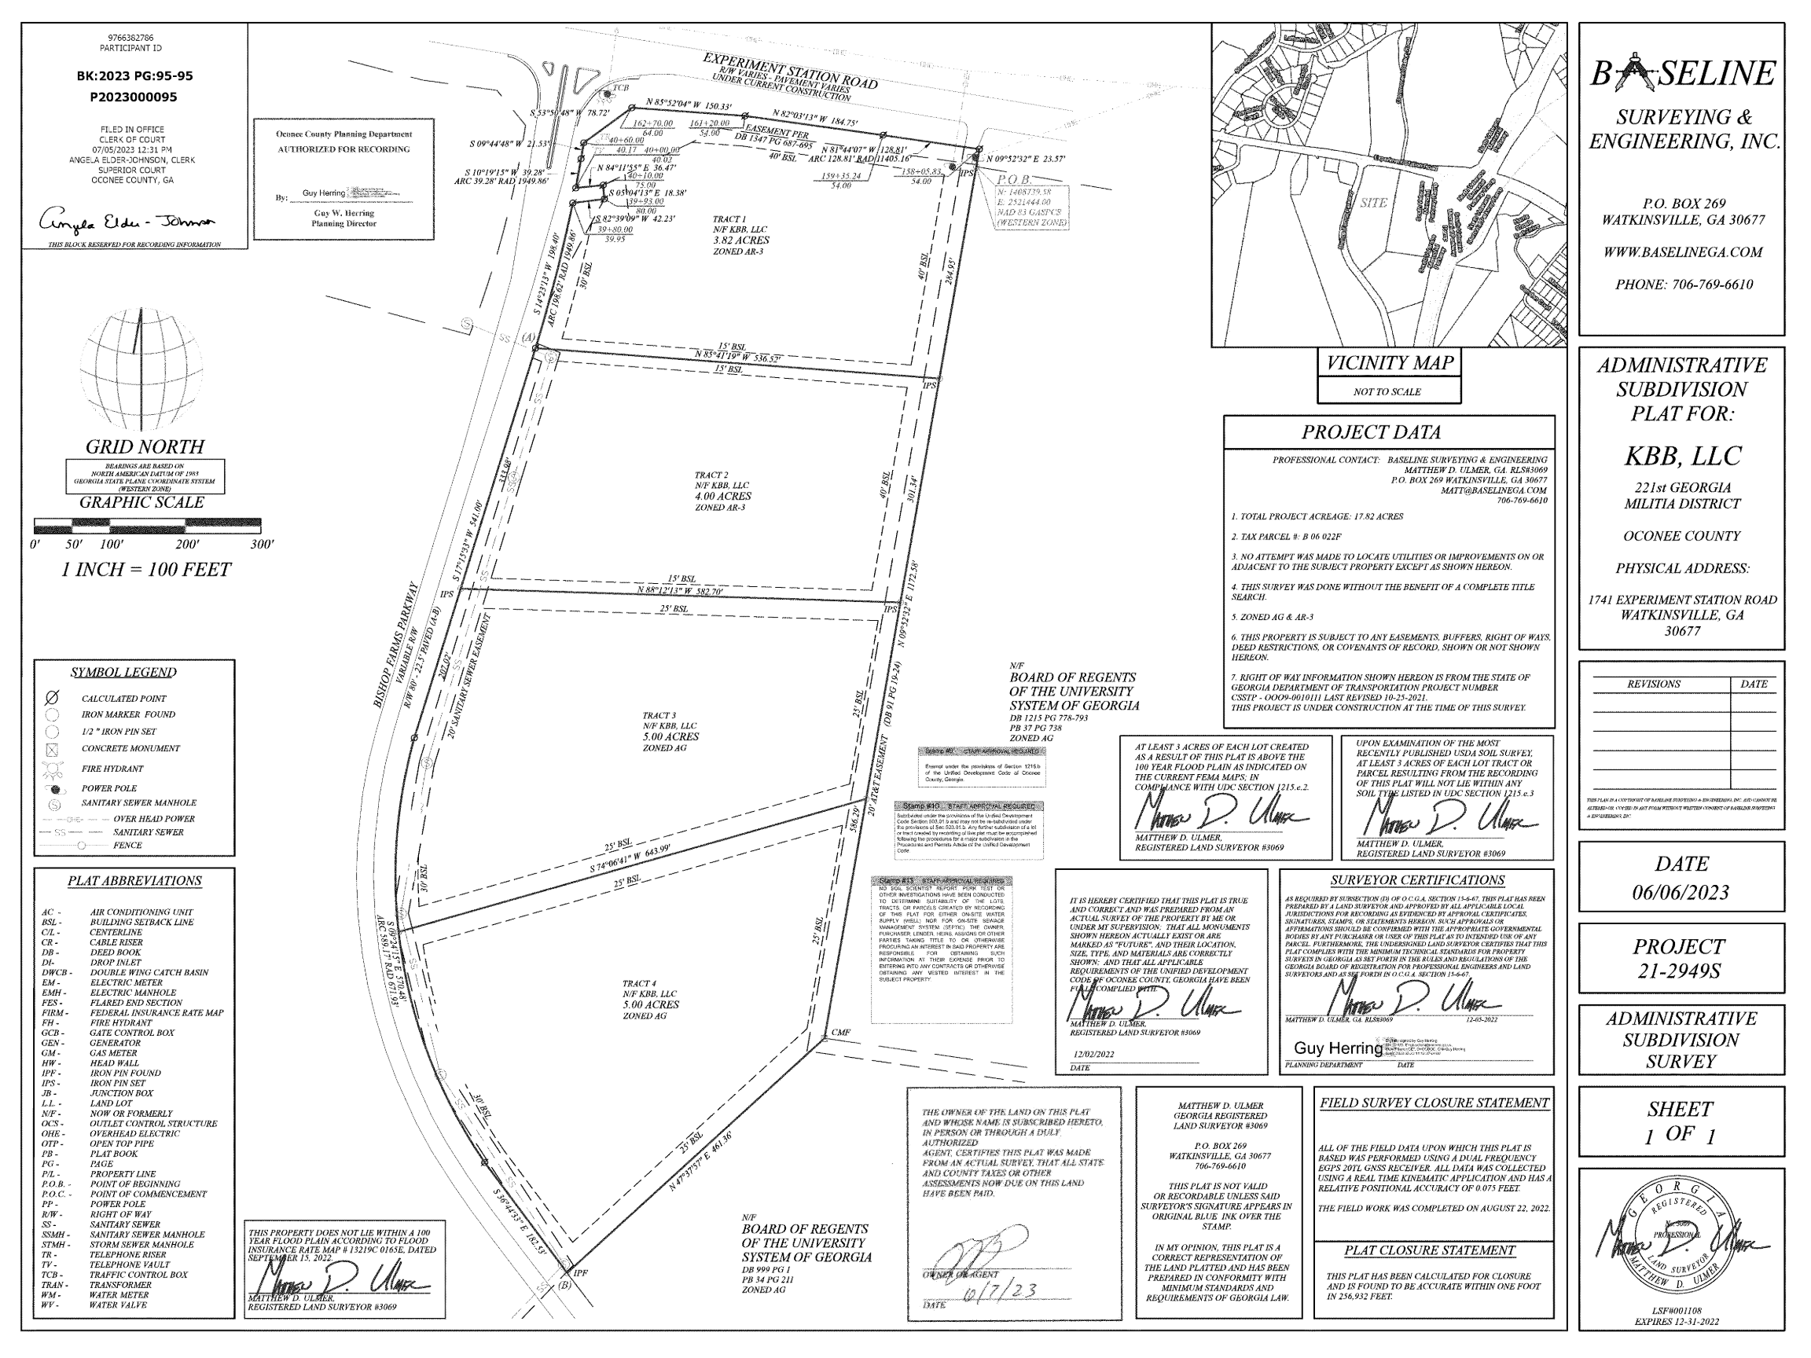
Recorded Plat

Slide 8
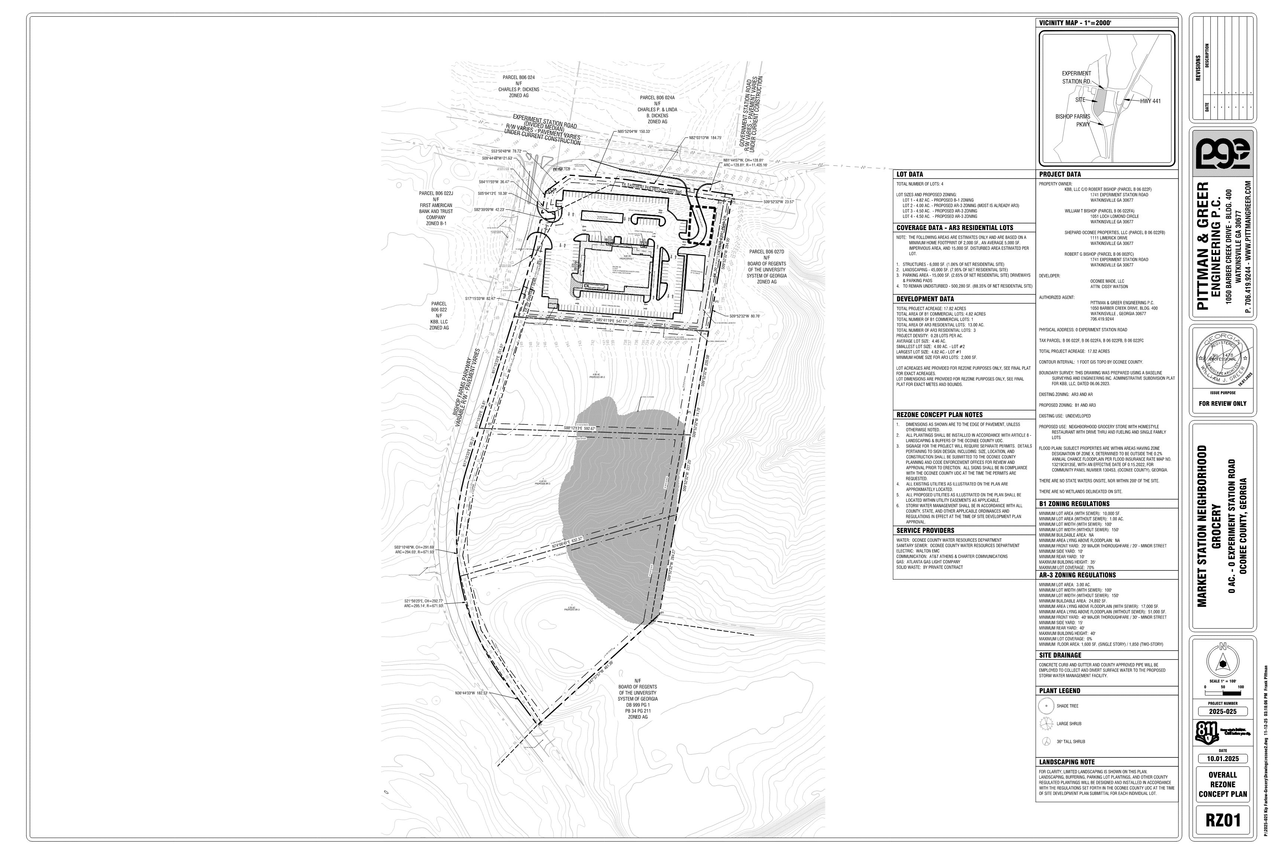
Concept Plan

Slide 9
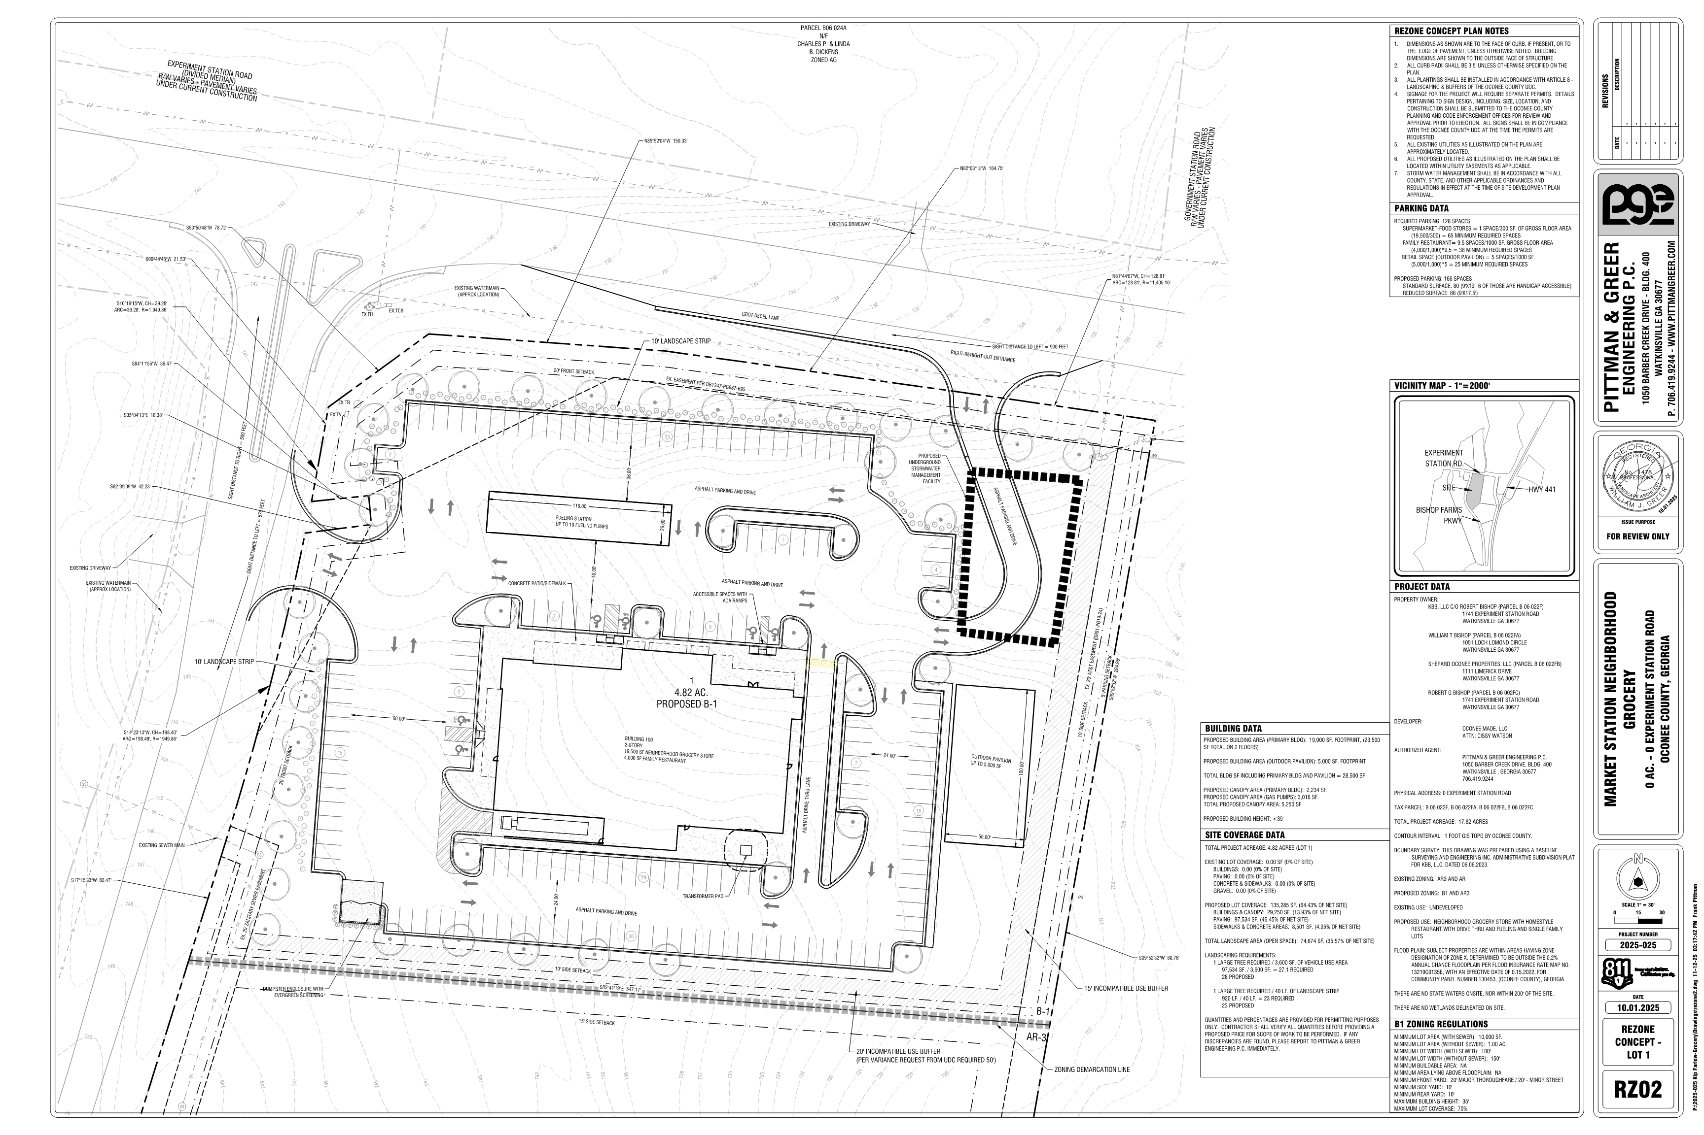
Concept Plan

Slide 10
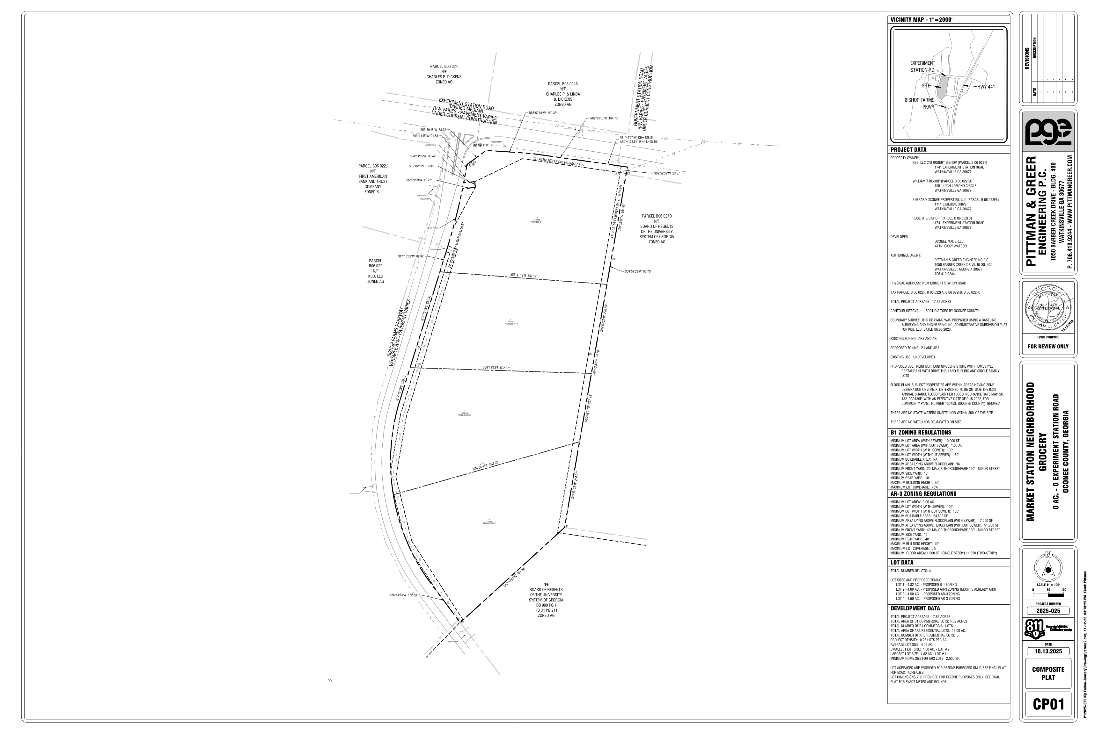
Concept Plan

Slide 11
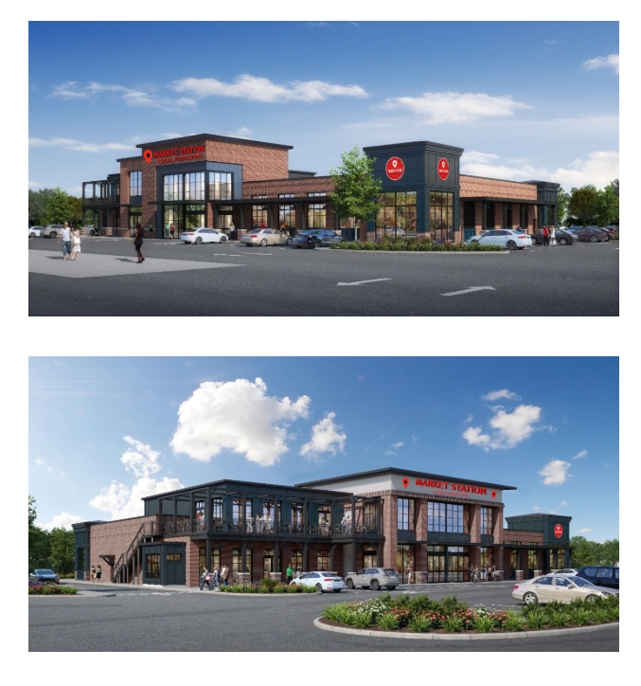
Representative Architecture

Slide 12
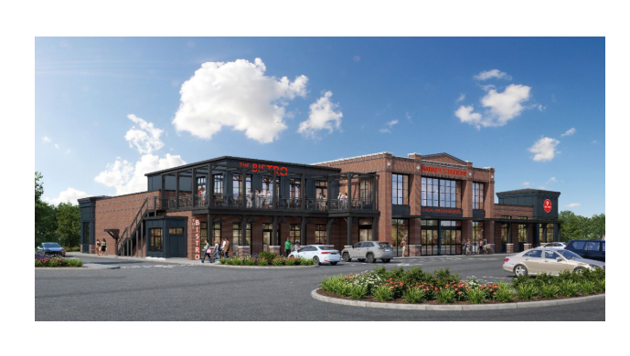
Representative Architecture

Slide 13
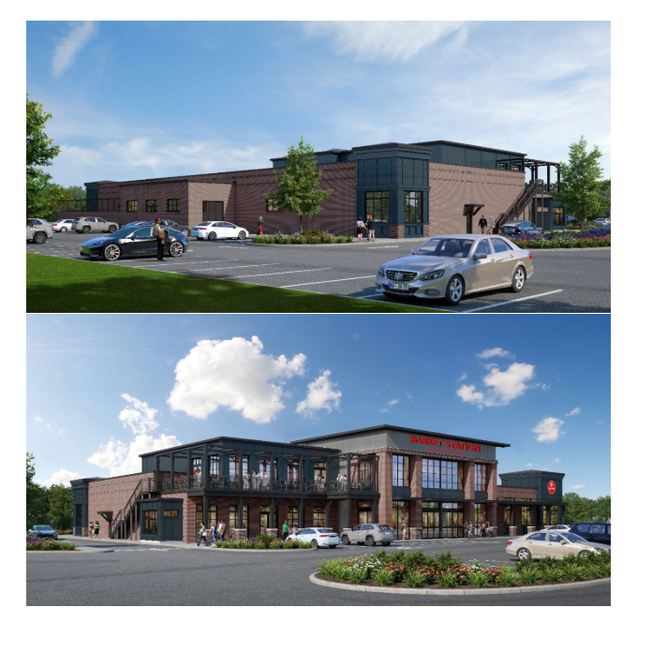
Representative Architecture

Slide 14
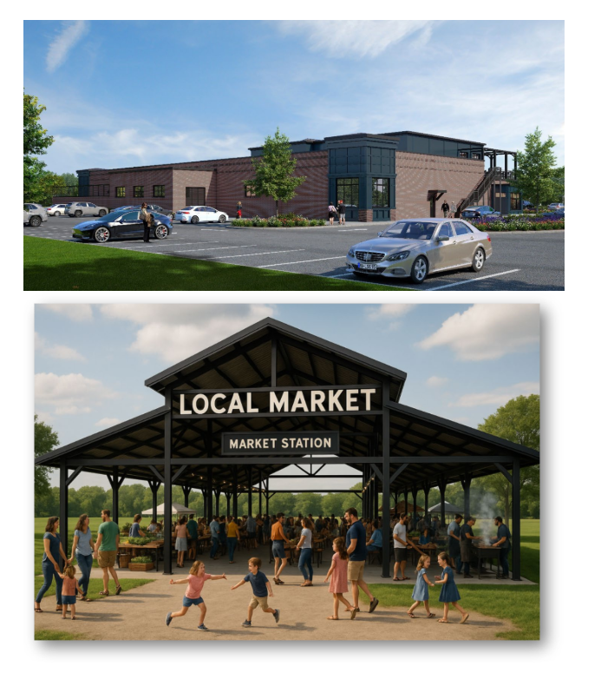
Representative Architecture

Slide 15
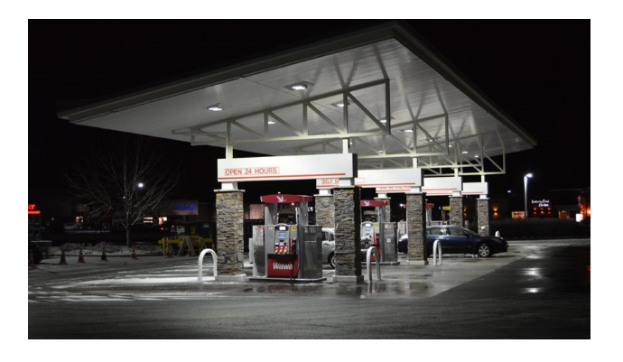
Representative Architecture

Slide 16
Staff Recommendation
Based on Board of Commissioners policies, decision-making criteria, and standards outlined in the development codes of Oconee County, staff recommends conditional approval of the request to rezone ±4.82 acres to B-1 and ±10.0 acres to AR-3 subject to the following conditions to be fulfilled at the expense of the owner/developer:
1. Development design and structures shall meet or exceed the standards indicated on the concept plan, narrative, representative architectural sketches, and other documents submitted with the zoning application and attached hereto. This condition shall not construe approval of any standard that is not in conformity with the Unified Development Code.
2. The owner at their own expense shall construct the improvements required by the County for public water and public waste services for the subject property and shall convey the same to the County, free of all liens. Said improvements shall include all on-site improvements and such off-site improvements as are required by the County to provide service to subject property.
3. At its expense, Owner shall make all right of way improvements and shall dedicate all rights of way which are required by the County after the County’s review of Owner's development plans pursuant to the County’s ordinances and regulations. All such improvements shall be shown on the preliminary site plan and site development plans for the project and no development permit shall be issued until Owner has agreed to such improvements and dedication.
4. At the owner’s expense, road improvements shall be made to ensure the impacted intersections shall meet the requirements of the UDC to ensure all impacted intersections meet a Level of Service C.

Slide 17
Staff Recommendation
Based on Board of Commissioners policies, decision-making criteria, and standards outlined in the development codes of Oconee County, staff recommends conditional approval of the request to rezone ±4.82 acres to B-1 and ±10.0 acres to AR-3 subject to the following conditions to be fulfilled at the expense of the owner/developer:
5. Service areas and dumpsters shall be visually screened from public view by a six-foot masonry wall with façade materials matching the exterior of the principal structure with black painted metal/steel enclosure doors. Enclosure doors made of wood or chain link are prohibited.
6. The proposed drive-through shall have a stacking lane according to the Institute of Transportation Engineers (ITE) standards to be approved by the Director of Planning and Code Enforcement and the Director of Public Works as part of the Site Development Plan. No parking space shall be allowed that crosses the stacking lane.

Slide 18
Planning Commission Recommendation
Planning Commission recommends approval subject to the conditions recommended by staff.

