Slide 1


Slide 2
Site Location

Slide 3
Aerial Imagery

Slide 4
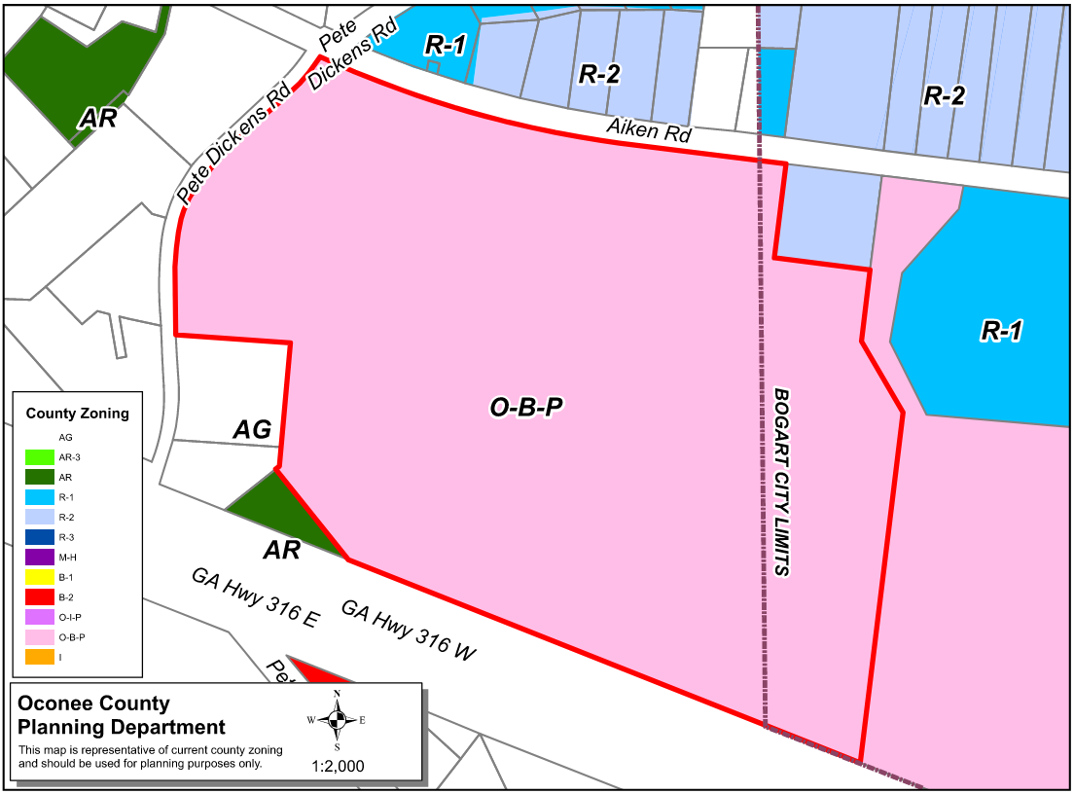
Zoning
AG

Slide 5
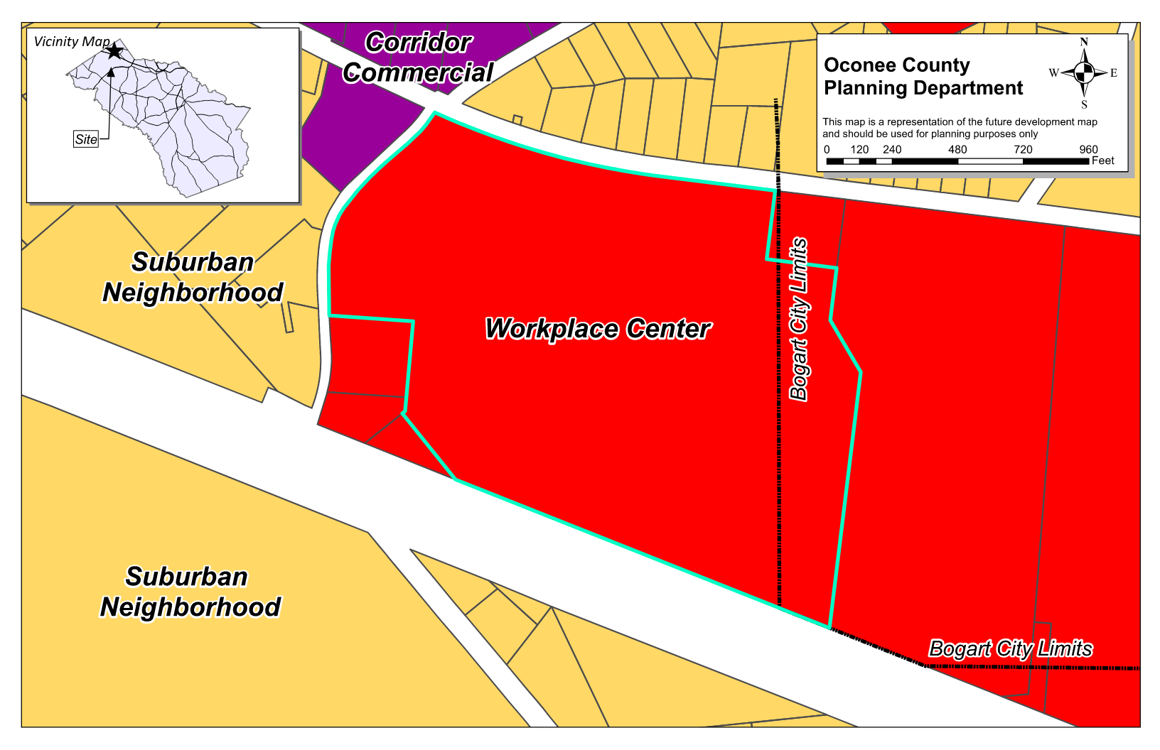
Future Development

Slide 6
Summary of Request
A special exception variance from Oconee County Unified Development Code Article 6 Section 604.01.b, Article 6 Section 609.01.d, and Table 6.1 to reduce the required parking for warehouse space and to eliminate the requirement for curb and gutter in the warehouse portion of the site. The proposed parking space reduction is 63 spaces: or 35% of the required 180 spaces for the proposed 228, 250 square feet of buildings.

Slide 7
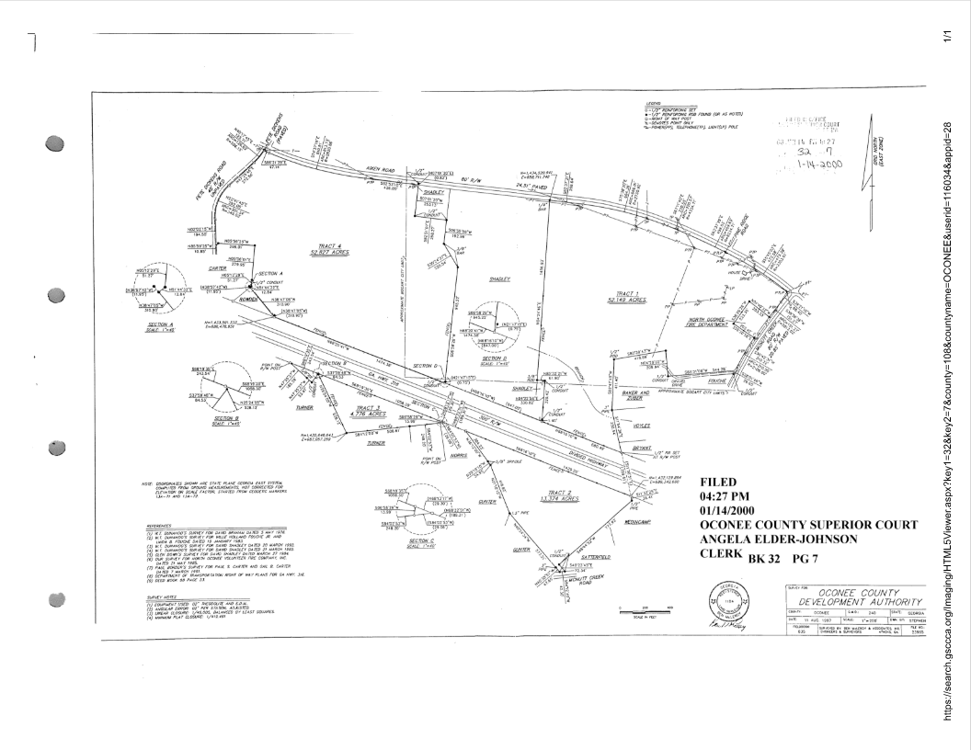
Recorded Plat

Slide 8
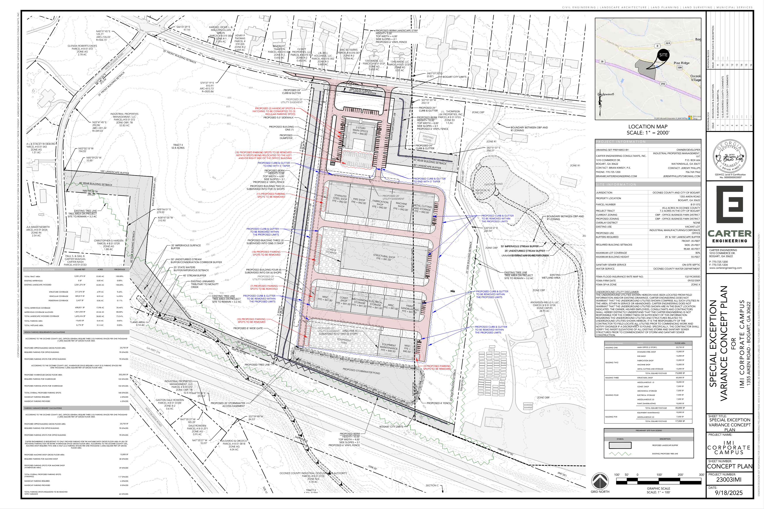
Concept Plan

Slide 9
Staff Recommendation
Based upon the standards and limitations for special exception variance approval, this request does meet all necessary conditions to grant a special exception variance to the garage setback standards. Should the present request be approved, staff recommends the following conditions to be fulfilled at the owner/developer’s expense. 1. Development design and structures shall meet or exceed the standards indicated on the concept plan, narrative, representative architectural sketches, and other documents submitted with the variance application and attached hereto. This condition shall not construe approval of any standard that is not in conformity with the Unified Development Code.
2. The owner at their own expense shall construct the improvements required by the County for public water for the subject property and shall convey the same to the County, free of all liens. Said improvements shall include all on-site improvements and such off-site improvements as are required by the County to provide service to subject property.
3. At its expense, Owner shall make all right of way improvements and shall dedicate all rights of way which are required by the County after the County’s review of Owner's development plans pursuant to the County’s ordinances and regulations. All such improvements shall be shown on the preliminary site plan and site development plans for the project and no development permit shall be issued until Owner has agreed to such improvements and dedication.
4. The applicant shall submit a Field Change along with a revised Hydrology Study for review and approval.

