Slide 1


Slide 2
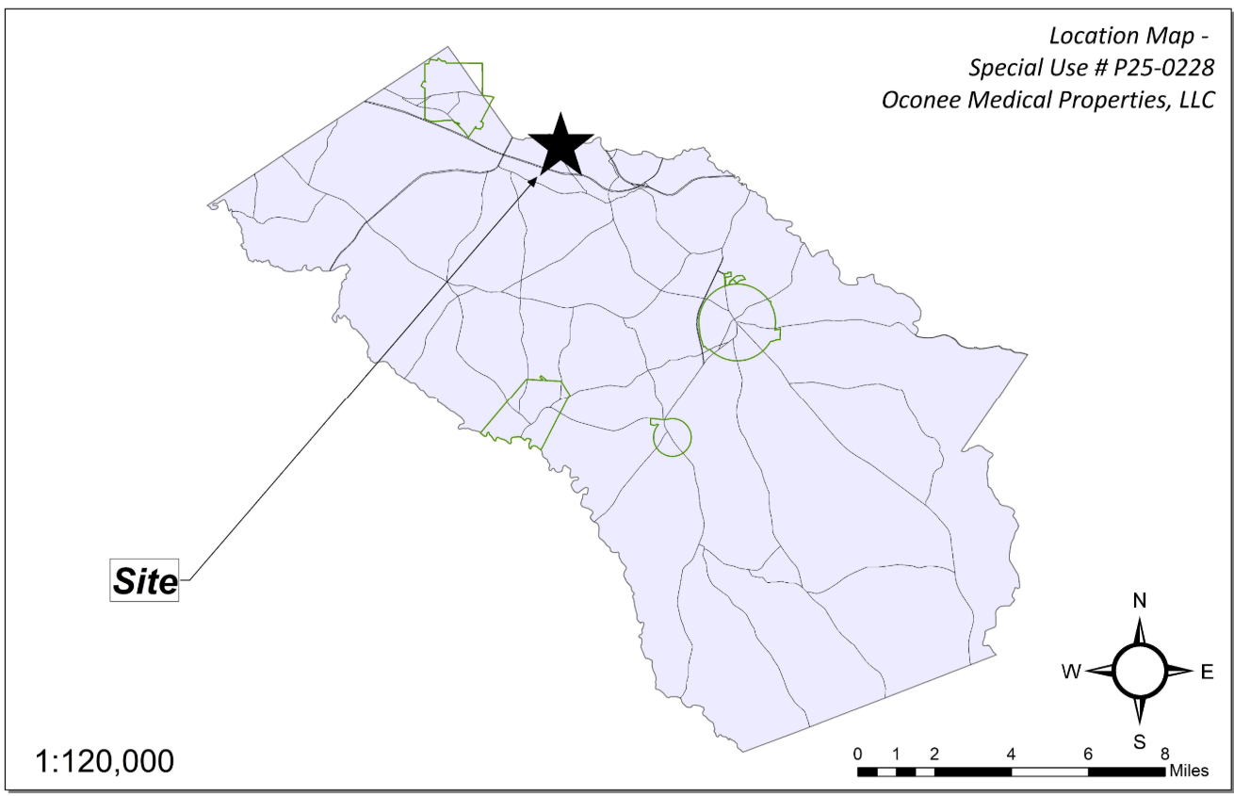
Site Location

Slide 3
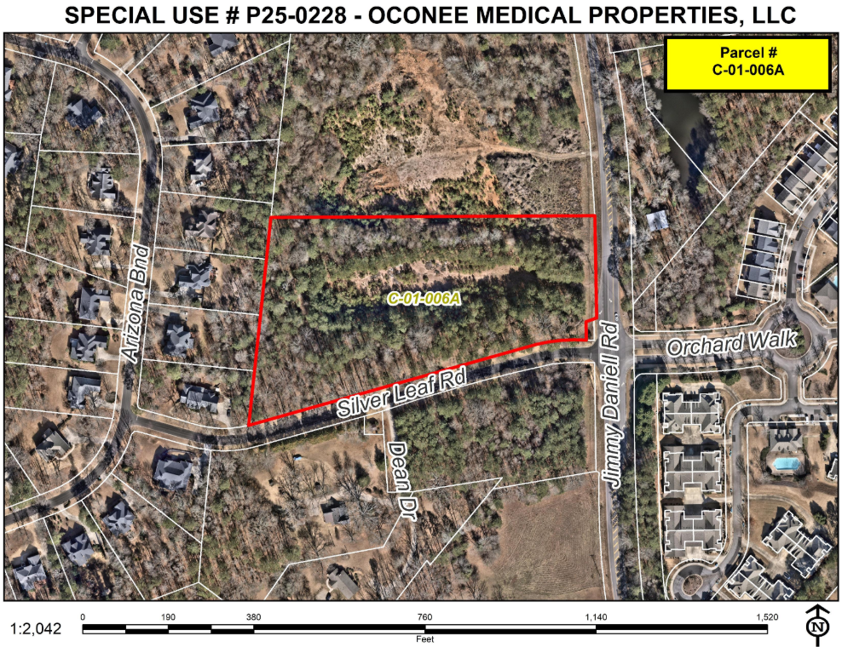
Aerial Imagery

Slide 4
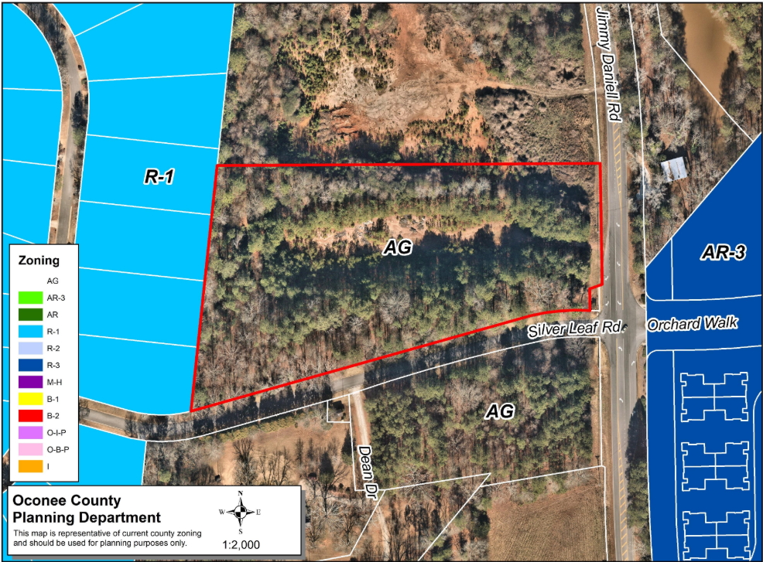
Zoning
AG

Slide 5
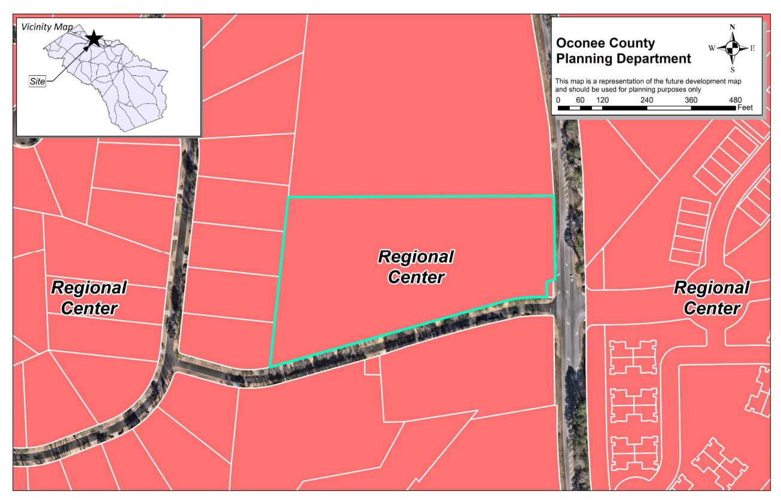
Future Development

Slide 6
Summary of Request
The applicant is requesting special use approval for a Contractor’s Office/Showroom/Warehouse/Corporate Area with limited outdoor storage within privacy-fenced area.

Slide 7
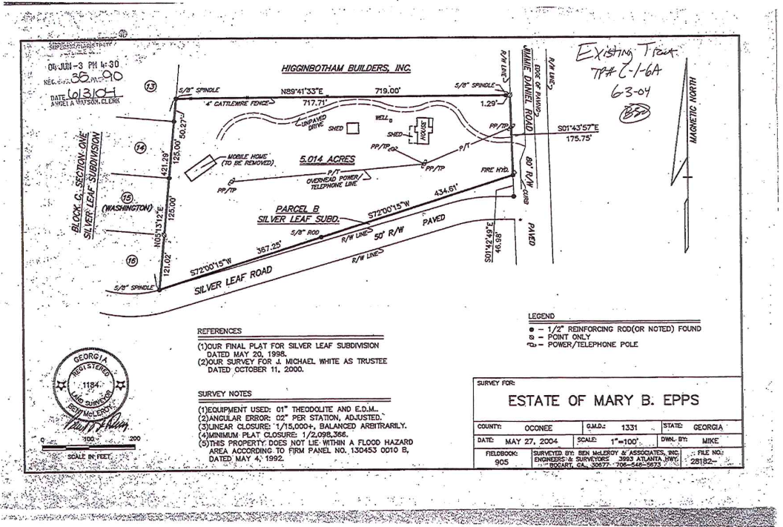
Recorded Plat

Slide 8
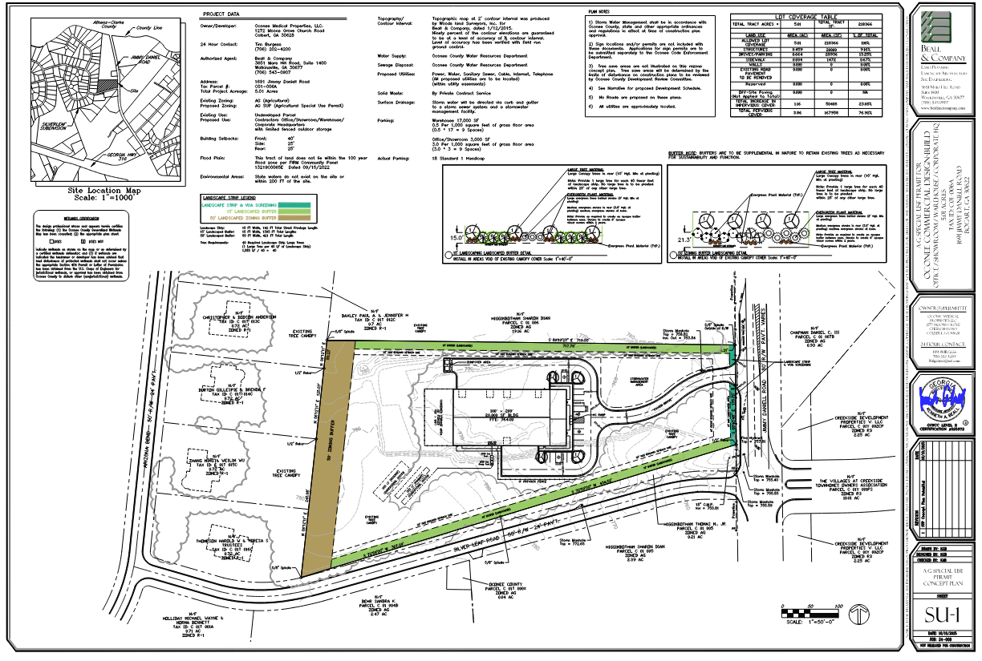
Concept Plan

Slide 9
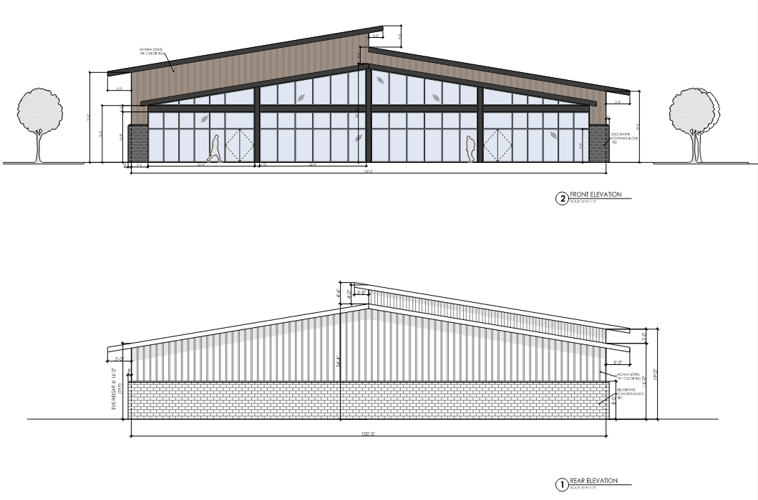
Architectural Images

Slide 10
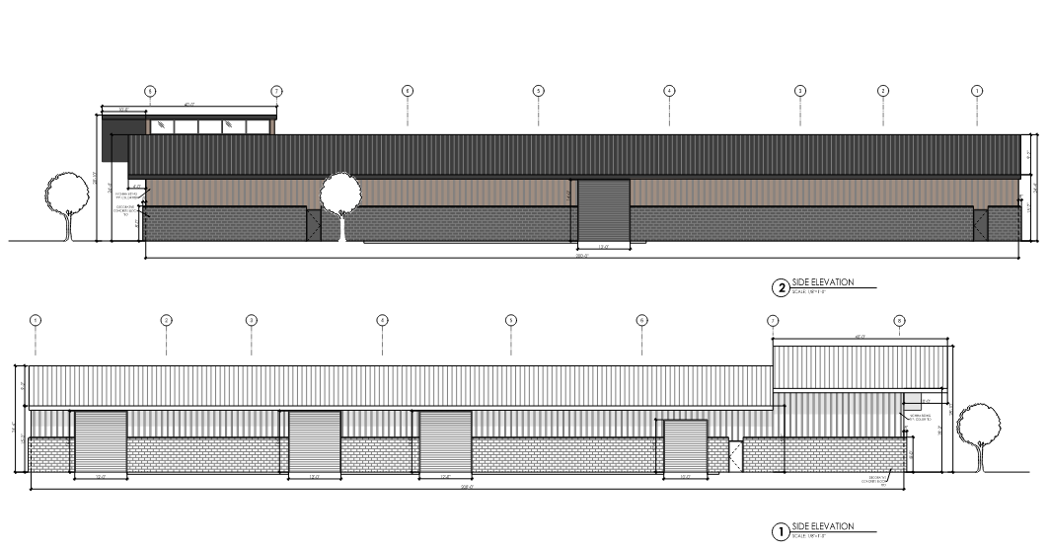
Architectural Images (Continued)

Slide 11
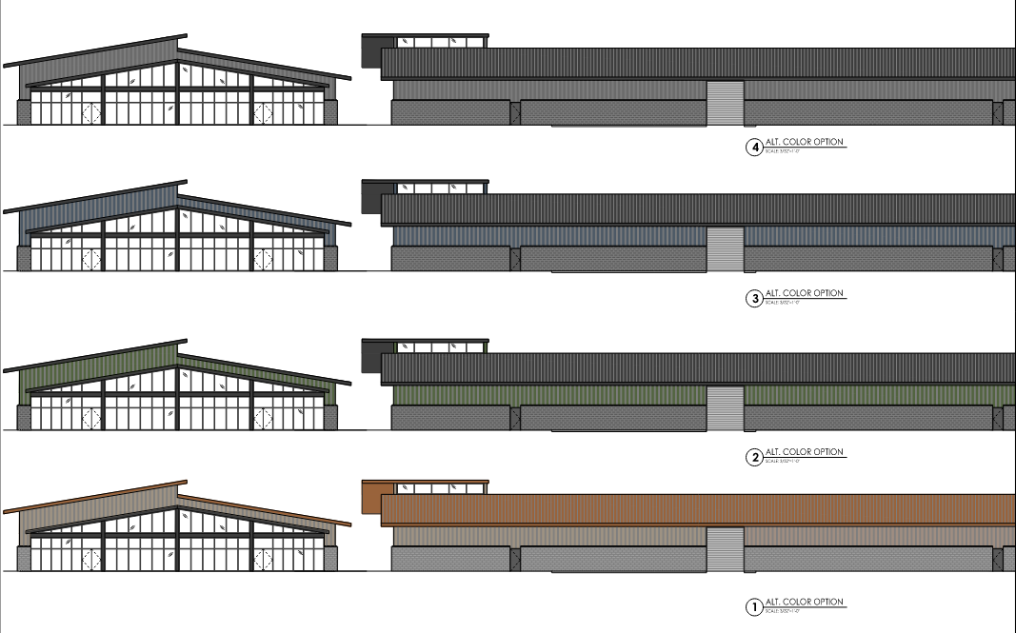
Architectural Images (Continued)

Slide 12
Staff Recommendations
Based on Board of Commissioners policies, decision-making criteria, and standards outlined in the development codes of Oconee County, staff recommends approval of the special use request. Staff recommends it be subject to the following conditions to be fulfilled by the developer/owner at their expense:
Development design and structures shall meet or exceed the standards indicated on the concept plan, narrative, representative architectural sketches, and other documents submitted with the zoning application and attached hereto. This condition shall not construe approval of any standard that is not in conformity with the Unified Development Code.
The owner at their own expense shall construct the improvements required by the County for public water and public waste services for the subject property and shall convey the same to the County, free of all liens. Said improvements shall include all on-site improvements and such off-site improvements as are required by the County to provide service to subject property.
At its expense, Owner shall make all right of way improvements and shall dedicate all rights of way which are required by the County after the County’s review of Owner's development plans pursuant to the County’s ordinances and regulations. All such improvements shall be shown on the preliminary site plan and site development plans for the project and no development permit shall be issued until Owner has agreed to such improvements and dedication.
All outdoor storage must be located in a side or rear yard and must be screened from public streets and residential districts by an opaque imitation-wood vinyl fence or free-standing wall no less than 12 feet in height
No required parking spaces, required landscaped area, or any other required site element shall be used for outdoor storage.

Slide 13
Staff Recommendations (Continued.)
Service areas and dumpsters shall be visually screened from public view by a six-foot masonry wall with façade materials matching the exterior of the principal structure with black painted metal/steel enclosure doors. Enclosure doors made of wood or chain link are prohibited.
This site shall have no access to Silver Leaf Road.
The total building square footage shall not exceed 20, 000 square feet as shown on the concept plan dated October 10, 2025.
All loading areas shall be screened by an opaque imitation-wood vinyl fence or free-standing wall no less than 8 feet in height.
To mitigate the impacts to adjacent, established residential uses, the site shall observe the following hours of operation, including receiving of deliveries and use of the warehouse area:
a. Weekdays: 8 AM to 7 PM
b. Saturdays: 8 AM to 7 PM
c. Sundays: 12 PM to 7 PM

Slide 14
Planning Commission Recommendation
Planning Commission recommends approval subject to the conditions recommended by staff.

